Slide 1
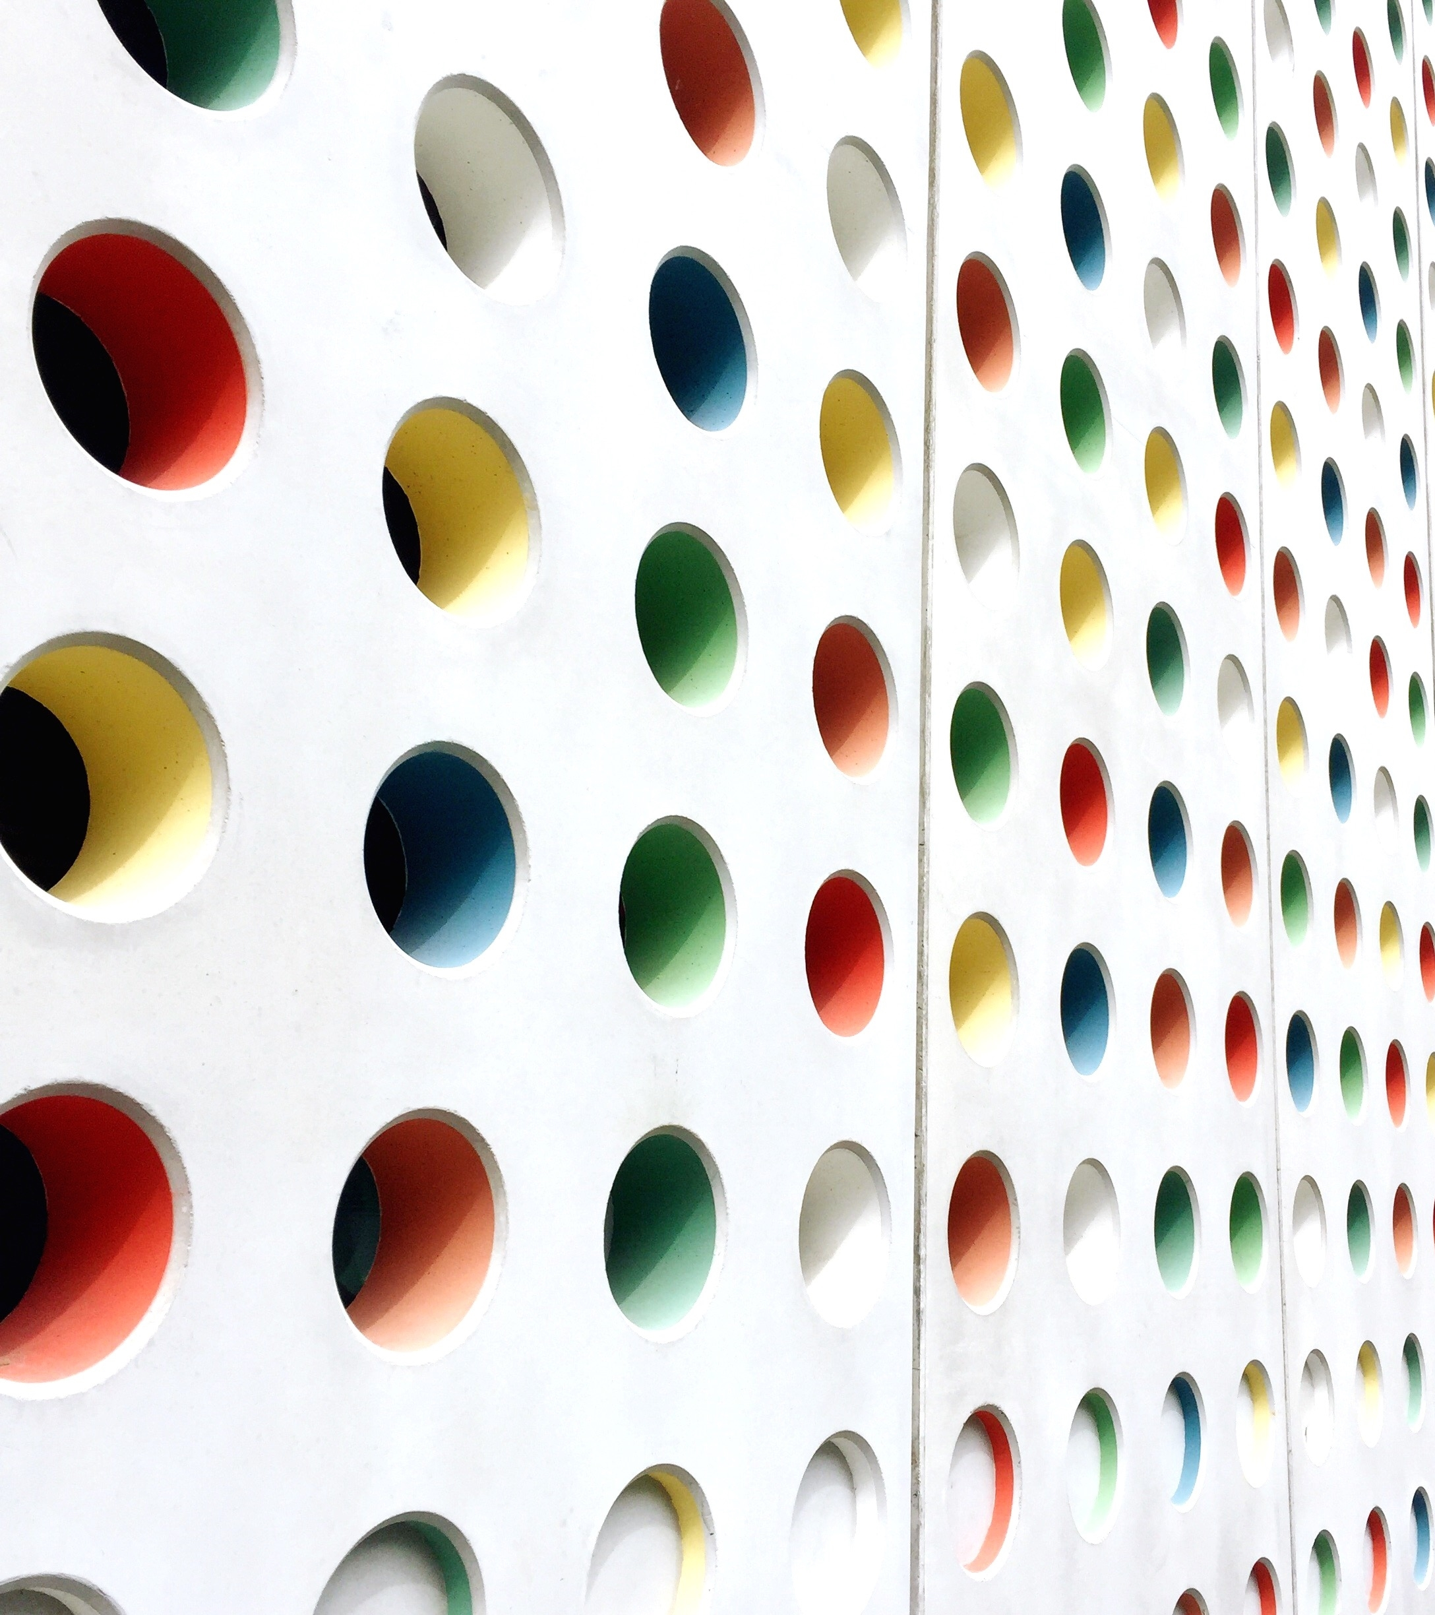
Branding
Dr. Chastity Clemons

Slide 2
PERSONAL BRANDING
Why should someone buy what your selling?
“It’s no longer who you know, it’s who knows you.”
Think of your personal brand as the icebreaker
ICE BREAKER- 2 Truths and a Lie
As you open up, that vulnerability will allow people to not only like you, but they’ll trust you.
Once your customers feel like a part of your friend circle, they’ll stick around

Slide 3
WHAT IS BRANDING?
The process where a business makes itself known to the public and differentiates itself from competitors.
Typically includes phrase, design or an idea the makes it easily identifiable to the public.
Creates a strong, positive perception of a company, its products or services in the customer's mind by combining
logo
design
mission statement
consistent theme throughout all marketing communications

Slide 4
YOUR COMPANY BRAND
Brands are important:
Represent authenticity
Promise of what the buyer is going to receive
A brand promise is a value or experience a company's customers can expect to receive every single time they interact with that company

Slide 5
ELEMENTS OF BRANDING
Good branding creates consumer recognition of what the brand means:
Logo
Color Palette
Shape
Tagline
Tone of Voice and Vocabulary
Fonts
Imagery
Positioning
Taste
Smell
Sounds
Location

Slide 6
LOGO
Every brand needs a logo
Brand’s whole personality boiled down into an easy-to-recognize image
Image sticks in your mind
Brings up memories (good, bad, indifferent)
Should go on every asset your brand owns (business cards, website, merchandise, social media)
Represent what your brand is about
Encapsulates the essence of your brand identity

Slide 7
COMPANIES WITH STRONG BRAND IDENTITY

Slide 8
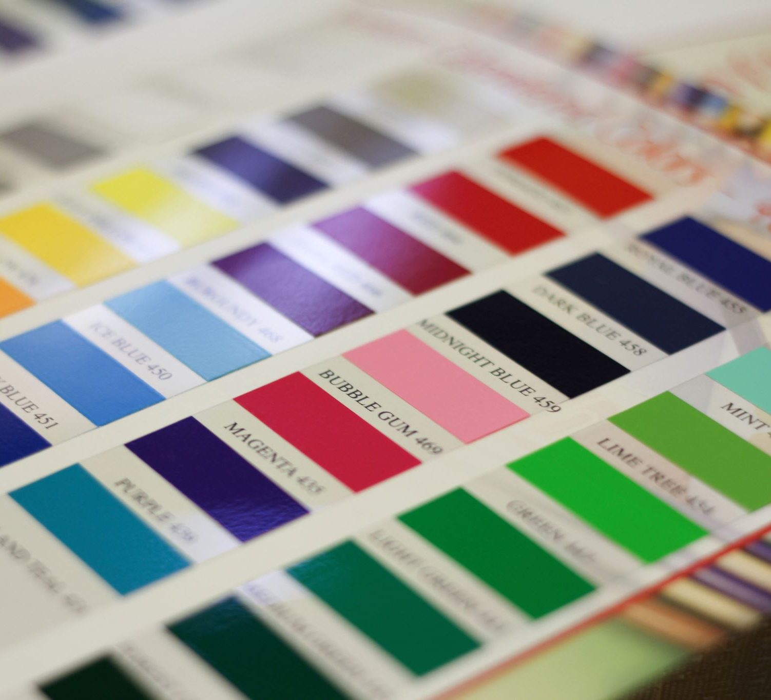
COLOR PALETTE
Colors are key to brand identity
Some companies have trademarked their signature colors
UPS brown
Tiffany blue
Fiskars orange

Slide 9
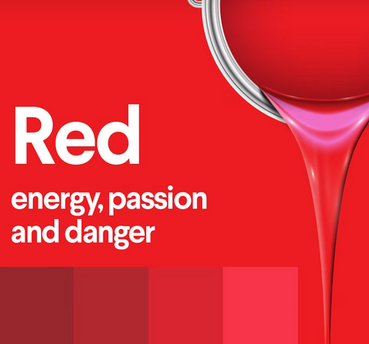
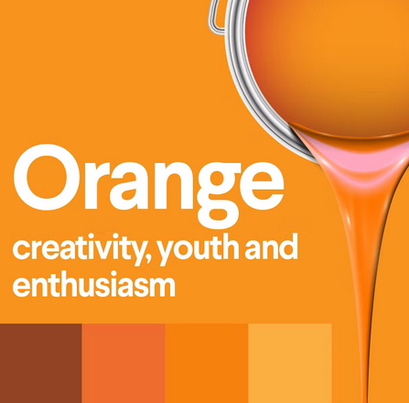
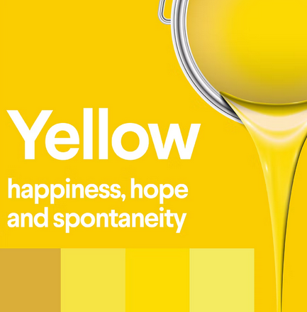
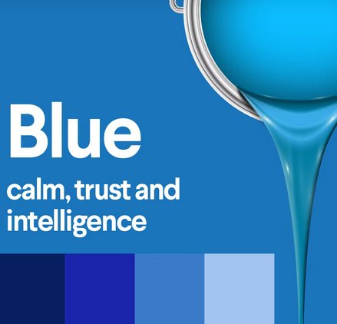
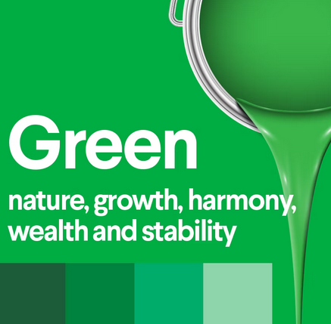
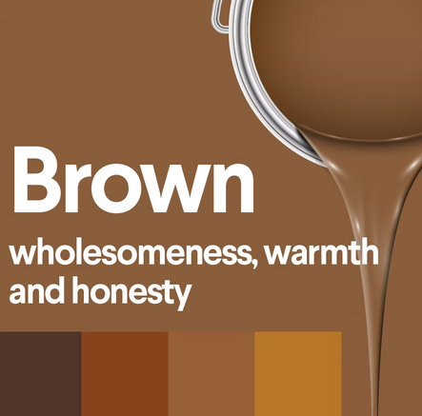
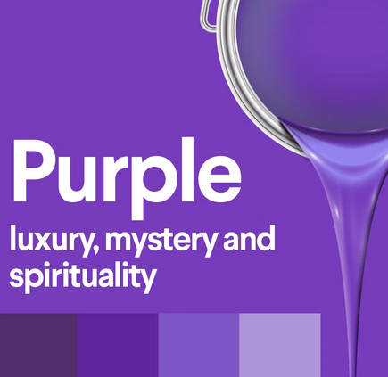
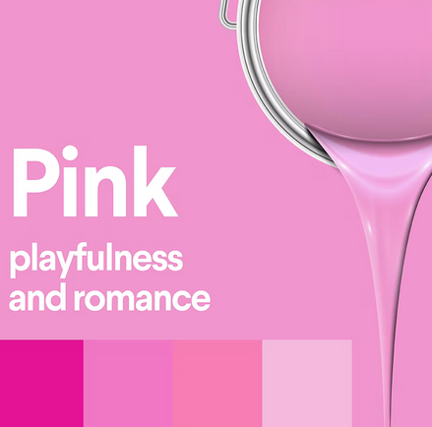
COLOR PSYCHOLOGY
Colors express key values and personality traits
RED- Passion, action, energy, danger (stop, signs, Target logo, roses, and most effective color for inciting hunger
ORANGE- Creativity, enthusiasm, energy, creativity, and youth. (traffic cones, high visibility clothing)
YELLOW- Joy, hope, playfulness, spontaneity, and positivity. (Sunshine, smiley faces)
BLUE- Calm and trustworthy (Financial institutions- Visa, PayPal, American Express), Major corporations (GE, Lowe’s, Boeing)
GREEN- Nature, growth, wealth (trees and money)
BROWN- Down-to-earth, warmth, nature, honesty, and wholesomeness
PURPLE- Mysterious, creativity, luxury, spirituality, wealth
PINK- Youthful, romance, playful

Slide 11
SHAPES
Shapes become intrinsic elements of the message Choose shapes that convey specific brand values, determine shapes that align with brands persona
Shapes in logo
Shapes on website backgrounds
Shapes within layout design
Shapes with packaging
Shapes of your business cards
Shape of your stationary

Slide 12
PSYCHOLOGY OF SHAPES
GEOMETRIC SHAPES- Often seen as road signs and in building structures
Example: Bank or online business may use rectangles and squares to appear sturdy and reliable.
ORGANIC SHAPES- Often seen with foods to create a sense of fresh and balance for a brand
Example: used for marketing organic foods and fresh products or to create a sense of balance.
ABSTRACT SHAPES- Often seen when creating icons or irregular imagery, or representations of real things
Example: the stick-like figures we see in crosswalk signs, or an outline of a camera icon used to indicate pictures or photography using an icon

Slide 13
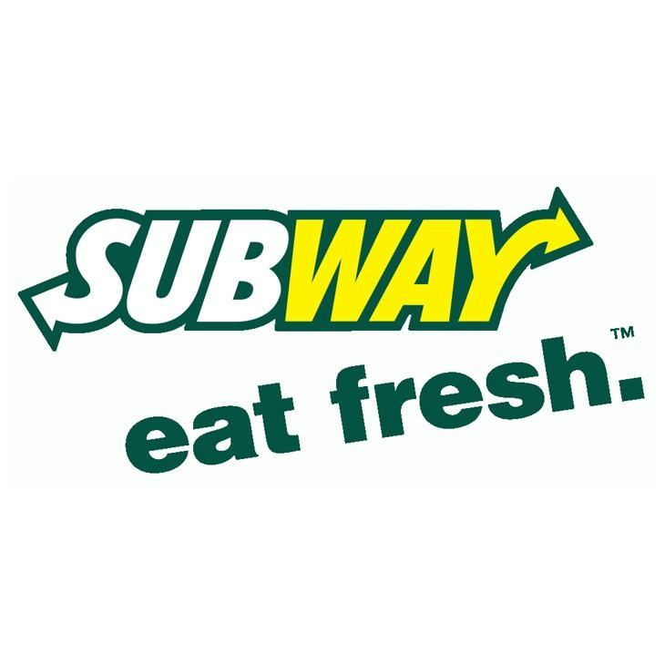
TAGLINE
Also known as Slogans
Flagship of brand messaging
How you communicate your brand’s unique offer
Example: Subway’s “Eat Fresh”
Differentiates the from other fast foods as healthy alternative (green in their branding)
Nike’s “Just Do It”
Don’t hesitate, take action, get up, exercise now, no excuses

Slide 14
TAGLINE/SLOGAN GUESSING GAME
McDonalds
Mazda
TRIX
Geico
Verizon
RAID
Mastercard
I'm lovin' it.
Zoom
Silly rabbi, ____ are for kids
So easy a caveman can do it
Can you hear me now?....Good
Kills bugs dead
Priceless

Slide 15
TONE OF VOICE & VOCABULARY
Specific vocabulary is a part of a brand’s tone of voice
Brand’s Tone of Voice:
Is not what you say, but how you say it
Is the words they choose, their order, rhythm, pace
is the voice the consumer reads from them (email, website, social media)
is the most effective way to shape and reshape how the consumer perceives the brand
Importance of Tone of Voice:
Expression of the people behind the brand
Sets you apart from the rest
Builds trust
Used to influence and persuade

Slide 17
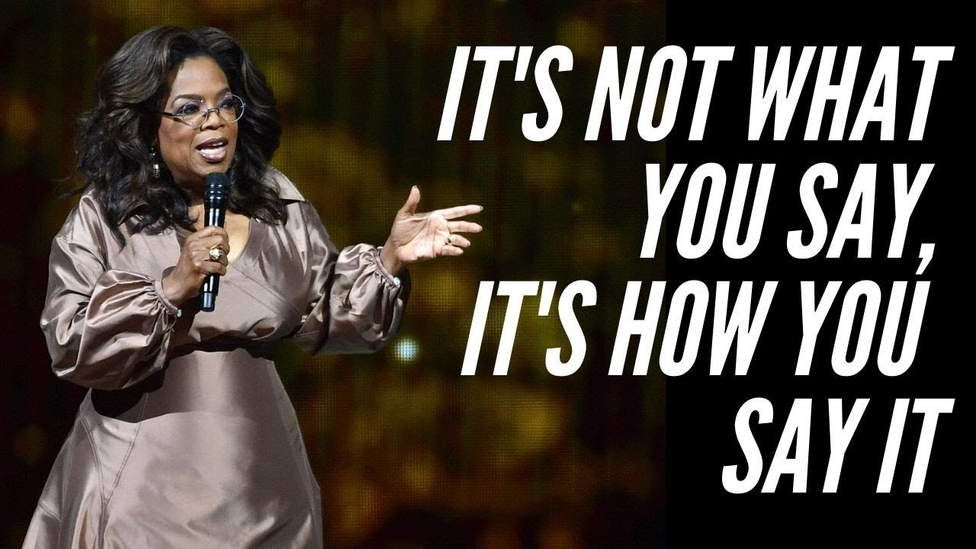
TONE OF VOICE & VOCABULARY CONT.
The way we say something that breeds a certain feeling.
People can be very sensitive to language, forming impressions of people as soon as they begin to hear or read their words.
A simple request can be articulated in different ways:
“You wouldn’t happen to have a pen I could borrow, would you?”
“Do you have a pen I can borrow?”
“Pass me that pen.”

Slide 18
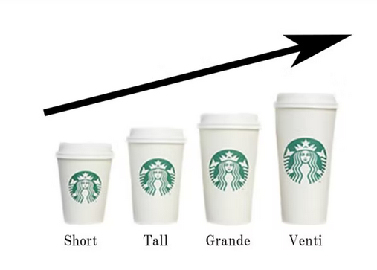
TONE OF VOICE & VOCABULARY CONT.
EXAMPLE:
Starbuck, you cannot get a small coffee
It’s their unique branded vocabulary to differentiate them, they are not new words, but they coined them in this unique way.
Deliberately choose to spell customer’s names wrong
Fun ways as part of the brand

Slide 19
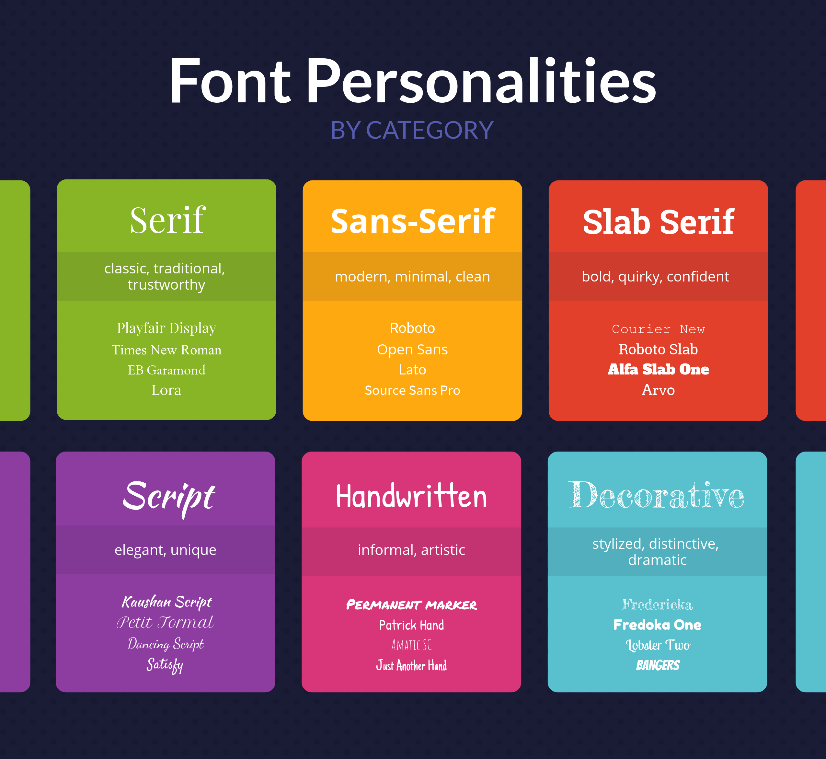
FONTS
Wherever a brand uses:
Text
Logo
Website
Email template
Cannot be chosen randomly, carefully select to communicate brand personality and values
Just like colors, correlate different emotions and traits

Slide 21
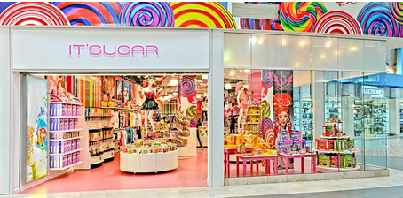
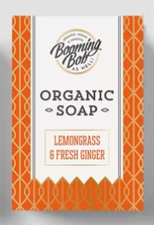
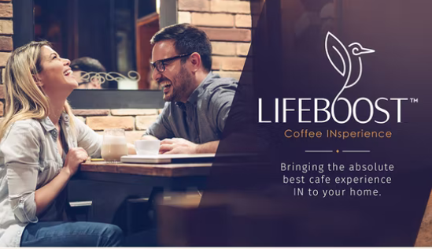
IMAGERY
Images use in branding, marketing, advertising
Not your logo or specific pieces of content you publish
Photos and stock images you chose to use
Style of graphics
Type of background,
Packaging,
Banners
Imagery works closely with color and shapes
What you present visually (even personal branding-dress)

Slide 22
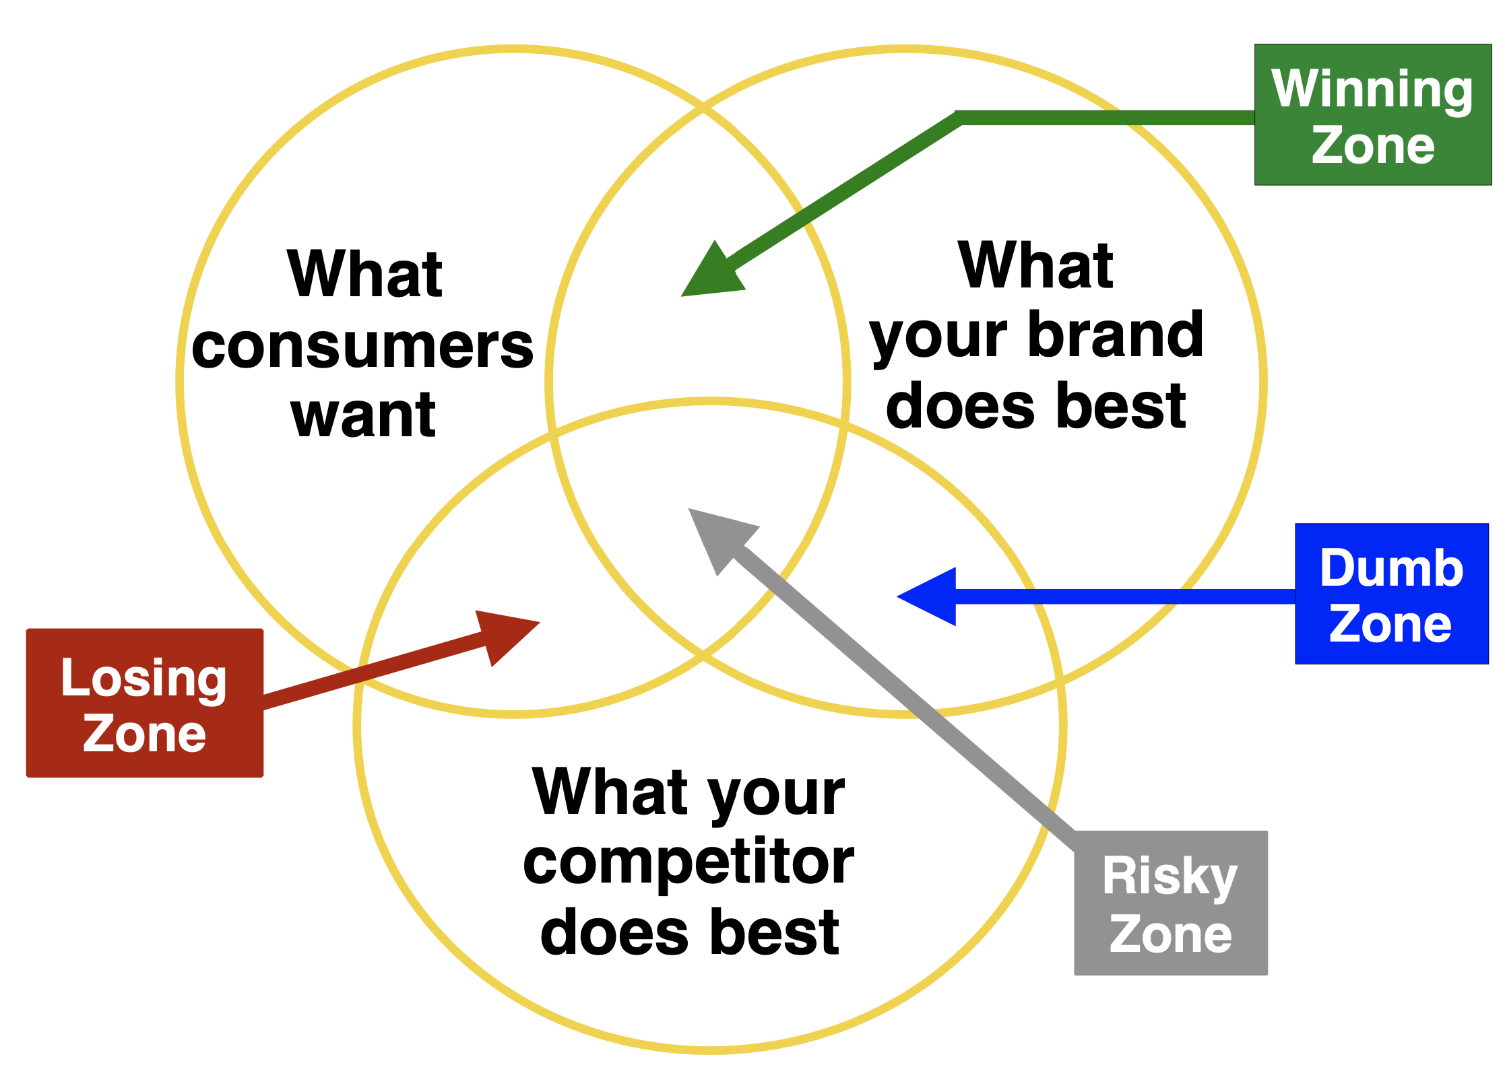
POSITIONING
Niche in market that brand fills
Persona (what it offers buyers, how does it fit among other brands in its space)Are you priced higher, lower, or the same?
What make your offer more attractive?
Direct impact on branding
Low prices communicates most economic-bright colors (yellow, orange)
Higher prices communicate more luxury or prestige-darker hues, mysterious brand voice
Interaction with other brands
Brands you partner with
Influencers

Slide 23
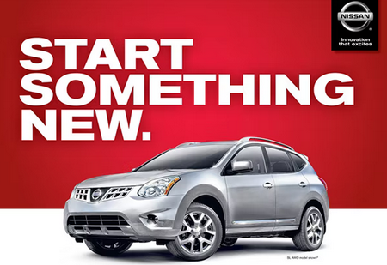
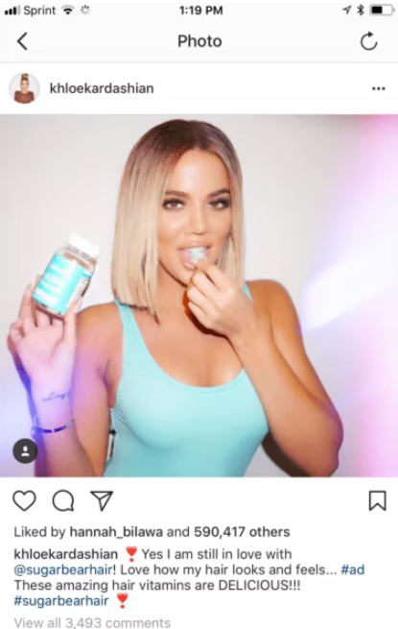
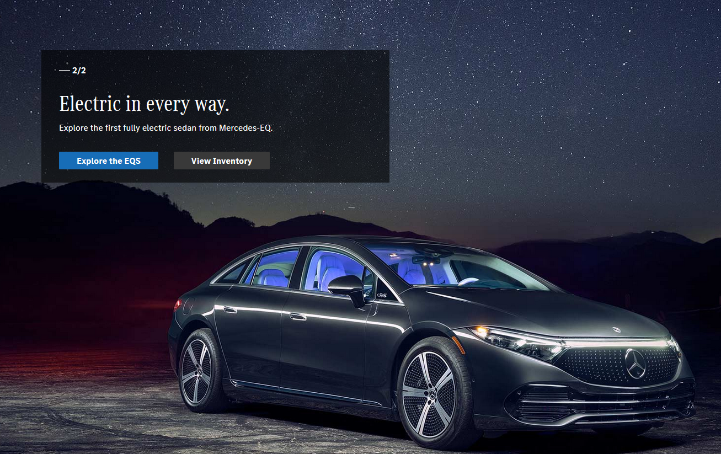

Slide 24
LESS COMMON ELEMENTS
Go beyond the common elements
Sensory input
Specific experience
Taste
Smell
Interactions
User Experience (UX)
User Interface (UI)
Sound
Location

Slide 25
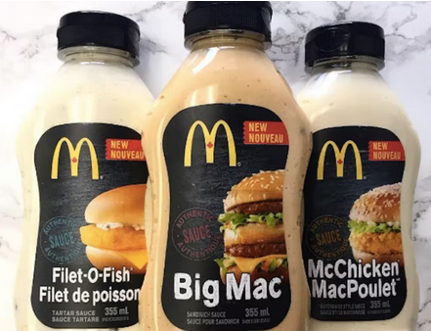
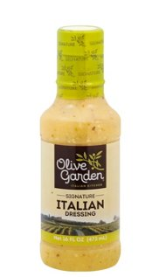
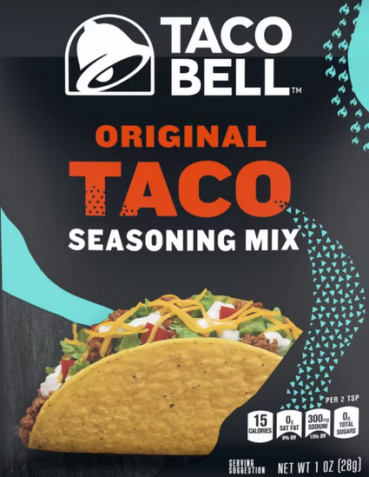
TASTE
Consistent taste builds loyalty
Taco Bell
Not Authentic Mexican Food
Unique Flavor
won’t find in mom-and-pop taquerias
Flavor linked to brand

Slide 26
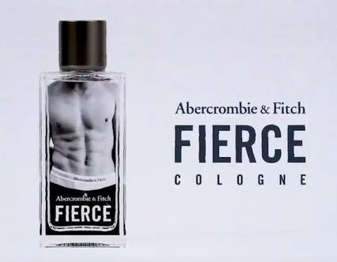
SMELL
Signature in-store scent
On purpose
Creates unique ambience
Offers buyers opportunity to purchase smell
Example:
Hollister (employees spritz brand cologne throughout store)

Slide 27
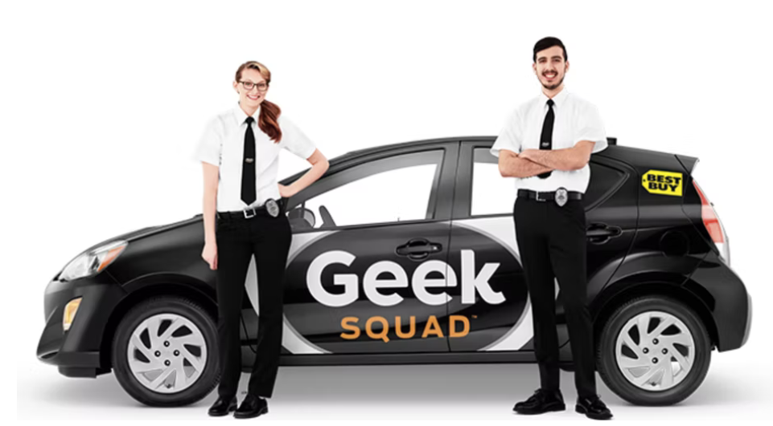
INTERACTIONS
Branded interactions go beyond words and phrases
How company employees refer to themselves
Examples:
Chick-fil-A: “my pleasure” responses to consumer
Best Buy:: Not service technician, Geek Squad member
Disney Parks: Not employees, Cast Members
Starbucks: Not employees, Baristas
Taco Bell: Not cashiers, but Champions
"One of the elements about the term "employee" is that it carries a lot of baggage and can often imply an us and them or feeling of division and objectification." -Chris Mann, CEO of Guayaki

Slide 28
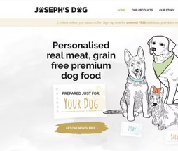
USER EXPERIENCE/USER INTERFACE
UX- User Experience
With an app
Website
Seamless
Engagement (design your custom version of product)
UI- User Interface
Interface through which they have that experience
Ease of enabling user to communicate to brand

Slide 29
SOUND
Creates brand identity
Jingles
Songs
Recorded phrases
Speech
Brief musical sentence
Examples:
Netflix (app opens)
Staples (that was easy-prerecorded buttons)
Yahoo (You've Got Mail)
Seek Copyright

Slide 30
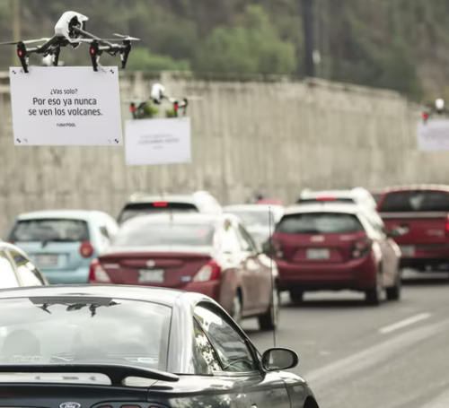
LOCATION
Important brand element
Where people see your brand has a huge impact
Not always where you conduct business, but where products and advertisements can be found
Example: UberPOOL

Slide 31
CONCLUSION
MORE THAN JUST CREATING A LOGO!!!
01
Design choices, assets and unique branding elements work together
02
Takes time, don’t rush or skip out on designing
03

