Slide 1
Simulations in CSD
And the importance of keeping your head down and eyes on the ball
Carol C Dudding, PhD CHSE, CAPCSD Pres-Elect
Mark DeRuiter, PhD, MBA, CAPCSD
Recorded April 9, 2020

Slide 2
As a result of our time together...
What simulation can do and not do
Types of simulations – currently focused on virtual and computer based
Identify resources for more info.

Slide 3
‘Simulation is a technique—not a technology—to replace or amplify real experiences with guided experiences that evoke or replicate substantial aspects of the real world in a fully interactive manner’
(Gaba, 2004, p. i2).
Cognitive
Psycho-
motor
Affective

Slide 4
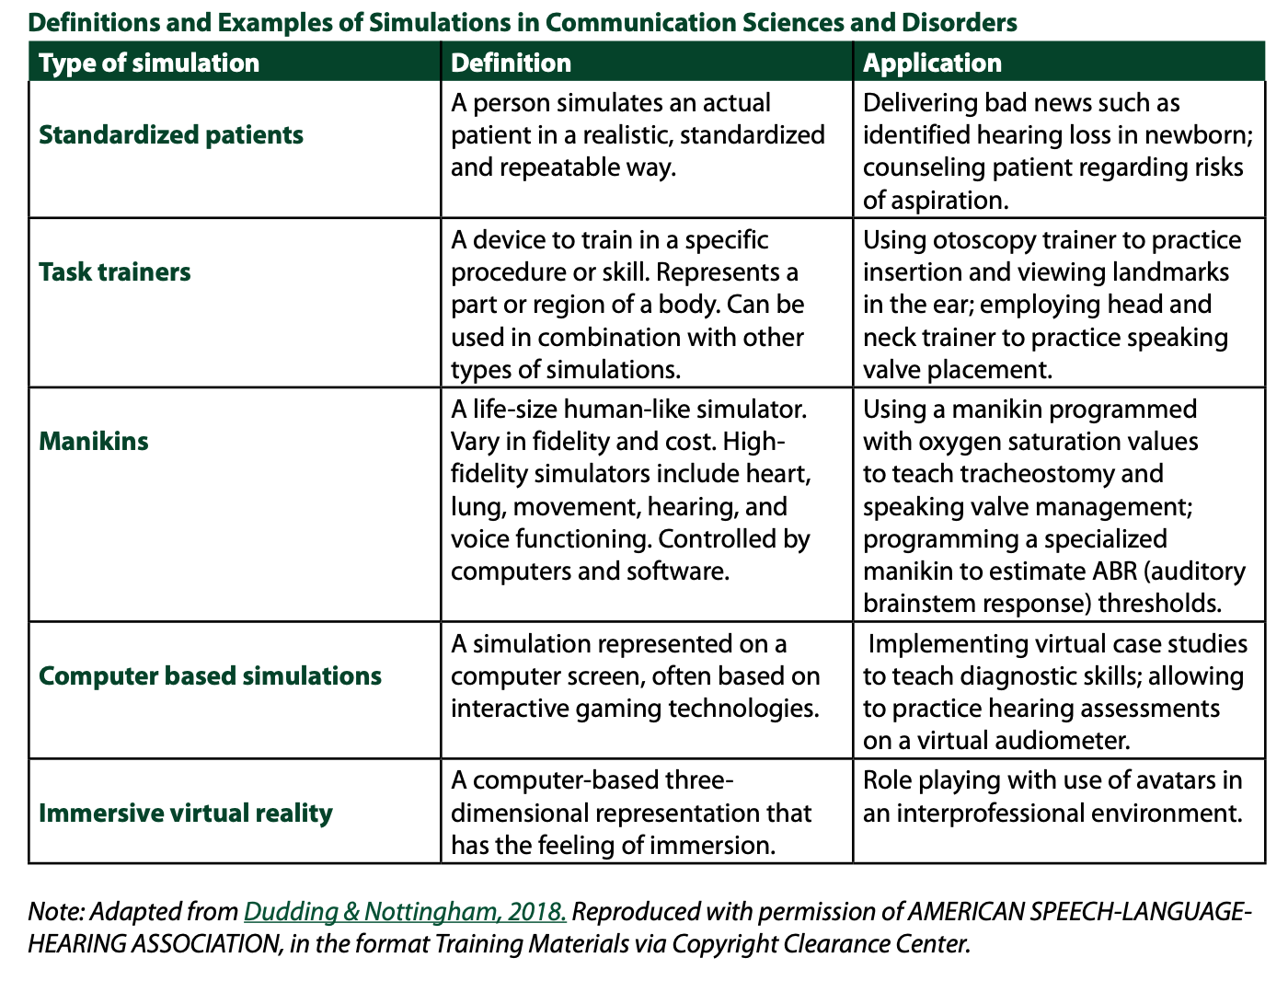
Notes:
Carol ends at 25 minutes

Slide 5
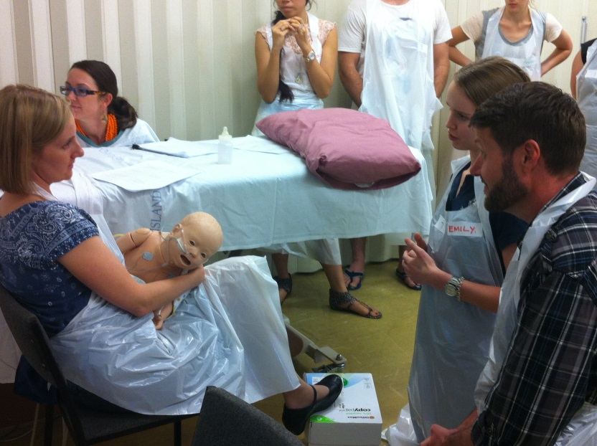
Simulation Learning Experiences (SLE)
Bridge the gap
Provide a safe learning environment
Repeated practice
Learn from mistakes
Exposure to low- incidence cases
Technical and non-technical skills
Confidence building
Reflective practice
(Gaba, 2004, Ker & Bradley, 2014)

Slide 6
Stages of a SLE
Debrief
Facilitate reflection
Provide feedback
Foster clinical/critical thinking
4
Preparation
Driven by the objectives, participant's knowledge or level of experience,
Determine the expected outcomes.
Include an evaluation of the participant(s), facilitator(s), the SLE, the facility, and the support team
04
1
01
3
03
Simulation
Practice in a safe environment
Experience a representation of a real health care event for the purpose of practice, learning, evaluation, testing.
Prebrief
Set the stage and share the rules
Orientation to the equipment/space
Introduction to the scenario
Sharing of objectives and assessment measures
2
02

Slide 7
Debriefing is the ‘heart and soul’ of any simulation experience

Slide 9
ASHA Standards FAQs

Slide 10
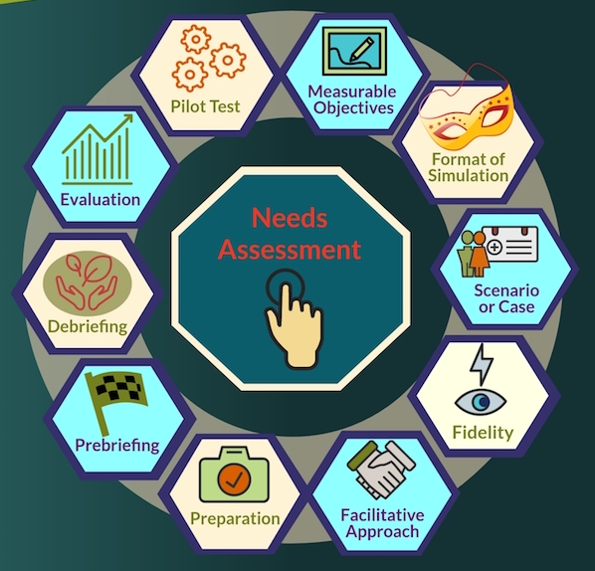
INACSL Standards of Best Practice:
Simulations
https://www.inacsl.org/inacsl-standards-of-best-practice-simulation/
Notes:
https://www.nursingsimulation.org/article/S1876-1399%2816%2930130-X/fulltext
Criterion 1
Participant evaluation is:
○Directed by the objectives/outcomes and/or the intent of the simulation.
○Guided by the type: formative, summative, or high-stakes evaluation.
Criterion 2
Formative evaluation is conducted to:
○Monitor progress toward achieving outcomes.
○Provide ongoing formative feedback.4, 5
○Support participant's clinical competencies.
○Identify and close gaps in knowledge and skills.
○Assess readiness for real-world experiences.
○Facilitate teaching and learning.
•Requires formally trained facilitators (see INACSL Standard: Facilitation).
•Use small group ratio, ideally a minimum ratio of one facilitator per three to five students.6, 7
Criterion 3
Summative evaluation is conducted:
○At a discrete point in time (i.e., at the end of a course or certain time period).
○In a safe learning environment.
○After orientation to the environment and equipment.
○Appropriate level of fidelity necessary to achieve the participant outcomes.
○Utilizing a standardized format and scoring methods (i.e., utilizing a standardized scenario that includes information on when to cue, scenario length of time, and other scenario details).
○With a video recording of the evaluation to allow review by multiple trained evaluators.6, 8
•Use a theoretically based method to determine passing or cut scores9 where appropriate.
•Select a valid and reliable instrument.
•Provide rater training for observation-based evaluation.4, 5
•Establish interrater reliability when more than one rater required.
•Inform participants in advance of the evaluation process.
•Provide summative feedback to participant about achievement of outcomes.
Criterion 4
High-stakes evaluation is conducted:
○At the end of the learning process, but may occur at other times to assess gaps in knowledge or to identify significant safety issues.
○Based on specific participant objectives.
○After the consequences and outcomes have been explained to the participants.
○With predetermined parameters for terminating the scenario for its completion.
○After the simulated-based experience has been piloted tested.
○By trained, nonbiased objective raters or evaluators.
○By an objective rater or evaluator using a comprehensive tool (i.e., checklist or rubric that clearly outlines desirable and undesirable behaviors).
○After the participant has had the opportunity for multiple exposures to simulation-based experiences including evaluations.7, 10
•Use an evaluation tool previously tested with similar populations.
•Use more than one evaluator for each participant, either directly observed or a video recording.8

Slide 12
THIS IS NOT A PROMOTION or ENDORSEMENT BUT IF YOUR USING IT, READ THE MANUAL or at least the FAQ

Slide 13
Join us for our next topics…
DEBRIEFING
THE LOGISTICS
assignments
documentation
tracking
We invite you to participate:
CAPCSD Community Conversations
Check the CAPCSD site for regular updates and resources
Look for results of the COVID Impact Survey
Participate in live events

