Slide 2
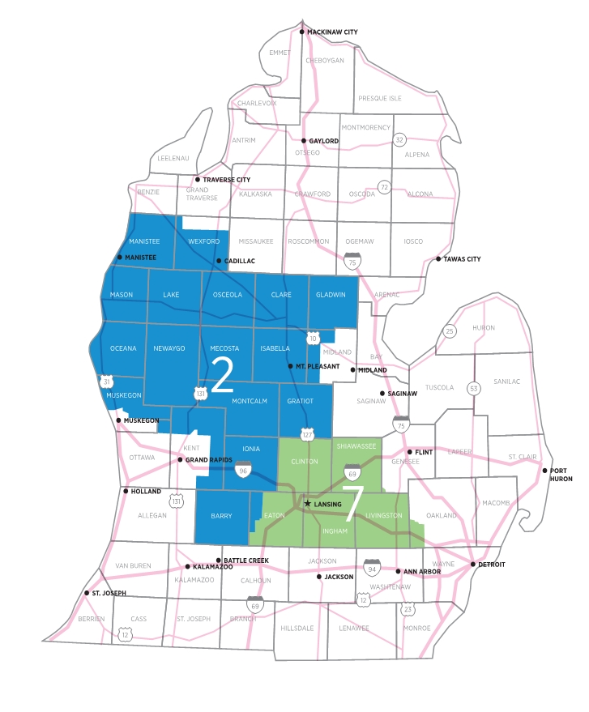
New Congressional Districts
Candidate | Party | District
John Moolenaar | Rep | 2nd
Thomas J. Norton | Rep | 2nd
Jerry Hilliard | Dem | 2nd
Elissa Slotkin | Dem | 7th
Tom Barrett | Rep | 7th
Jack Hagg | Rep | 7th
Paid for by the LRC-PAC | 500 E. Michigan Avenue Suite 200 | Lansing, MI 48912

Slide 3
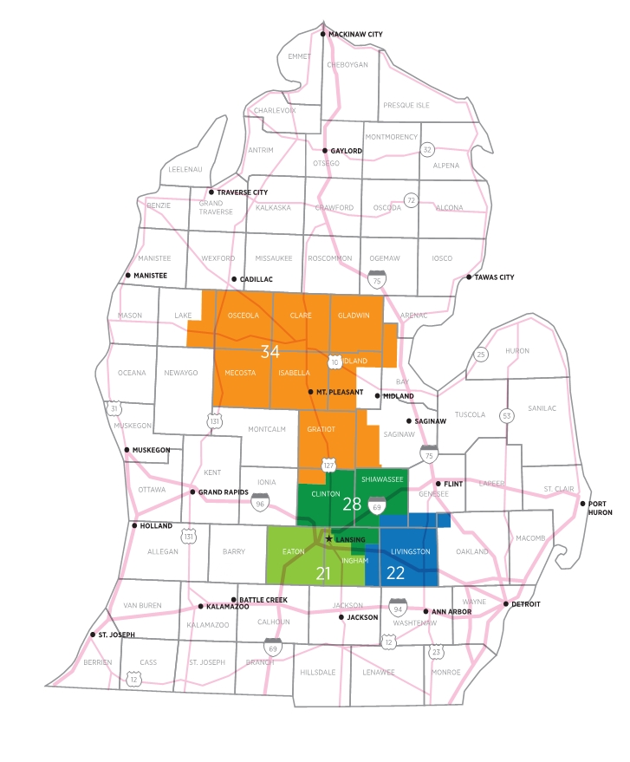
New State Senate Districts
Candidate | Party | District
Sarah Anthony | Dem | 21st
Nkenge Ayanna Robertson | Rep | 21st
Jordan Genso | Dem | 22nd
Mike Detmer | Rep | 22nd
Lana L. Theis (i) | Rep | 22nd
Muhammad Salman Rais | Dem | 28th
Sam Singh | Dem | 28th
Madhu Anderson | Rep | 28th
Daylen W. Howard | Rep | 28th
Roger Hauck | Rep | 34th
Lisa M Sowers | Rep | 34th
Christine Gerace | Dem | 34th
Paid for by the LRC-PAC | 500 E. Michigan Avenue Suite 200 | Lansing, MI 48912

Slide 4
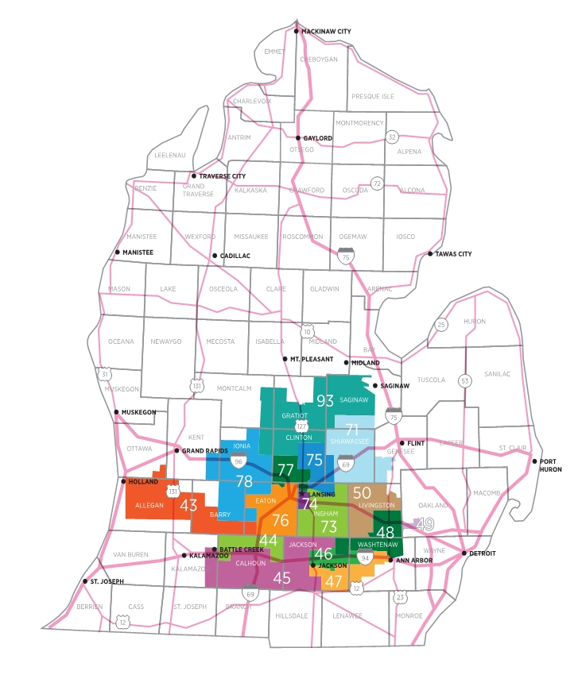
New State House Districts
Candidate | Party | District
Mark Ludwig | Dem | 43rd
Nevin Cooper-Keel | Rep | 43rd
Phillip Joseph | Rep | 43rd
Lindsay Kronemeyer | Rep | 43rd
Rachelle M. Smit | Rep | 43rd
Mark D. Zacharda | Dem | 71st
Brian BeGole | Rep | 71st
Ali Williston | Rep | 71st
Bob Carlin | Rep | 71st
Kevin Rathbun | Rep | 71st
Julie Brixie | Dem | 73rd
Norm Shinkle | Rep | 73rd
Kara Hope | Dem | 74th
Carlee Knott | Dem | 74th
Jennifer Sokol | Rep | 74th
Albert L. Kelley Jr. | Dem | 74th
Emily Stivers | Dem | 75th
Don L. Keskey | Dem | 75th
Penelope Tsernoglou | Dem | 75th
Chris Stewart | Rep | 75th
Angela Witwer | Dem | 76th
Jeremy Whittum | Rep | 76th
John J. Magoola | Rep | 77th
Logan Byrne | Dem | 77th
Emily Dievendorf | Dem | 77th
John Horford | Dem | 77th
Leah M. Groves | Dem | 78th
Ben Geiger | Rep | 78th
Christine E. Barnes | Rep | 78th
Gina Johnsen | Rep | 78th
Jon Rocha | Rep | 78th
Jeffrey, Lockwood | Dem | 93rd
Graham Filler | Rep | 93rd
Alan Hoover | Rep | 93rd
Paid for by the LRC-PAC | 500 E. Michigan Avenue Suite 200 | Lansing, MI 48912

