Slide 1
UNDERSTANDING AUTOMOBILE INSURANCE

Slide 2
Congratulations! You finally have your driver’s license. But there are some things you need to consider before you hit the road…

Slide 3
PROOF OF FINANCIAL RESPONSIBILITY
It is illegal in Ohio to drive without insurance or other proof of financial responsibility. There are several ways, in addition to obtaining auto insurance, you can meet this requirement.
However, most people will meet this requirement by purchasing auto insurance.

Slide 4
KEY INSURANCE TERMS
Policy - A written contract for insurance between you and your insurance company.
Premium - The amount you pay to your insurer regularly to keep a policy in force.
Deductible - The portion of a covered loss you pay before the insurance company becomes responsible for payment under the policy.

Slide 5
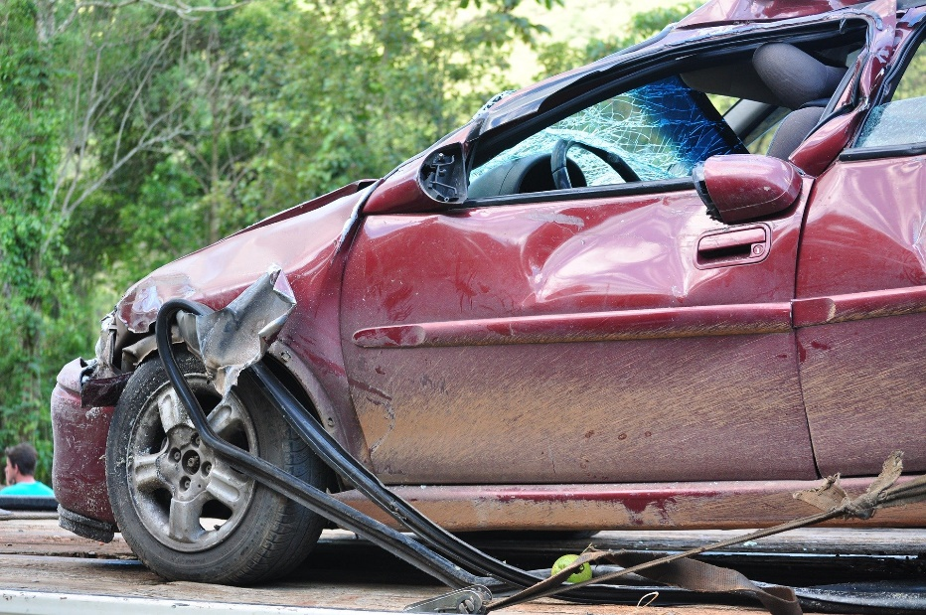
COVERAGE OPTIONS
Bodily Injury Liability Coverage
Property Damage Liability Coverage
Collision
Comprehensive
Medical Payments
Uninsured/Underinsured Motorists

Slide 6
SAFETY TIPS
Avoid distracted driving. In Ohio, it is a primary offense for drivers under 18 years old to use any wireless communication device while driving. Penalties can include license suspension and fines.
Wear your seat belt.
Obey the speed limit.
Drive solo. Studies have shown that having passengers can increase the risk of crashes.

Slide 7
COST SAVING TIPS
Keep your grades up! Many insurance companies give you a discount for maintaining an overall B or better average.
• Shop around for insurance quotes. Check your parents’ carrier and others to compare costs.

Slide 8
INSURANCE CAREERS
The insurance industry has positions and career paths for every interest and ambition – you can find roles in customer service, technology, claims, underwriting and more.
Find additional information by visiting insurancecareers.org!

Slide 9
QUESTIONS?

