Slide 1
Work Ethic Award Program

Slide 2
About the Chamber
Not-for-Profit Organization
Network of nearly 500 businesses located throughout Eastern Kentucky
Our goal is to help grow our communities and the economy

Slide 3
What is Work Ethic?
Work Ethic
The principle that hard work is intrinsically virtuous or worthy of reward.

Slide 4
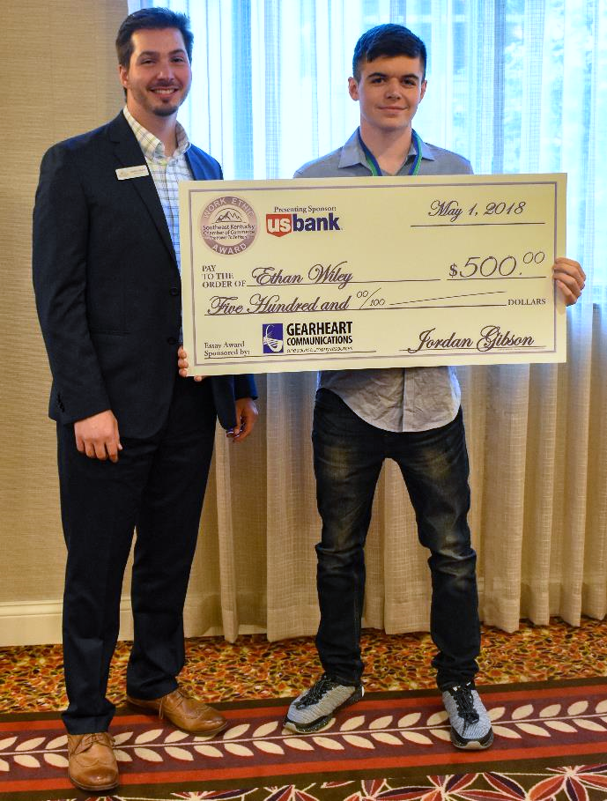
POURPOSE OF the WEA Program
To produce Eastern Kentucky graduates who are responsible, productive members of the community.

Slide 5
About the WEA Program
Eastern Kentucky seniors participate
Year long program, ending in March
Must meet a complete list of objective and subjective criteria to qualify
Upon completion you receive:
WEA Certificate
WEA Medallion
Invitation to the WEA Reception

Slide 6
The Standards
OBJECTIVE CRITERIA
Quantifiable.
Based on verifiable facts.
SUBJECTIVE CRITERIA
Opinion.
Based on others’ perceptions.

Slide 7
Objective Criteria
Discipline
Attendance
Community Services
Achievement
Video Participation
Punctuality
PAGE 5
WEA Application

Slide 8
SUBJECTIVE Criteria
Work Ethic
Dependability
Respectfulness
Cooperation
PAGE 6
WEA Application

Slide 9
The Scoring
For most criterion, you can earn 0-2 points
A maximum score of 22 points is possible
You must earn at least 1 point in each category
You must earn at least 16 points total to qualify
Your teachers and counselor will award your points

Slide 10
Why You Should Participate
Helps build your future
Resume
College Application
Recognized in regional media
Opportunity to win $500

Slide 11
Timeline of Important Dates
September 15
WEA Commitment
Form Due
March 8
WEA Application
Due
March 15
Subjective
Criteria Due
Mar. 29
Tentative List of
Eligible Seniors Due
April 5
Final List of
Eligible Seniors Due
April 12
Essays
Due

Slide 12
CONTACT US
(606)
432-5504
info@
sekchamber
.com
178
College Street
Pikeville, KY 41501
facebook.com/
sekchamber

Slide 13
sekchamber.com/work-ethic-award

Slide 14
Work Ethic Award Program

