Slide 1
#DataStrategyForum2019

Slide 2
2018 Brought huge shifts in charitable giving. Carol Rhine, Principal Fundraising Analyst at Target Analytics will provide a review of industry indices and reports revealing the state of our industry sector and what we can expect for the future.

Slide 3
MAY 22 | 8:45AM - 4:45PM
NAPCO | 1500 Spring Garden St #1200 | Philadelphia
Buy One, Get One!
Agencies: Buy One, get one free to take a nonprofit client
Nonprofits: Buy One, get one free to take a nonprofit colleague!

Slide 4
Digital Day brings together some of the industry’s leading digital marketing experts. They will share their knowledge and provide you with answers to your toughest online marketing questions to help you save time, bolster your response, and increase revenue.

Slide 6
DATA STRATEGY
FORUM 2019
Multi-Channel Marketing:
Breaking Down The Walls
For sponsorship information, program questions or to register:
dmaw.org
#DataStrategyForum2019

Slide 7
SPONSORS
DATA STRATEGY
FORUM 2019
#DataStrategyForum2019

Slide 8
SPONSORS
DATA STRATEGY
FORUM 2019
#DataStrategyForum2019

Slide 9
SPONSORS
DATA STRATEGY
FORUM 2019
#DataStrategyForum2019

Slide 10
Whova Mobile App
DATA STRATEGY
FORUM 2019
Sponsored by
#DataStrategyForum2019

Slide 11
Table Top Displays
DATA STRATEGY
FORUM 2019
#DataStrategyForum2019

Slide 12
Data Strategy Committee
Co-Chairs
DATA STRATEGY
FORUM 2019
Zack Carpenter Vice President, Nova List
Dan Sonners Assistant Vice President, Director of Nonprofit Marketing
Conrad Direct
#DataStrategyForum2019

Slide 13
Data Strategy Committee
DATA STRATEGY
FORUM 2019
Lori Magill-Cook, Executive Vice President, ALC
Heather Philpot, Senior Vice President Political & Public Affairs, Infogroup
Krista Sassaman, Senior Director, ABD Direct
Bruce Demaree, President, DonorBase
Gabrianne Williams
Tracy Dietz, CEO, DonorBureau
Samantha Muljadi, Associate Director, Marketing & Strategy
Sherene Kelly, Executive Vice President, Sales & Marketing, DonorBase
#DataStrategyForum2019

Slide 14
Data Strategy Committee
Co-Chair Welcome Remarks
DATA STRATEGY
FORUM 2019
Dan Sonners Assistant Vice President, Director of Nonprofit Marketing
Conrad Direct
#DataStrategyForum2019

Slide 15
DATA STRATEGY
FORUM 2019
Multi-Channel Marketing:
Breaking Down The Walls
#DataStrategyForum2019

Slide 17
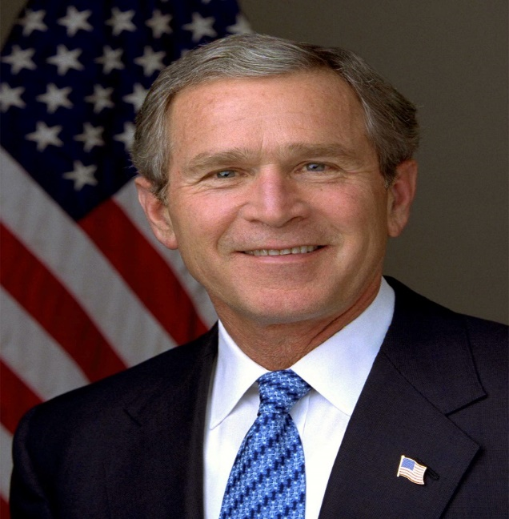

Slide 18
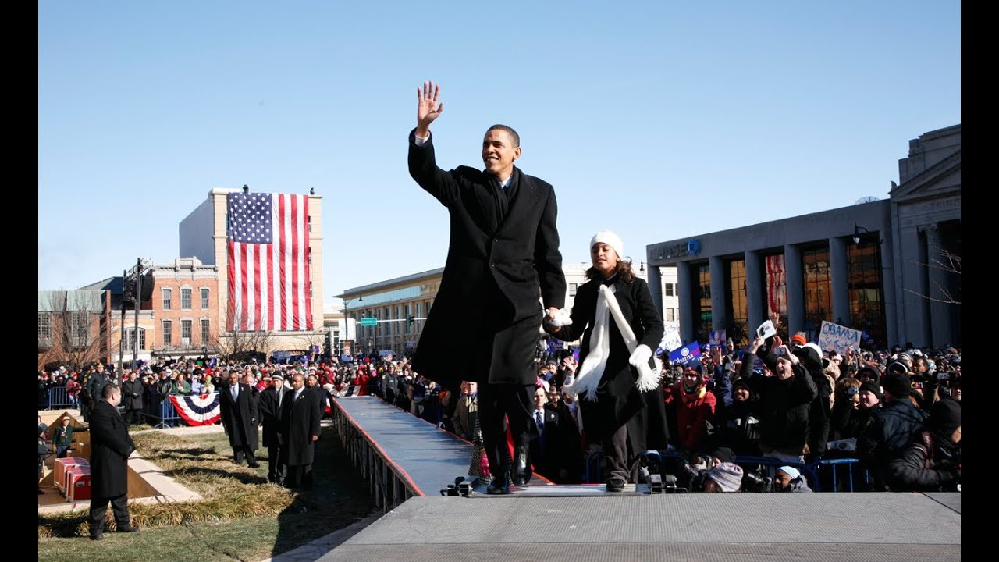

Slide 20
June 29, 2007
iPhone Unveiled

Slide 21
“Don’t They Know
Direct Mail Is Dying?!”

Slide 22
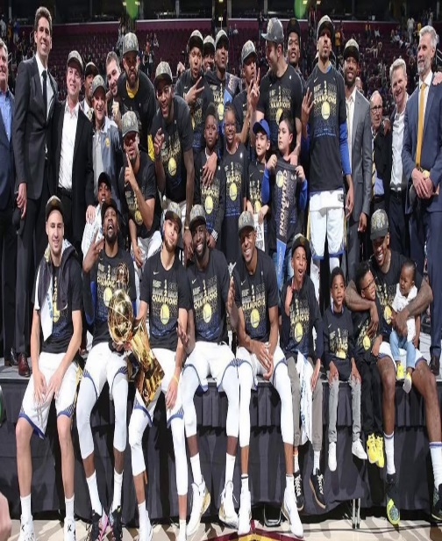
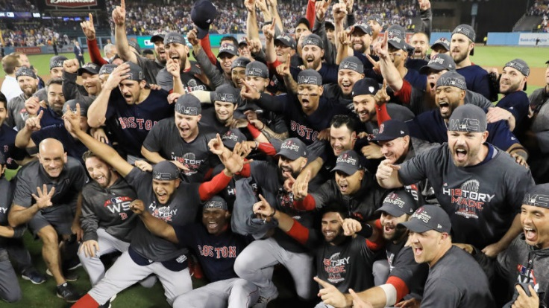
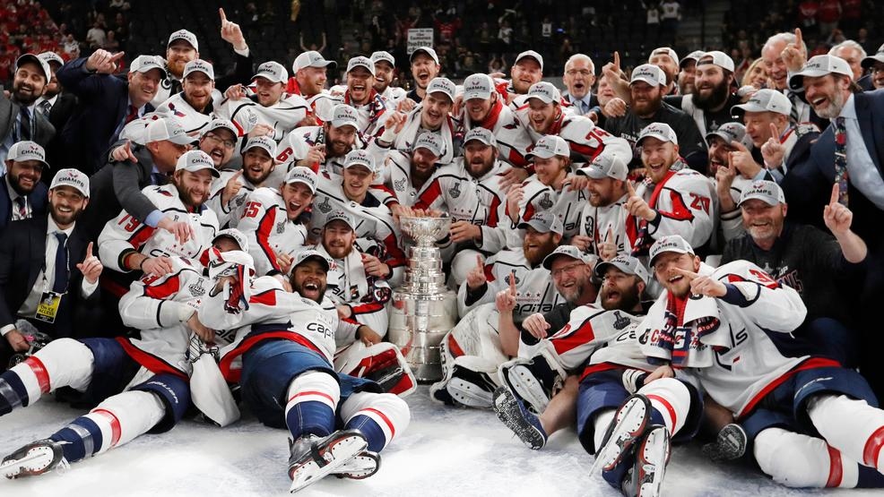

Slide 23
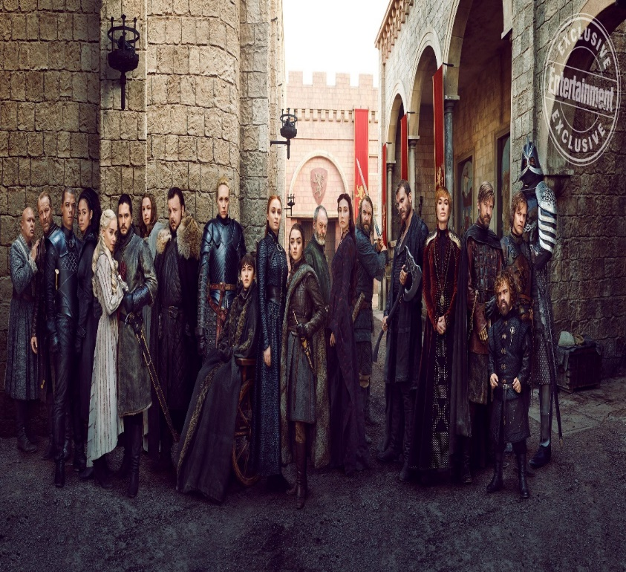
OR

Slide 24
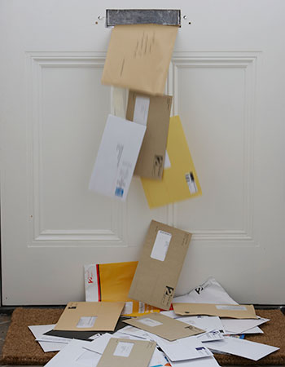
VS

Slide 25
DIRECT MAIL

Slide 26
DIRECT MAIL
WEB TRAFFIC

Slide 27
DIRECT MAIL
WEB TRAFFIC

Slide 29
“Other Bars Are Not The Enemy”

Slide 30
Channels
“Other Bars Are Not The Enemy”

Slide 31
Ideas
Channels
“Other Bars Are Not The Enemy”

Slide 32
Companies
Ideas
Channels
“Other Bars Are Not The Enemy”

Slide 34
DATA STRATEGY
FORUM 2019
Multi-Channel Marketing:
Breaking Down The Walls
#DataStrategyForum2019

