Slide 1
Target Analytics donorCentrics™ Index of Direct Marketing Fundraising
Quarterly Presentation of Trends and Findings
2018 Fourth Quarter Results
Carol Rhine

Slide 2
Target Analytics donorCentrics Index of Direct Marketing Fundraising
59 national non-profit organizations with 100,000+ active (0-12 month) donors
30 million donors and more than 78 million gifts totaling over $2.9 billion in revenue
Direct marketing giving (mail, telemarketing, web, canvassing; no events)
Individual payments greater than $10,000, soft credits, matching gift payments are excluded.
Q4 2018 performance results
Return to more normal giving patterns following the atypical performance in 2017. Most organizations had year over year declines in all measures.
Revenue decreased by a median 2.7%.
Donor numbers declined by 5.6%, just one-fifth of the organizations had positive donor growth.
Median new donor numbers fell 8.8%.
Decreases in retention and reactivation rates contributed to donor declines as well.
  Retention rate down a median 3.8%
  Reactivation down a median 7.8%

Slide 3
The Fundraising Landscape

Slide 4
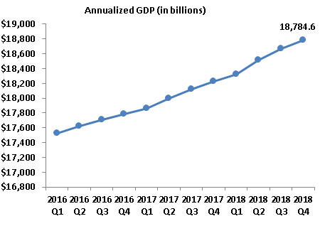
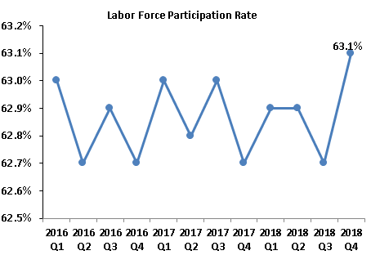
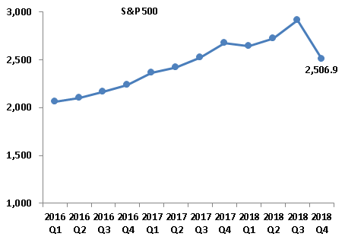
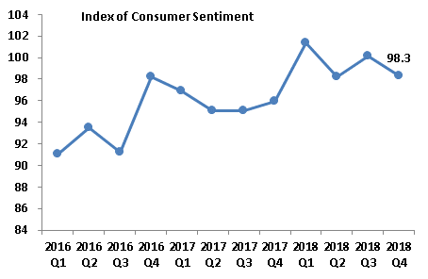
Economic Indicators
Q1 2019 $21bn

Slide 5
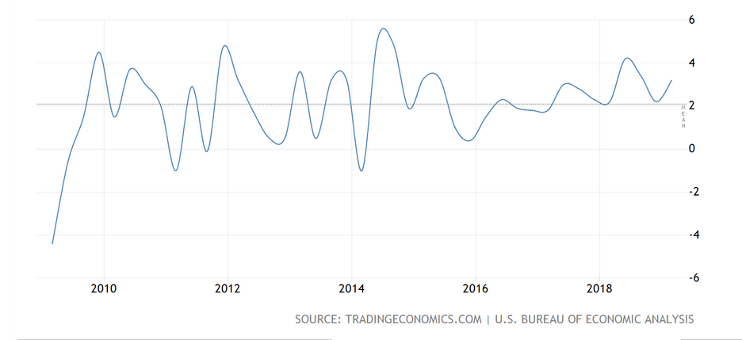
US GDP Growth Rate
Current Forecast is 2.3% in 2019

Slide 6
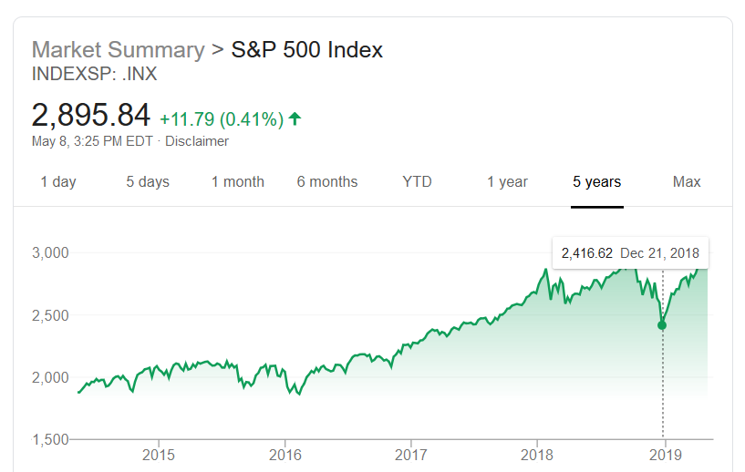
S&P 500 Index

Slide 7
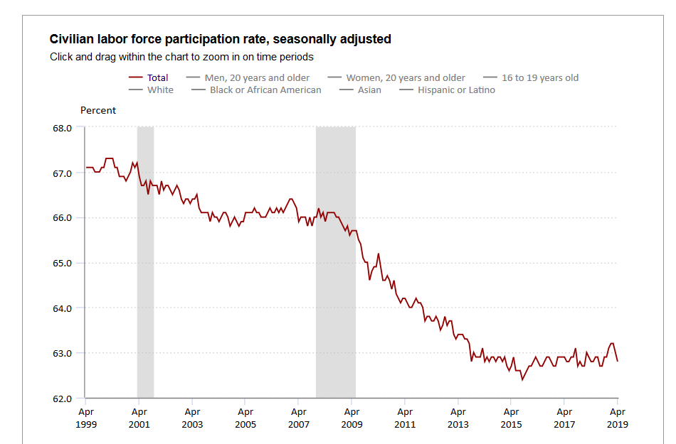
US Bureau of Labor Statistics

Slide 8

What the Market Looks Like
Tumultuous Fundraising Landscape (not a complete list!)
    US-China trade relationship.
    Economic uncertainty – tariffs
    Tax changes
    Recession
    Data privacy
    Self-curation of news
    Climate change
    Political issues
Decline in Donors
    The number of donors in the U.S. was highest in 2005 and has been in decline since.
    56% of Americans give – that was 68% five years ago

Slide 9
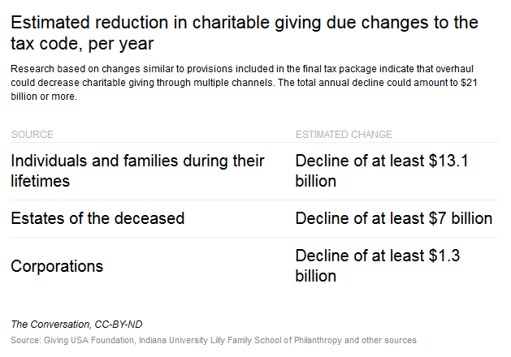
Effect of the New Tax Law
Currently on track to be down about 3% or $9 billion in 2018

Slide 10
Other Projections
Effect of the Tax Cuts and Jobs Act on Giving
1.7% - 4.6%
4% – 6.5%
5.3% - 8%
Decrease of $4.9-$13.1 billion
Tax Policy and Charitable Giving Report
Decrease of $12-$20 billion
Tax Policy Center
Decrease of $16 - $24 billion
Council on Foundations
Giving by individuals/households would have increased in 2018 and 2019 without the TCJA.

Slide 11

FEP Report published by AFP
The basic concept of the Fundraising Effectiveness Survey is that growth in giving from one year to the next is the net of gains minus losses.

Slide 12
FEP Update Q2 2018

Slide 13
FEP Update Q2 2018

Slide 14
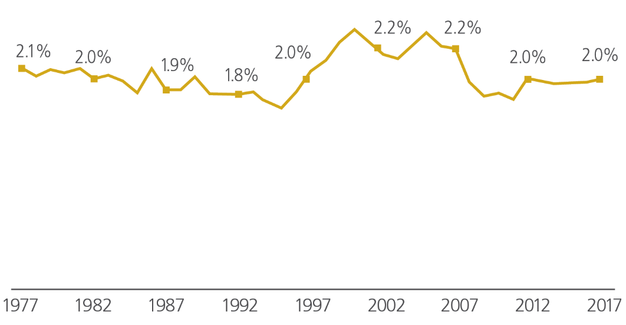

Individual giving as a percentage of disposable personal income, 1977−2017 (in current dollars)
17
Notes:
Disposable personal income is tied to a household’s total income, which is a key determinant in how much a household gives. For many households, how much they give depends on their spendable income, or disposable (personal) income. This type of income is that which is available after taxes have been paid.¹¹
In 2017, disposable income increased 2.9 percent (in current dollars) from 2016. This is compared with growth in disposable income of 2.6 percent between 2015 and 2016.¹²
Individual giving as a percentage of disposable personal income (in current dollars) was 2.0 percent in 2017⎯a slight increase from the 1.9% rate that held constant from 2014 to 2016.
In the last 40 years, individual giving as a percentage of disposable personal income was at its highest in 2000, when it reached 2.4 percent. Its lowest point was in 1995, when it dropped to 1.7 percent.

Slide 15
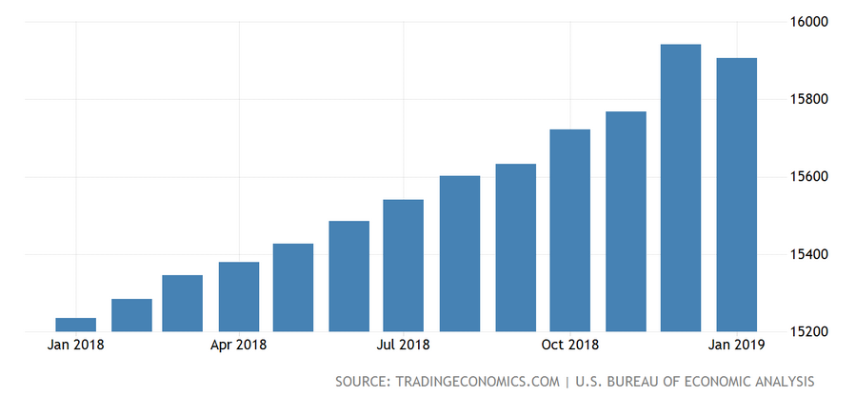
Disposable Personal Income

Slide 16
One Last Thing to Consider

Slide 17
4th Quarter 2018
Summary Findings

Slide 18
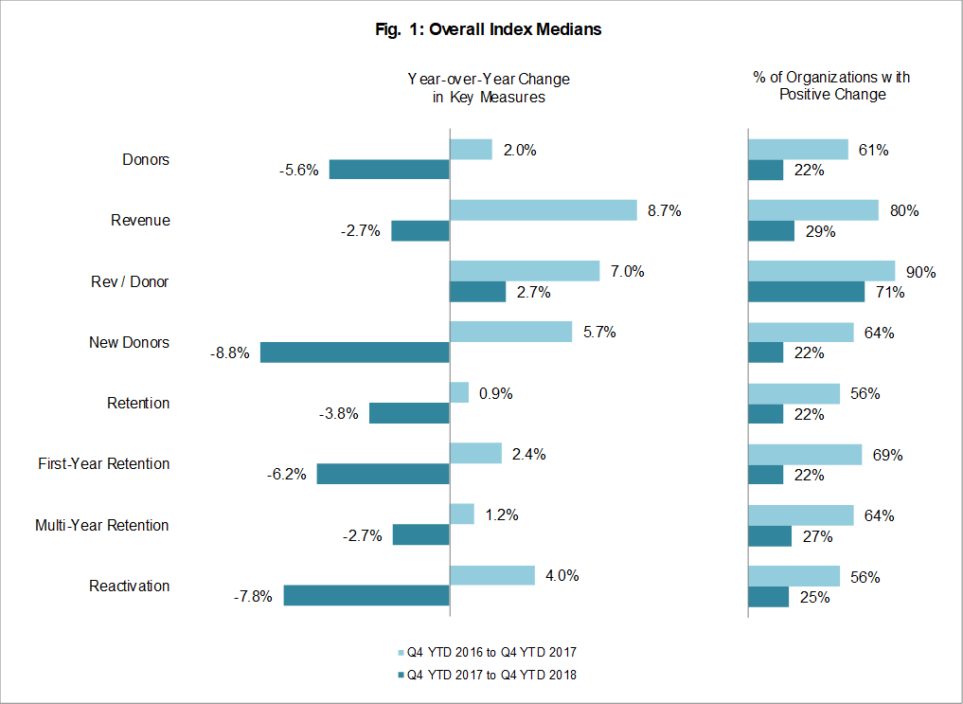
Overall Index Medians

Slide 19
Long-term Trends

Slide 20
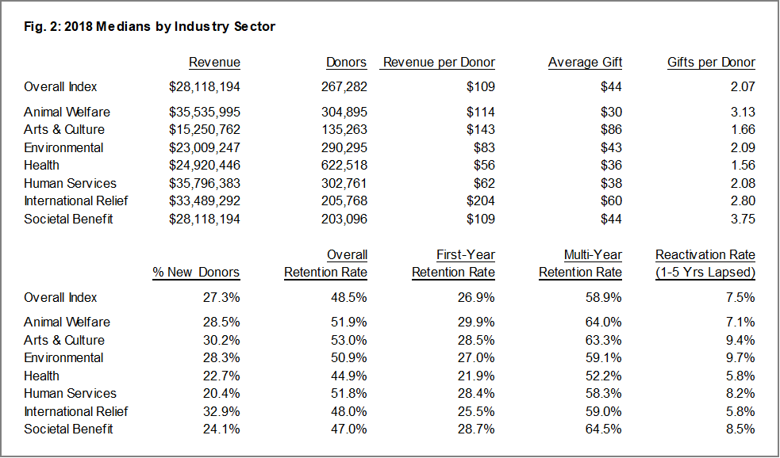
Median Measures

Slide 21
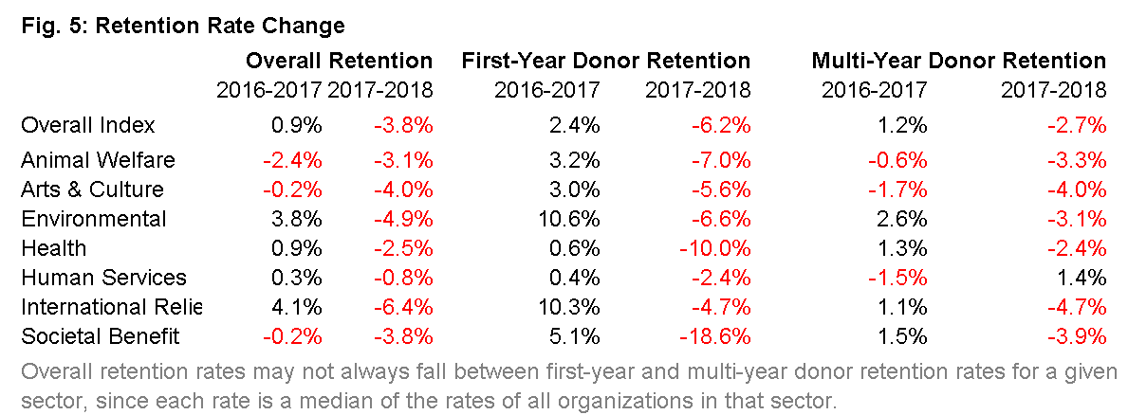
Retention Rates
Overall retention rates declined substantially in 2018, after slight increases the previous year. While more than half of the organizations in the index had retention rate increases in 2017, only one fifth had increases in 2018.

Slide 22
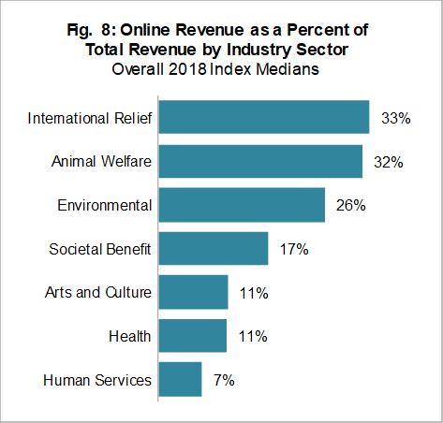
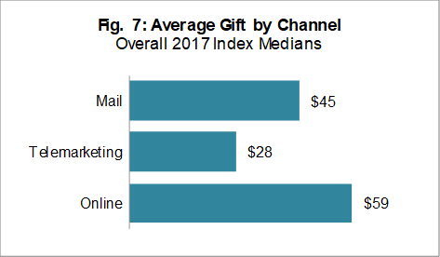
Sources of Giving

Slide 23
donorCentrics™
Sustainer Summit Learnings

Slide 24
donorCentrics Sustainer Summit
  Sharing and learning from 35 organizations of different sizes and missions
  Data analysis covering a combined
    17.7 million donors
    who gave 61.4 million gifts
    for a total of $2.41 billion in 2018.

Slide 25
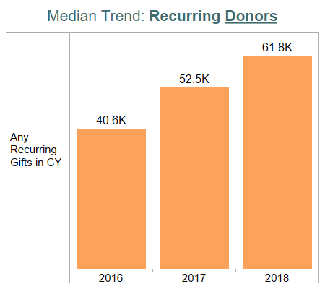
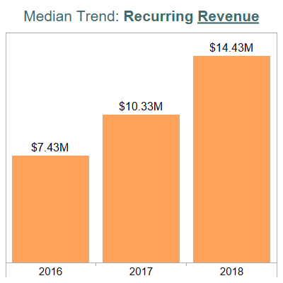

Recurring Populations and Revenue Increased at the Median.
+52%
+94%
Change in median recurring donors over
3 years
Change in median recurring revenue over 3 years

Slide 26
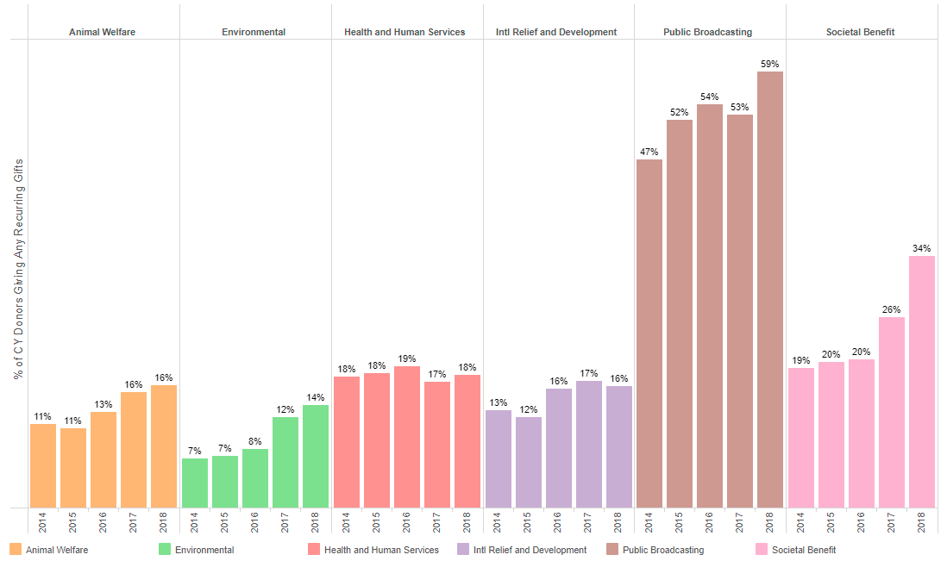
The Share of Active Donors that are Sustainers increased over time for most sectors.

Slide 27
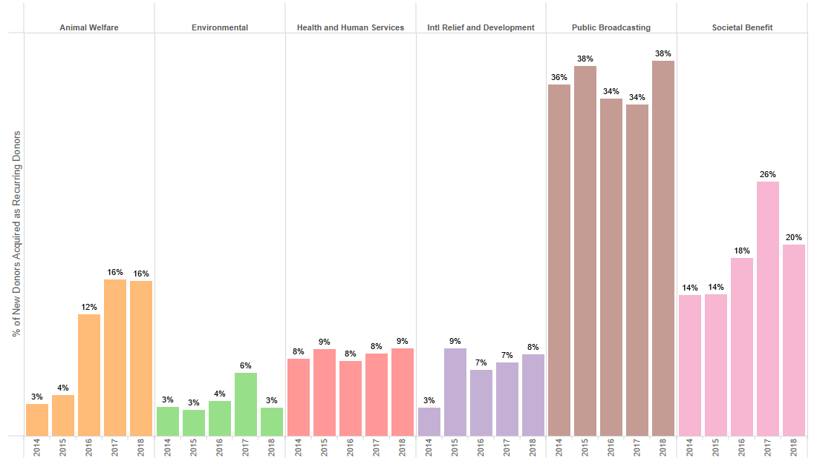
Trends for Share of New Donors Acquired as Sustainers are mixed but are increasing over time for most sectors.

Slide 28
First Year Retention Rate of All New Donors was Flat in 2018.
35.8%
35.4%
Composite First Year Retention Rate 2017
Composite First Year Retention Rate 2018
Notes:
NEED TO UPDATE WHAT WE SAY:
For programs of 75,000+ sustainers, the median was 35% and ranged between 34% and 36% over the last five years.
Roughly flat at the median.
For programs of 20,000-74,999 sustainers, the median was 21% in 2017. It increased from 18% in 2016 and it held steady at 16% between 2013-2015.
5 percentage point increase in 3 years.
For programs with less than 20,000 sustainers the median was 13% in 2017 and it increased over time from 11% in 2013.
2 percentage point increase in 5 years.

Slide 29
First Year Retention Rate of New Single Gift Donors Declined in 2018.
30.8%
26.3%
Composite First Year Retention Rate for Single Gift Donors 2017
Composite First Year Retention Rate for Single Gift Donors 2018
Notes:
NEED TO UPDATE WHAT WE SAY:
For programs of 75,000+ sustainers, the median was 35% and ranged between 34% and 36% over the last five years.
Roughly flat at the median.
For programs of 20,000-74,999 sustainers, the median was 21% in 2017. It increased from 18% in 2016 and it held steady at 16% between 2013-2015.
5 percentage point increase in 3 years.
For programs with less than 20,000 sustainers the median was 13% in 2017 and it increased over time from 11% in 2013.
2 percentage point increase in 5 years.

Slide 30
Median Month 13 Donor Retention Rate for Recurring Acquired Donors Increased in 2018, driving stable First-Year Retention Rates Overall.
3,184 | 4,948 | 6,630 | 6,709 | 9,518
Median Number of New Recurring-Acquired Donors to Retain Each Year
Notes:
Range in PY donor counts each year – excluded orgs with less than 100 PY donors:
2014: 289 – 59k / 83k (the lowest one is Best Friends, the largest ones are ASPCA, GP / ALSAC )
2015: 291 – 73k / 76k (the lowest one is FOE, the largest ones are ASPCA / ALSAC )
2016: 316 – 68k (the lowest one is IFAW, the largest ones are ASPCA / ALSAC )
2017: 380 – 64k / 76k (the lowest one is FOE, the largest ones are ASPCA / ALSAC )
2018: 449 – 120k / 211k (the lowest one is Habitat, the largest ones are PPFA / ACLU )

Slide 31
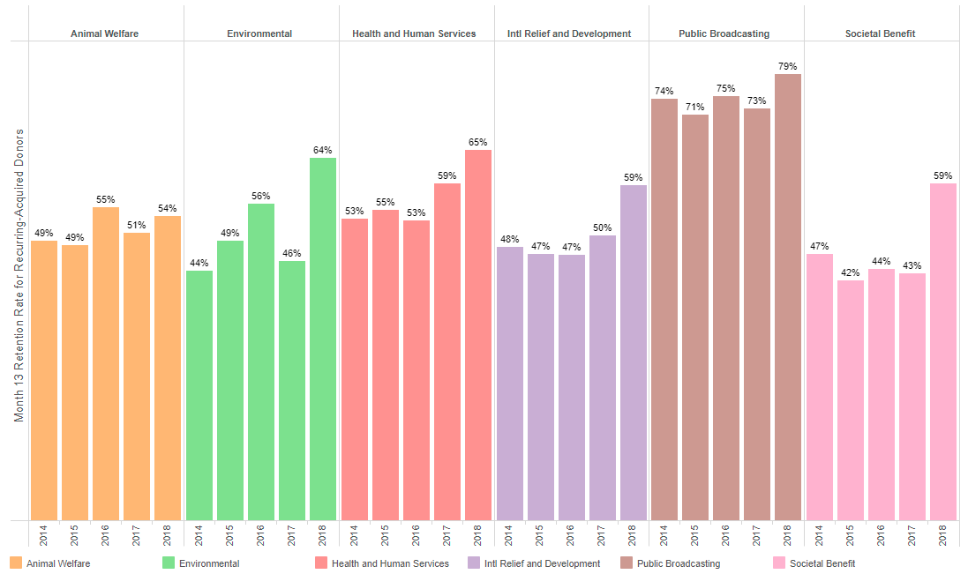
The Median Month 13 Donor Retention Rate reached new highs for most sectors in 2018.

Slide 32
donorCentrics™
Sector findings

Slide 33
Q4 2018 Summary Results
The animal welfare and arts and culture sectors had arguably the strongest performances in the index in 2018. Both had small declines in overall donors and essentially flat growth in revenue at a time when all other sectors had significantly larger declines in both areas. It did not appear that either sector was significantly affected by the 2016 presidential election.
The human services sector had continued donor losses and little change in revenue.
The environmental and societal benefit sectors had large decreases in most key metrics in 2018. For both sectors, these declines come after significant growth in 2017—likely due to donors’ unease about the policies of the presidential administration—and are likely a return to more normal giving, rather than a real cause for concern.
For the relief sector, 2017 included significant giving associated with three Caribbean hurricanes, while 2018 was relatively free of large-scale natural disasters. As a result, relief organizations had declines in most measures this year.
After experiencing moderate growth in most metrics in 2017, the health sector appears to have returned to the declines we have seen more typically for these organizations over the past decade.

Slide 40
Thank you
Carol.Rhine@Blackbaud.com

