Slide 1




DATA STRATEGY
FORUM 2019
Multi-Channel Marketing:
Breaking Down The Walls
A holistic approach to the Donor’s Multi-Channel Journey
#DataStrategyForum2019

Slide 2

Presented By
Liz Kincheloe
Major Market Account Executive
EveryAction
Megan Buchheit
Digital Account Executive
Lautman Maska Neil and Company
DATA STRATEGY FORUM | 5.9.19

Slide 3
What’s a Donor Journey?
CONNECTING AND ENGAGING
Streamlined Funnel
Multifaceted Adventure

Slide 4
  Let’s Start at the Very Beginning
A
B
C
Donors
Members
Prospects
Engage
Cultivate
Upgrade
Relationships
Commitment
Dedication
WHO
WHAT
  WHY

Slide 5
The Donor Journey
1
2
5
6
Identify the
Connection
Individualized
Correspondence
Feel the love
Elevate &
Recalibrate
Strategy
Execution
Analysis
*
Source of
Interaction
*
Automated
Marketing

Slide 6
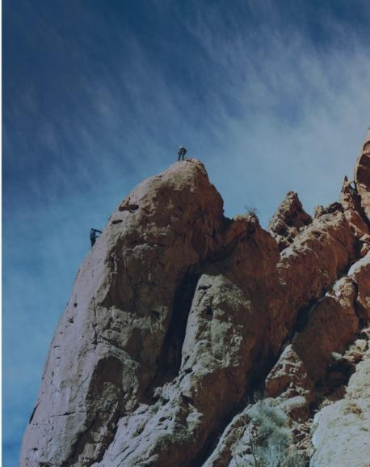
Remain Focused and Adaptable
Adjust to variable needs, wants and wishes
Maintain clean and accurate data
Integrate messaging and strategy
Rinse and Repeat

Slide 7
Collaboration
AUTOMATED MARKETING
Volunteers
Referrers
Advocacy
Event Attendees

Slide 8
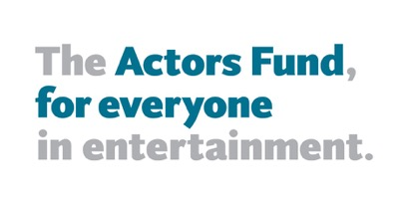

  Case Studies
1
2
ACCESS
MARKETING AUTOMATION
MULTICHANNEL MESSAGING

Slide 9
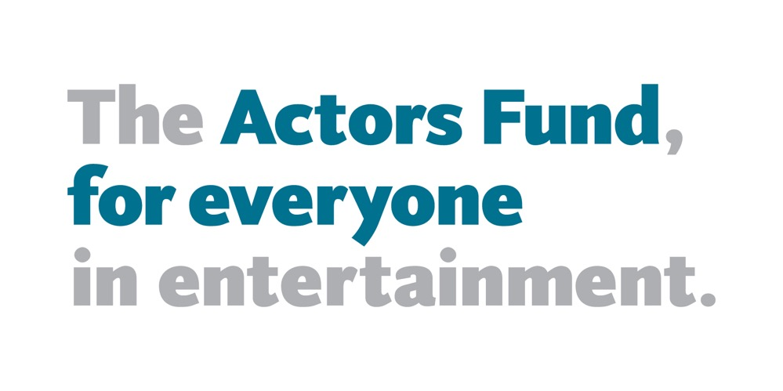
ACCESS

Slide 10
Messaging Differences
Acquisition & Appeals: Mission-focused
Renewals: Membership Benefits

Slide 11

Communicating with Donors

Slide 12




Channels We Use
Direct Mail
Email
Website

Slide 13
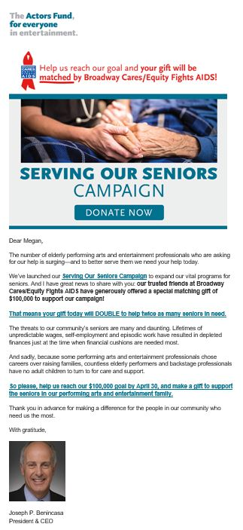


Receive Appeals Through Email and Direct Mail

Slide 14
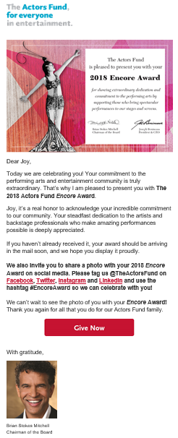
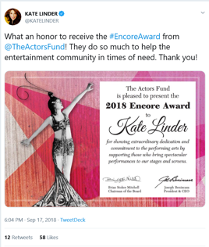
Cultivation and Engagement Opportunities

Slide 15
Renewals: Direct Mail + Email
Sent on a rolling basis each month
Renewal 1 + Email
Renewal 2
Renewal 3 + Email
Renewal 4
Renewal 5
Renewal 6 + Email

Slide 16
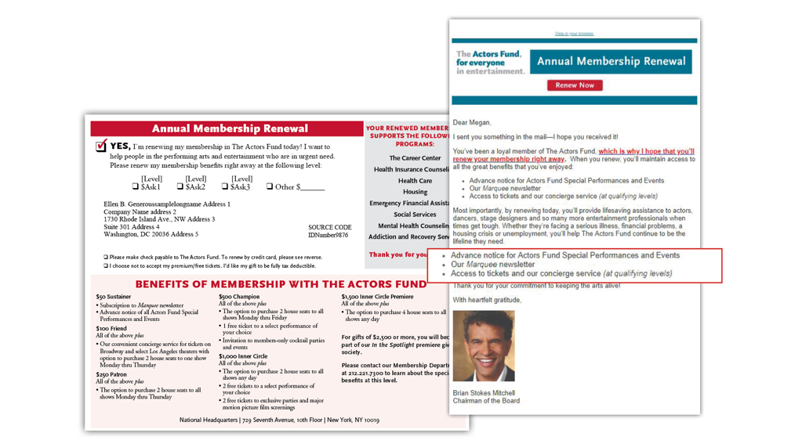
Renewal 1

Slide 17
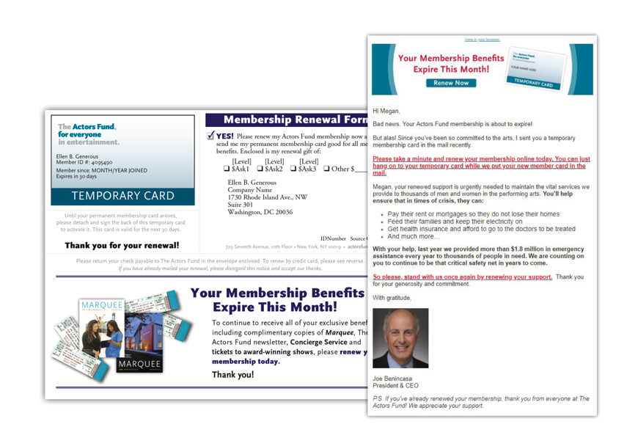
Renewal 3

Slide 18
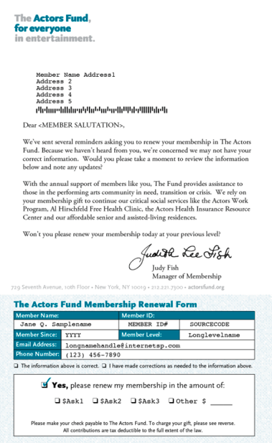
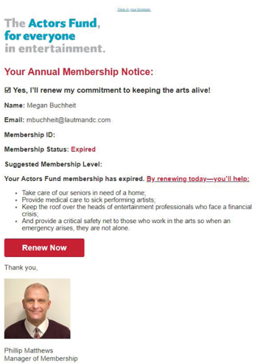
Renewal 6

Slide 19
Introducing In the Spotlight (ITS)
High touch program for high value donors
Membership begins at $2,500
Targeted to a small quantity of overall donor file
Four part renewal series

Slide 20
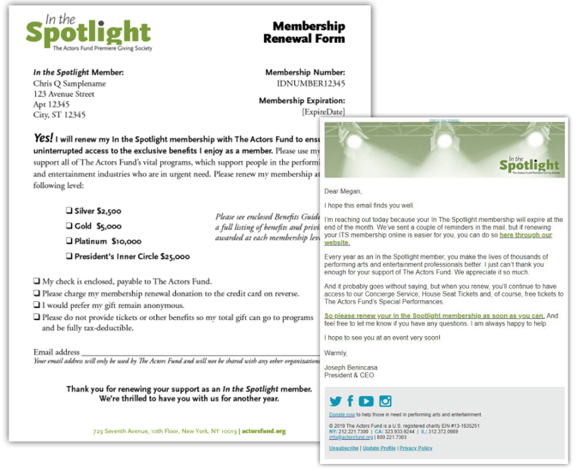
Renewal 3

Slide 21
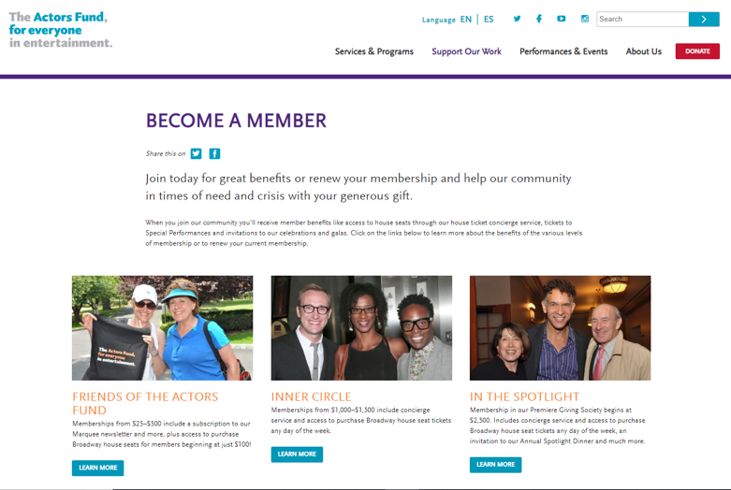
Website

Slide 22
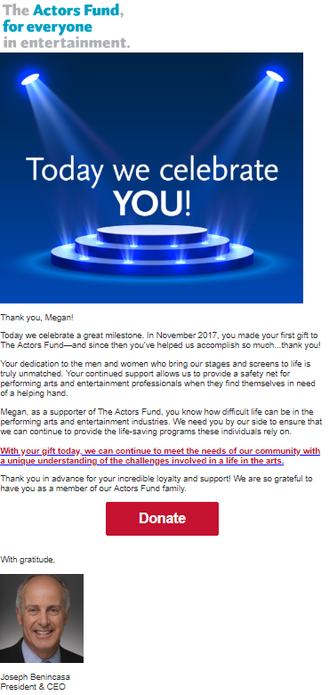
Anniversary Email Sent to Non-Member Donors

Slide 23

ACCESS

Slide 24

Two Messages: Two Programs
Animal Welfare
Nutrition/Health

Slide 25

Channels We Use
Direct Mail
Email
Website
Telemarketing
Notes:
Assigned: DB
Haven’t started text yet – but is the goal.

Slide 26
Sustainer Invite Campaigns
REMEMBERING RODNEY SOCIETY

Slide 27
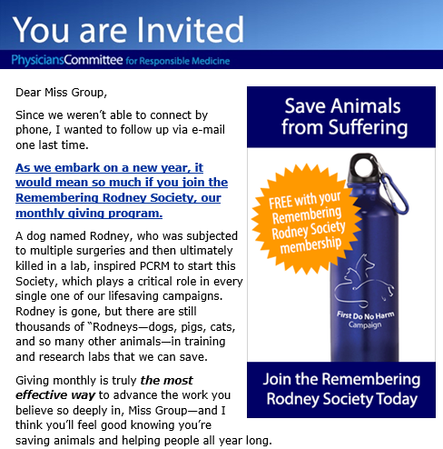
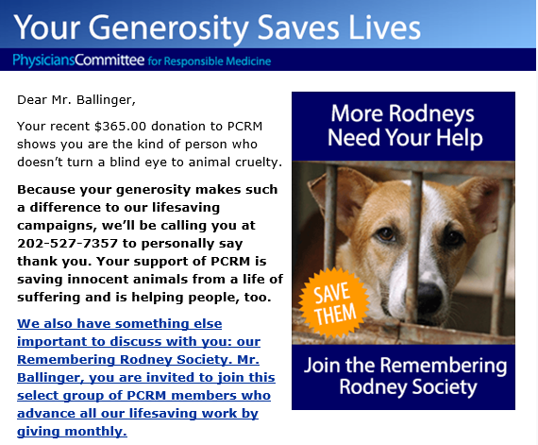
Integrated Sustainer Invites
3-4 annual sustainer invite email campaigns
Timed with telemarketing and mail efforts
Notes:
Assigned: RK
Examples show integration with TM invite

Slide 28
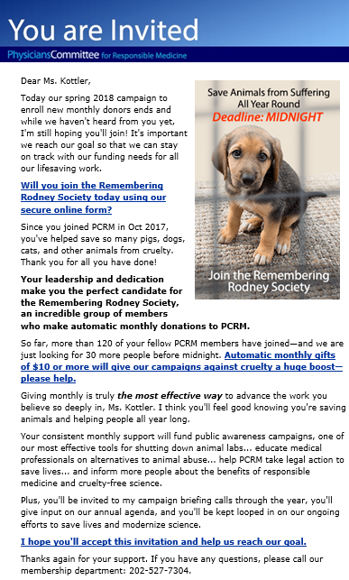
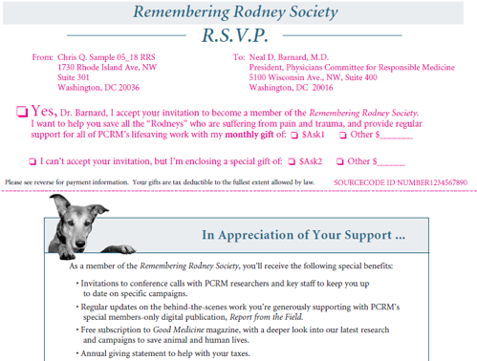
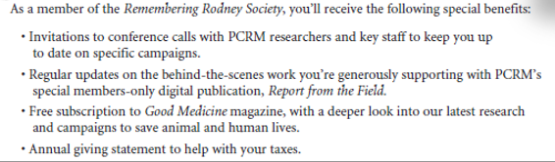

Highlight Benefits
Notes:
Assigned: RK
Societal benefits are used here.
Expect 100-200 new sustainers from these invites.

Slide 29
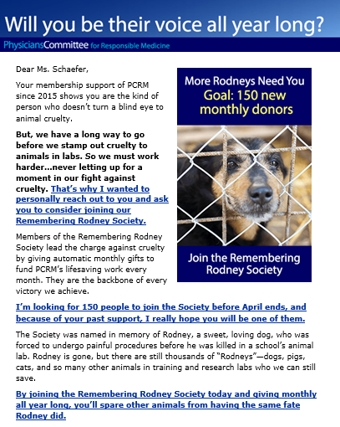
Strong Case
For Support
Notes:
Assigned: RK
Examples show integration with TM invite

Slide 30
Donation Form Improvements

Slide 31
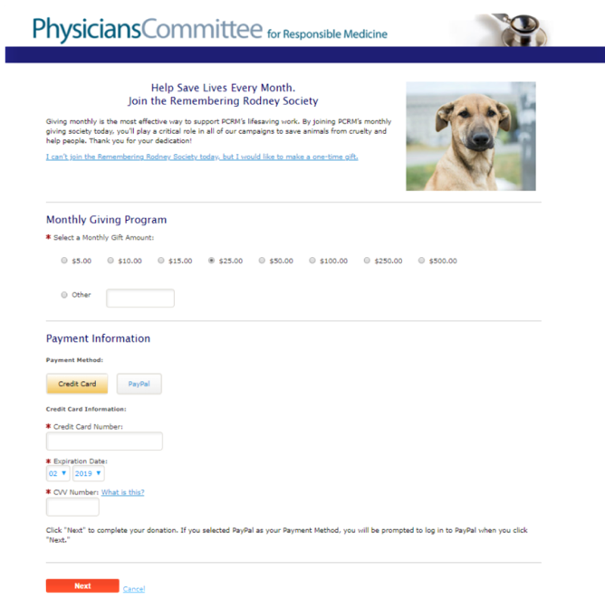
Old Form
Clicked off to a new page
Notes:
Assigned: RK
Examples show integration with TM invite

Slide 32
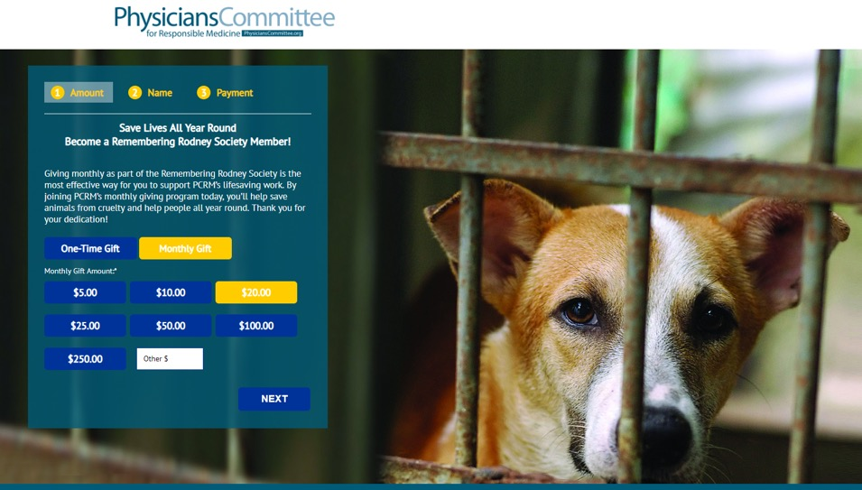
New Form
Notes:
Assigned: RK
Examples show integration with TM invite

Slide 33
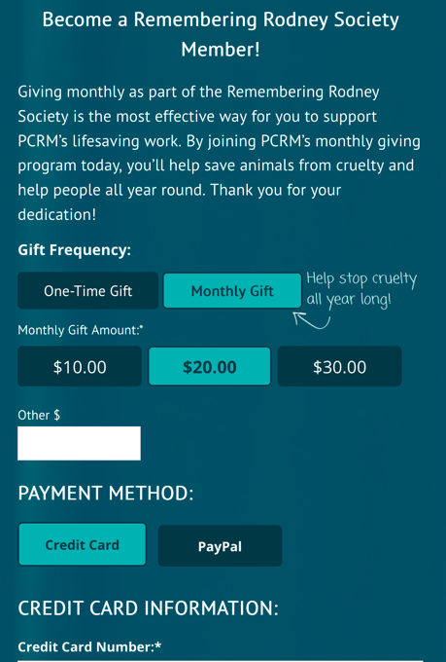
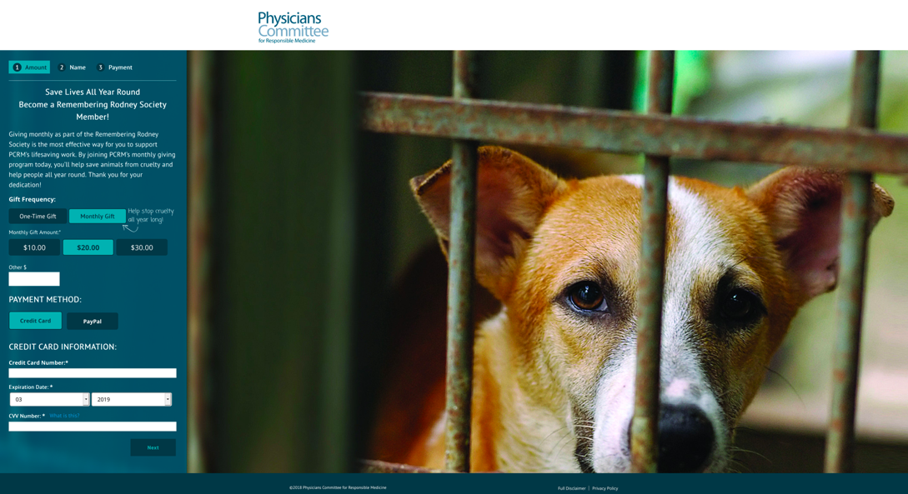
Tested nudge
Notes:
Assigned: RK
Examples show integration with TM invite

Slide 34
Communicating with Sustainers

Slide 35
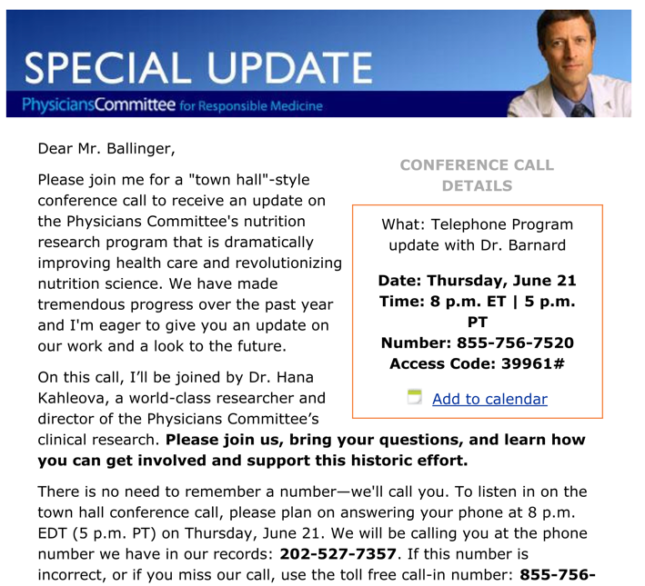
Sustainer Cultivation
Notes:
Assigned: RK
Examples show integration with TM invite

Slide 36
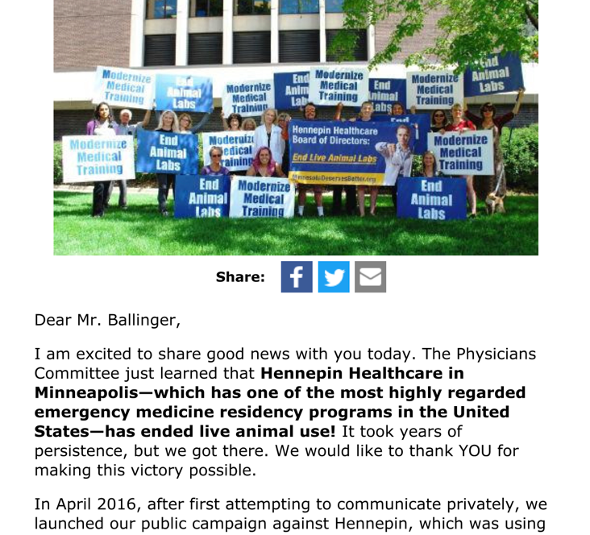
Victory Announcement
Notes:
Assigned: RK
Examples show integration with TM invite

Slide 37
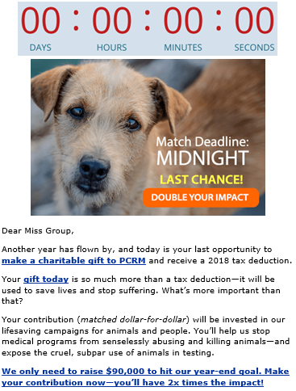
Send 3-4 Fundraising Messages at Year-end
Notes:
Assigned: RK
Examples show integration with TM invite

Slide 38
Best Practices
Automate as much as possible
Integrate with multiple channels for a renewal ask
Always look for new ways to reach out

Slide 39

QUESTIONS?
Contact Information
Liz Kincheloe, Major Markets Account Executive, EveryAction
202.315.0319 | lkincheloe@everyaction.com
Megan Buchheit, Digital Account Executive, Lautman Mask Neil & Company
202.296.9660 x 227 | mbuchheit@lautmandc.com

