Slide 1

10:00 -11:00 AM – Modeling – Lists – Email Match – Coop
Speaker: Roger Hiyama,
Sr. Vice President,
Client Services, Wiland
Angela Newsom, Client Services Director, Wiland
#DM201

Slide 2
A few questions for the class
Areas of focus in your job?
  Data
  Production
  Creative/Agency Services
  Business Development/Sales
Channels of focus?
  Direct Mail
  Email
  Digital
  TM
Years of Experience?
Special areas for me to cover?
#DM201

Slide 3
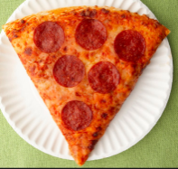
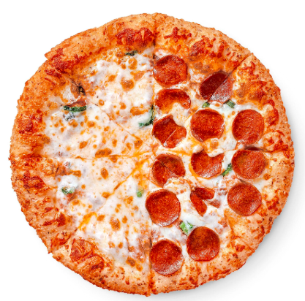
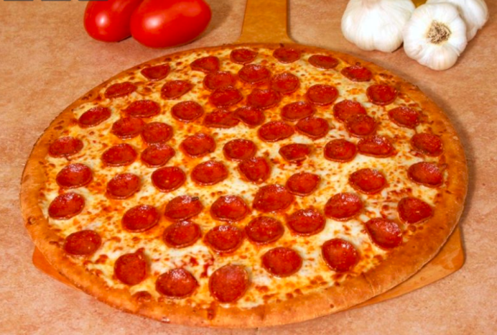
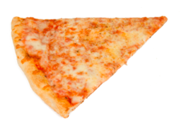
Modeling – Simplified Explanation
#DM201

Slide 4
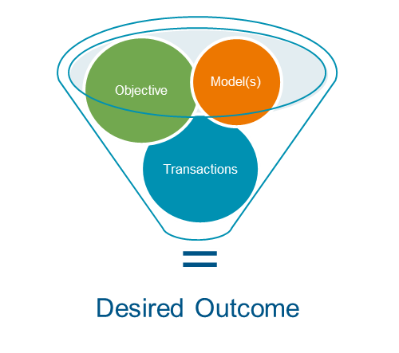
Modeling – Defined
What is a model?
  A statistical model is a mathematical tool used to predict a desired outcome using a pool of sample data (like past transactions, demographic, interests, social media activity, etc.)
  Types of objectives:
    Cost to Acquire
    Average Donation
    Revenue per Piece
    Response Rate
    Lifetime Value
#DM201

Slide 5
Modeling – mathematical tool
Ax + By + Cz = Score*
Scores get sorted from top to bottom
x, y, z are the variables identified as key variables
A = weighting for variable x
B = weighting for variable y
C = weighting for variable z
Score = the sum of the weighted variables
*Each record gets a different score based upon its variable characteristics
Segment 1
Segment 2
Segment 3
Segment 4
Segment X
Segments get created
#DM201

Slide 6

Types of Models
Profile/Clone Models vs. Response Models
Mail File #1
Mail File #2
Mail File #3
Descriptive or Look-a-Like variables
Differentiating Variables
2,000 responders per mailing is desirable
Response #1
Response #2
Response #3
#DM201

Slide 7
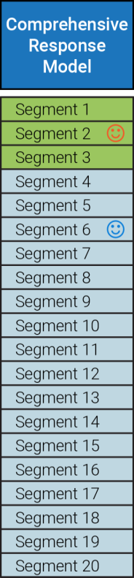


Model Ranking and Segmentation
Traditional Methodology
Selections from individual models are made “vertically” from the top segment down, typically with 25M to 75M names/segment.
Mr. Orange is identified by the lens of a revenue-focused model as a Segment 2 donor. Meanwhile, Ms. Blue is placed in Segment 6 by the model.
As a revenue-focused model, in this view, Mr. Orange is seen as having a greater likelihood of giving and giving a larger gift than Ms. Blue.
In a response-focused model, Ms. Blue would likely be in segment 1 and Mr. Orange would be in segment 6.
Mr. Orange donates $50 once a year
Ms. Blue donates 10 times a year at $10/donation
#DM201

Slide 8



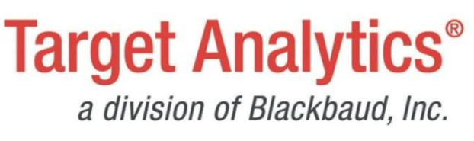


Coop Databases
#DM201

Slide 9
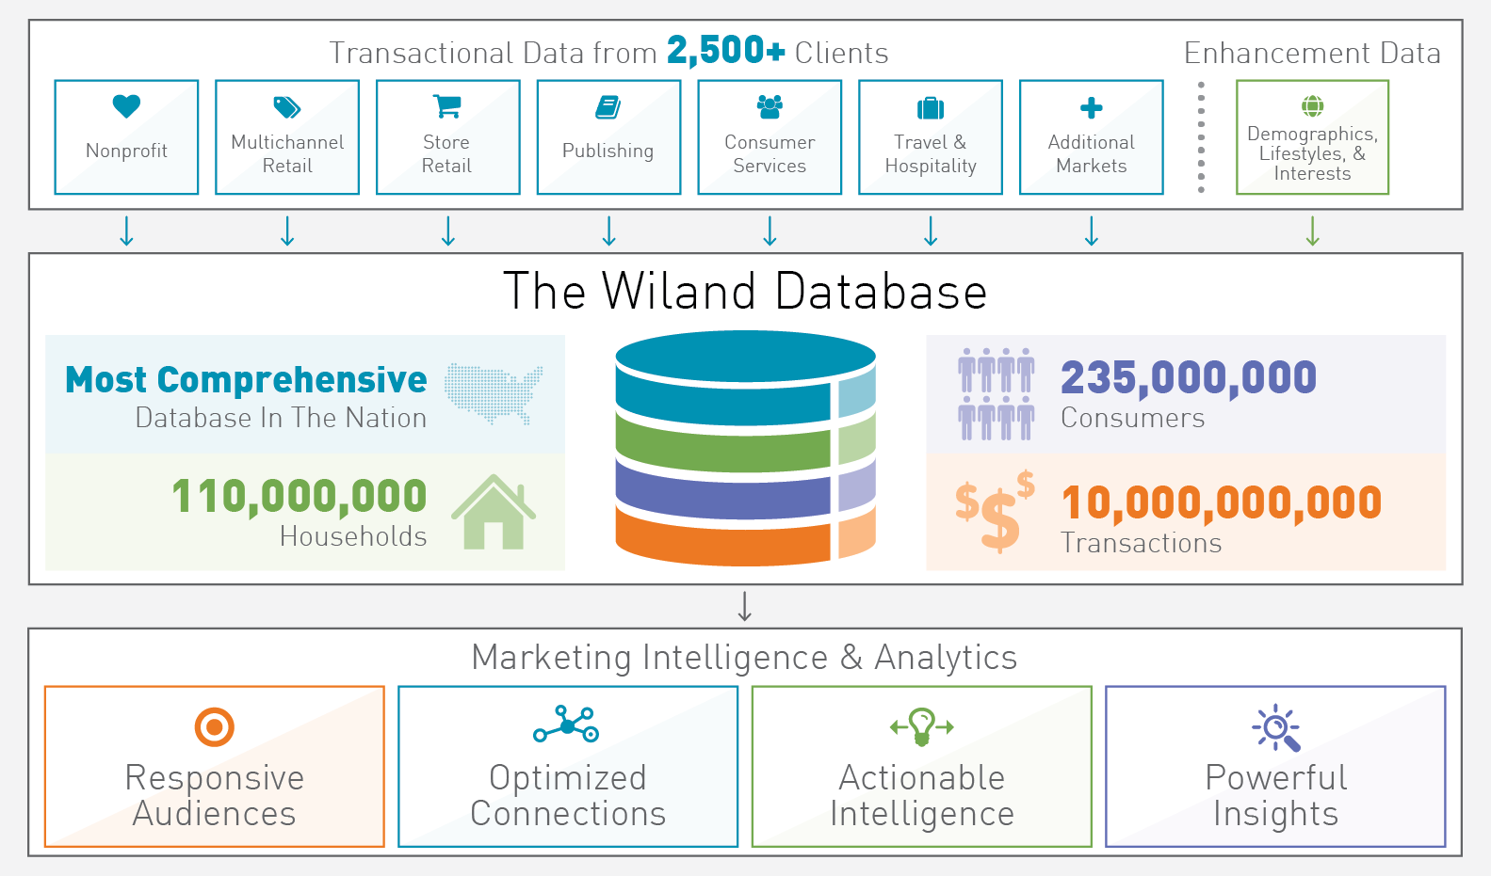
What is a Coop Database?
    The depth and breadth of the data, combined with innovative modeling techniques, provided a comprehensive view of consumer behavior, enabling a wide array of effective solutions for fundraisers.
#DM201

Slide 10
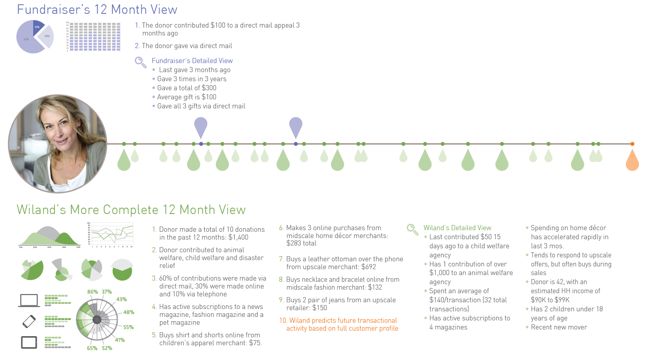
The Breadth and Depth of Coop Data
#DM201

Slide 11
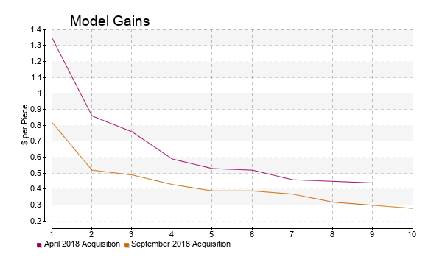
A Modeling Example – Gains Chart & Variables
Variables of Importance |  | Sign
1 | Number of Brands with an initial donation in the last 12 months in the Charitable NP: Environmental Matters Market | +
2 | Recency of activity with sources in the Co-op | -
3 | Number of sources per month on file in the Charitable NP: Environmental Matters Market | +
4 | Email gifts in the last 12 months in the Fundraising Industry | +
5 | Number of synergistic lists with a recent transaction in the Fundraising Industry | +
6 | Number of subscriptions sources in the Periodicals: Outdoor Nature Market | +
7 | Gender Code: Female(+) Male(-) | +
#DM201

Slide 12
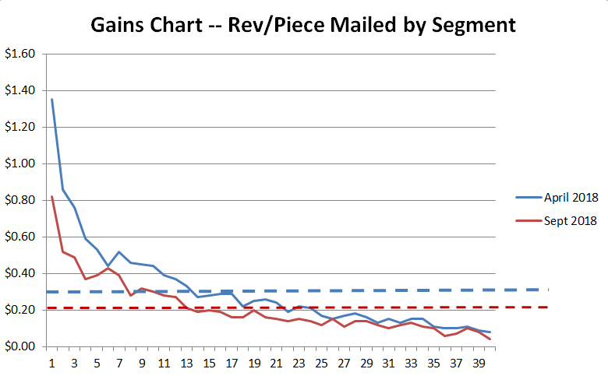
Revenue-focused Model : Gains Chart
Revenue-Focused Model:
2 campaigns used in model build
Dotted line represents campaign average
17:1 top to bottom ratio for April 2018
21:1 top to bottom ratio for Sept 2018
This model type does a great job in finding “higher tops” and “lower bottoms” than other model types
Great to use as a Marketing Budget Optimization (MBO) model in post merge processing to drop poor names
#DM201

Slide 13
Campaign Metrics:
Qty Mailed: 1,104,068
Resp Rate: 1.00%
Avg Gift: $30
Rev/Piece: $ .30
Detailed Gains Chart – top 20 segs
#DM201

Slide 14
Detailed Gains Chart – bottom 20 segs
Worst is First to focus on!
#DM201

Slide 15
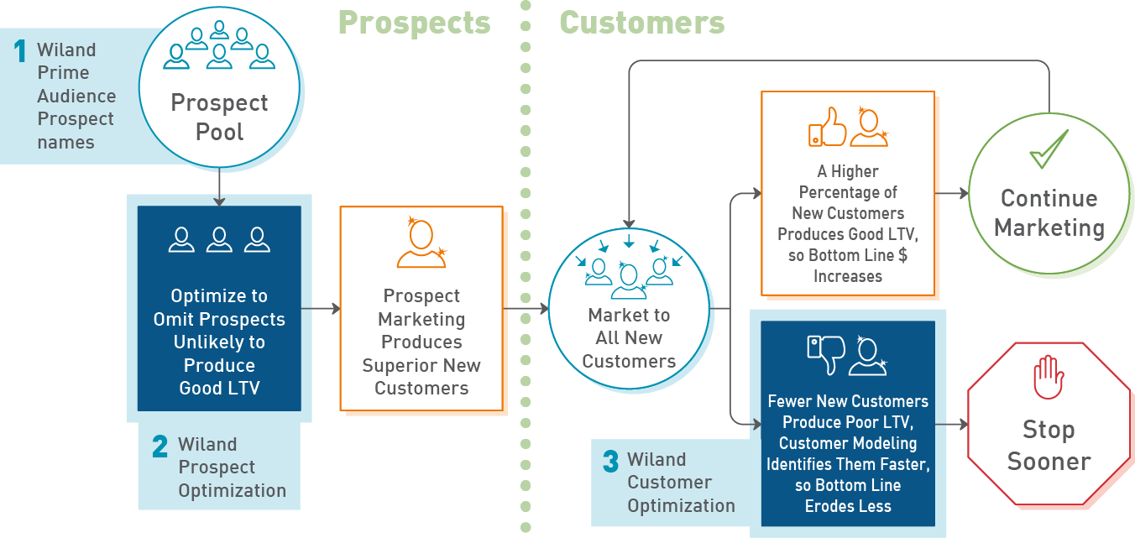
Why Coops Work
#DM201

Slide 16
Primary Coop Solutions
#1 Prospect Audiences
#2 Lapsed Reactivation Modeling
#3 Telemarketing Specific Modeling
#4 Other House File Solutions
  Major and Mid-Level Donor Targeting
  Sustainer Targeting
  Overlay and Data Append
#DM201

Slide 17
What’s trending in Coop Database World
Multiple Model Solutions
Balance Models
Post Merge Optimization
  Marketing Budget Optimization
  Drop & Replace Strategies
Machine Learning and AI technology
Digital Marketing Options
Non-Coop Options – Ultimate Data and Ultimate Audiences
#DM201

Slide 18
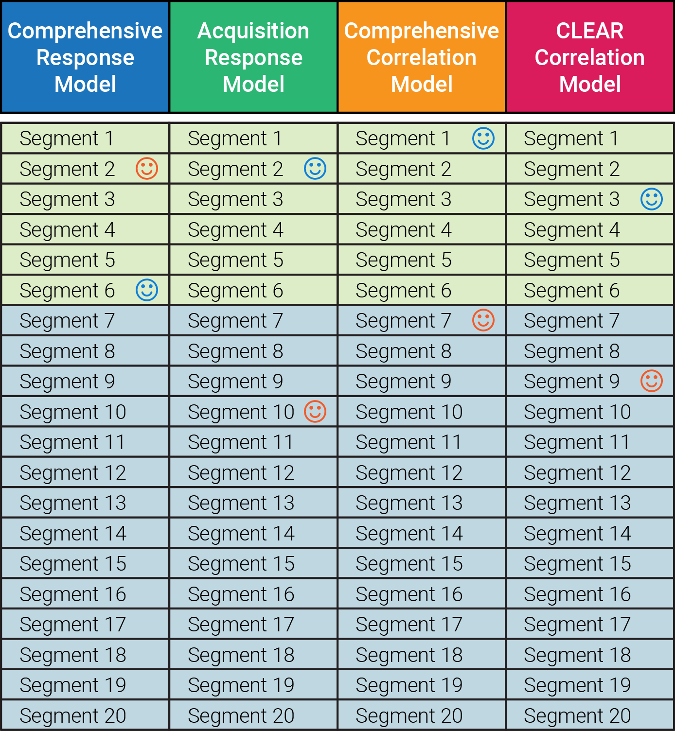
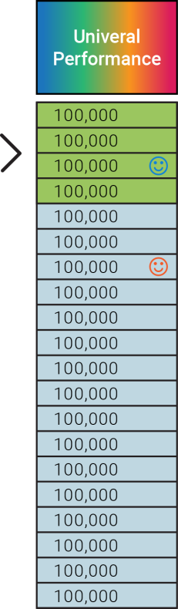
Multiple Models – Composite Model Solution
Composite Methodology
Scoring is done “horizontally” across multiple models in order to create composite model segments which are combined to identify strong incremental names not selected by the traditional method, typically with 100M to 500M names/segment.
Mr. Orange donates $50 once a year
With the benefit of a multi-model view, Mr. Orange and Ms. Blue have changed places as to the value the model assigns. In this view, Mr. Orange is ranked below Ms. Blue in the composite model since his overall score across multiple models is lower. The multi-model solution identified that Ms. Blue more consistently ranked at the top of multiple models, even if she didn’t in the one Comp Response model on the prior page.
The composite methodology not only re-ranks the names, but it introduces names that are previously overlooked when mailers take only the top segments of a single model.
Ms. Blue donates 10 times a year at $10/donation
#DM201

Slide 19
Balance Models (Post-Merge)
Kill/ Suppress Files
Coop Balance Model(s)
Back-Fill with best available names
Fill to meet quantity requirements for production
Pay on net basis since done post merge
Merge Net File
Balance Names
#DM201

Slide 20
Marketing Budget Optimization (MBO)
Drop bottom segments that will perform at 1/3 of average performance – in this case, drop 37,38,39, 40
#DM201

Slide 21
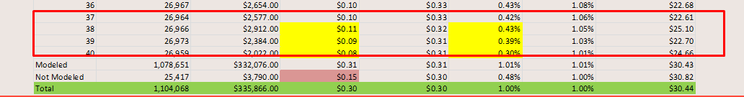
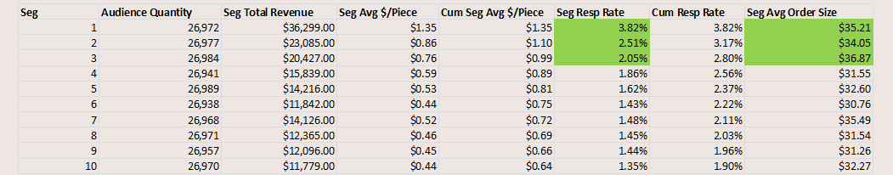
Drop and Replace Strategy
Replace = best available balance names
Averaging $.44+ rev/piece
Drop Segments 37, 38, 39, 40
Averaging $.10 rev/piece
#DM201

Slide 22
Machine Learning and AI
It’s not required but it can certainly help
Left to its own devices, it can create bad models (needs data science experience) (Cowboy Museum example)
CLEAR platform (Custom LEARning)
  Can create new data elements on the fly based on combination variables and more sophisticated variable interaction statistical techniques
  Examples:
    In a traditional regression model, points are assigned on a univariate basis – points assigned for Female, points assigned for Age
    In a CLEAR model, combination variables are created with points assigned based upon the multi-variate combo variable – points assigned based on combination of age ranges if female
#DM201

Slide 23
What Makes for Good Models
  Good modeling samples (mail files and response files)
  The greater the # of responders, the better
  Modeling from campaigns with similar results
  Breadth and depth of modeling data
  Modeling software – we use 4 different platforms
  Data Science expertise
#DM201

Slide 24
Email Append and Reverse Append
Match rates: 50% to 70%
Requires “permission pass” opt-out email which allows the consumer to opt-out within a 10 day period
Costs vary depending upon volume (est $15-50/M)
Many e-append vendors
Uses:
  Increasing size of email file
  Reverse append to retrieve postal address for DM
  Hashed files for onboarding for digital advertising
#DM201

Slide 25






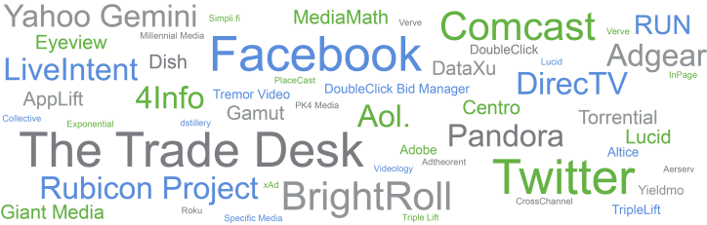

Digital Advertising – Anyone actively pursuing?
Organic Search
Google Ad Grants
Paid Search
Co-Targeting
Remarketing
Acquisition
Customer
#DM201

Slide 26
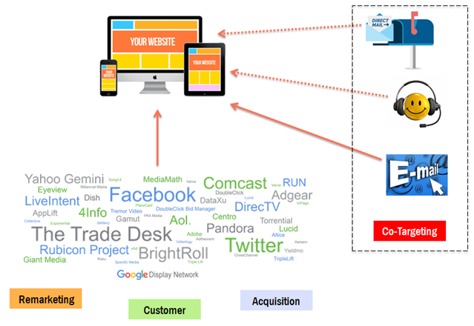
Digital Co-Targeting Modeled Coop and House Names
Co-Targeting
Good option for integrated DM & Digital display ad marketing
Areas to target:
  House File
  Lapsed Reactivation
  DM Acquisition
  TM
  E-mail
#DM201

Slide 27
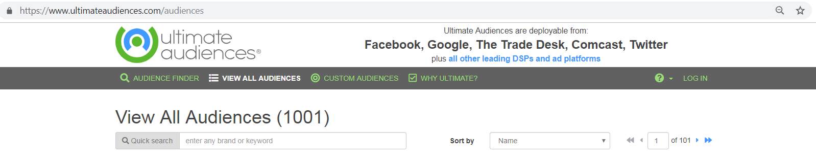
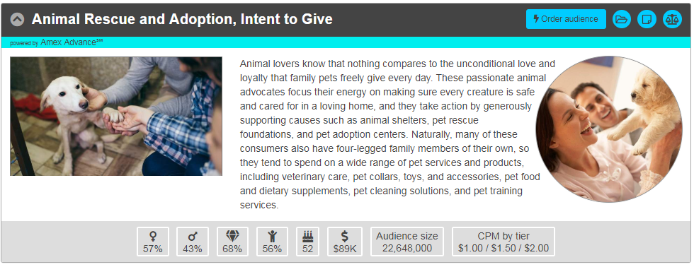
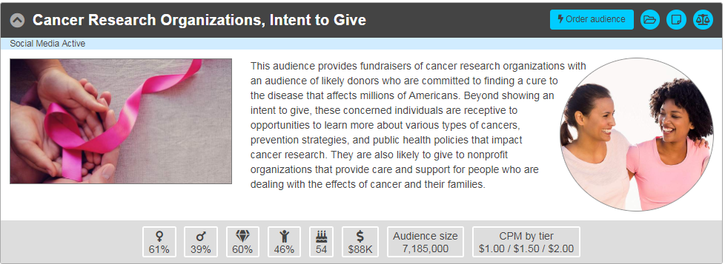
Digital Solutions Pre-Loaded Audiences available on many DSP’s
#DM201

Slide 28
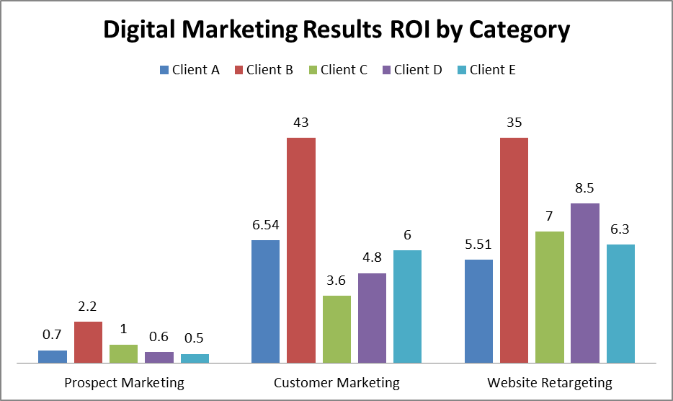
Digital Display Advertising – ROI results examples
#DM201

