Slide 1


Slide 2
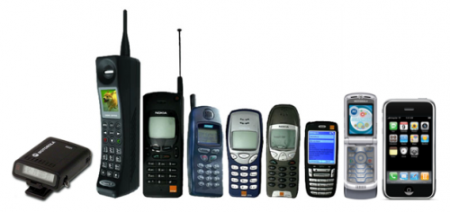
Notes:
Technology has changed everything in our world. Today I want to talk about how the changes in technology have made it possible for every one of you use your data + technology to cure fundraising pains that we all feel.

Slide 3
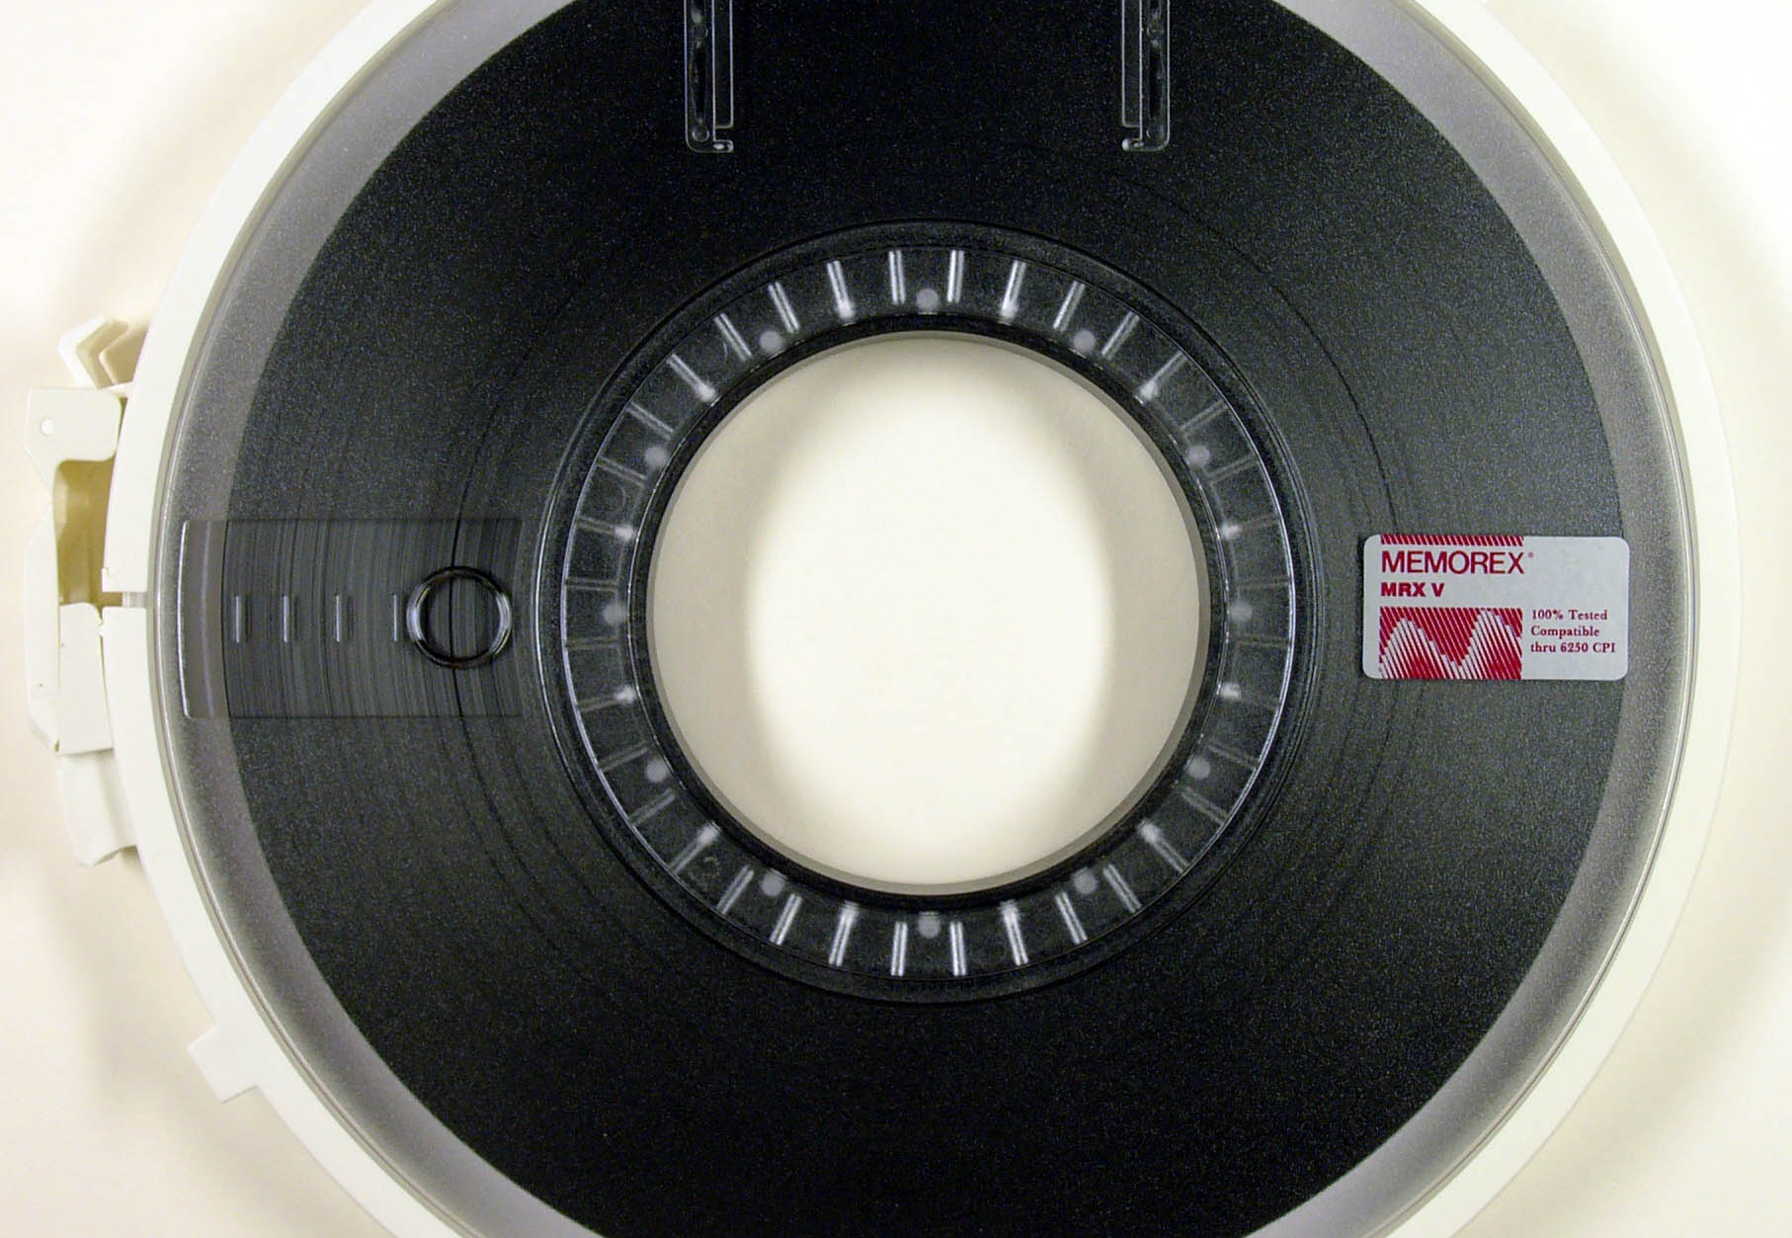

Notes:
Raise your hand if you know what this is. When I started in this industry – this is how we delivered data. Some of you in this room remember punch cards – others of you can’t imagine life without a cloud.

Slide 4

The Data Spend
$4.3 billion – supporting data integration, processing, and hygiene
$4.2 billion – hosting and management solutions
$1.63 billion – analytics, modeling, and segmentation solutions
Data source: DMA and IAB DATA Center of Excellence
Notes:
Data is getting to be a critical asset for any organization. And, in 2018, it looks like businesses are putting even more budget behind data management. Is all this investment helping grow fundraising?

Slide 5
Notes:
What are we doing with all this data. If I were a betting woman [and I am] I would wager than 98% of your marketing collateral contain ‘data driven approach’ to fundraising. How are you using data to make smarter fundraising decisions? Our industry is not yet truly ‘data driven’ – we’re data aware, some are even data critical but few are data driven

Slide 6

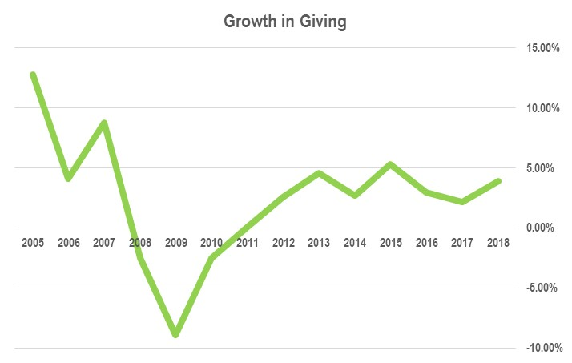
Data source: FEP 2018 Annual Report
Notes:
Are we winning?

Slide 7

Data source: FEP 2018 Annual Report

Slide 8
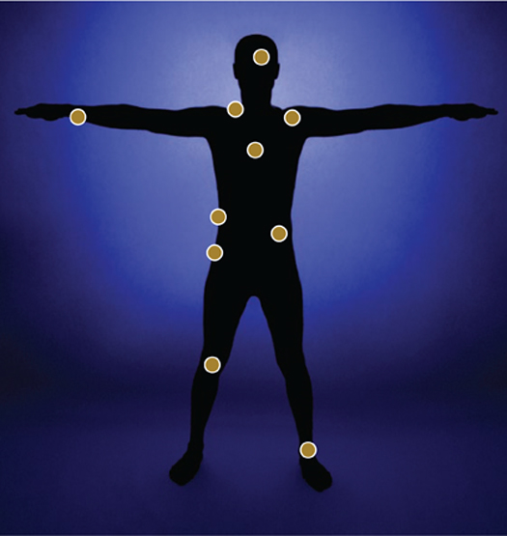
Where is your Fundraising Pain Point?
Monthly Givers
Lapsed Donor Reactivation
Actionable Reporting
Major Donors
Retention
Reduce Costs
Mid Level Upgrade
Planned Gifts

Slide 9
Most common fundraising pain points
Donor file is shrinking.
Lack of a mid-level donor program.
Mailing too much. Need to cut costs and improve net revenue.
Lapsed donor reactivation rates are declining.
Access to Actionable Reports / Dashboard
Very dependent on major donors. Lack of an upgrade strategy.

Slide 10

Notes:
When you step on to the plane and see the Pilot,
What if he looked into the cockpit and said ‘whoa’ look at all those buttons
Our fundraising programs are like planes – we don’t look at the gas if we’re trying determine our direction? So many fundraisers don’t get too distracted by all the controls and levers and when performance goes down they start pushing them all.
Are you on course … are you going to crash or land safely?
How can we use the controls in front of us to make better data-driven decisions?

Slide 11
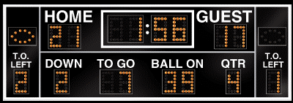
Notes:
If you can’t read the scoreboard, do you know the score?
If you don’t how to read the scoreboard then you will fail at fundraising
A good scoreboard tells you who winning / likelihood of winning / identifies possible strategies

Slide 12
Are we winning?
Notes:
Let’s take a look at how most of use gauge our success.

Slide 13
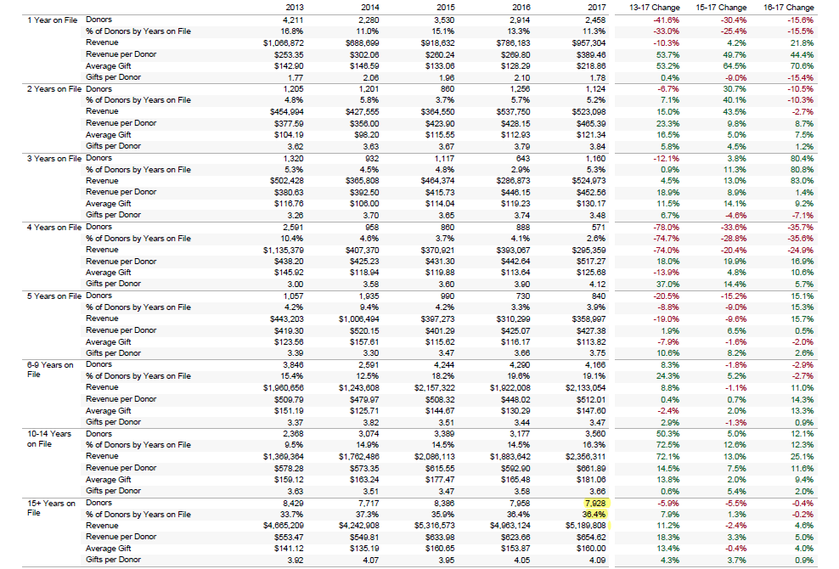

Slide 14
Build Your Scoreboard
Donors
Dollars
Response
Revenue
Notes:
Your Donor Dashboard needs to indicate the health of the two elements of fundraising: donors and dollars

Slide 15
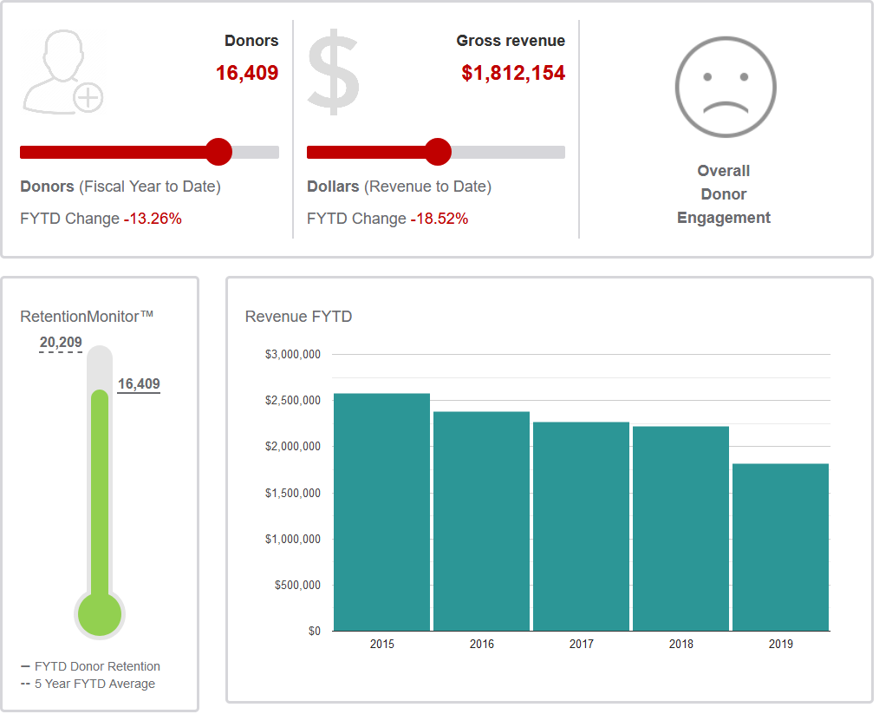

Slide 16
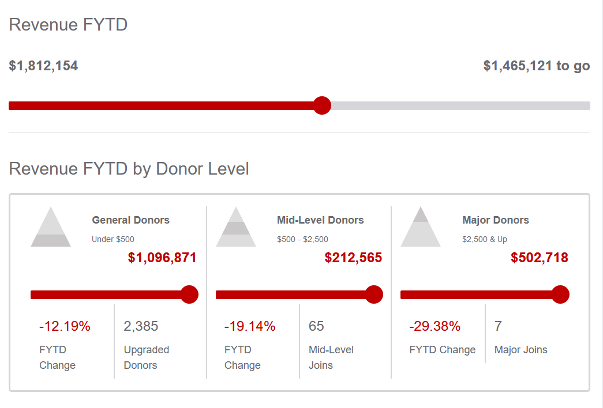

Slide 17
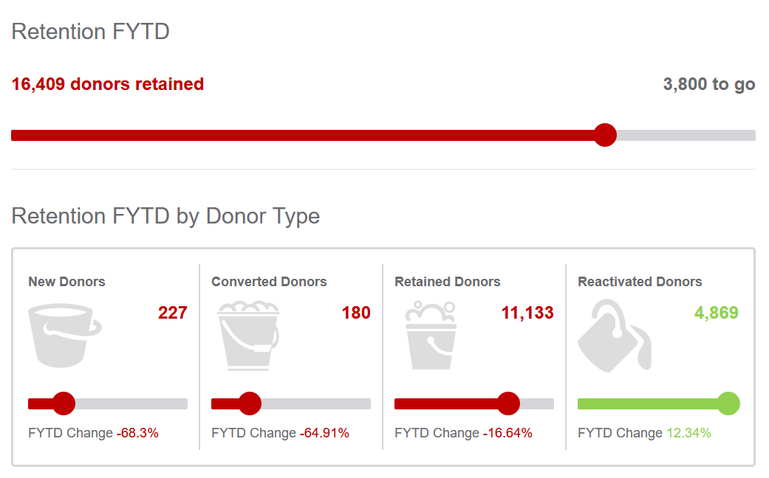

Slide 18
What gets measured gets moved
Notes:
We've all heard the saying, “What gets measured gets done.” It means regular measurement and reporting keeps you focused — because you use that information to make decisions to improve your results.

Slide 19
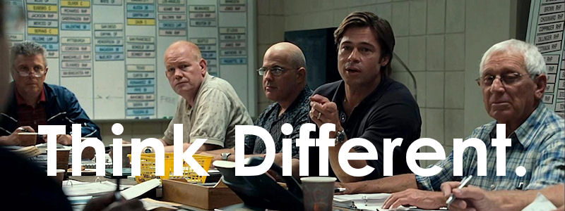
Moneyballing Fundraising
Notes:
So I wanted to do things differently. I wanted to introduce data and analytics and rigorous statistical analysis into our work. In short, I wanted to moneyball criminal justice.
Now, moneyball, as many of you know, is what the Oakland A's did, where they used smart data and statistics to figure out how to pick players that would help them win games, and they went from a system that was based on baseball scouts who used to go out and watch players and use their instinct and experience, the scouts' instincts and experience, to pick players, from one to use smart data and rigorous statistical analysis to figure out how to pick players that would help them win games.
It worked for the Oakland A's, and it worked in the state of New Jersey.

Slide 20
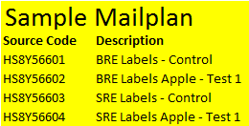
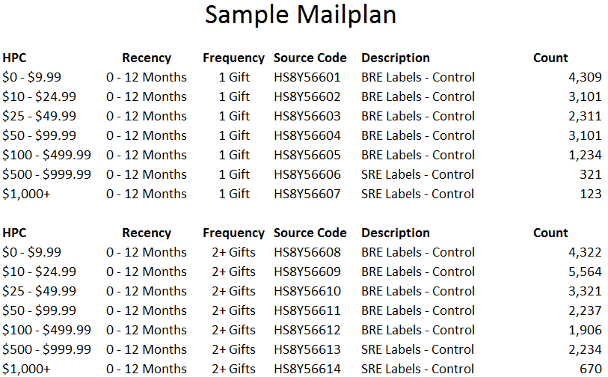
Fear of Change

Slide 21
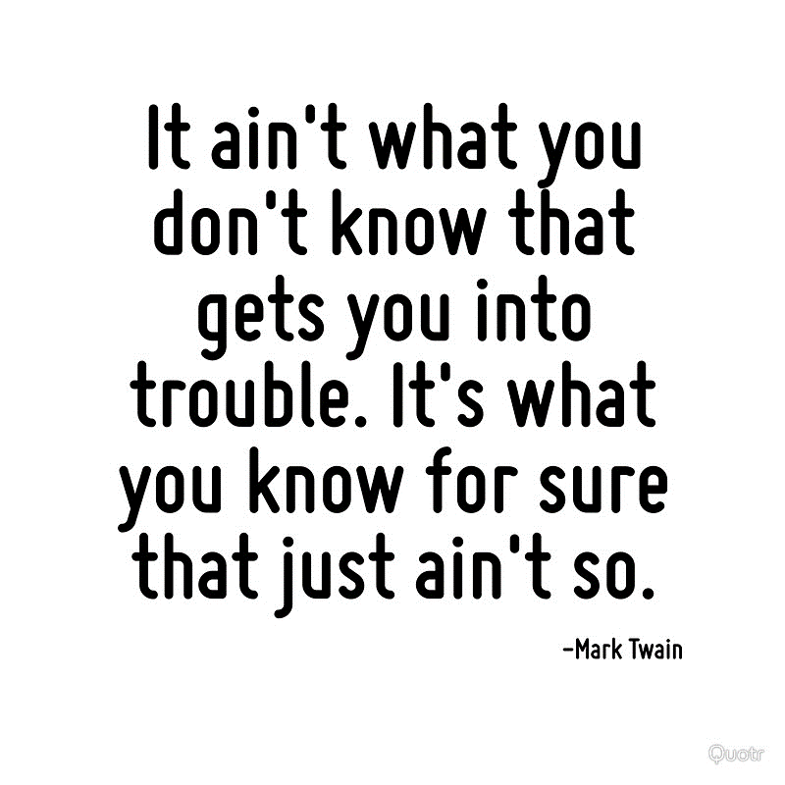

Slide 22

Value of Data
Budget
How to make it happen
Contact
Cadence
What is likely to happen
Modeling
What has happened
Reporting /
Appends
Descriptive
Predictive
Prescriptive
Information
Insight
Action
Results

Slide 23

Predict Your Donor’s Potential

Slide 24
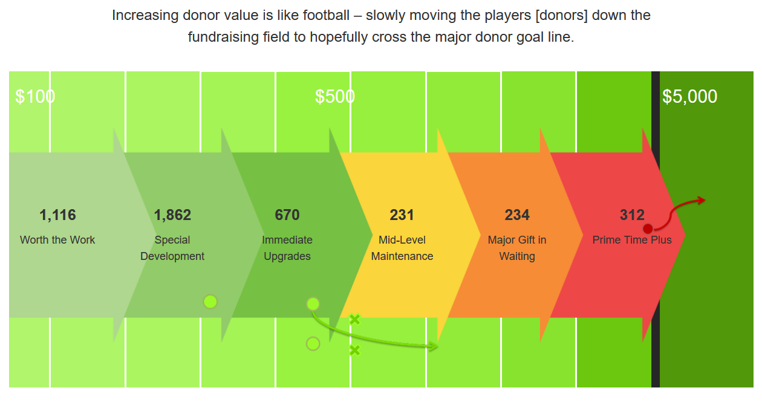
AGGRESSIVE ASK
INVITE
QUALIFY

Slide 25

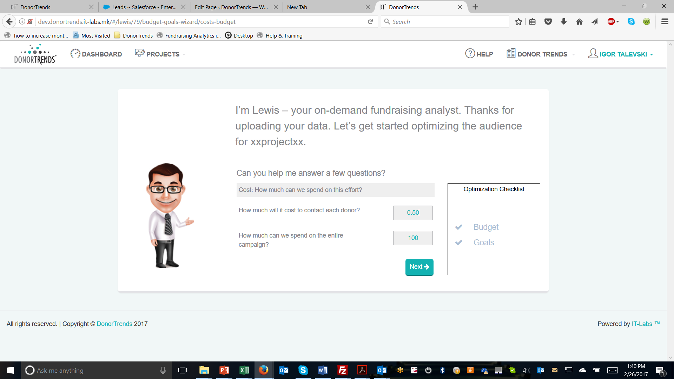
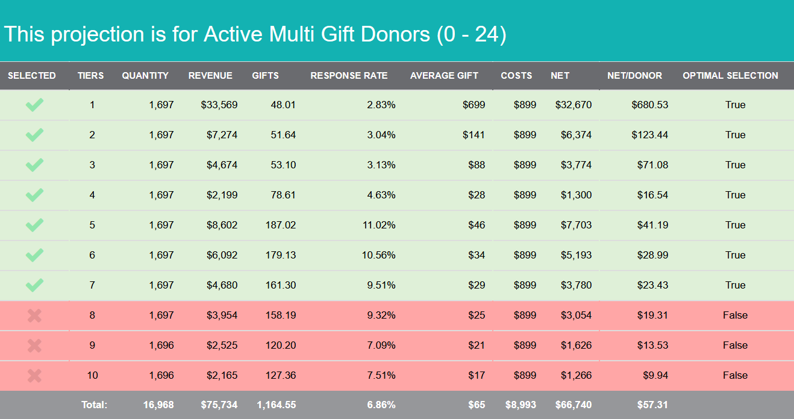
The prediction behind predictive analytics

Slide 26
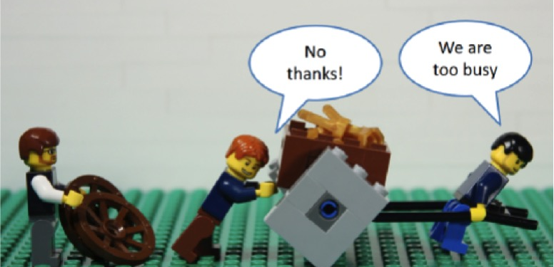
Are you too busy to improve?

Slide 27


What a pain in the bag!
Your fundraising pains / questions go here.

Slide 28

Prescription for
Fundraising Success
Know your Numbers!
  Identify the Vital Signs that are aligned with your organization’s fundraising goals.
  Build a Dashboard that you measures what you’re trying to move
Develop a strategy [based on data] to cure Fundraising Pain Points.
Using scoring to target the right donors to improve revenue and response.

