Slide 1
What the heck is a data strategy and why do you need one, now.
DATA STRATEGY
FORUM 2019
Multi-Channel Marketing:
Breaking Down The Walls
#DataStrategyForum2019

Slide 2
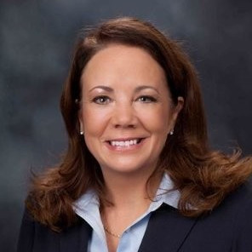
Introductions
This is Cathy
And that’s Justin

Slide 3
Data governance
Your data is your most important asset
“…Data Governance is just as much about stewardship as is the management of time and money” Philanthropy and Digital Civil Society: Blueprint 2019 (Stanford PACS)
Good governance -> good data

Slide 4
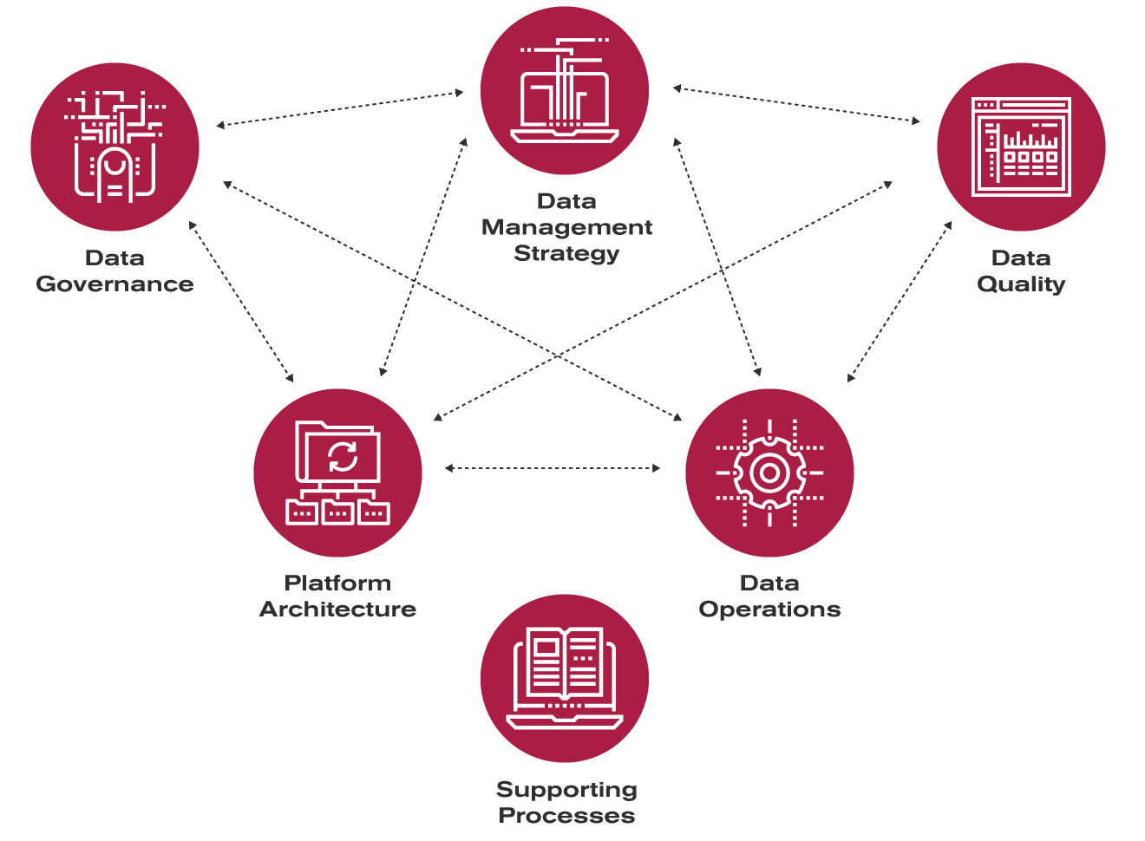
Data governance construct

Slide 5
Honest look at standard nonprofit data engineering
Multiple methods
SQL, COBOL, Alteryx, CSV, Excel, SAS
Various levels of documentation
Various levels of quality control
Lack of change management
Not meta data driven
Significantly Staff Dependent
Account Management Defining Technical Solutions
No Single Point of Knowledge for All Data Available

Slide 6
Nonprofit data quality is declining
Declining number of service bureaus
Nonprofits thinking they can manage the data themselves without the knowledge and tool sets to really make it work
A lack of understanding from nonprofits around the financial impact of poor and or missing data until it is too late
Multi-channel CRM tools are not really connected, just services under the same roof
CRM companies not wanting to support quality conversion (“here’s the tool, you make it work”)

Slide 7
Failing to become data driven
The percentage of firms identifying themselves as being data driven has declined in each of the past three years (Harvard Business Review) 31.7% in 2017 32.4% in 2018 31% in 2019
Even scarier is the depth of that reality
72% have yet to forge a data culture
53% are not treating data as a business asset
93% identify people and processes as the obstacle

Slide 8
We need to change the data engineering paradigm by being strategic in data management
IT Focus | High risk of failure | Low possibility of information and strategic business enablement
Value Generation Focus | Low risk of failure | High possibility of information and strategic business enablement
Review and revise data processes
Make data strategy the hero

Slide 9
Defining data strategy
Can you define data strategy without using the words ‘data’ and ‘strategy’?

Slide 10
Components of data strategy
Combine Strategies
Merge Data Silos
Plan for Future
Reporting and BI
Campaign Selection and Execution

Slide 11
Elements of Data Strategy
 | Defense | Offense
Key Objectives | Ensure data security, privacy, integrity, quality, regulatory compliance and governance | Improve competitive position and profitability
Core Activities | Optimize data extraction, standardization, storage and access | Optimize data analytics, modeling, visualization, transformation and enrichment
Data Management Orientation | Control | Flexibility
Enabling Architecture | SSOT (Single source of truth) | MVOTs (Multiple versions of the truth)

Slide 12
Is this conceptual? Or does it exist in the wild?
Organizations that are committing to data strategy as a primary vehicle for planning are seeing higher volumes of sustainable growth

Slide 13
Data strategy applied to national orgs
5-year strategic plan started in FY15
Direct marketing goal to increase new donors acquired and multiyear donors
Focus on new donor acquisition and optimized second gift
Multiple sources of truth include Raiser’s Edge & Multichannel dashboard
New
2nd

Slide 14
Data strategy applied to regional orgs
5-year strategic plan started in FY15
Multichannel goal to increase active and multiyear donors
Investment in acquisition offline and online
Multiple sources of truth include Raiser’s Edge & Multichannel dashboard
New
2nd

Slide 15
Data strategy applied to local orgs
5-year strategic plan started in FY19
Multichannel goal to increase active donors and second gifts
Integrated planning, channel specific implementation, integrated reporting
Multiple sources of truth include Raiser’s Edge & Multichannel dashboard
New
2nd

Slide 16
Data Strategy for organizations with channel specific objectives
Data strategy used to launch website redesign
Prioritized, documented and agreed on goals for new site
Integrated planning between marketing, development, corporate and programs teams
Goals backed by data in Google Analytics and a commitment of what to measure to see if new site is more effective

Slide 17
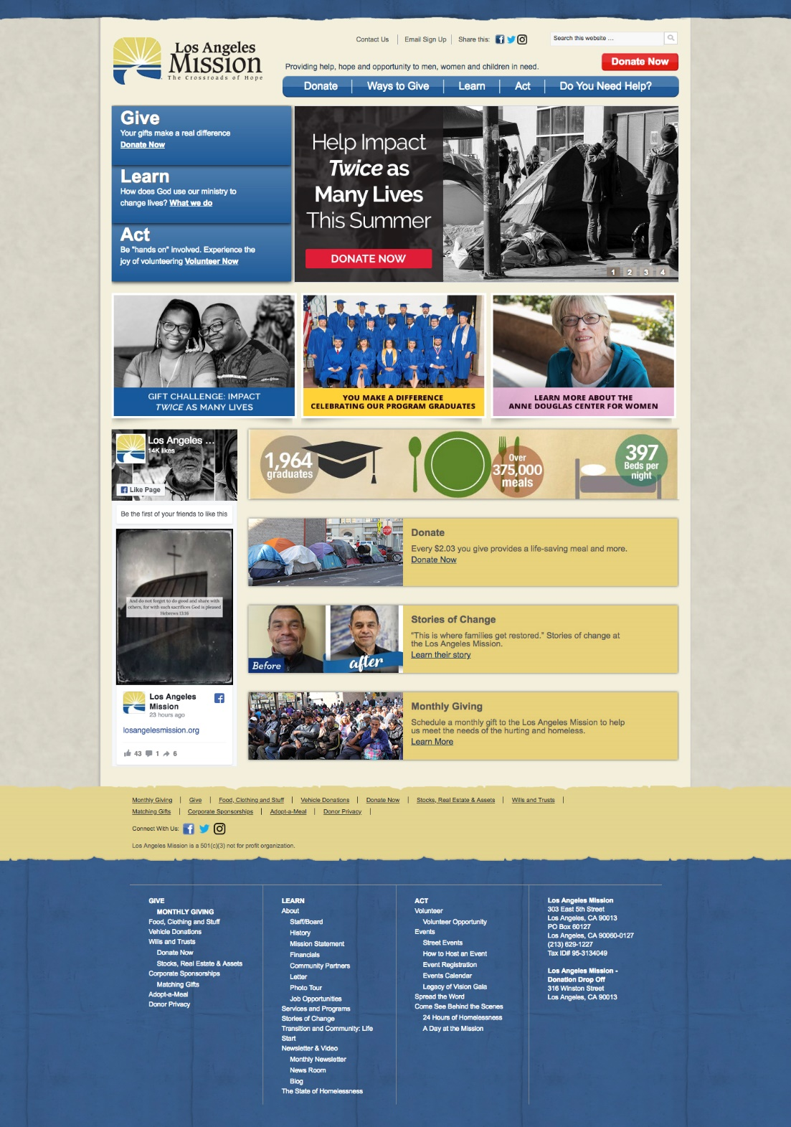
Here’s the old site
Not mobile friendly
Dated aesthetic
Content strategy free-for-all

Slide 18
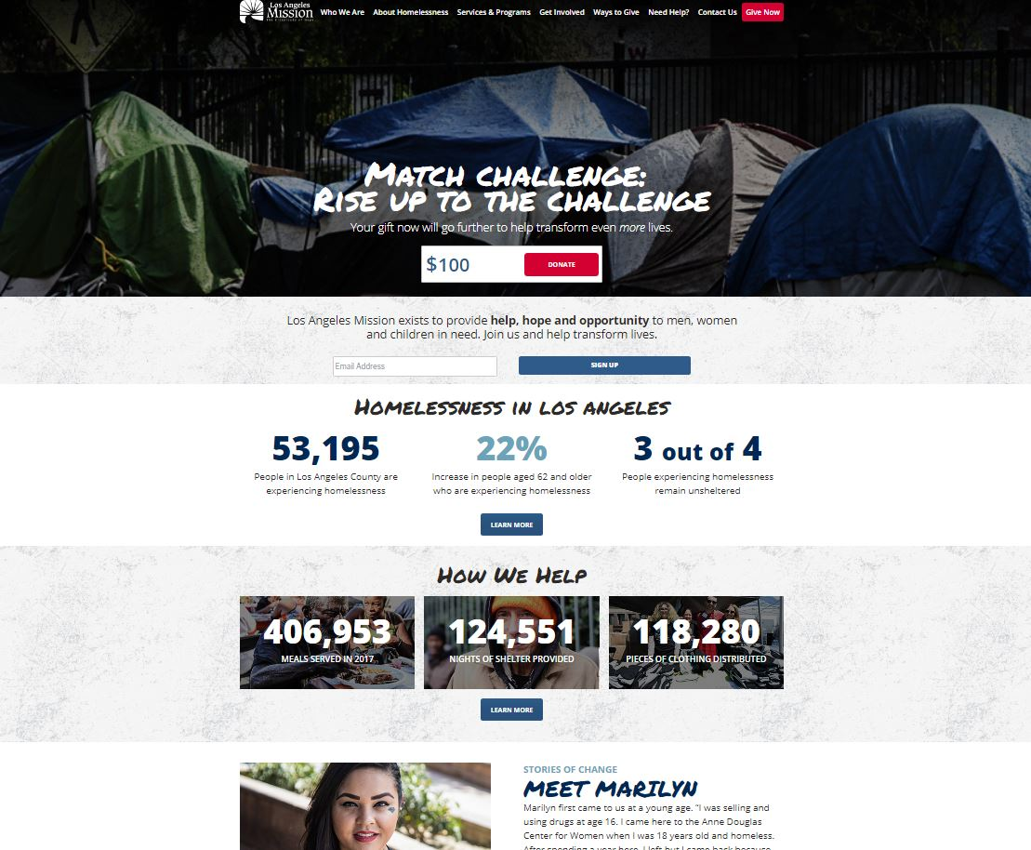
Here’s the new site
Modern aesthetic
Content strategy designed to highlight the case for support
Data strategy applied, up front, to plan for enhanced tracking

Slide 19
Here’s the new site
Mobile revenue increased 73.41%
Total conversion rate increased 15.73%
Total online revenue increased 13.52%

Slide 20
How to start implementing a data strategy, today.
Identify your data management practices
Create a road map for optimization of data management
Integrate data strategy into your strategic planning, whether campaign or annual plan
Share data strategy with your teams

