Slide 1

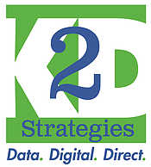

Upgrading Midlevel
Strategies
Karin Krichoff
Founder & President
K2D Strategies
Kathy Swayze
Principal
Impact Communications
#DM201

Slide 2
Introductions… we’ll go first…
Kathy Swayze, CFRE:
Impact Communications
Karin Kirchoff:
K2D Strategies
30+ year industry veteran
Experienced copywriter, storyteller
Consultant on mid-level programs for Carnegie Science, Minnesota Public Radio, National Park Foundation, National Geographic Society and more
25+ years of experience in non profit fundraising/management
Experience working on staff for NPOs and for the agencies who support them.
Nearly every program touched in the last 20 years has had a midlevel component

Slide 3
How about you? Who are you?
Agency? Non Profit? Other industry supplier/provider?
Year of experience? Less than 5? 5-10? 10+
Channels? Mail? Digital? Both? Neither?
Do you work on midlevel programs?
Notes:
And now you? Who are you? What role do you play in your organization? – by show of hands…

Slide 4
Why midlevel giving?

Slide 5


Midlevel donors often make up…
1%
1/3
but…

Slide 6
What does “Midlevel” mean?
Giving level definition varies
Generally between $500-$10,000
Variables to consider
  Size and scope of the ‘mass market’ direct response program
  Overall average gift of the individual giving program
  Threshold for major gifts (and availability of major gifts officers to manage donor portfolios)
Investment of leadership (giving level buy in/who ‘owns’ the program)?
How do you define it?

Slide 7
Major Gifts
Direct Response
One to One
Midlevel uses tactics from major gifts and direct response to achieve a high-touch, personalized, one to some strategy.
$ $ $ $ $ $
One to Many
Notes:
So let’s admit it – these two groups of folks think a little bit differently. Ask them to raise hands if work in direct response, major gifts, grants?, communications?
Major gifts people – honest opinions about direct mail in your organizzation. What you hear from donors about direct mail?
Direct response folks? What’s your opinion about major gifts in your org? when was the last time you talked to a major gifts person? Did you enjoy it?
Truth is we come from very different worlds.

Slide 8
Data to consider when defining audience
Besides knowing average gift and where the major gifts program begins…
Understand single vs. multi year donors
Inception gifts vs. those who upgrade
Single gift size vs. cumulative giving
Channel preferences
Gift triggers (episodic giving vs. institutional)

Slide 9
Not Just a Fancier Envelope . . .
A Different Conversation
Treat them like family, offer insider access, information and excellent service
Define the solution in grand terms – not your work plan but how you will change the world
Create a strong case for giving; a good story is not enough
Share data – don’t skimp on details
Position your donor in the center of the solution; invite them to invest
Give them perks but acknowledge their intentions are bigger than perks.
Share results and share credit.

Slide 10
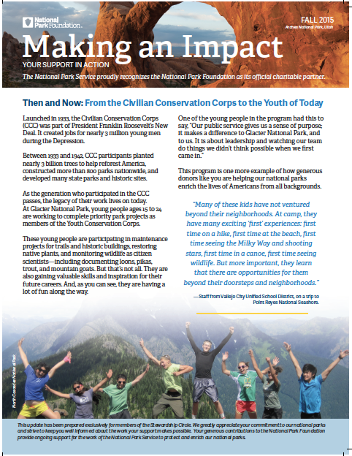
Add More Cultivation
Letters from the CEO
Impact Reports
Insider Phone Briefings
Handwritten notes
Invitations to events
Volunteer opportunities
How are you? Calls
Surveys
Notes:
Karin – I like the blue color you haver on your graphics (instead of the black here) but I don’t know how to change it.

Slide 11
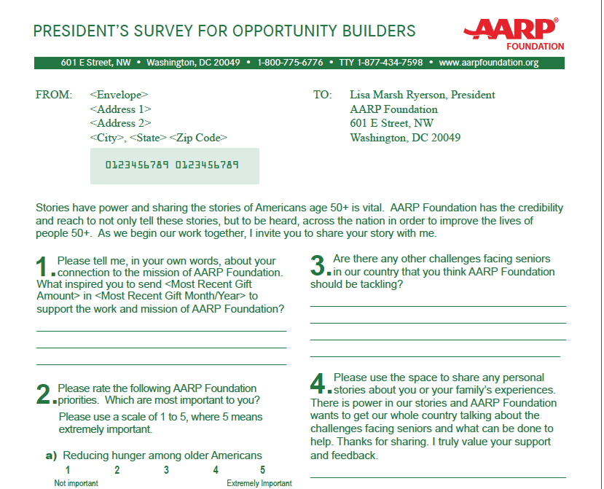
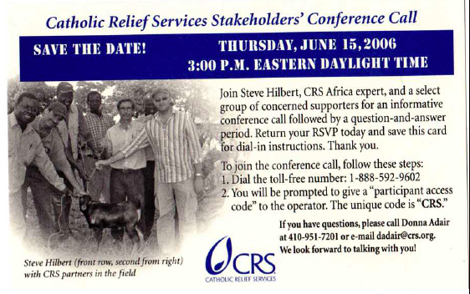

Slide 12
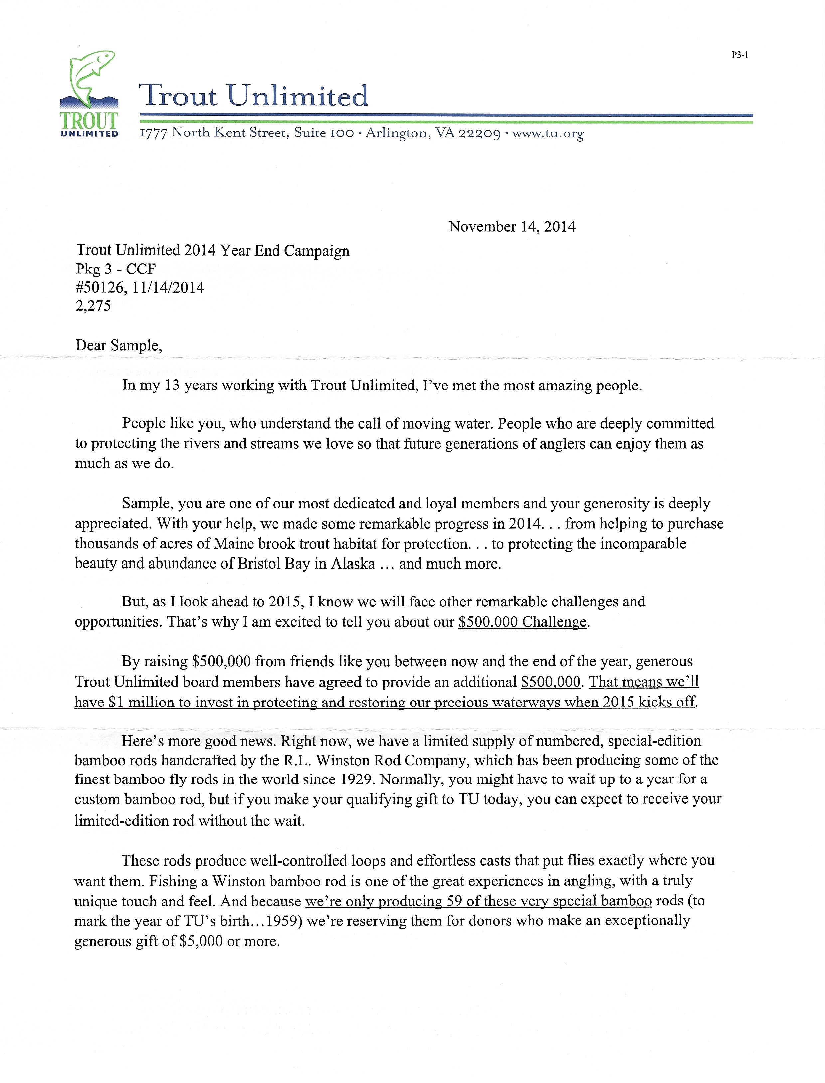
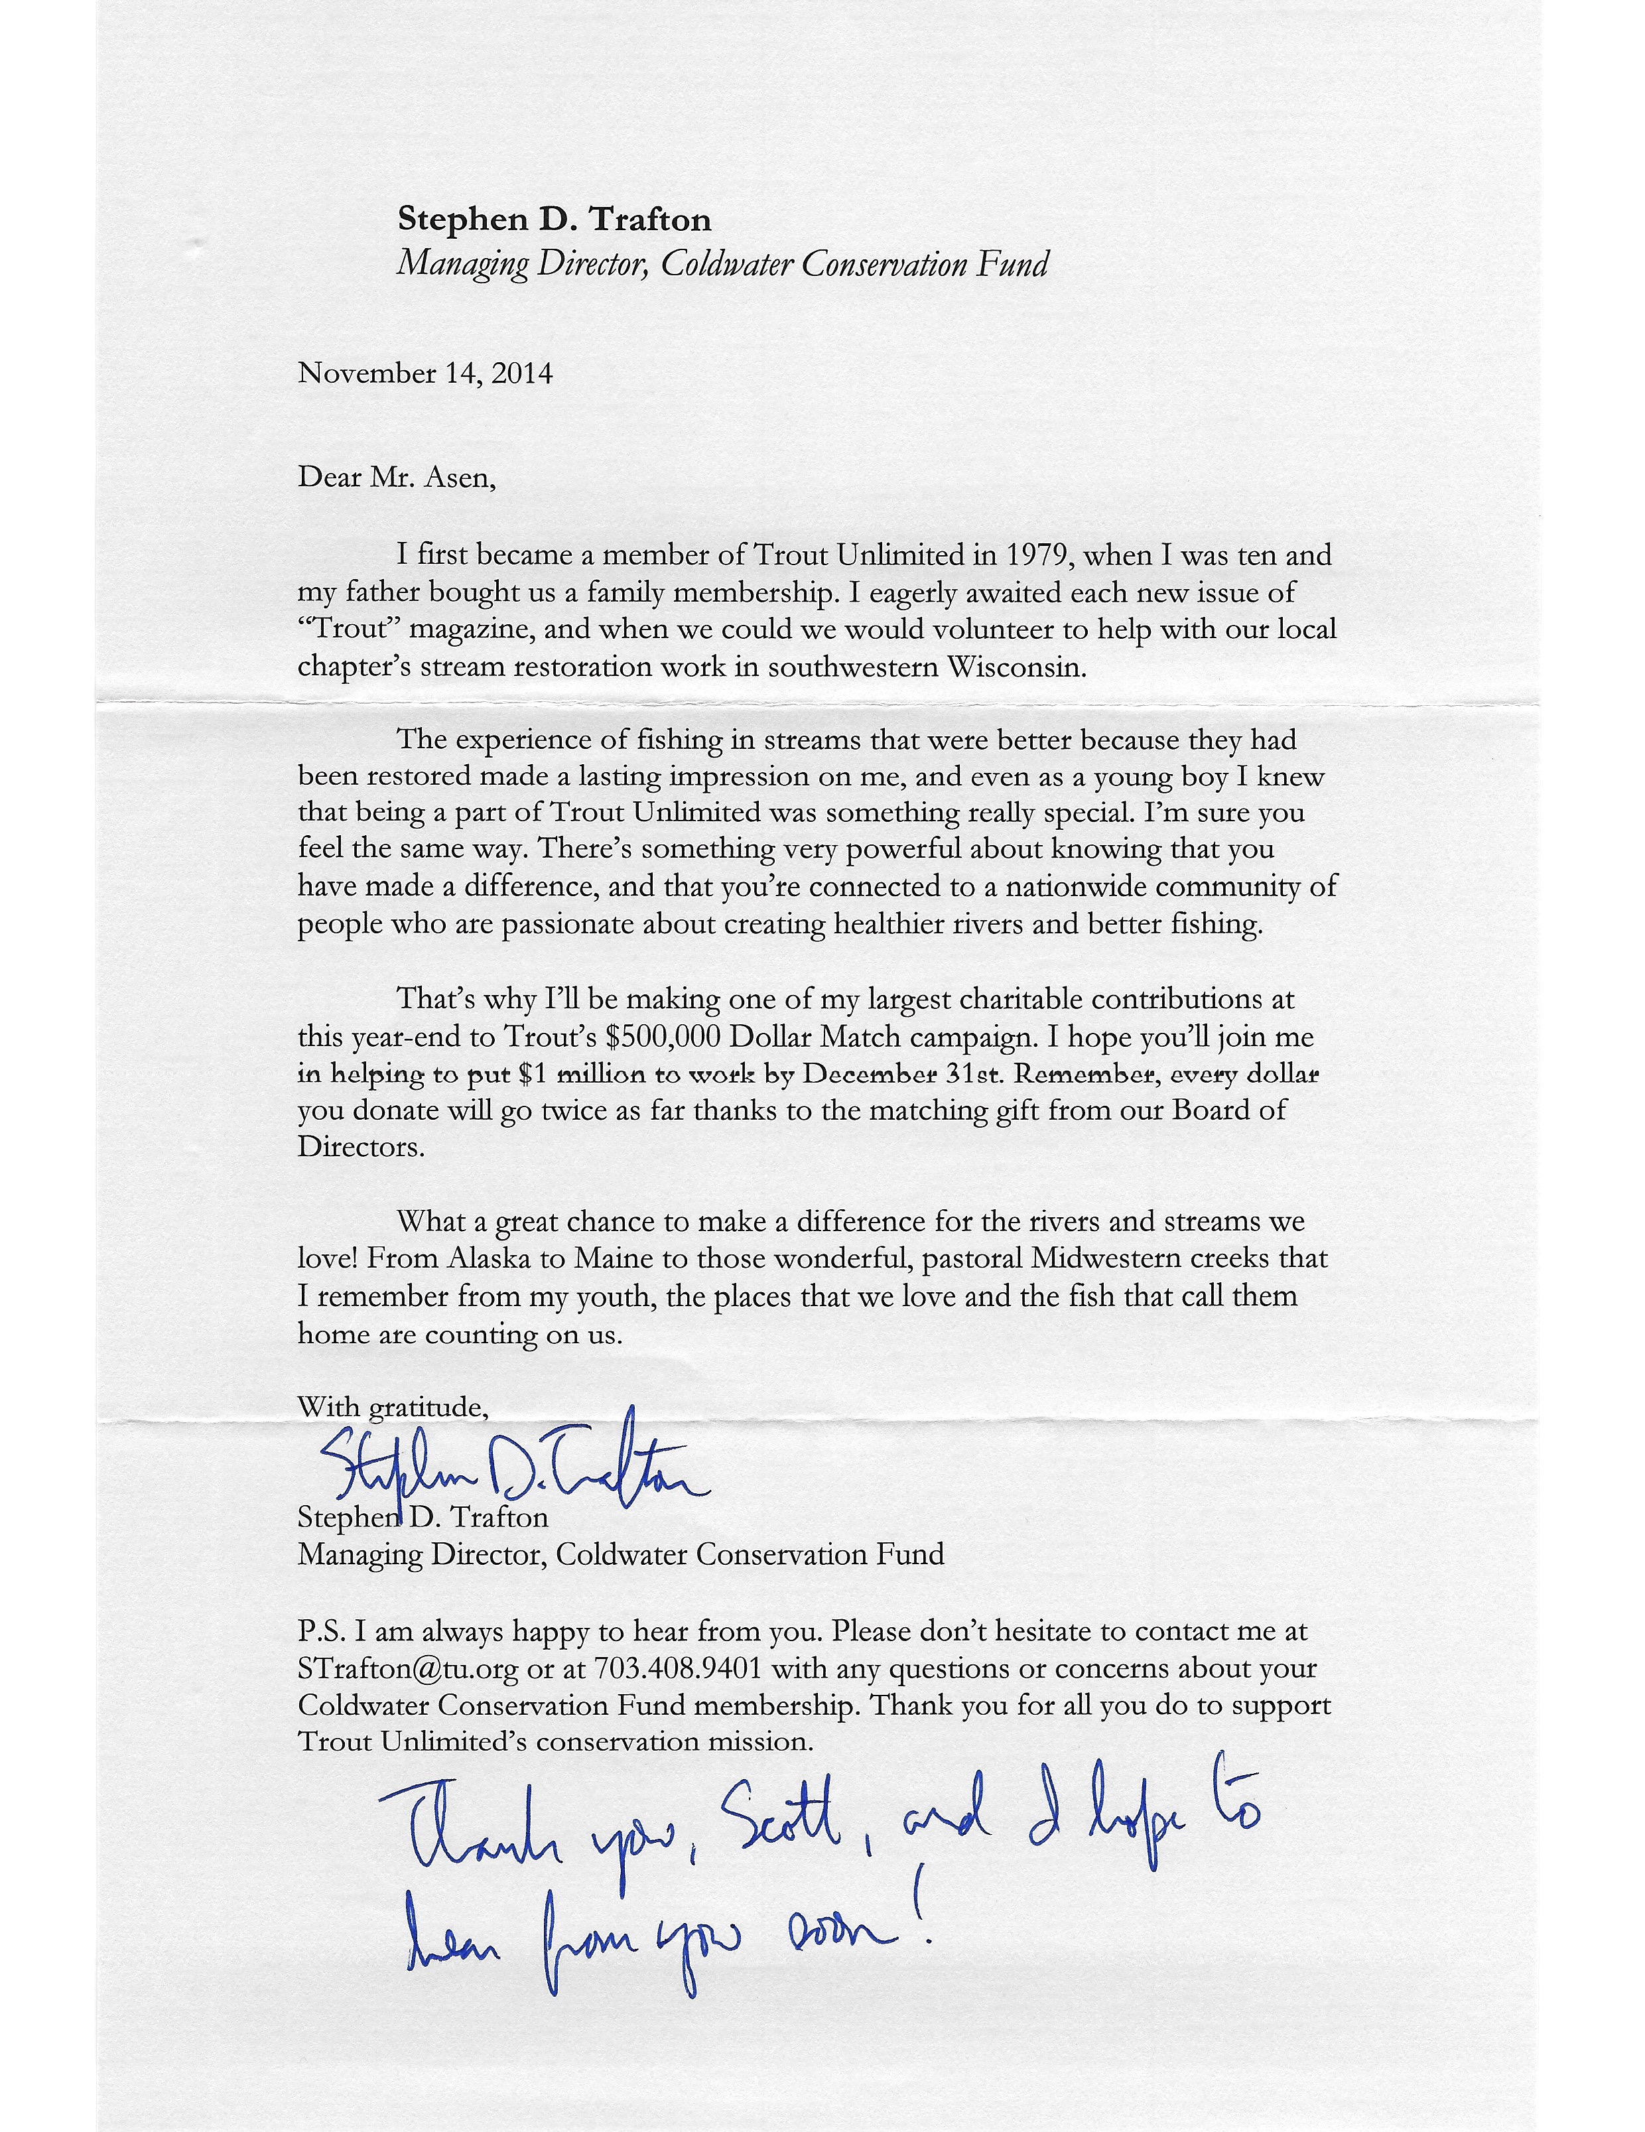
Tried & True Mailings
Mini Proposal
Lift note from CEO or gift officer
Campaign Style Giving Chart
Oversized envelopes

Slide 13
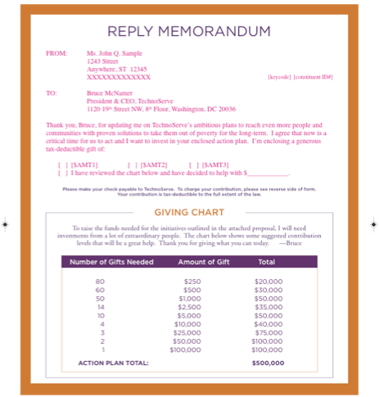

Slide 14
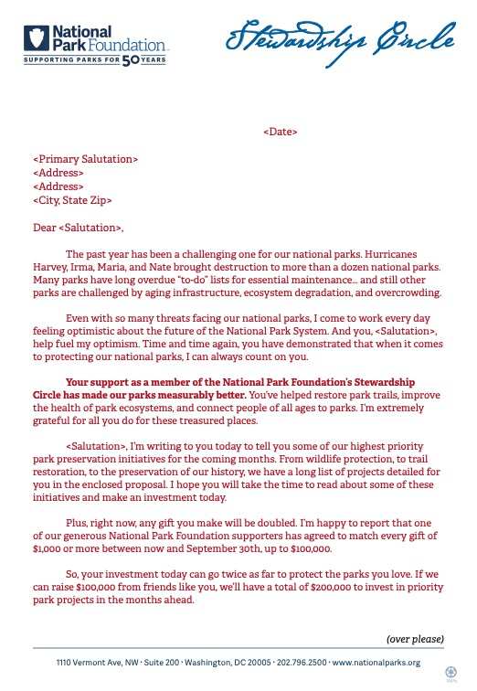
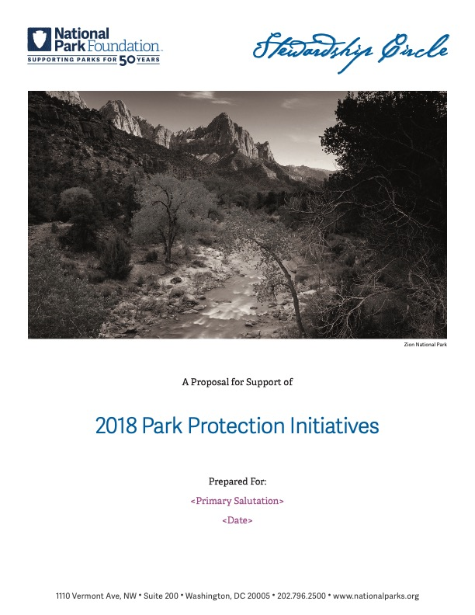
Case Study: National Park Foundation Mini Proposal

Slide 15
Results
Mailed 2,910
Raised $259,000 from 124 donors
Average Gift: $2,090
Response Rate 4.26%
204% increase over prior year

Slide 16

Using your entire quiver…
National Center for Lesbian Rights (NCLR) launches a major fundraising drive every fall to mid and major donors.
Direct mail appeal featuring in depth content and personalization are an important pillar in the high touch campaign
This campaign in the past had generated ~$500K from ~1000 donors.

Slide 17
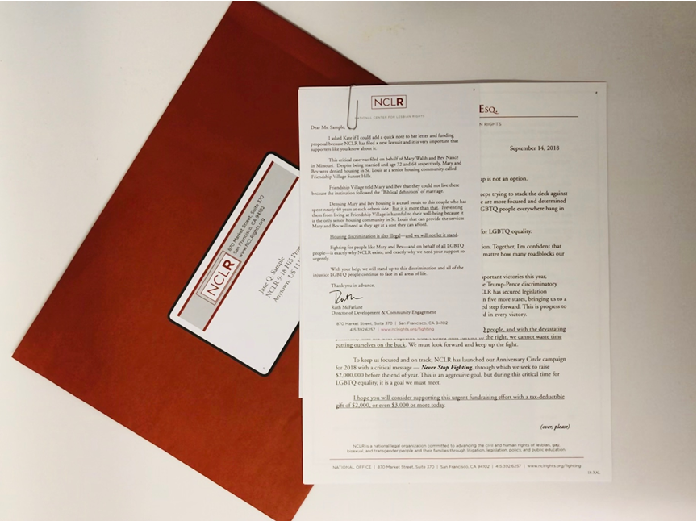
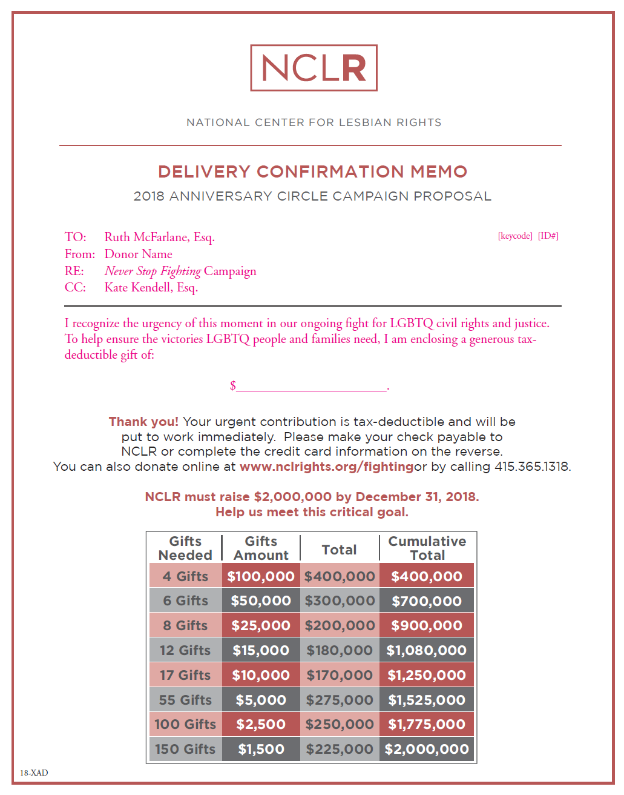
The campaign:
Oversized envelope featuring a faux-label and a string of stamps (not pictured)
Personalized letter and lift note (from CDO) were paperclipped to the report.
Reply form featured a gift pyramid and a blank ask
Return envelope was stamped
Other campaign elements included a brunch event, outreach from board members/staff solicitors, and a direct mail follow up.

Slide 18
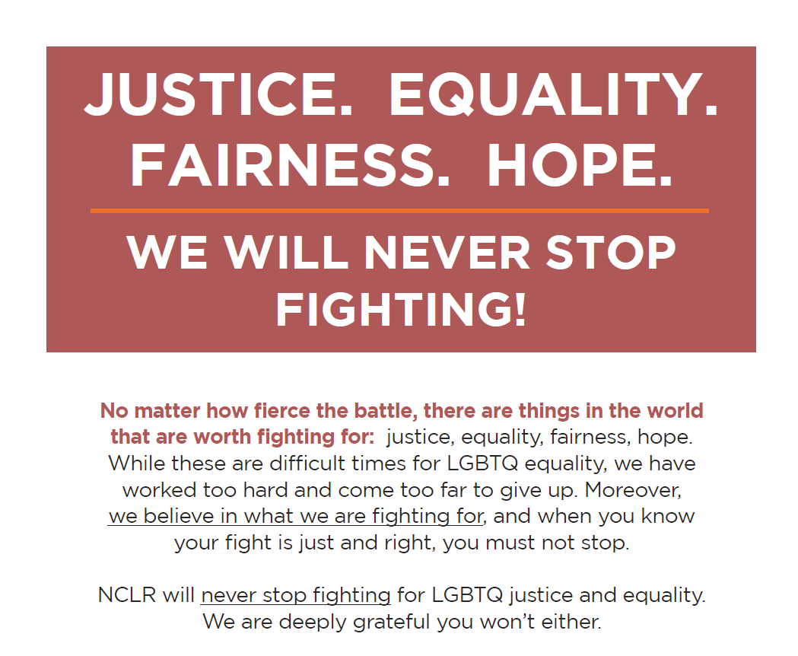
Results
Mailed 1,064
Raised $1,121,484 from 198 donors
Average Gift: $5,664
Response Rate 18.61%
213% increase over budget

Slide 19
What happens when they stop giving…
Identify (or establish) business rules.
  Easier to do when donors upgrade, harder to do when they don’t renew at that level.
Map communications cadence.
  Appeals/Renewals
  Stewardship/Cultivation
  Mail/Phones/Digital
Use all of your channels!
  When a donor hasn’t renewed at the middle dollar donor level, phones are among the best channels to re-engage.
  Depending on audience size, retargeting (especially on Facebook) can be low LOE and high ROI.
Notes:
We’ve talked about upgrading donors into your midlevel program… but what happens when they stop giving? This is often a black hole… and is worth beginning with an audit of your organization’s business rules to understand how this is currently defined and whether the direct response folks and the major gift folks are on the same page!

Slide 20
Other considerations
Benchmarks
2018 Midlevel study* of 20 organizations:
On average three full-time mid-level fundraisers.
Retention rates 60 to 85%
Mid-level giving as percentage of overall individual giving: 6 to 25%
Get leadership buy-in from C-Suite
Teamwork: Requires close collaboration with program teams for content and direct marketing team for recruitment
Invest in listening: phone calls, surveys, focus groups
Notes:
Source Sea Change Strategies, The Missing Middle Part 2
Impact clients: staffing
MPR: 3,700 donors 2.5 staff;
NPF 2,000 donors, 2 staff;
WWF 8000 donors, 4.5 staff;
Nat Geo 1,500 donors 1.5 staff
K2D clients
TWS: ~1000 donors 1 staff
NCLR ~1000 donors .5 staff
AFB – 500 donors .25 staff
American Rivers 1 staff

Slide 21
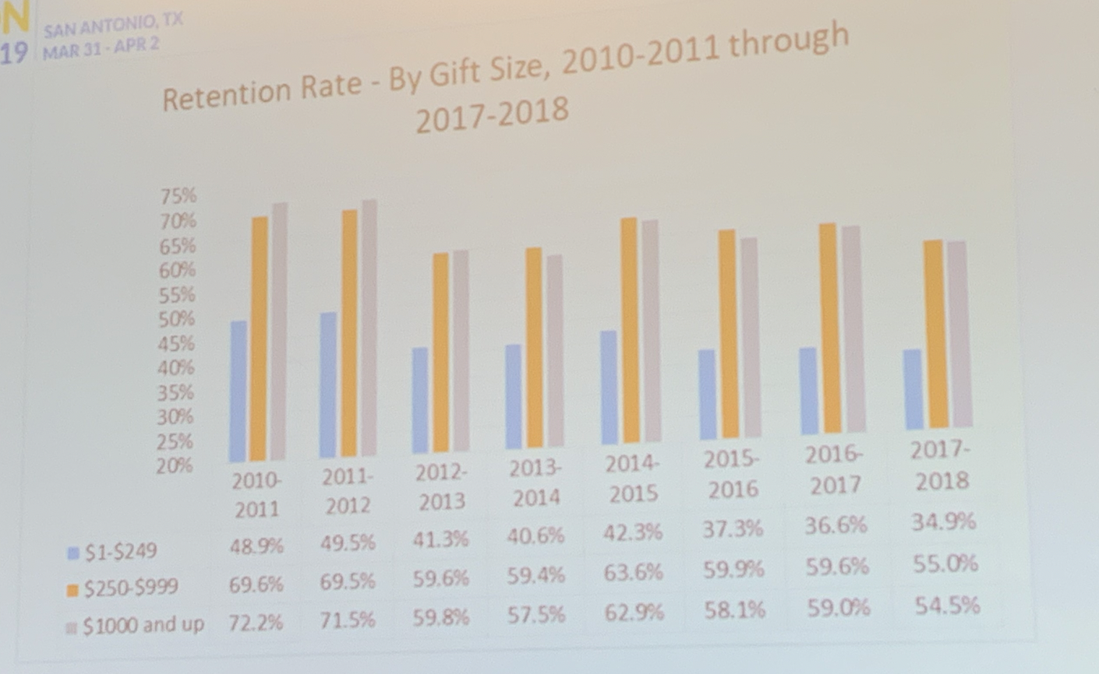

Impact of Tax Reform…early warning sign
Notes:
Source: donorperfect study of transactions from 700 organizations

Slide 22
What else do you want to talk about?
Kathy Swayze, CFRE
President and Creative Director
Impact Communications
www.impactdc.com
Kswayze@impactdc.com
202-262-4469
On Twitter: @impactdc
Karin Kirchoff
President and Founder
K2D Strategies
www.K2DStrategies.com
kkirchoff@K2DStrategies.com
703.650.7491
On Facebook: @K2DStrategiesLLC
Notes:
Karin – maybe a resources page. Sea Change did an update of their midlevel study and it has good stats on staffing, revenue, etc. for 20 orgs.
http://seachangestrategies.com/scwp/wp-content/uploads/2018/05/the-missing-middle-part-two.pdf

Slide 23

Resources
This deck!
Midlevel study conducted by Sea Change Strategies
  http://seachangestrategies.com/scwp/wp-content/uploads/2018/05/the-missing-middle-part-two.pdf
The Agitator: www.theagitator.net

