Slide 1
Integrated Marketing
DM201

Slide 2
What are you going to learn
Integrated Marketing - What and Why
Donor Experience Across Channels
Campaign Planning & Coordination
Multi-channel Measurement
How others are doing it
Notes:
Approach to Multi-Channel Marketing
Benefits of a Multi-channel Donor
Looking at a supporter journey across channels
Getting tactical - coordination within digital alone
Lessons learned from the commercial world
A word about attribution

Slide 3
TRUE OR FALSE?
Multichannel Marketing
=
Integrated Marketing

Slide 4
FALSE
Multichannel marketing is the ability to deliver messaging to potential customers/donors on various platforms.
Integrated marketing (or cross-channel marketing) is the ability to deliver a single campaign with a consistent message to potential customers/donors on various platforms so that channels reinforce and strengthen each other.

Slide 5
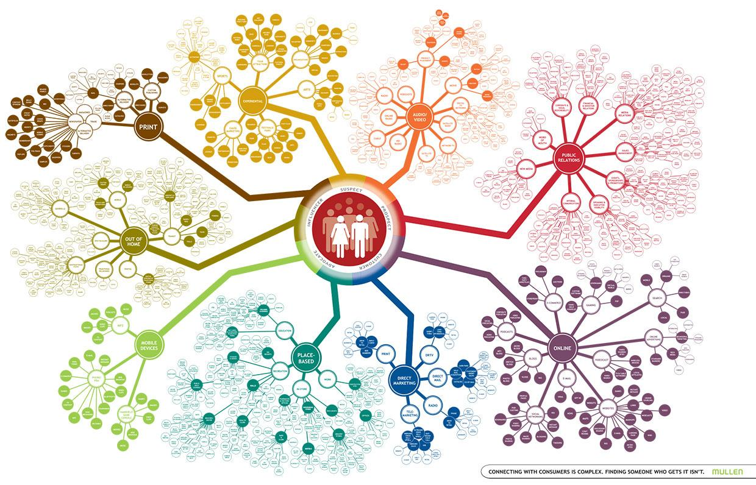

Slide 6
“Brands are competing more on customer experience. They’re being forced to be much more meaningful and much more relevant.”
“Donors don’t want bombardment or overlapping messages. They don’t want inappropriate noise.”
Chris Paradysz
Anneka Gupta
Notes:
Donors expect to navigate seamlessly between channels due to expectations being set in the commercial world.
Estimates range between 3000-20000 advertisements a day

Slide 7
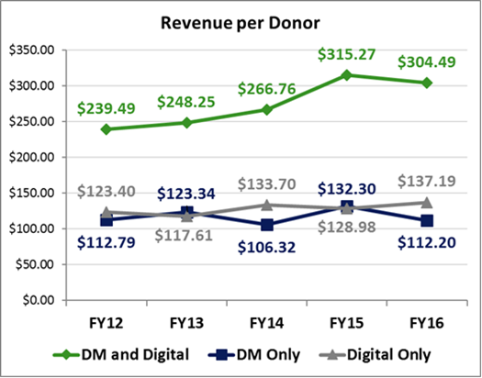
Benefits
Multi-channel campaigns result in higher overall response and engagement and ultimately higher LTV
Allows you to test various messaging an timing across channels; online has the ability to adjust messaging and increase urgency quickly
Reach a larger audience more cost effectively
We see more online to offline conversion than the other way around
Multi-channel donors are more likely to upgrade regardless of channel of origin

Slide 8
Developing a Plan

Slide 9
Audience Centric Approach
Campaign view vs. channel view
How can other channels improve each campaign performance?
Prioritize touch points based on audience
Where will you get most impact?
Channel
Campaign
Notes:
Get access to all relevant forms of data (digital, traditional, offline, customer profiles)
Find a place to organize and make sense of it
Make it actionable

Slide 10






Channel Strengths
Website – where you have the most control over your brand
Email – where you’ll drive strong revenue online
Facebook – where you’ll find new donors and volunteers
Display Advertising – think of it like a billboard for brand recall
Search Advertising – how most people will find you
Mail – it’s not dead – still where the majority of donations come from

Slide 11
Today’s Consumer Journey is Fragmented
Awareness Consideration Evaluation Conversion Loyalty
The traditional funnel focuses on conversion
But today’s user journey has splintered into hundreds of touchpoints
...And it’s being disrupted by new players
Copyright © 2018 PMX Agency LLC. All rights reserved. This information is deemed proprietary and confidential. Unauthorized use or disclosure is prohibited.
Notes:
The customer journey is complex and commoditized

Slide 12
Develop Audience-Centric Marketing Plan
Apply Across Key Initiatives
Target
Core segments
1
Lead Generation &
Brand Awareness
2
Offer & Message
Highlight offers and reason to donate
Donor Conversion &
Retention
Define & Measure KPIs
3
Grow Sustainer Program
Creative
Focus on brand differentiator as core message, highlight brand value and offers to cover all segments
4
Event Marketing Support
Note: PMX used sustainer specific personas for illustration on how we'd use audience profiles per program to inform process

Slide 13
Map Out Marquis and Evergreen Campaign
Start with the campaign and goals, then factor in the channel/media mix
Summer
Fall
Year-End Setup
Year-End
Event Season
May
Lead Generation
Messaging Testing
Rollout/Optimize Tests
Donor Push
High Volume Donations
Events & Sustainer
Tribute Giving
June – August
September-October
November
December
January - April
May
Caregiver Awareness/
Giving Tuesday Support
Summer Safety
Back to School
Health Walk
Holiday End of Year Giving
Mother’s Day
Memorial Day
News Driven Moments in Time
Evergreen Lead Gen/Donor Conversion
Always on Content and Engagement Messaging

Slide 14
Audience-specific Campaign Strategy
Audience | Conversion Goal | Tactics
One-Time Donors | Acquire New Donors | Build awareness, Case for giving
 | Retain Current Donors | Target custom audiences, reinforce value proposition
 | Reactivate Lapsed Donors | Re-engage, re-introduce brand message and value proposition
Sustainers | Acquire New Sustainers | Speak to need for ongoing support, Target audiences likely to convert to sustainer
 | Retain Current Sustainers | Ongoing engagement, impact messaging, credit card stabilization and upgrade campaigns
 | Reactivate Lapsed Sustainers | Custom audience targeting, re-introduce value proposition, reinforce donor impact, bail out one time gift opportunities
Leads/Prospects | Generate Brand Awareness | Focus on reason to believe and engage with the brand
 | Drive Engagement | Focus on reason to believe and submit lead information, build and target custom audiences based on touchpoint or previous interaction
Health Walk | Acquire New Walkers | Build awareness and drive engagement and registration in events, retargeting to warm prospects
 | Retain Prior Walkers | Integrate outreach efforts with cross-channel activities, tailor messaging to acknowledge prior participation
 | Drive Fundraising Revenue | Behavior-based targeting to drive more fundraising. Align with milestones and event timing

Slide 15
Audience-specific Campaign Strategy
Goal
Audience
Channel Considerations
Channel Mix
  Acquisition
  Retention
  Upgrade
  Cultivate
  Leads
  Donors
  Sustainers
  Event Walkers
  Event Donors
  Responsiveness (by demo)
  Cost to Acquire
  Donor Value
  LTV by channel, audience
  Ability to Scale
  Media and Technology Costs
  Direct Mail
  TV
  Telemarketing
  Email
  Paid Digital Media
  Face 2 Face / Canvassing
  SMS
  PSAs
  Performance Partners

Slide 16
“Just as data gives marketers an advantage, it also drives complexity. Understanding the right level of investment across channels is a huge challenge.”
Haley Rubin
Notes:
Donors expect to navigate seamlessly between channels due to expectations being set in the commercial world.
Estimates range between 3000-20000 advertisements a day

Slide 17
Make the most of your messaging
1
2
3
Figure out the best types of data to personalize with
Know that a message is much more than text
Be mindful of what data is and isn’t fair game

Slide 18

Notes:
100% integration is not attainable

Slide 19
So what does this look like?

Slide 20
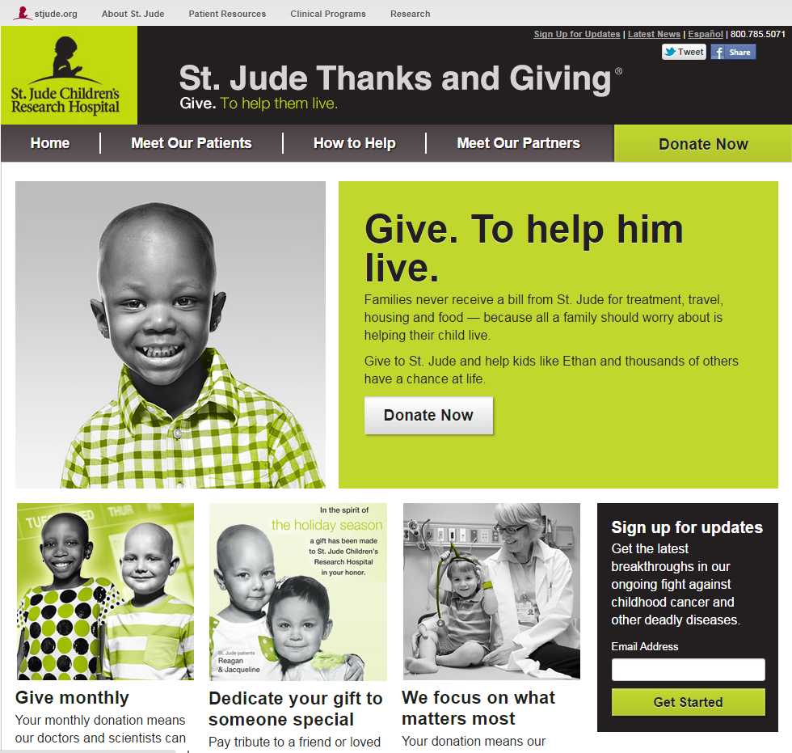
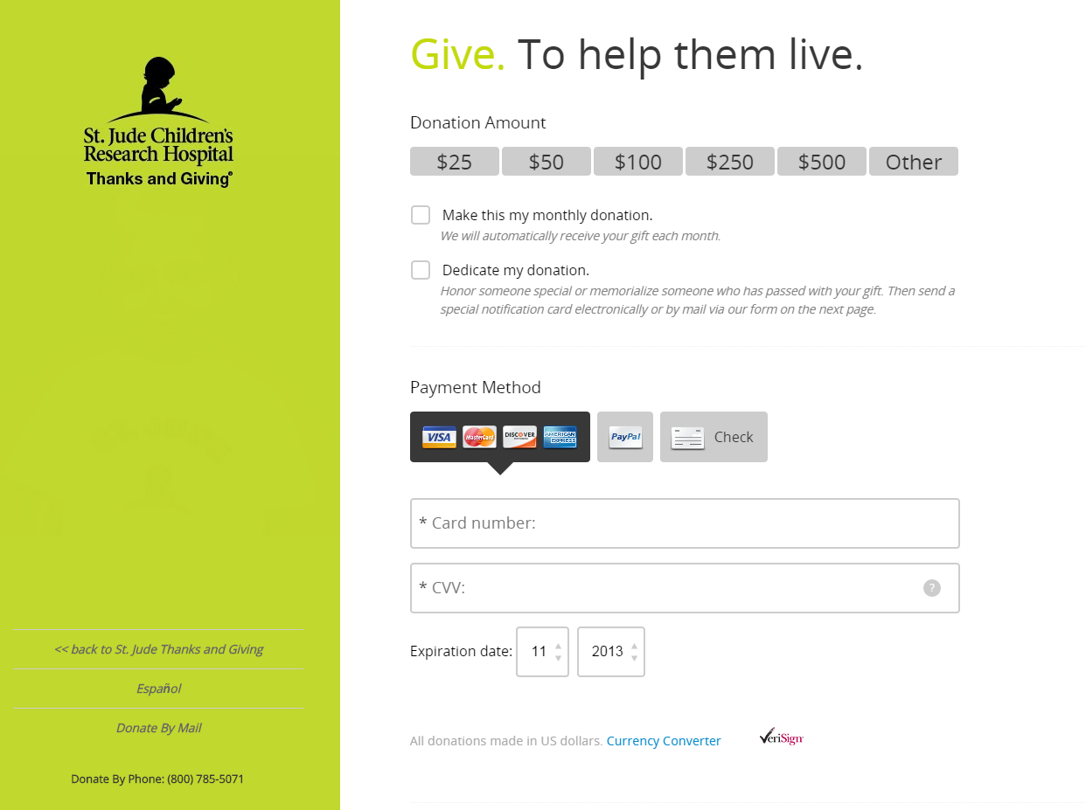


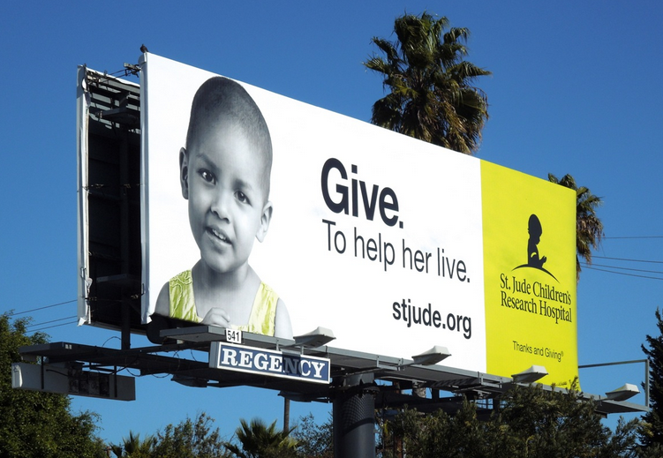

St. Jude Children’s Research Hospital
Thanks and Giving Campaign
Notes:
TV, Mail, Digital – this is what it looks like

Slide 21


CASE STUDY
THE PROBLEM
Both direct mail and online acquisition efforts were taking place simultaneously, yet were not being utilized in a cohesive manner. Each channel was successfully acquiring new donors; however they were not leveraging one another to create a whole that is greater than the sum of its two parts.
THE SOLUTION
Thorough the process of e-mail appends and social media uploads off of the direct mail file, consistent messaging can be delivered to donor prospects in a timeline that is well thought out to provide a ‘surround sound’ effect creating top of funnel awareness down through bottom of funnel transactions.
BENEFITS
205%
Response Increase with Email & Social
107%
Rev/M Increase
with Email & Social
76%
P&L Improvement
with Email & Social

Slide 22
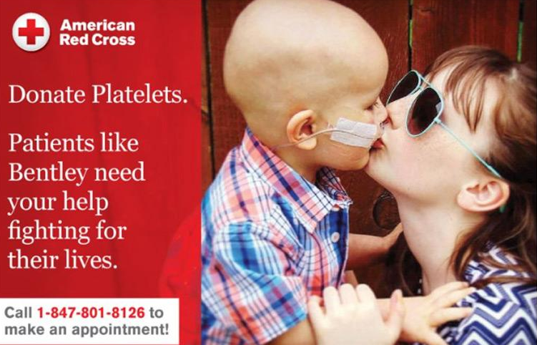


CASE STUDY
  OBJECTIVE
  Inspire new donors to give for the first time, and remind lapsed donors to return and give again.
  STRATEGY
  Use Programmatic Direct Mail to reconnect with donor prospects who visited key pages of the ARC website.
BENEFITS
1,617
Donations
1.85%
Response Rate
17%
Lift in Conversion

Slide 23
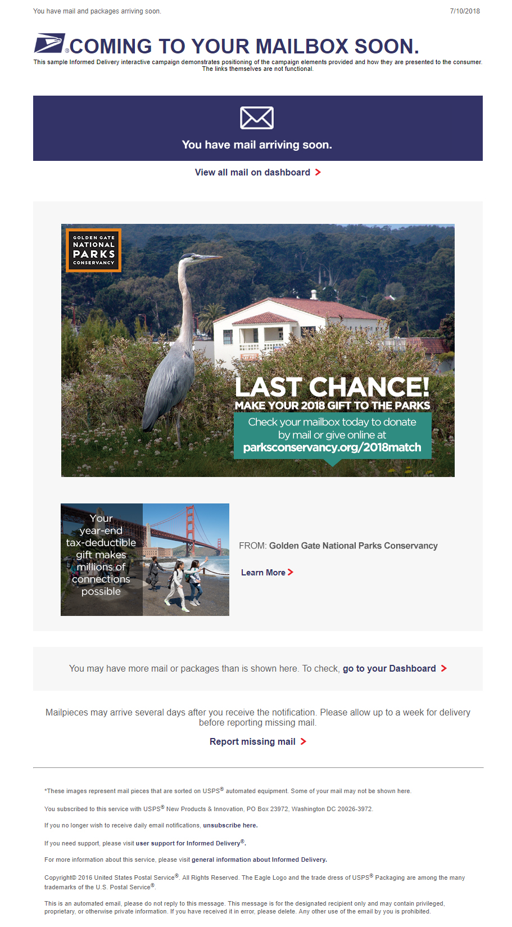
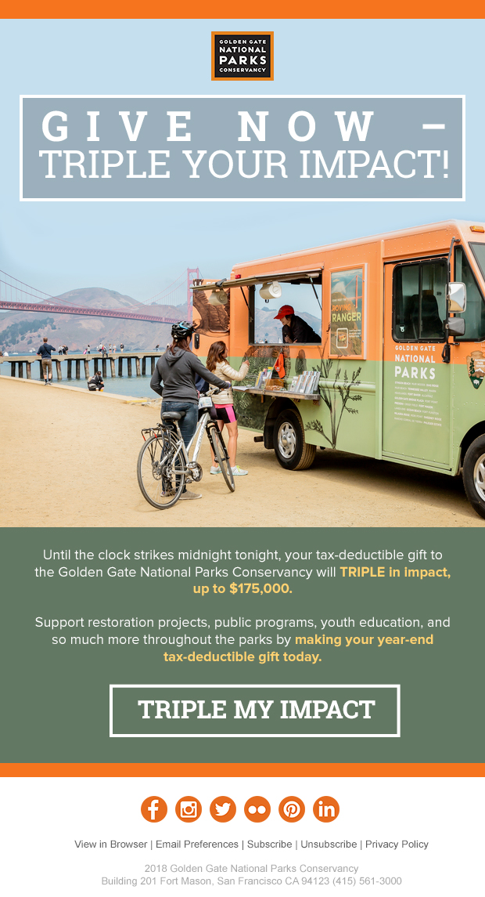
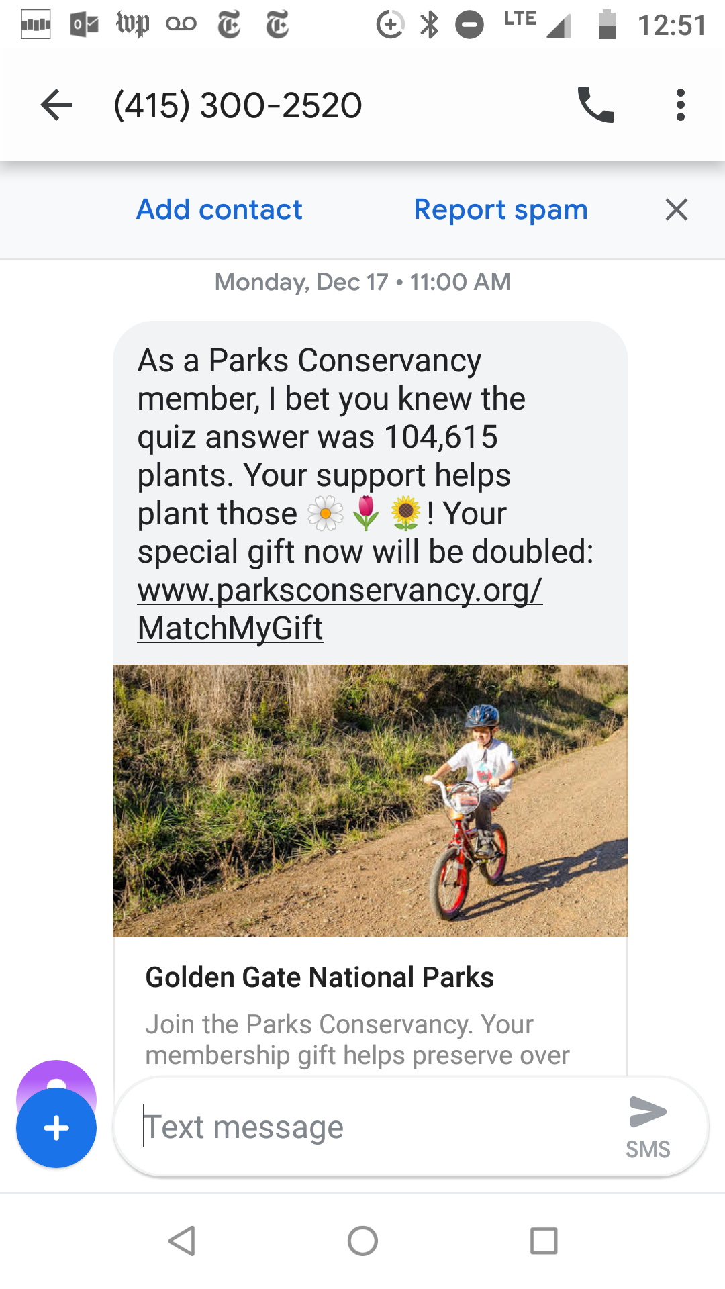
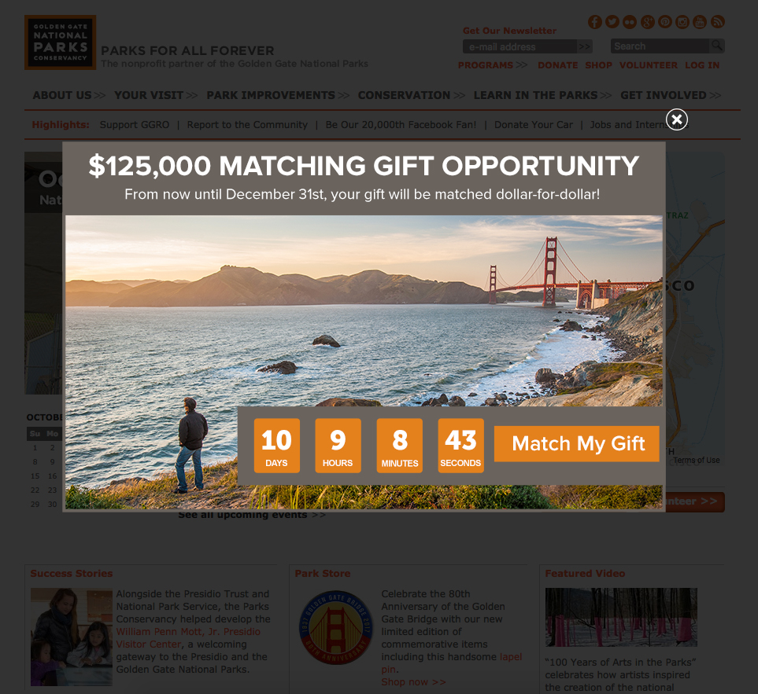
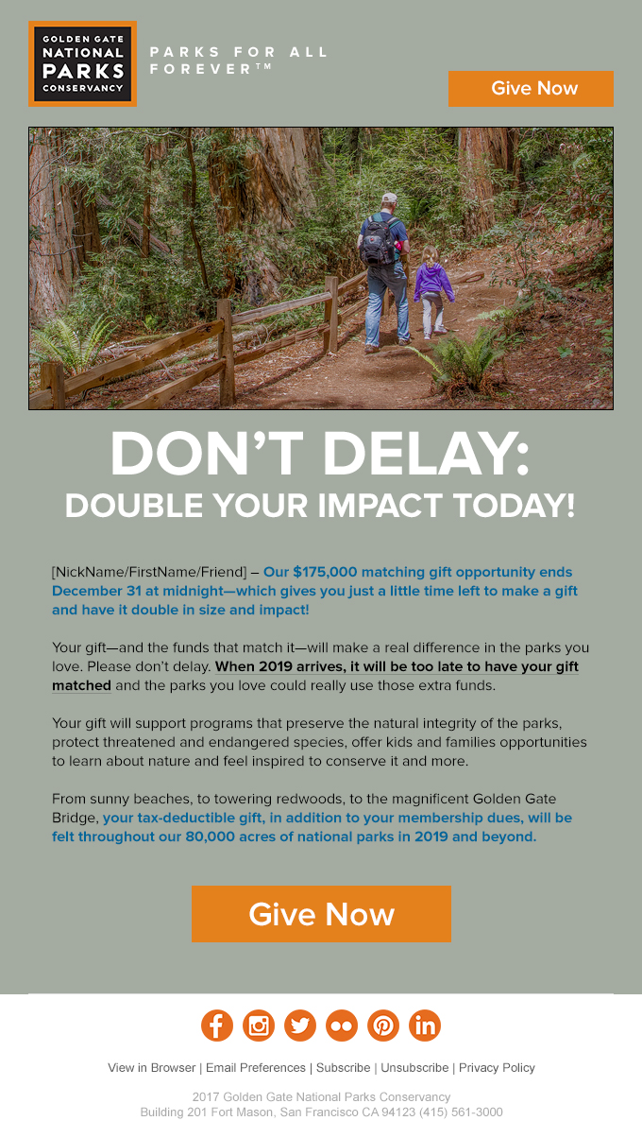
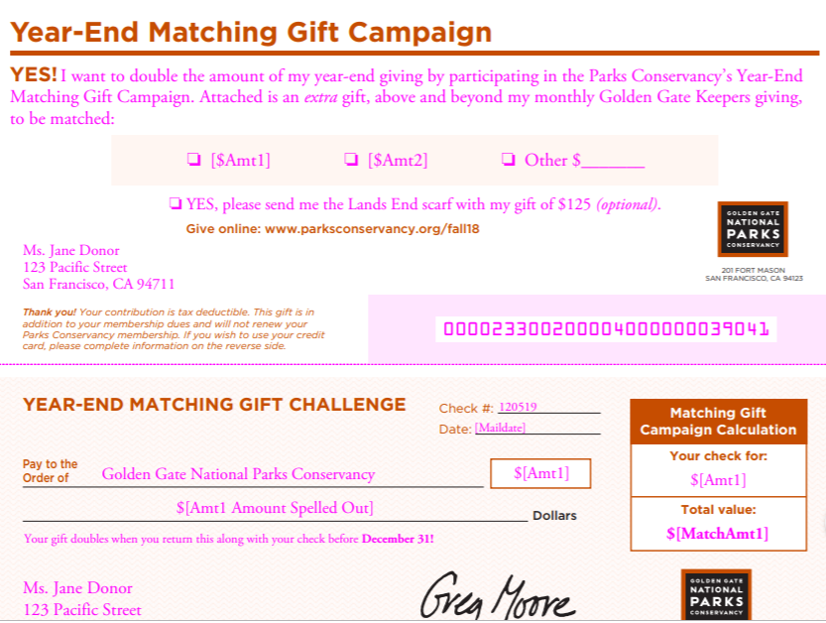



Golden Gate Nationals Parks Conservancy
Year End Matching Gift Campaign
Notes:
TV, Mail, Digital – this is what it looks like

Slide 24
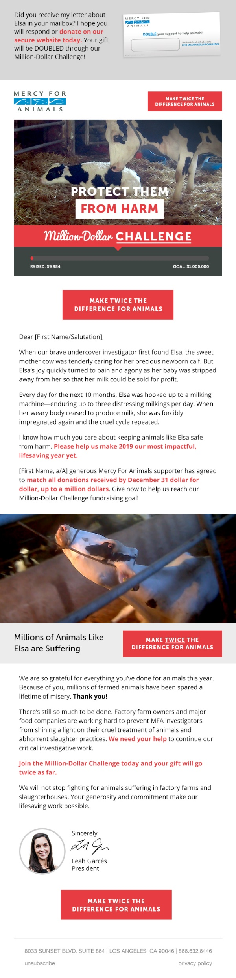
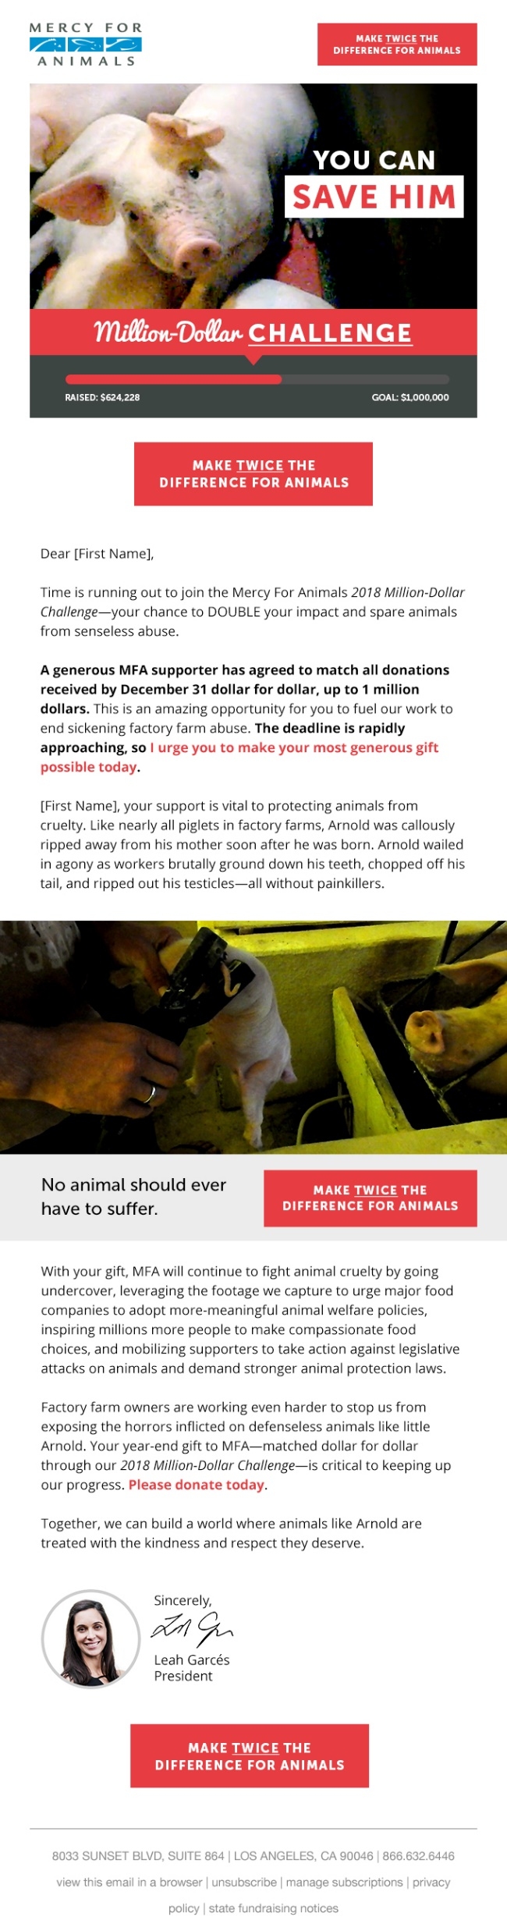
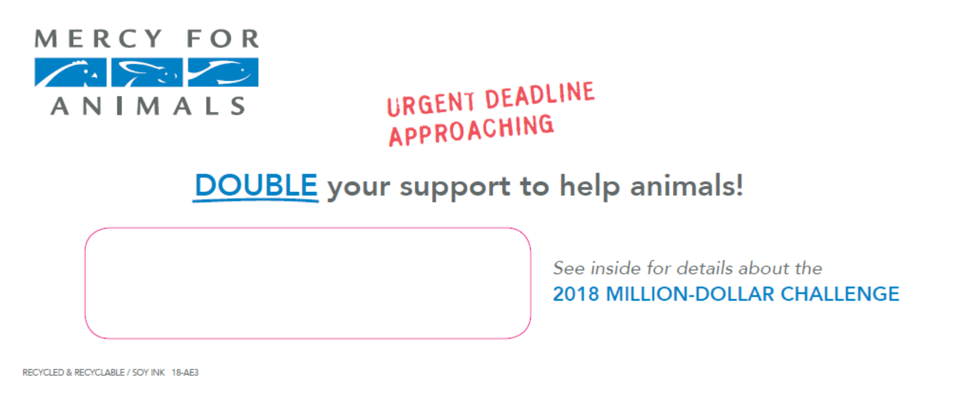
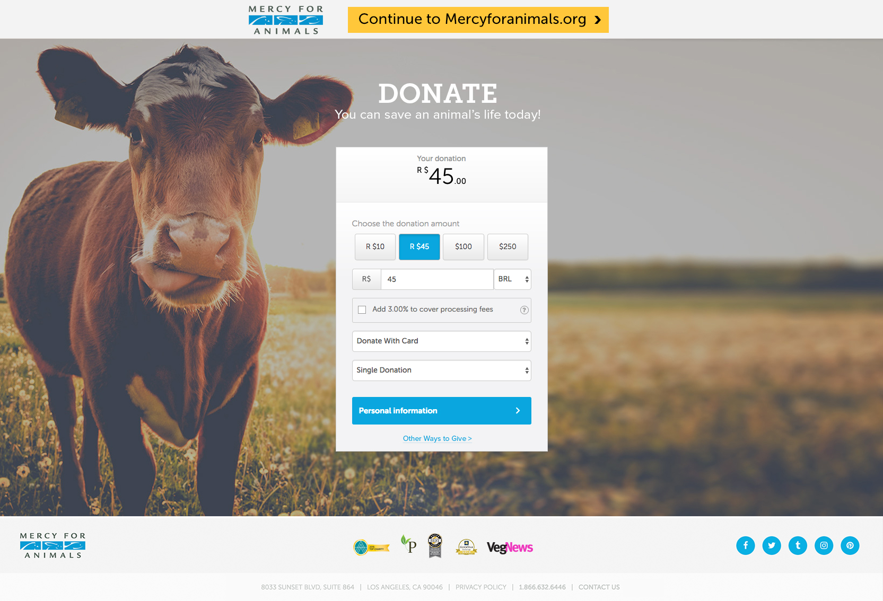
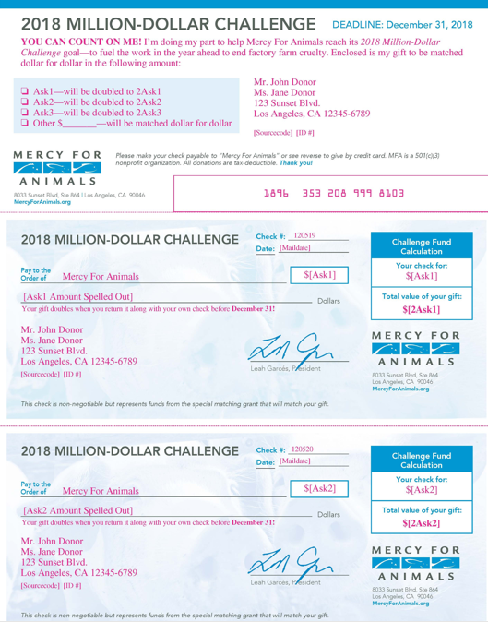
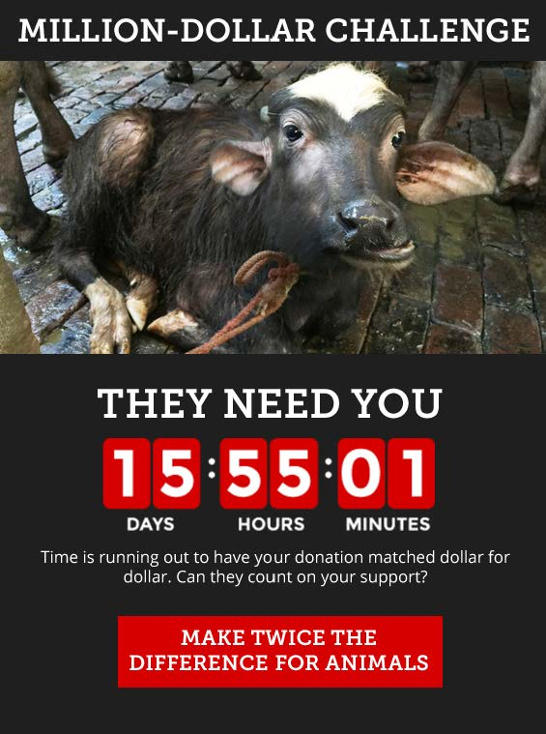
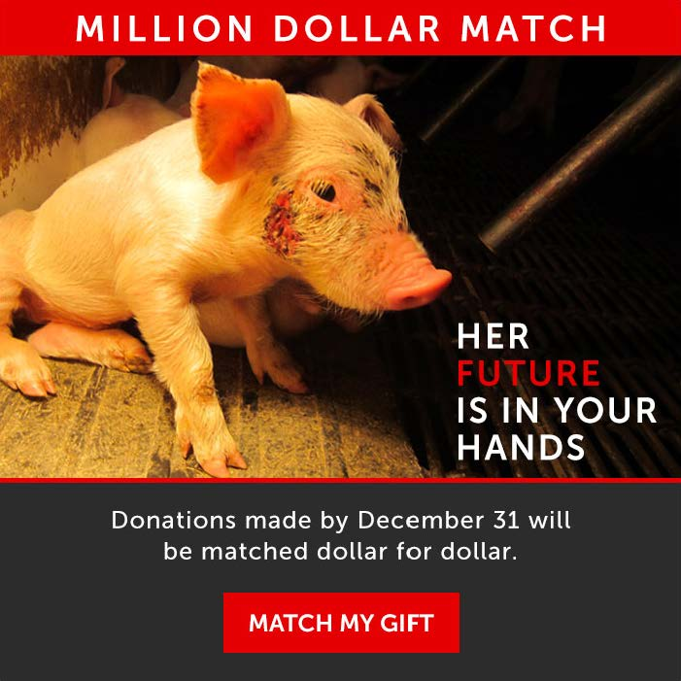
Mercy For Animals
Million Dollar Challenge

Slide 25
Measuring Results

Slide 26
Learning Agenda
Learn and iterate quickly -- maximizing returns on optimizations over time.
1. Hypothesis
Develop hypotheses around acquisition, engagement, or donor conversion to support objective like increasing gift sizes, generating repeat giving, etc.
4. Implement
Take your learnings to market, cascading changes rapidly across your program to maximize our results.
Implement
Hypothesis
3. Analyze
Once you’ve accumulated a significant sample, move quickly into analysis.
2. Test
Devise experiments to test your hypotheses in market, keeping in mind constraints and objectives.
Analyze
Test

Slide 27

Measurement
Method of assigning credit to a particular marketing touchpoint
Allows us to measure how spend in one channel drives revenue in another
There is no one method
Actionability is key
Remember – it’s a single organization
If you can’t measure it, you can’t manage it

Slide 28
Returns: source & channel
Integrated program metrics
Channel: gifts & donors
Loyalty: value & upgrading
Cohort: conversion & ROI

Slide 30
Notes:
If you’re not properly aligned internally and you’re too siloed, then you really haven’t solved the problem. It means realignment of people and things like resetting titles and compensation and incentive bonuses. All of those things used to be pretty well set, but now they’re being challenged.
Obstacles
*lots of moving parts to manage
*can be overwhelming – all the combinations
*increased time and expense
*simply don’t have control

Slide 31
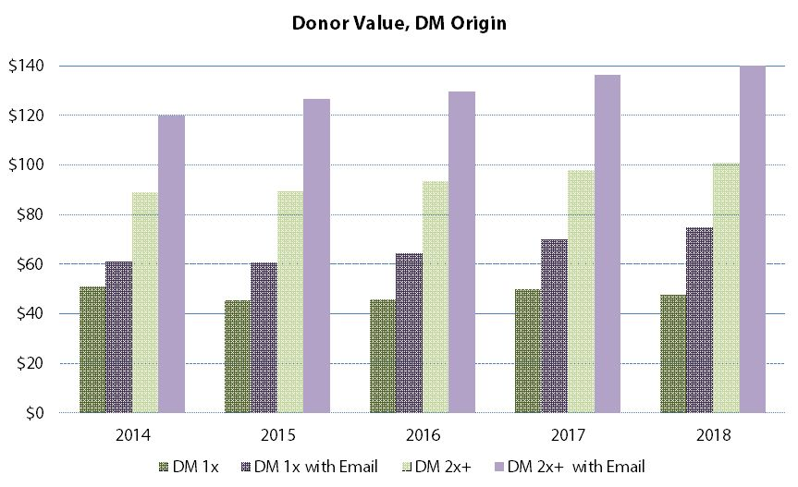

Slide 32

But what if I only own one piece?
Notes:
If you’re not properly aligned internally and you’re too siloed, then you really haven’t solved the problem. It means realignment of people and things like resetting titles and compensation and incentive bonuses. All of those things used to be pretty well set, but now they’re being challenged.
Obstacles
*lots of moving parts to manage
*can be overwhelming – all the combinations
*increased time and expense
*simply don’t have control

Slide 33
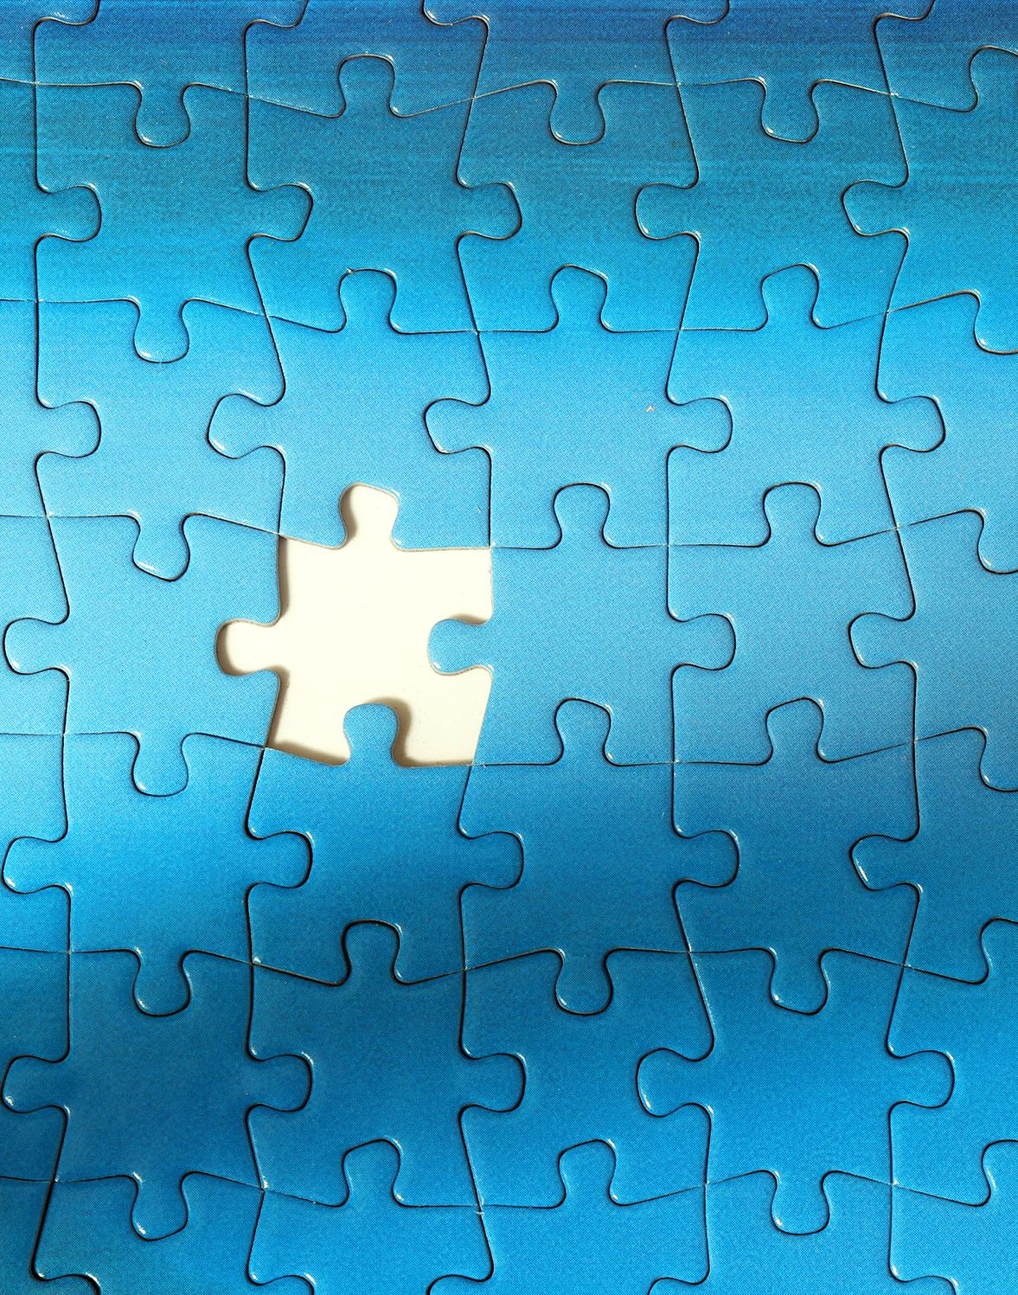
Get all the pieces together
Numbers Talk
Share Credit
Redefining Success
Cross Channel Goals
Fluid Budgets
Additional KPIs

Slide 34
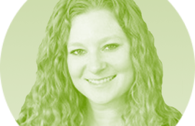
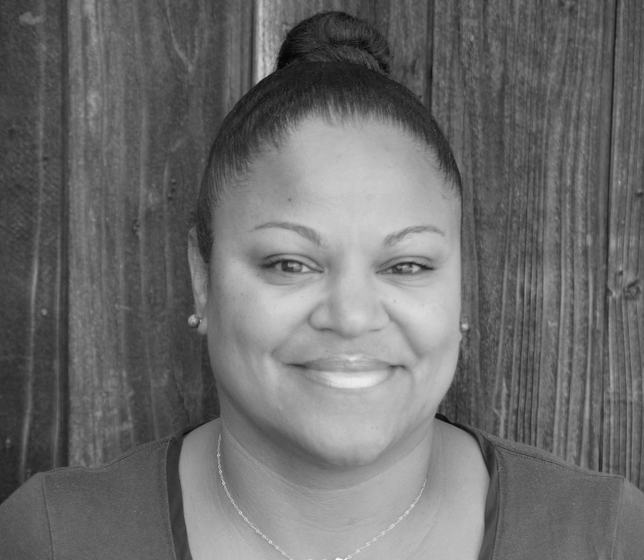
Katy Jordan
VP of Integrated Media & Strategy
ForwardPMX kjordan@forwardpmx.com
Mwosi Swenson
President & CEO
Mal Warwick Donordigital
mswenson@mwdagency.com

