Slide 1
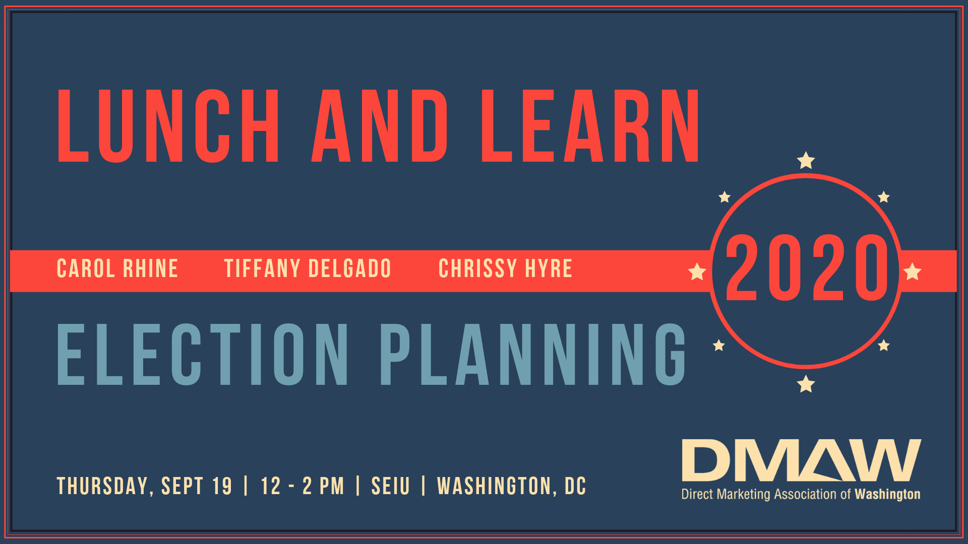

Slide 2

Upcoming
Events
Young Professional Happy Hour
Thursday, October 3 | 5:30 PM – 7:30 PM
The Players Club| Washington, DC
Copywriting Workshop
Thursday, October 17| 9AM – 12PM
AARP | Washington, DC
Autumn Happy Hour
Thursday, October 24 | 5:30 PM – 7:00 PM
Arlington Rooftop & Grill | Arlington, VA
2020 Election Planning

Slide 3
Upcoming
Events
Lunch & Learn: Donor Advised Funds
Thursday, November 21 | 12 – 2PM
SEIU | Washington, DC
Best of Direct Holiday Party and Awards Ceremony
Tuesday, December 3 | 6 – 9PM
National Press Club | Washington, DC
2020 Annual Meeting, Keynote and Networking Reception
Thursday, January 16 | 6 – 9PM
SEIU| Washington, DC
2020 Election Planning

Slide 4
For sponsorship info, program questions or to register:
dmaw.org

Slide 5

Thank you to our sponsor!
Marcus Shibler

Slide 6
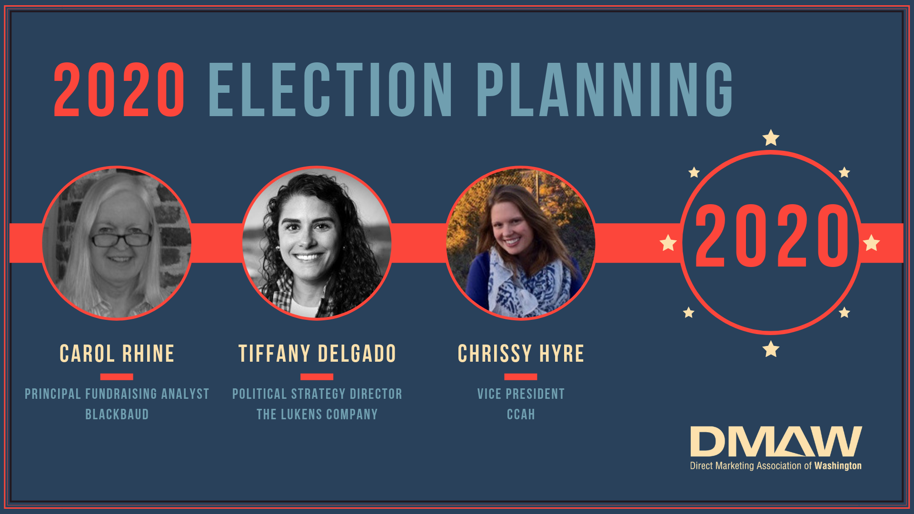

Slide 7
Giving in an Election Year
Presented by Carol Rhine

Slide 8

Effects of the Economy on Giving
Research by the Giving USA Foundation™ tells us that charitable giving rises during periods of strong economic growth and slows during periods of relative economic weakness.
Median index revenue growth has generally followed national economic performance and tends to grow more slowly or even to decline during periods of relative economic hardship.
Since the presidential election in the fourth quarter of 2016, public policy concerns appear to have overshadowed the influence of the economy on giving. But if these concerns do continue to abate in the future, the economy will likely re-emerge as a primary driver of giving trends.
As the debate continues on whether the US is headed for a recession, charities are looking for ways to shore up their base to withstand any coming economic storms on the horizon, including diversifying channels and expanding engagement to emerging immigrant communities.

Slide 9
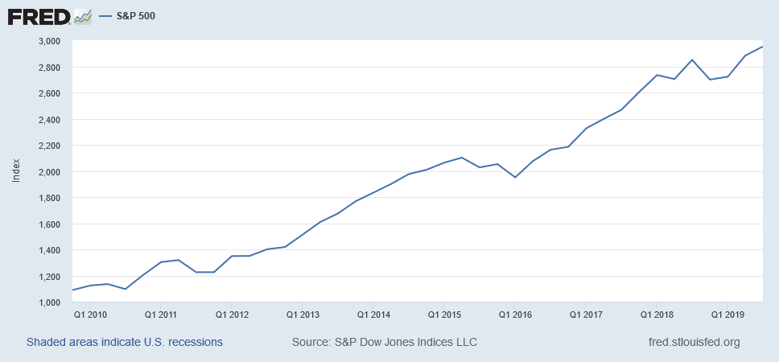
S&P 500 Quarterly
S&P 500 Quarterly

Slide 10
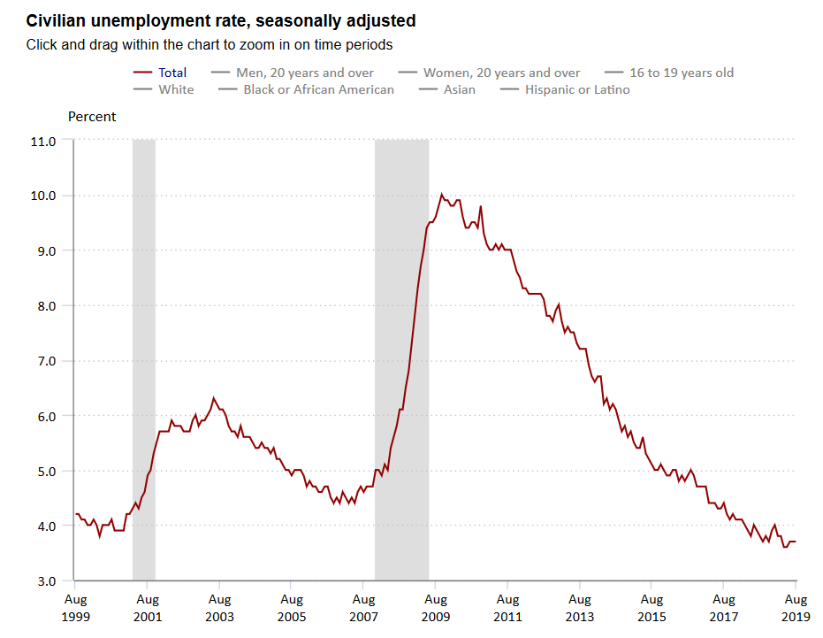
Civilian Unemployment Rate
US Bureau of Labor Statistics

Slide 11
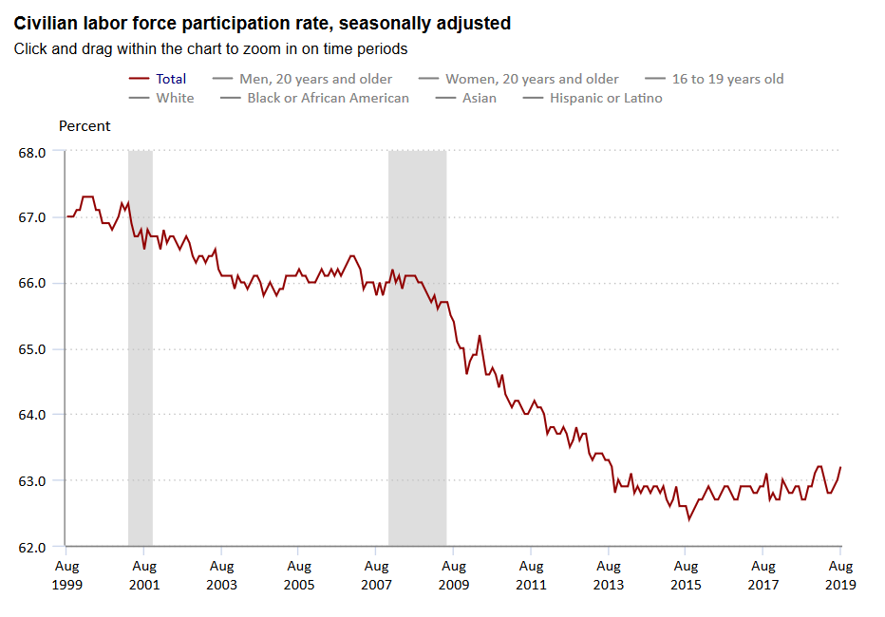
Civilian Labor Force Participation
US Bureau of Labor Statistics

Slide 12
“For decades, important decisions affecting
fundraising programs in presidential election
years have largely been based on undocumented,
conventional thought.”

Slide 13
Effects of the Presidential Elections on Giving
Effect of the Presidential Elections on Giving
The Giving USA Foundation reports that campaigns themselves historically have had no discernible impact on overall individual giving.
Past index results do indicate that while the nonprofit industry as a whole appears to be unaffected by political fundraising, election year campaigning may have, if anything, a positive effect on specific sectors or individual organizations that are working on issues highlighted by those campaigns.
Blackbaud did an in-depth study of the charitable giving habits of 400,000 political donors and how their giving changed in the 2012 election cycle. This data showed that political donors tracked by the Federal Election Commission gave more to nonprofit organizations in 2012 than they did in 2011. Political donors gave 0.9% more in 2012 than in 2011, while non-political donors (those not tracked by the FEC) gave 2.1% less.
Particularly of note was the discovery that among political donors aged 25 to 34, charitable giving increased 10.8% in the 2012 election year.

Slide 14
GIVING IN AN
ELECTION YEAR
How Political Giving
Impacts Nonprofit
Support
Presented by: Chuck Longfield and Chris Dann
RESEARCH: JIM O’SHAUGHNESSY
FOREWORD: ANDREW WATT

Slide 15


Key Findings
Donors who gave to federal political campaigns in 2012 gave 0.9% more to the charitable organizations we studied in 2012 than they had in 2011.
Donors who did not give to political campaigns reduced their giving to the charities we studied in 2012 by 2.1%.
These findings held true across all sub-sectors as well as the demographic segments of age range, household income, and head of household gender.

Slide 16
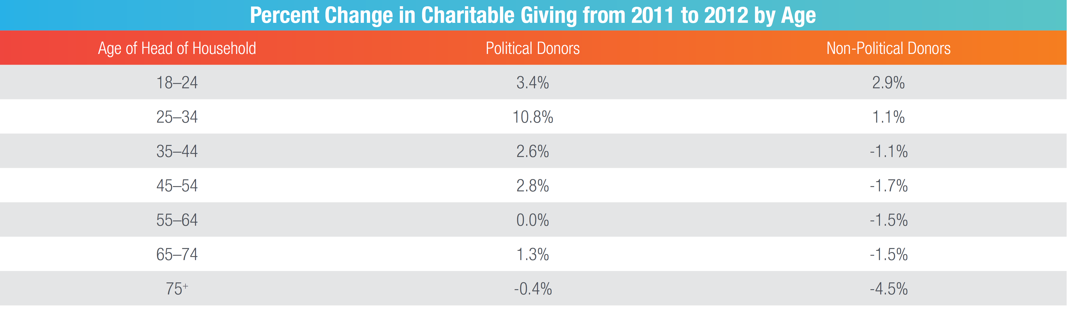
Change by Age
“We may have discovered in this study that high-profile campaign years are ideal target times for nonprofits to acquire young donors.”

Slide 17
Observations
“...nonprofits involved in missions and programs
touched by prominent campaign issues would
benefit from political discourse on those themes. We
would also expect that nonprofits focused on public
policy advocacy would benefit most.”
“The fact that the giving response to a major disaster
increased substantially among political donors in
comparison with non-political donors is very much
worth noting and studying further. Because it is not
likely explained by politics, it is most likely attributed
to conviction of civic responsibility.”

Slide 18
Recommendations for Election Year Fundraising
Decisions about new donor acquisition and reinstating lapsed donors should be based on an assessment of the aggressiveness of 2020 campaign fundraising and the state of the economy heading into the fall. While alignment of campaign issues, organization mission, and programs can be a good bet, risk should be weighed when making acquisition and reinstatement strategy decisions.
This study illustrates a clear connection between passion for a cause and contributions. Use 2020 as an opportunity to align your advocacy and fundraising teams internally toward shared goals.
Take heed and look for opportunities to rally advocates around your cause.
Pay attention to major donors whose engagement in politics is known, especially if an organization’s mission and program has relevance to the elections! Note: If donors’ engagement in political giving is unknown, make it part of your research. Donors who give to political campaigns while increasing nonprofit support provide clear evidence of their capacity by doing so.
And as always, for general fundraising, continue to emphasize retention by converting to sustainers, cultivating existing donors, and reinstating lapsed donors.

Slide 19
Is 2020 going to be 2008?
It’s the economy!
  Watch for recession signs
  Track effects of tax law changes
  Encourage giving through DAFs and IRAs
Election cycles disrupt the mail and email.
  Time-sensitive political mail moves other bulk mail to the back of the queue.
  Individuals are inundated with emails and may not see messages from your organization.

Slide 20
Open Conversation
Through June 30, 2019…
$394,500,000
in contributions to PRESIDENTIAL campaigns.
This doesn’t include Senate races, Congressional races, Governor’s races, local and state races, or Party Committees.

