Slide 1


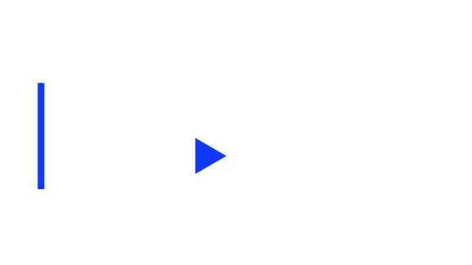
36 Hot Digital Ideas to Heat Up Your Fundraising Results
Anne Kottler, Partner Matt Reese, Sr. Director of National Digital Campaigns
Sage Communications Everytown for Gun Safety
#DMAWDigitalDay

Slide 2

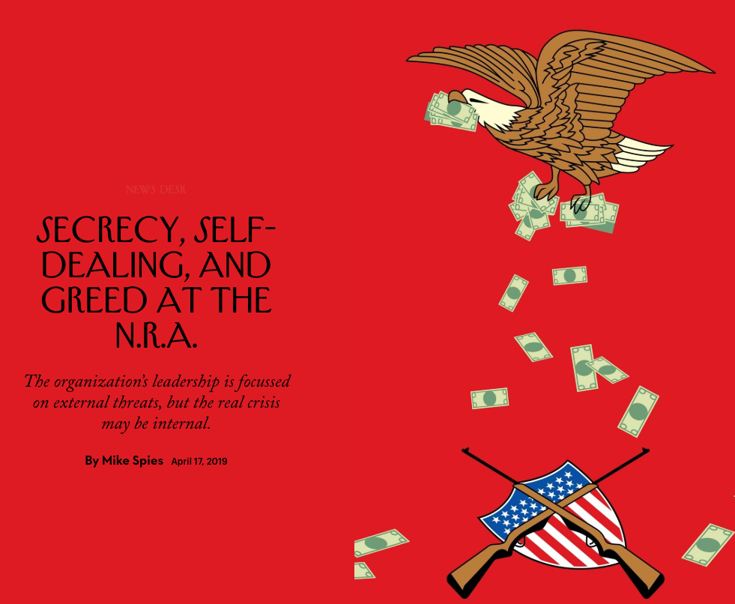
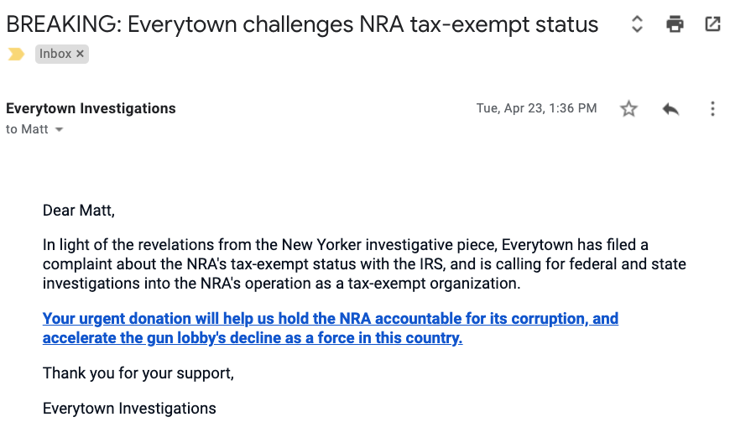
1. Harness the Power of News Events
Everytown for Gun Safety:
NRA in Crisis

Slide 3
2. Establish a Rapid-Response Protocol

Slide 4

3. Turn Negative News into a Positive Message
Notes:
After the announcement of the travel ban in 2017 – We launched a campaign to remind our supporters that Refugee Children were a priority and we stood with them

Slide 5
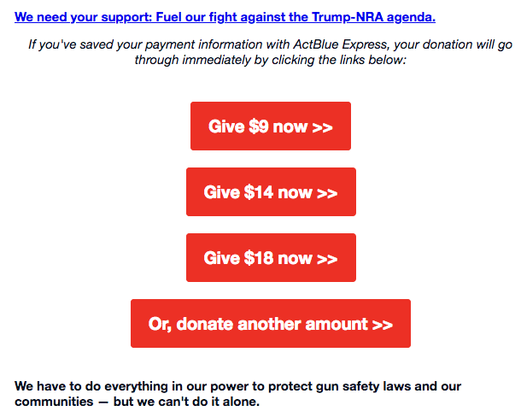
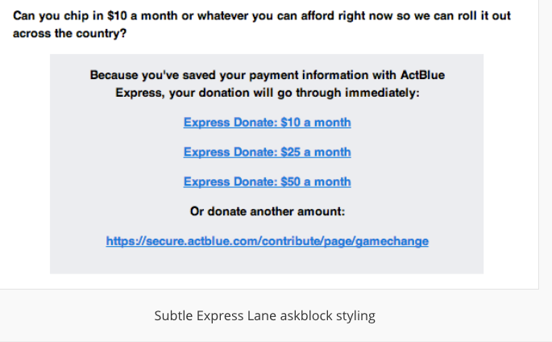
4. Use Multiple CTA Buttons and Links for Your Ask Array
Everytown for Gun Safety

Slide 6
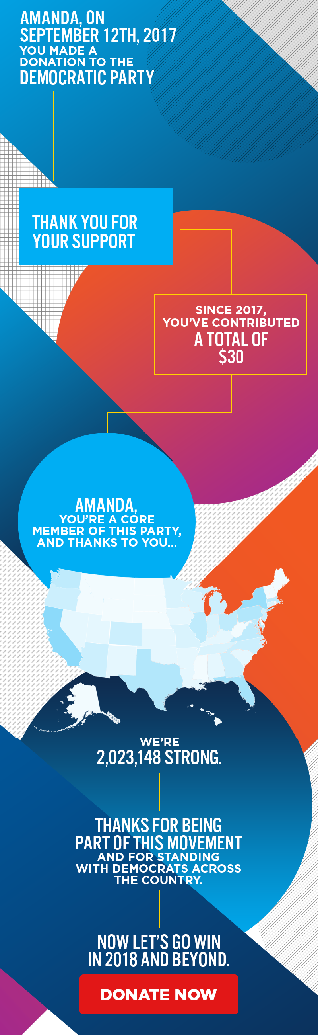
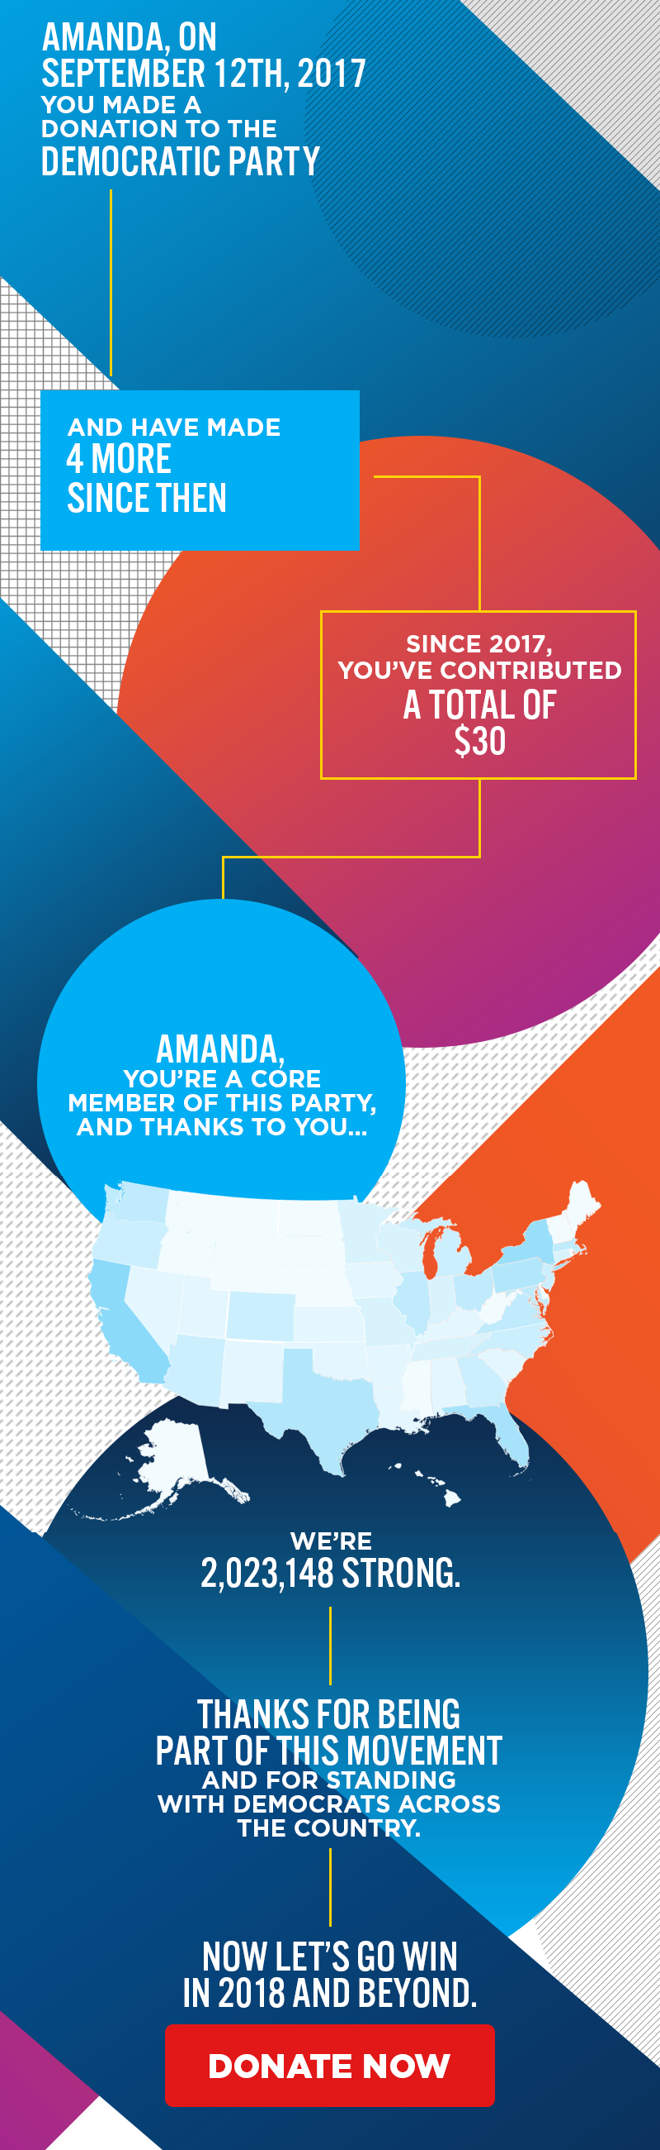
5. Use Image Personalization and Smart Data to Target Your Message
1 Donation
More than 1 Donation
Use Case: Democratic National Committee
The DNC wanted to send an email communication that would display how much an individual has contributed since their first donation.
Using Movable Ink’s Image Personalization functionality, they were able to create an on-brand email design that reviews each unique donor’s participation.
Copyright 2019. Movable, Ink. All rights reserved.

Slide 7
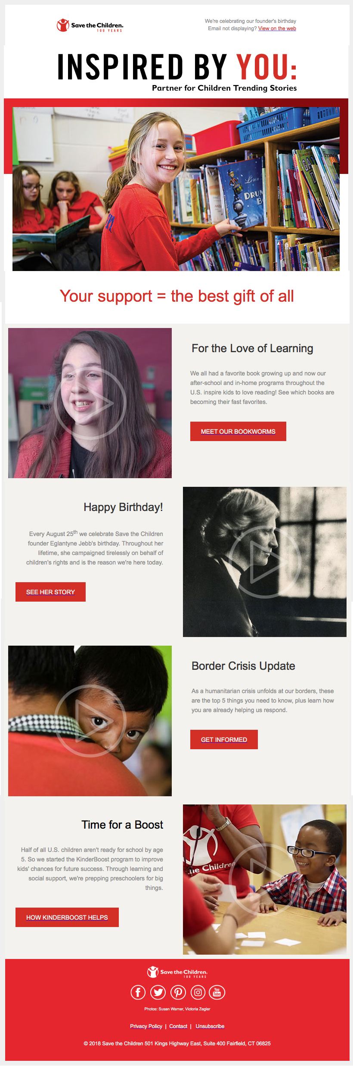
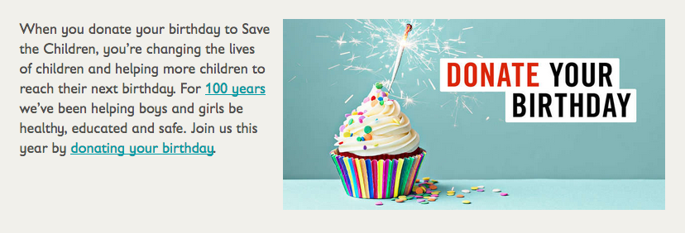
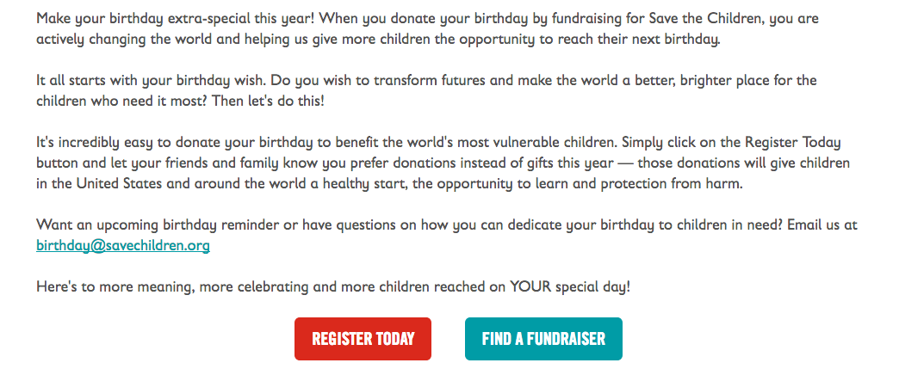
6. Celebrate Your Organization’s Birthday... or Your Own

Slide 8
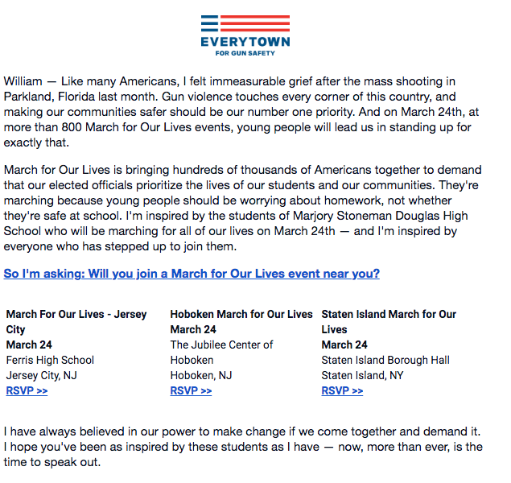
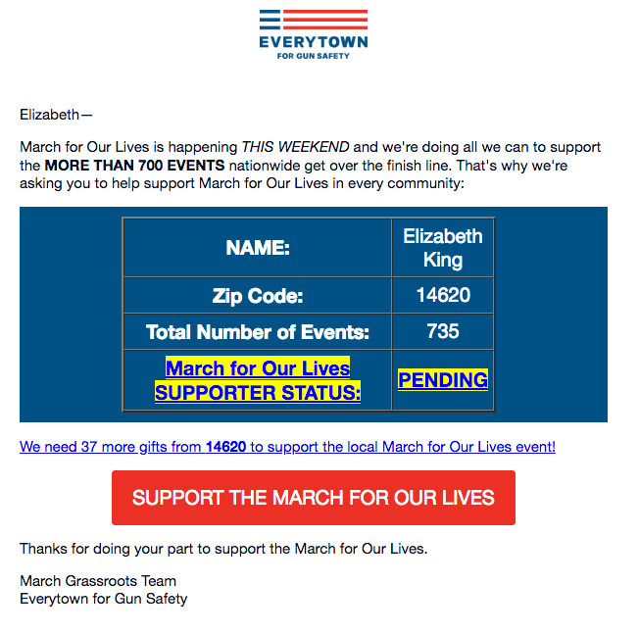
7. Use First Name and Local Content to Personalize Your Message Further
Notes:
Note to Matt from Josef: this looks very similar to the idea we are illustrating on slide 6 (Hot Idea #4).

Slide 9
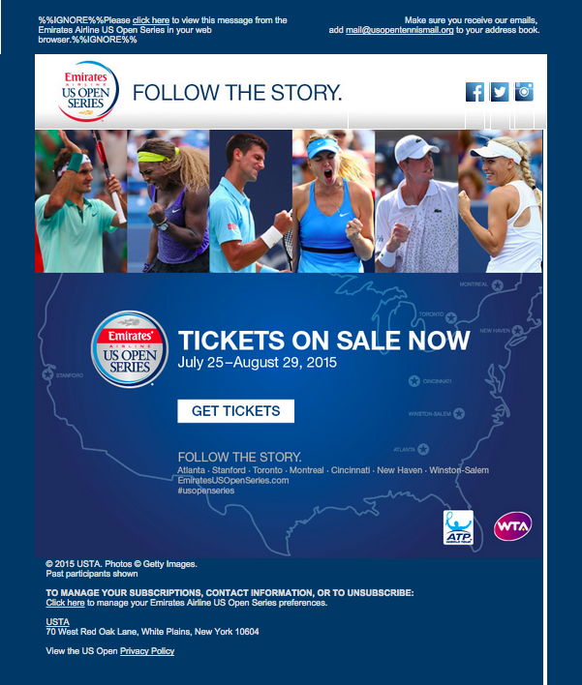
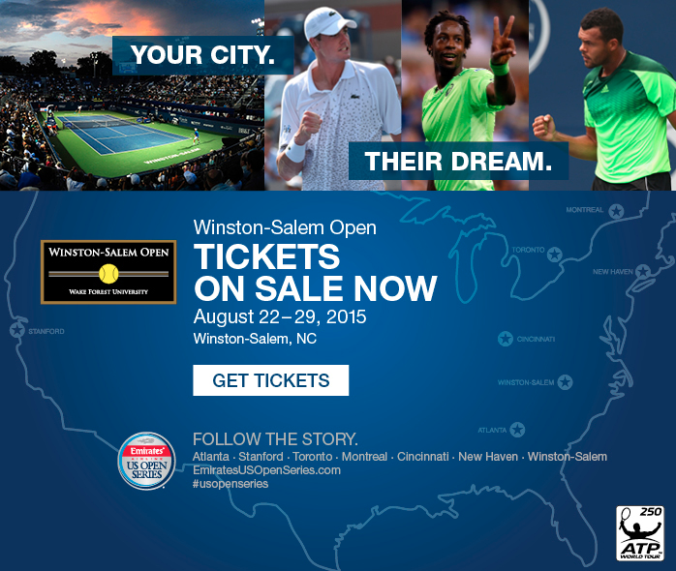

8. Use Location-Targeted Personalization
Default
North Carolina
Montreal
Use Case: USTA
USTA swaps in/out match-relevant creative based on the location of the subscriber to drive ticket sales.
Copyright 2019. Movable, Ink. All rights reserved.

Slide 10
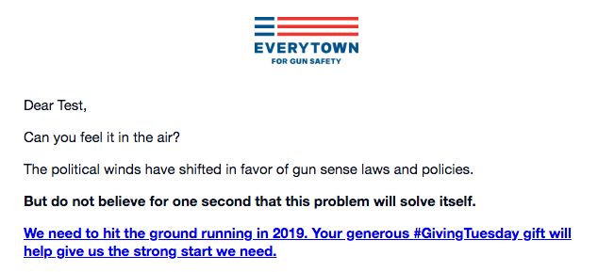


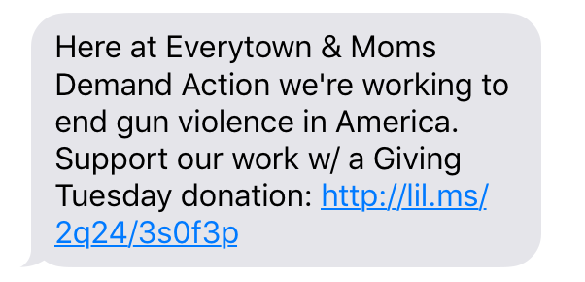
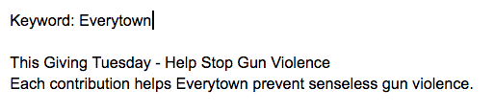
9. Use a Multi-Channel Approach

Slide 11
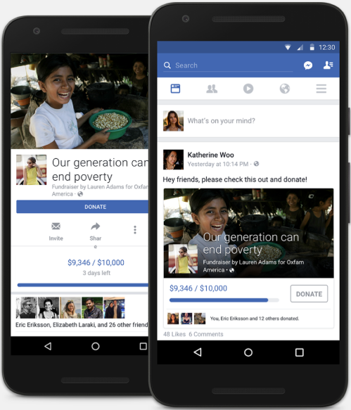
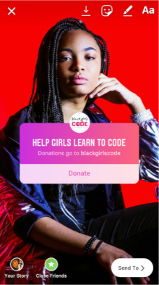
10. Leverage Facebook (& Instagram!) Donations

Slide 12
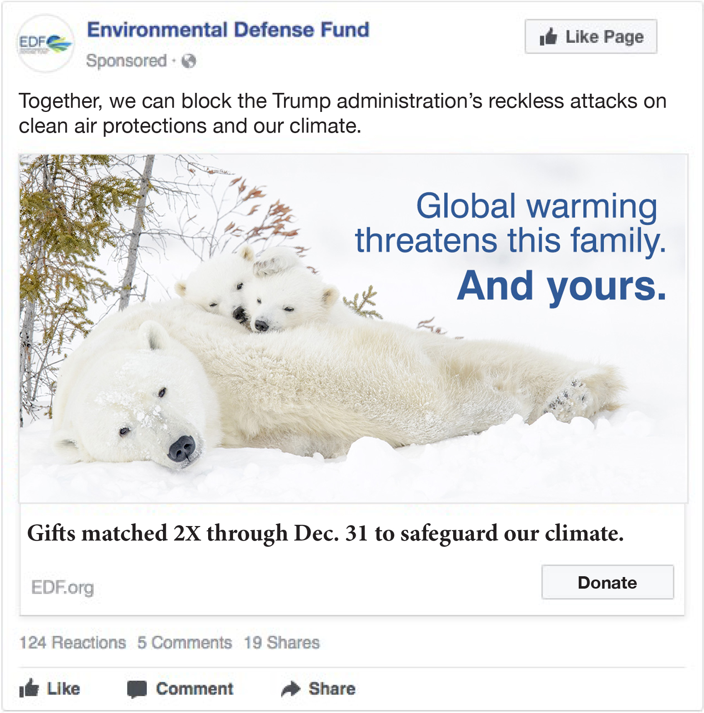
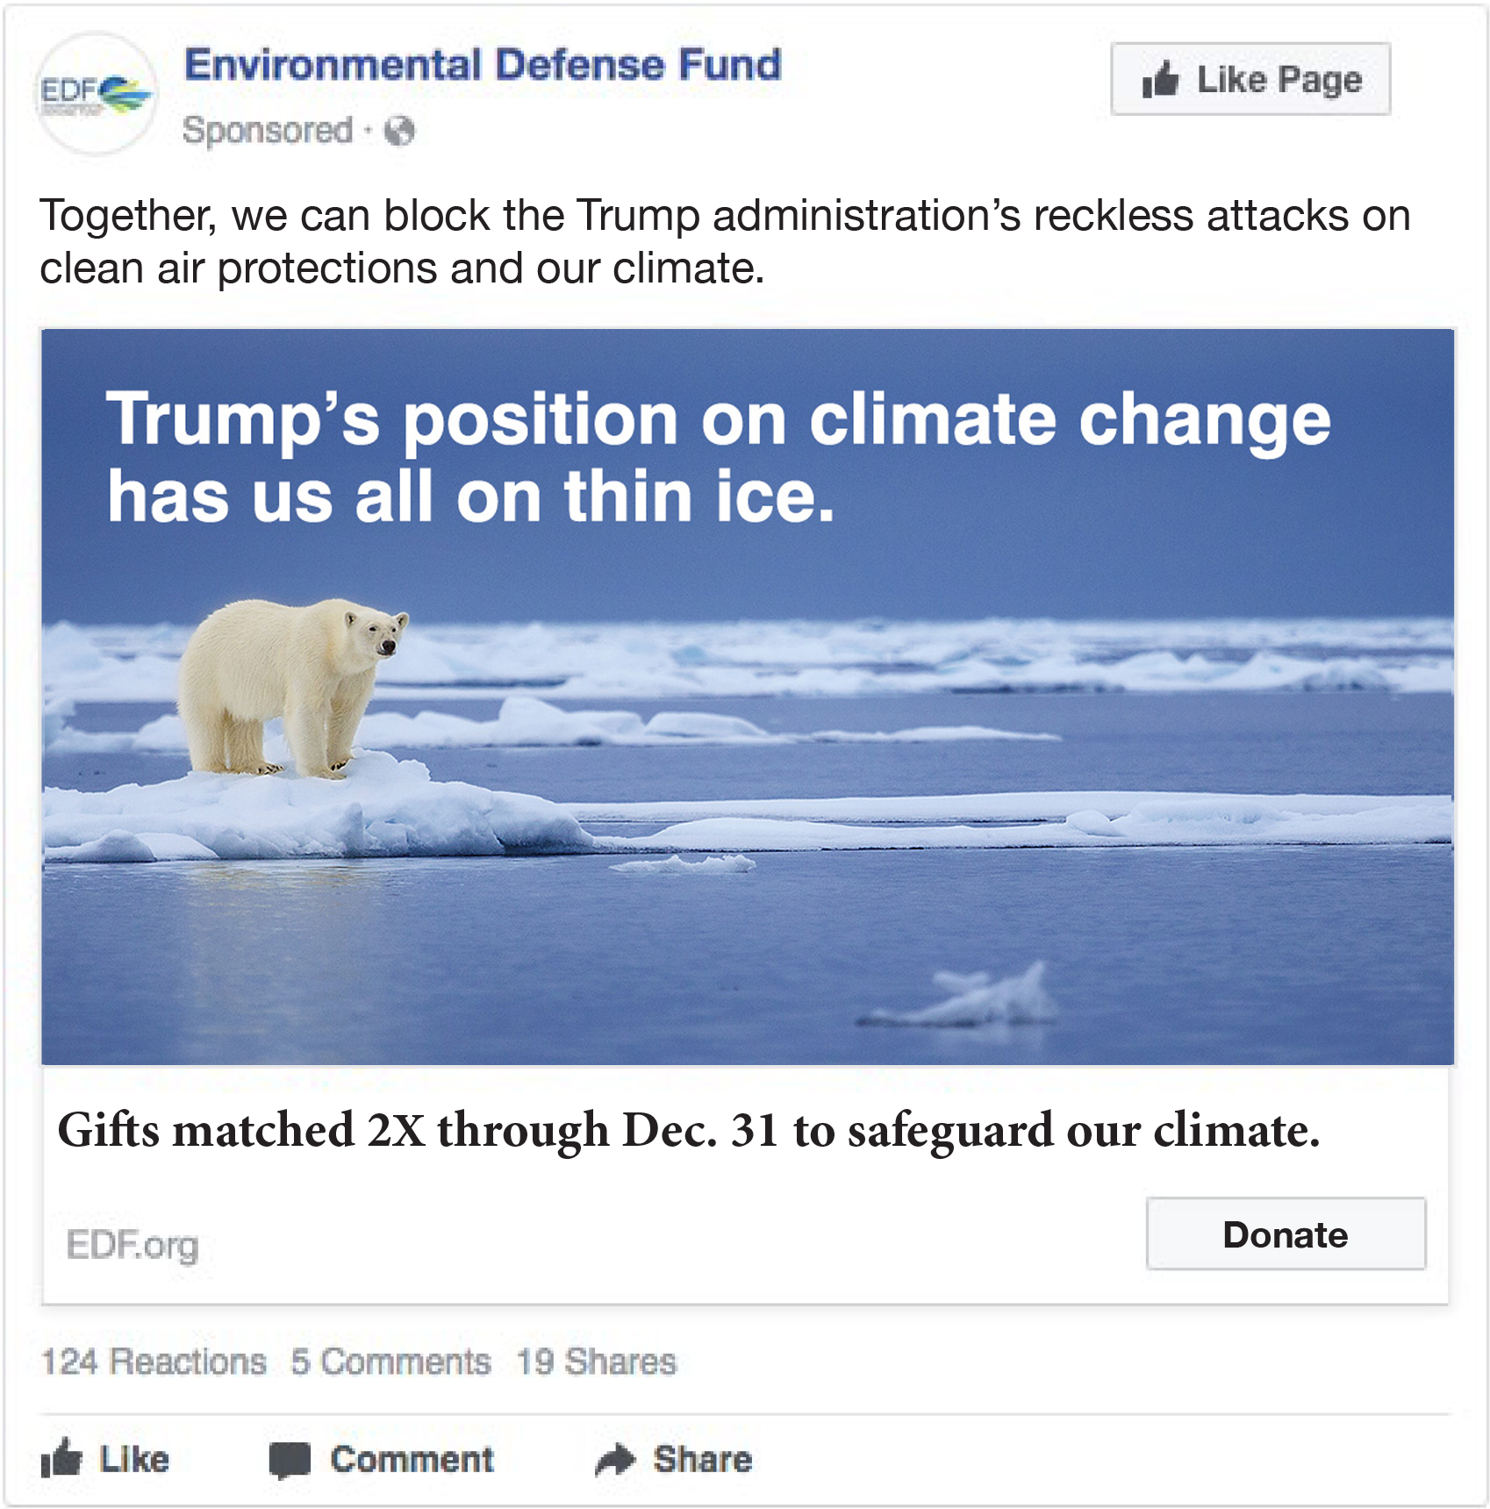
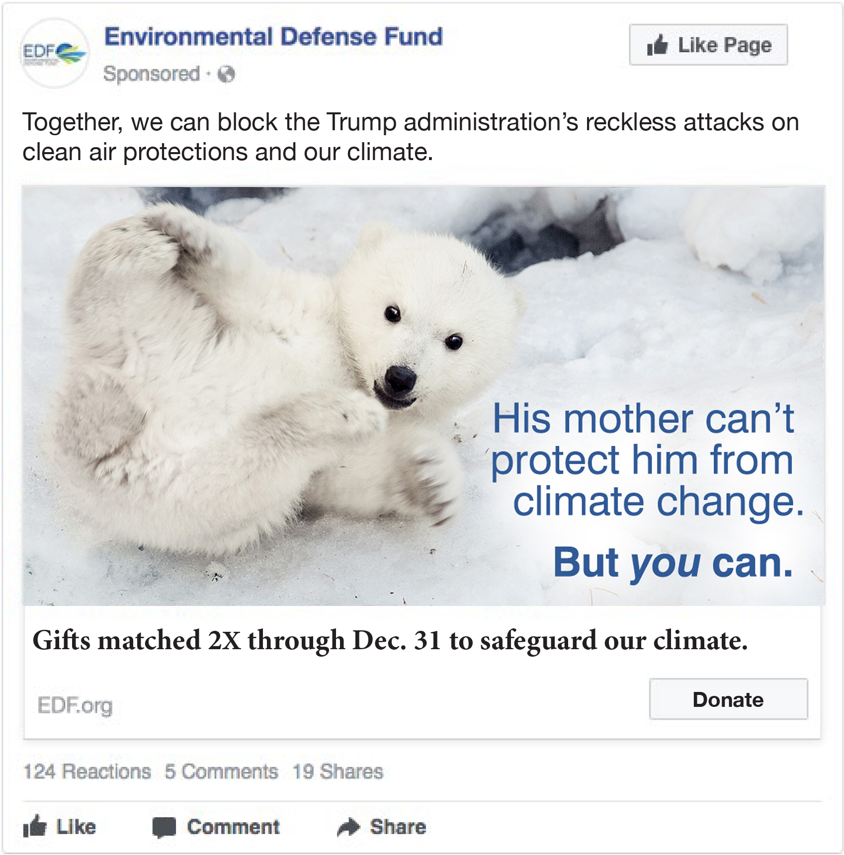
11. Test Creative Concepts for DM First on Facebook

Slide 13
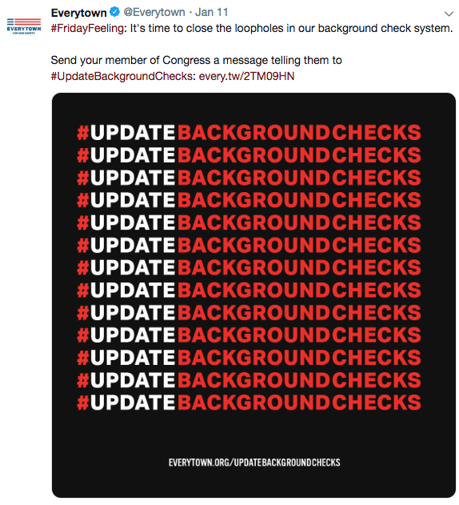
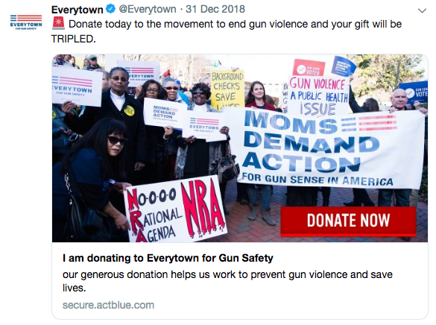
12. Use Cross-Channel Social Marketing to Funnel People into Your Donor Pool

Slide 14


13. Use Off-Line Tactics to Boost Online Fundraising

Slide 15
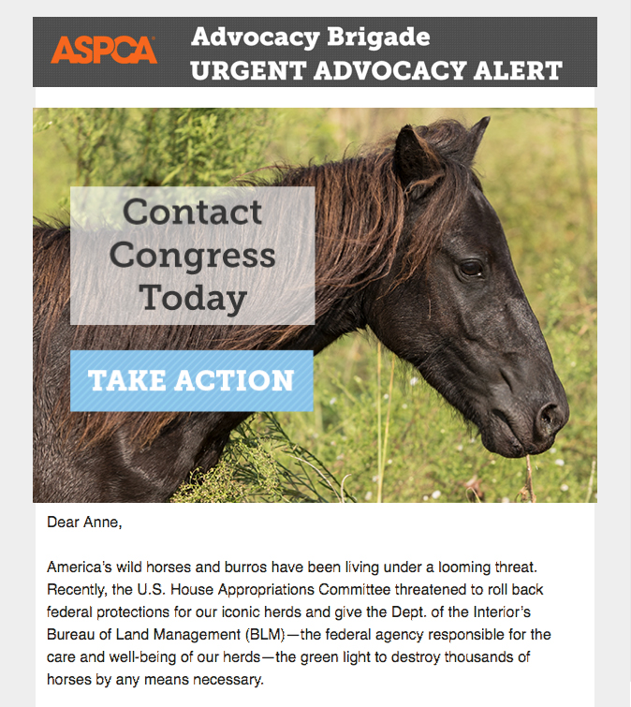
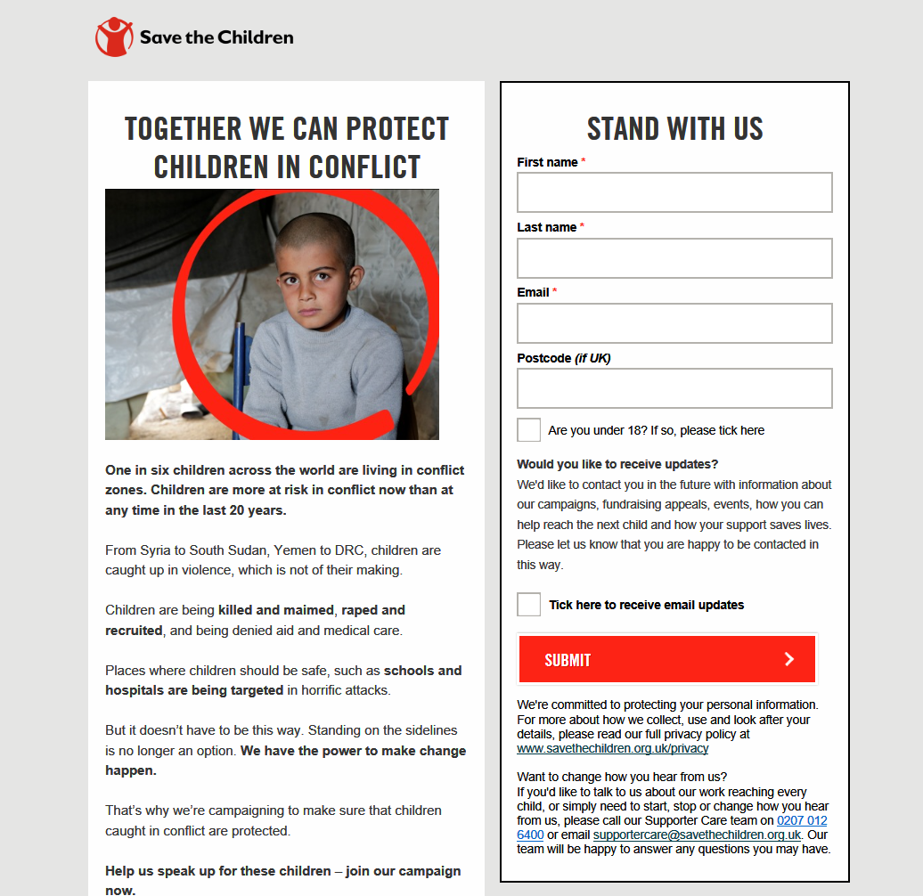
14. Use an Urgent Call to Activism to Activate New Donors
Notes:
Advocacy petition from SCUK – In support of removing/helping Children in conflict

Slide 16
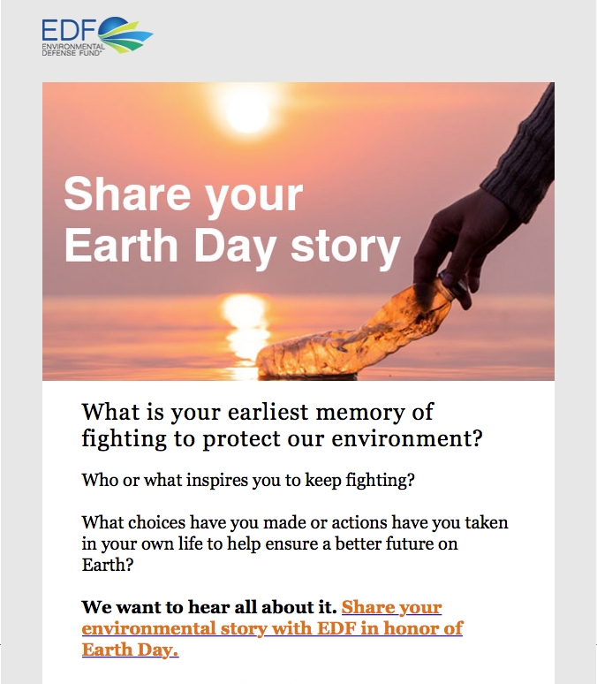
15. Invite Donors to Engage by Sharing Their Stories

Slide 17
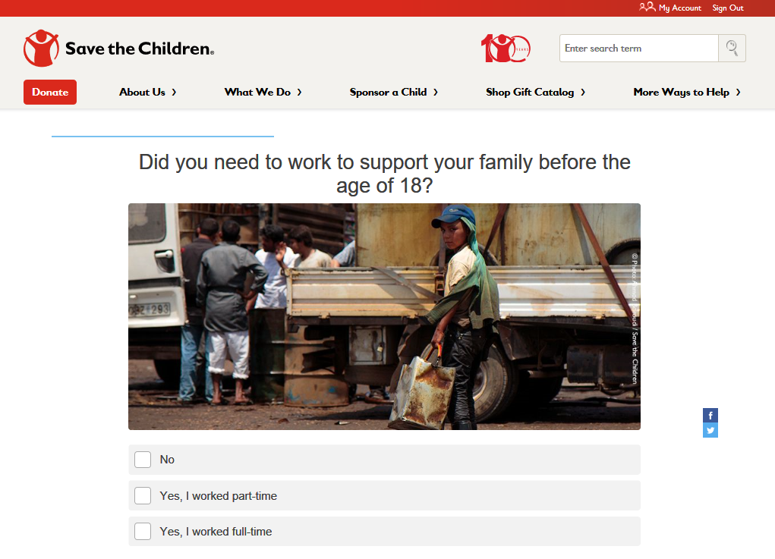
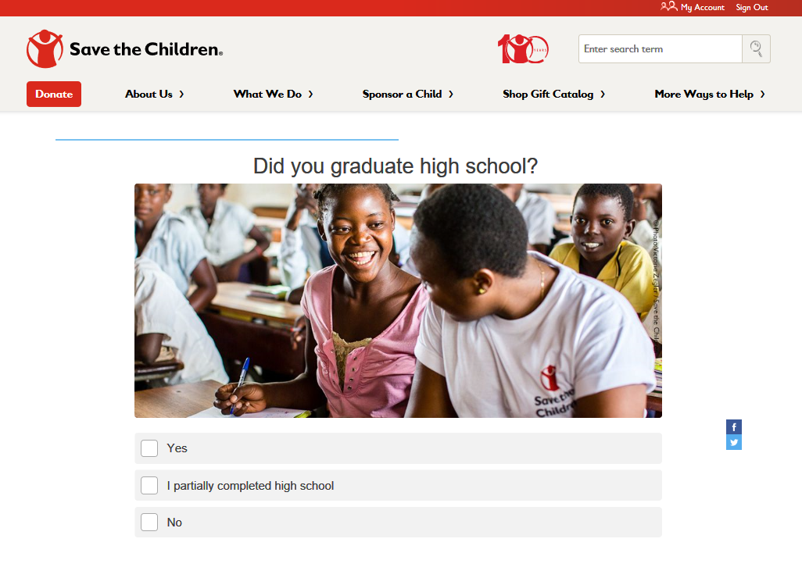
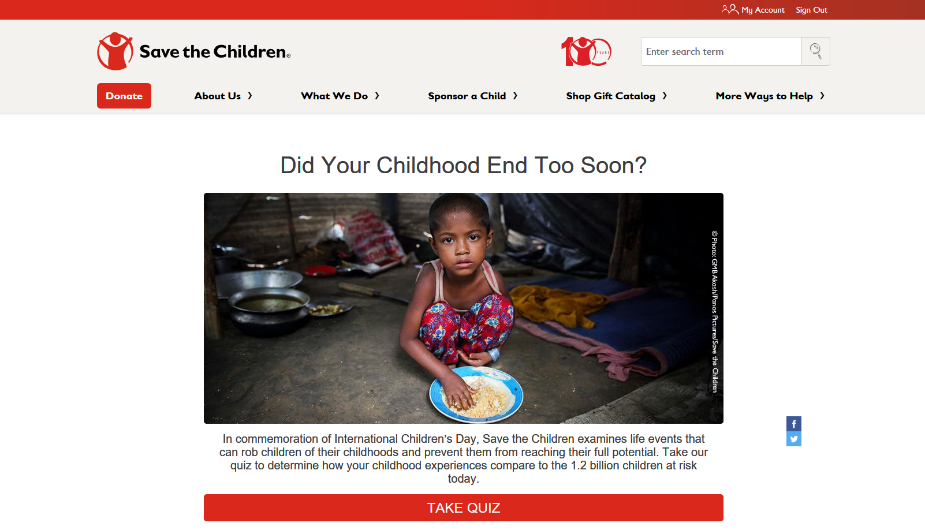
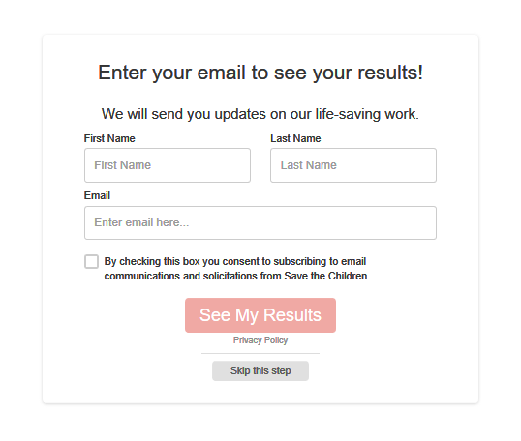
16. Generate Fresh Names with a Thought-Provoking Quiz
Notes:
The next several slides are a part of a Lead Generation Quiz we did at SCUS surrounding our “End of Childhood” Report
We asked supporters to take a short quiz about their childhood – In order to “unlock” their results they needed to provide an email address

Slide 18
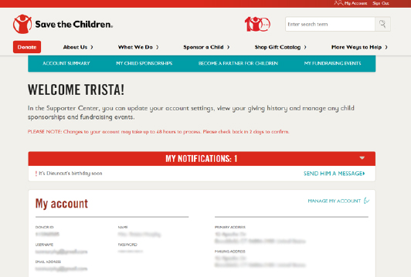
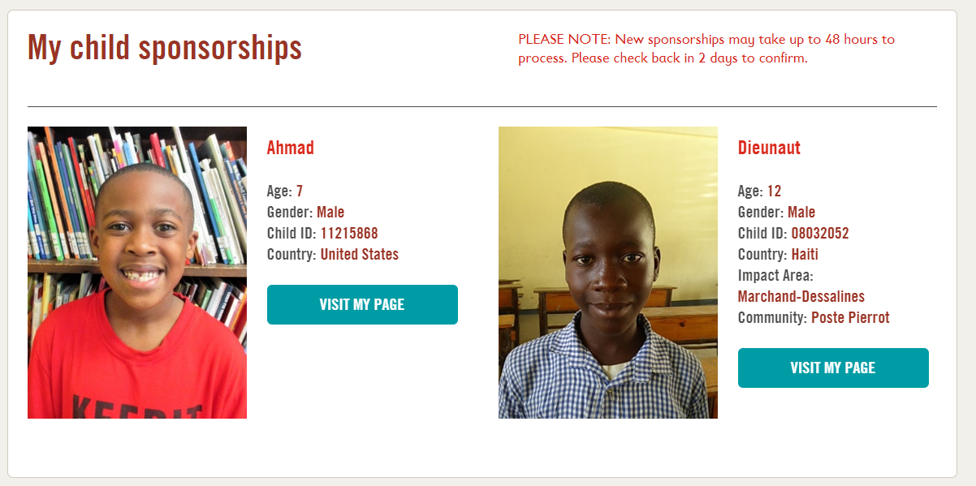
17. Personalize Your Website to Provide a More Customized Experience
Notes:
Personalization and Donor recognition on our site
Member center displays Sponsorships and Giving History

Slide 19
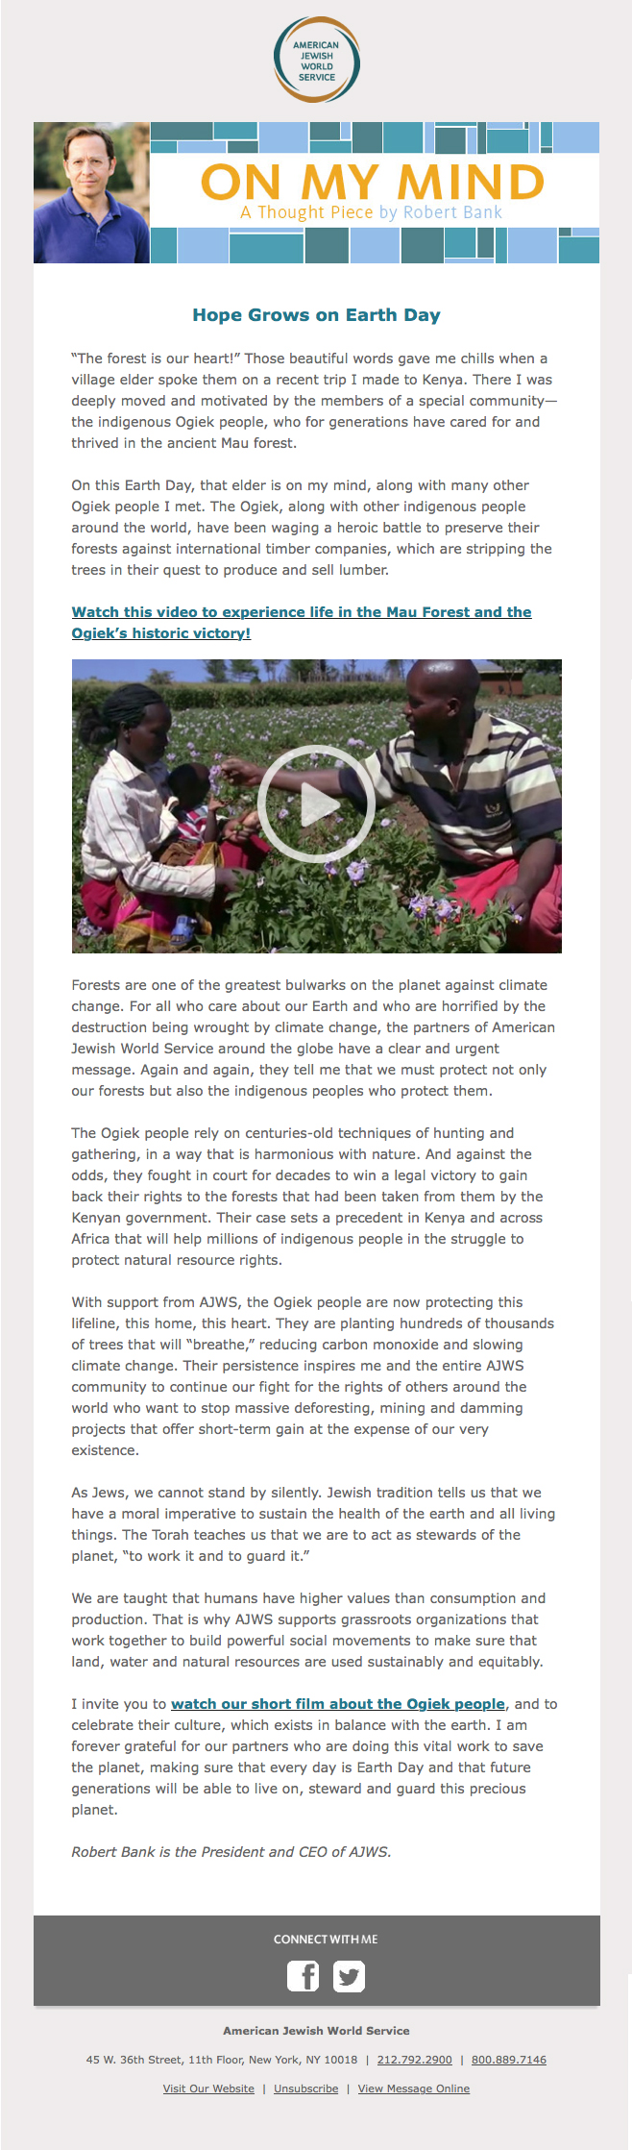
18. Use Video to Increase the Impact of Your Message

Slide 20
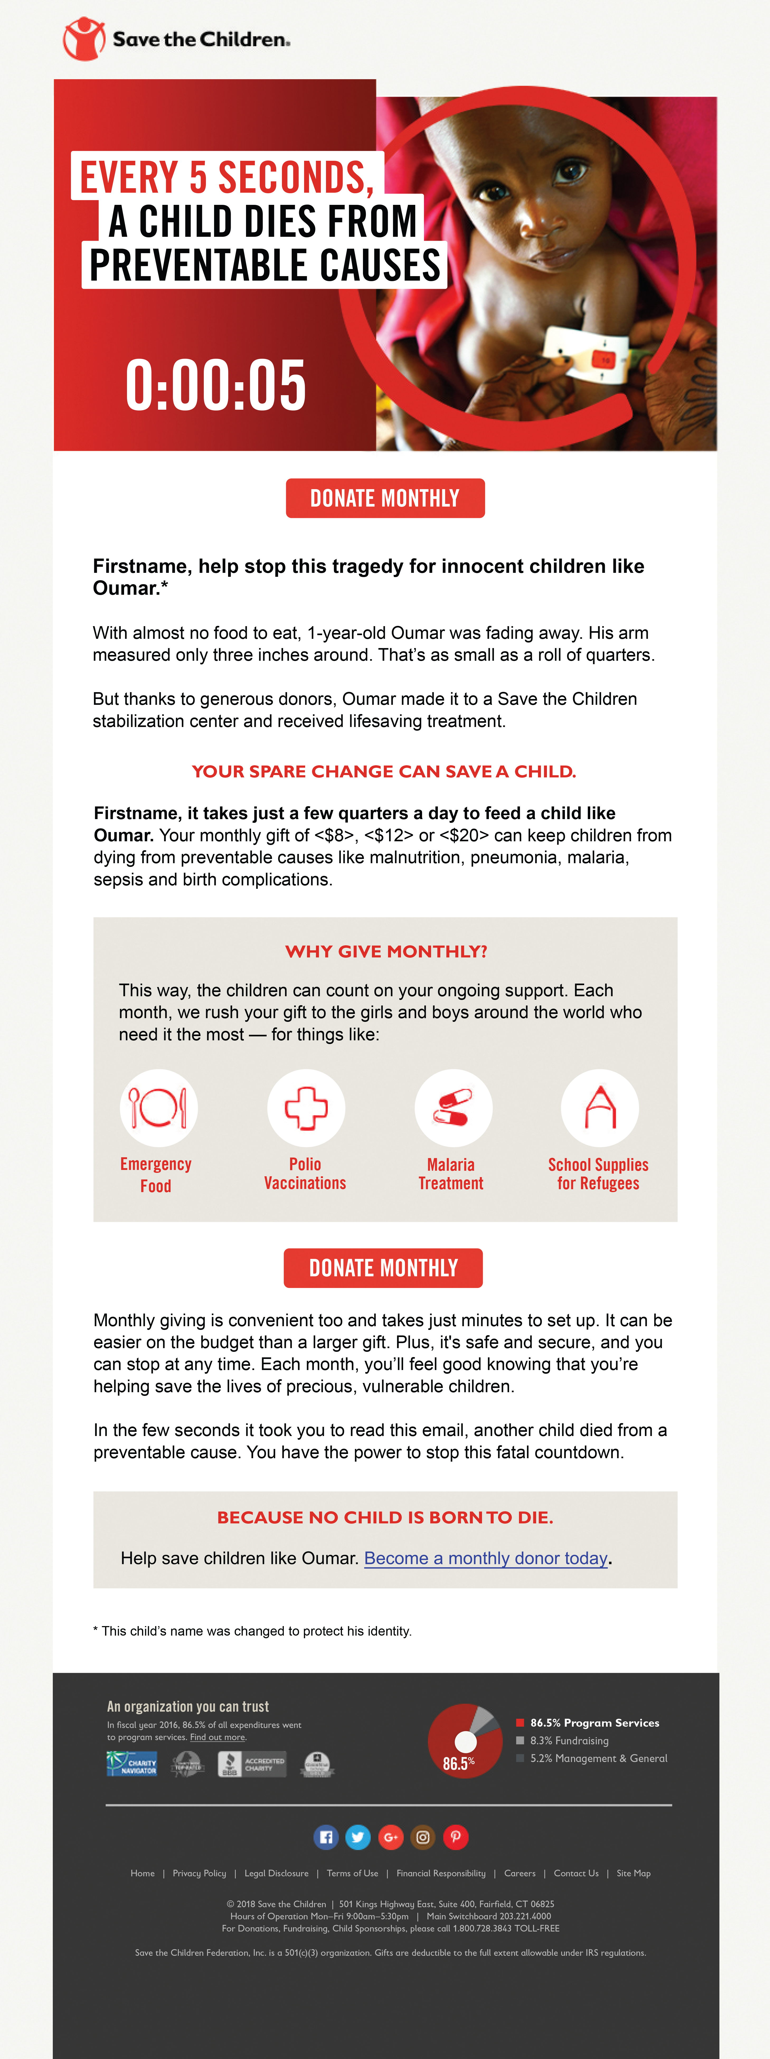
19. Use a Countdown Clock to Increase Urgency

Slide 21
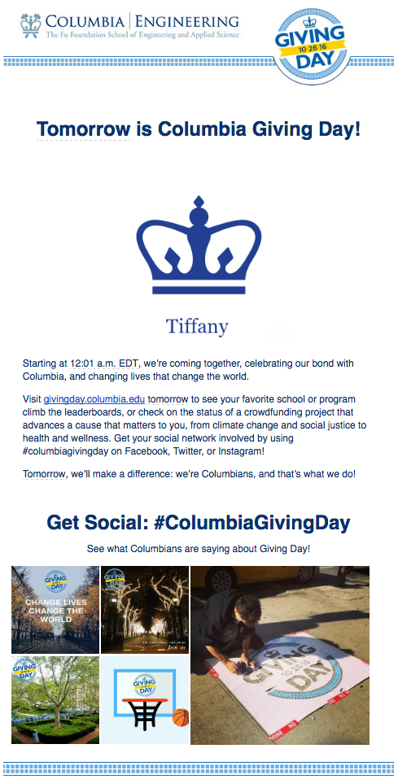
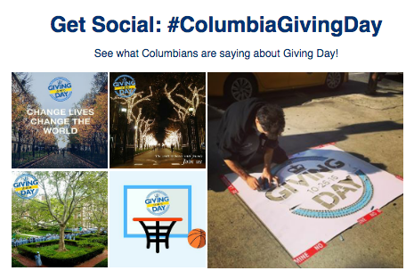
20. Insert Social Media Posts into Emails
Use Case: Columbia University
To celebrate Giving Day, Columbia University used Movable Ink to pull in #ColumbiaGivingDay-specific Instagram posts directly from the handle into email.
Copyright 2019. Movable, Ink. All rights reserved.

Slide 22
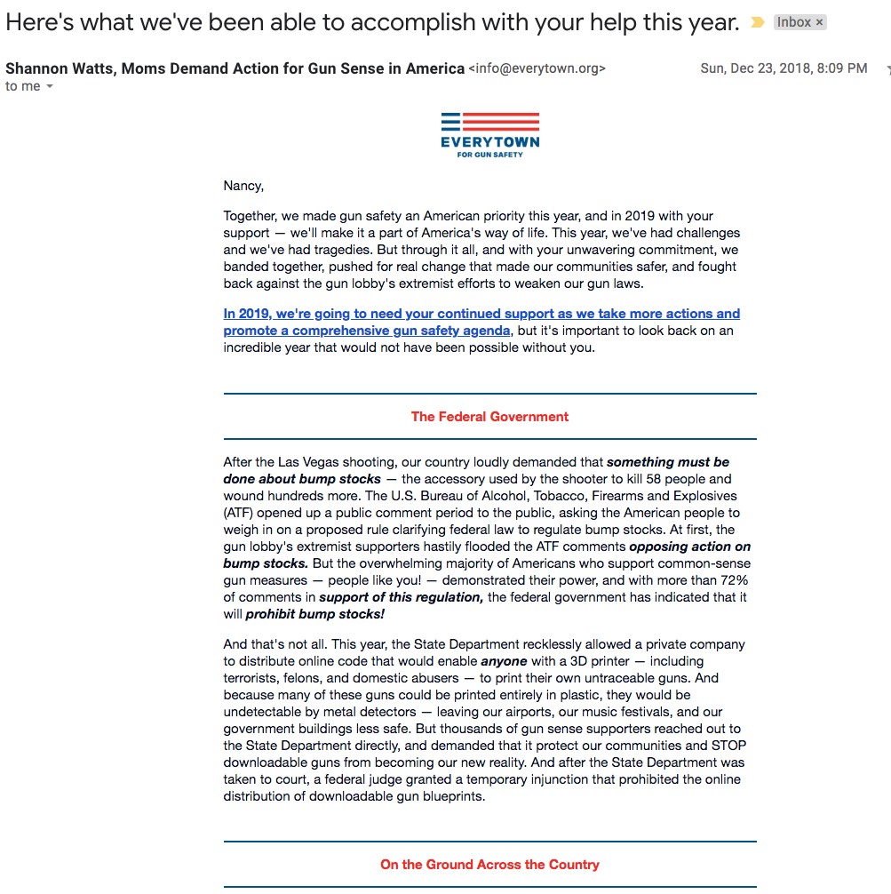
21. Send a Text-Style Cultivation Email Prior to Your Year-End Campaign

Slide 23
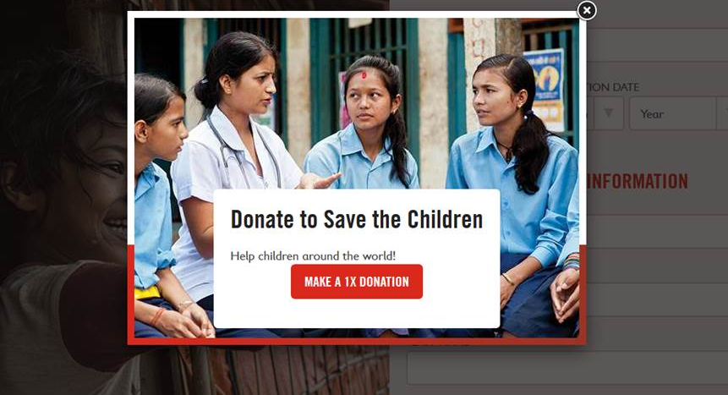
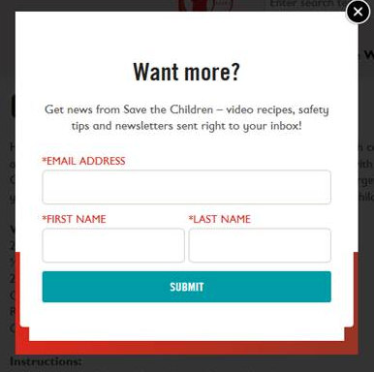
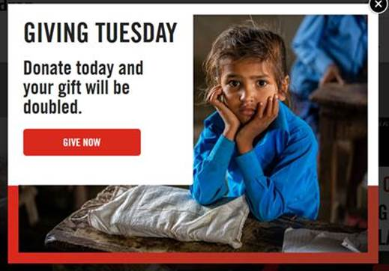
22. Use a Pop-Up Ad to Rescue an Abandoned Cart Donation
Notes:
End of Year and Giving Tuesday “Rescue Pop Ups” when a supporter went to “leave” the page without donating

Slide 24
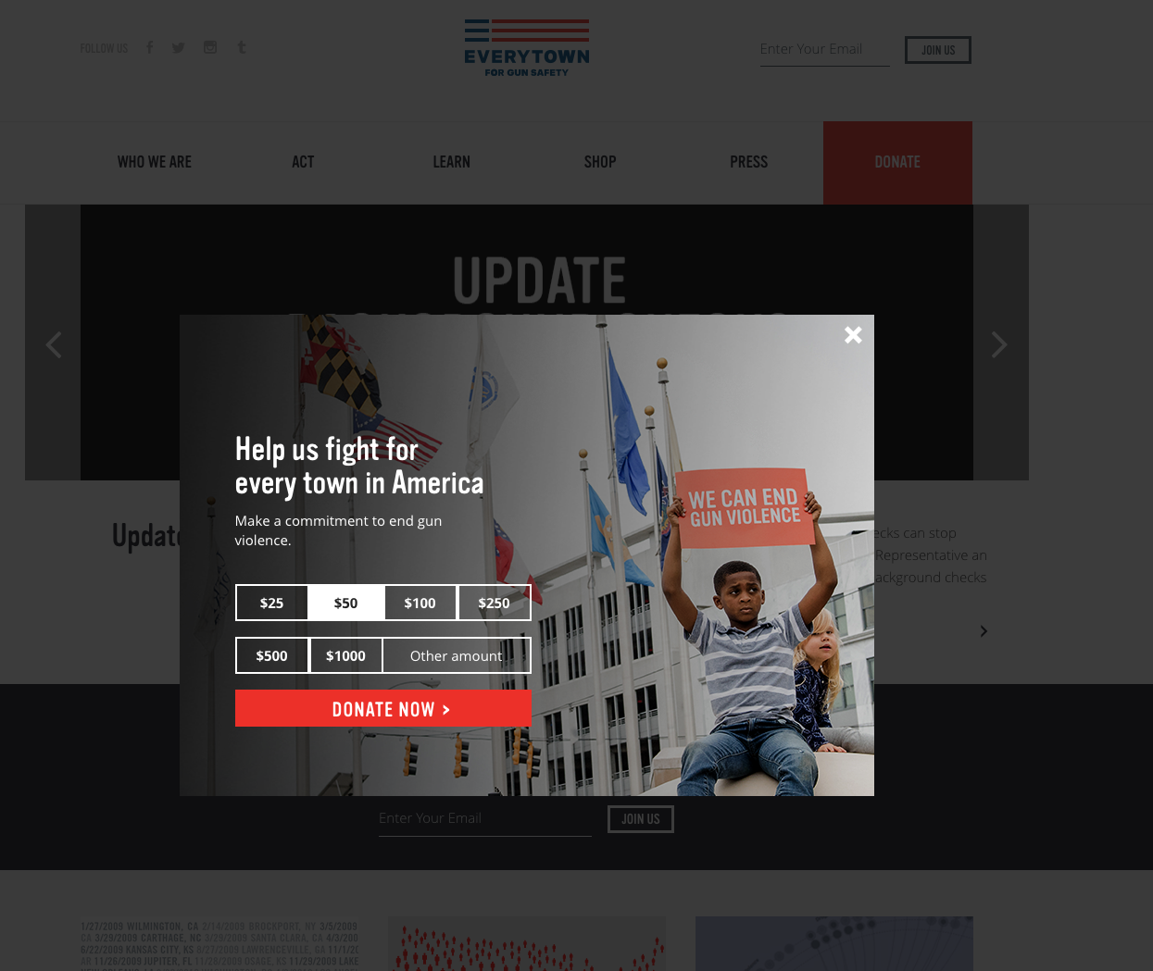
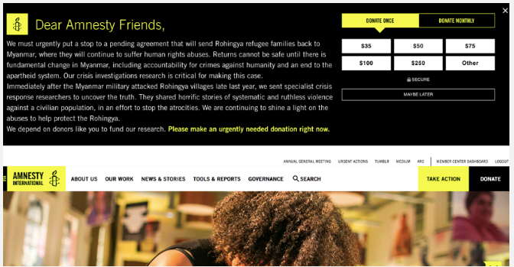
23. Don’t Just Pop Up — Push Down!
Notes:
Here I'll talk about the Parkland shooting and how we didn't make an explicit ask, but gave people the option to do so if they wanted. We then followed up with an action plan without a specific ask. We then asked for an explicit ask when Executive Vice President of the NRA gave a talk at CPAC one week after Parkland.

Slide 25
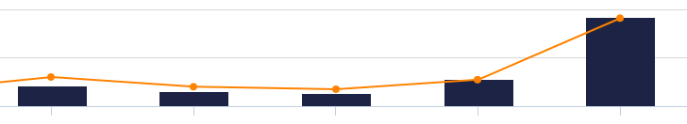
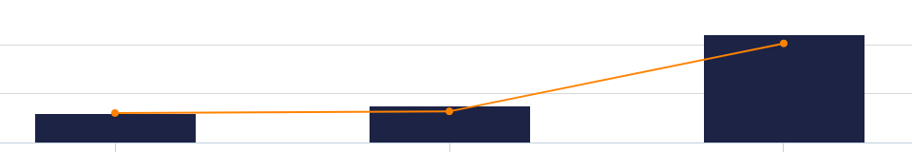
24. Up Frequency of Emails without Negative Churn — but Test First!
12/31/17
Three Emails
12/31/18
Five Emails
Revenue 220% Increase
Unsubscribe Rate: No Significant Change

Slide 26
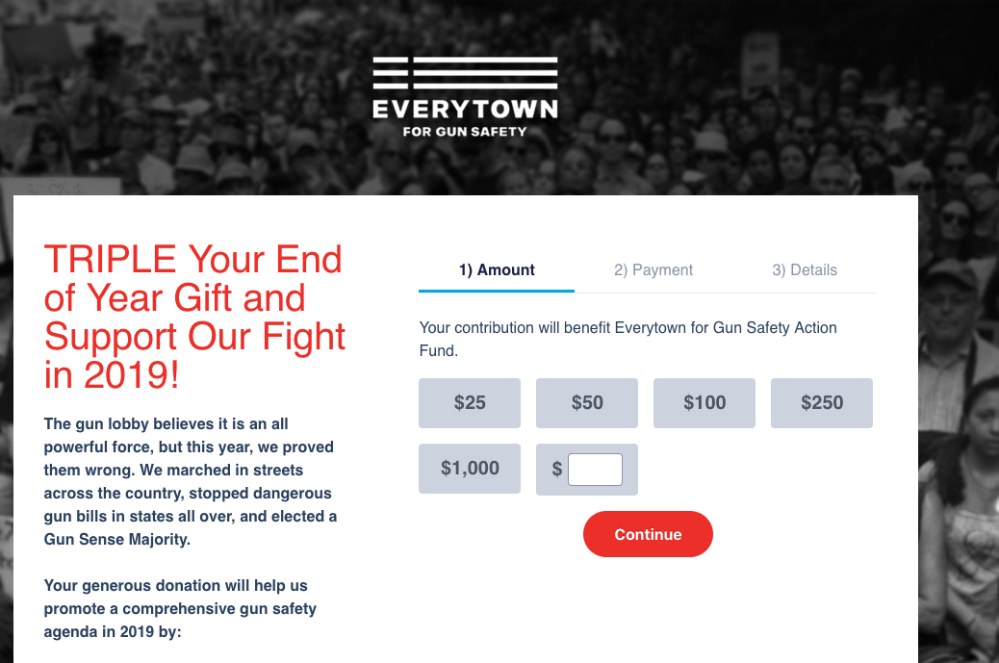
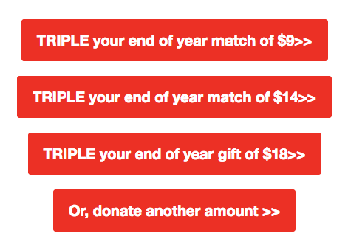
25. Use a Match at Year-End
Notes:
Triple Match used with End of Year Campaign on Dec 31

Slide 27
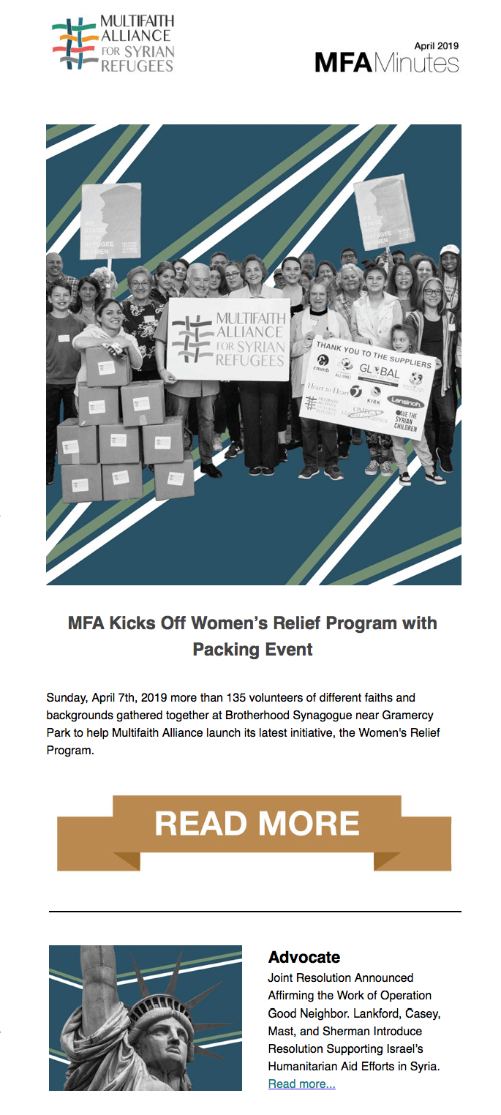

26. Use Color Animations to Grab Attention
Notes:
Triple Match used with End of Year Campaign on Dec 31

Slide 28

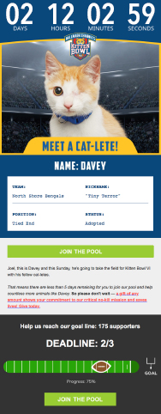
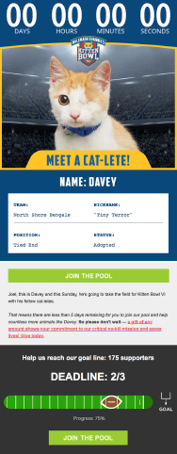

27. Countdown to the Super Bowl (Go Pats! I Mean Cats!)

Slide 29



28. Engage Donors by Inviting Them to Play a Game

Slide 30

29. Ask Donors to Auto-Renew Their Gift on Your Landing Page
Notes:
Following slide is about the "Stack of CTA buttons with options for donation amount" item. Talking about testing and implementation.

Slide 31

30. Partner with For-Profit Companies to Increase Your Donor Pool

Slide 32


31. Let Donors Know Their Opinions Matter!
Vote for your favorite photo!

Slide 33


32. Live Polling — Which T-Shirt Do You Like Best?

Slide 34
33. Invite Donors to Choose Their Membership Card

Slide 35



34. Tie-In Appeals with National Holidays — and Share the Love

Slide 36

35. Or, Create Your Own Holiday

Slide 37


36. Don’t Forget to Say “Thank You!”

Slide 38

QUESTIONS?
?
?
?
Questions?

Slide 39
CONTACT INFORMATION:
Anne Kottler, Sage Communications
anne@sagecommunications.com
anne-kottler
Matt Reese, Everytown for Gun Safety
mreese@everytown.org
#DMAWDigitalDay

