Slide 1




Slide 2
Today's Agenda
  Welcome: Van Wert Chamber update and FY 2024 Safety Council update
  Dayna Noble, BWC Update
  Featuring speaker Rick Skilliter, Executive Director of Prevention Awareness Support Services, (PASS), a support program available to area businesses.

Slide 3



YP
OF vAN wERT cOUNTY
YOUNG PROFESSIONALS
EVENTS
Upcoming
SEP
CHAMBER LUNCH AND LEARN
SEP
Ribbon Cutting & Open House
12:00PM-1:00PM
11:00am-1:00pm
27
15
Superior Credit Union
OHIOHEALTH NORTH
DEC
SALUTE TO SMALL
1
BUSINESS LUNCHEON
11:00AM - 12:30PM
WILLOW BEND COUNTRY CLUB

Slide 4


Slide 5


Slide 6


Slide 7


Slide 8
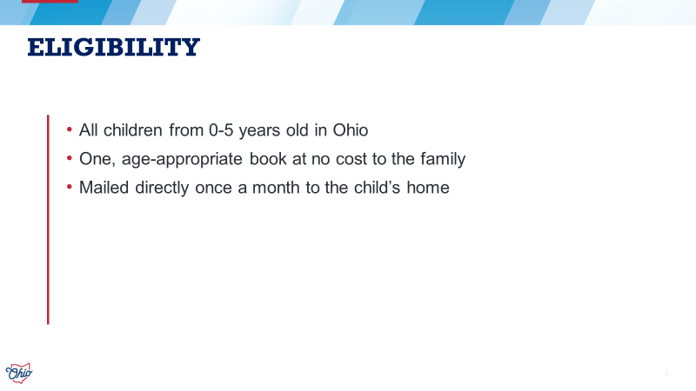

Slide 9


Slide 10
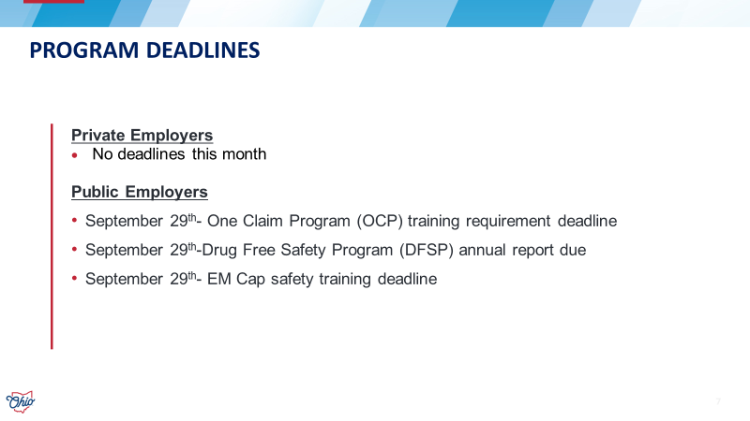

Slide 11


Slide 12


Slide 13


Slide 14


Slide 15


Slide 16


Slide 17




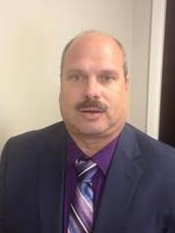





Rick Skilliter is a retired police chief, and continues to serve the Bluffton community as a volunteer firefighter and the assistant EMS chief. His life-long dedication to helping others led him to his second (or third or fourth) career as the executive director of Prevention Awareness Support Services (PASS). His passion of providing peer support response and services has blossomed to where the Critical Incident Stress Management team, of 165 volunteers, provides initial response and stabilization to emotionally charged incidents throughout west central Ohio.
Rick Skilliter

Slide 18


Slide 19


Slide 20
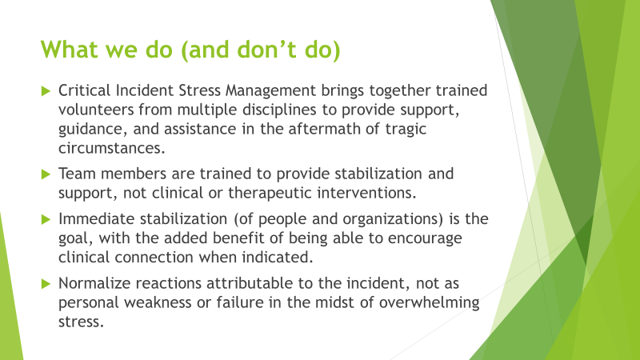

Slide 21


Slide 22


Slide 23


Slide 24


Slide 25
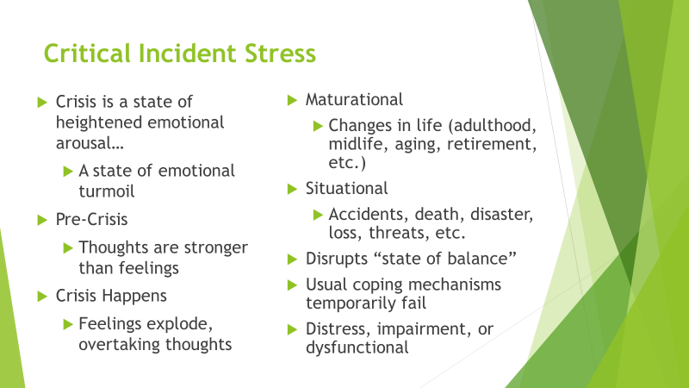

Slide 26


Slide 27


Slide 28


Slide 29


Slide 30


Slide 31


Slide 32


