Slide 1
Selling in Uncertain Times
Presented by Sandler Training
Al Simon

Slide 2
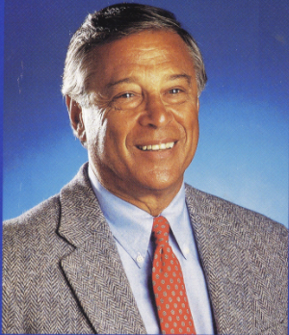
A little about
Sandler Training ®
Notes:
About David H Sandler
About Sandler Training Worldwide
About Yourself as the Trainer

Slide 3
Chat: What is one thing you are struggling with right now?
Notes:
Type your answers in the chat area…

Slide 4
All Crisis Is Temporary
Notes:
Fight – Flight – Freeze: Where are you?
Many (your competitors) will or may use this time as an excuse to stop, decrease production, lower momentum
It is tempting to stay in your comfort zone
Understand that your sales cycle will become longer
Successful people will find a way
These graphs are from 2001 and 2009… We will bounce back and make it through.

Slide 5
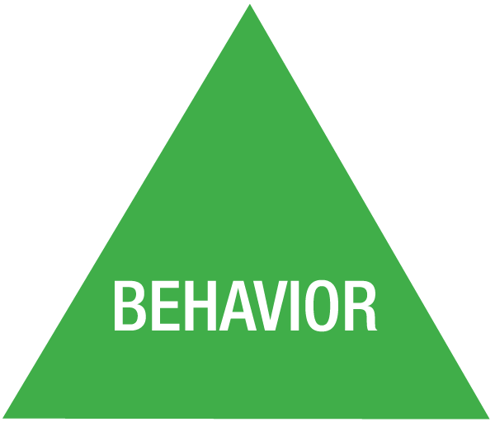
Sandler Success Triangle
SUCCESS
Notes:
Attitude – Philosophy – Beliefs - WHY
Behavior – Strategy – Plans & Goals - WHAT
Technique – Skill – Personal Presence – HOW
Connecting These three creates MOMENTUM positively or negatively depending on you’re your outlook…

Slide 6
B.A.T. - You Now Have Time …
It’s a time to learn … new Techniques
It’s a time to work on your Attitudes
It’s a time to CHANGE your Behaviors
PLAN
Notes:
Outpace the competition – they are goofing-off watching Netflix
Read – Listen – Try – SOL & ‘My Sandler’ – Certification

Slide 7
How Do You Feel About Your…
Personal Presence
Prospecting
Pipeline
Performance
Notes:
Are you sitting at home reading the news or rebuilding your pipeline?

Slide 8
Expand our Comfort Zones
Leaders, help your people through the change curve – flatter and faster
Challenges are good – they are breeding grounds for growth
Empathy goes a long way in times of crisis

Slide 9
Attitude: Getting our Mindsets Right
Those with the right mindset thrive – those without, cave
Be a beacon of calm – hope – confidence – GRATITUDE
Fear and Anxiety are damaging
Notes:
Don’t freeze
Antidote = swift action – establish a new agenda – control what you choose – confront the new real

Slide 10
Elements of the Ideal Attitude
Commitment
Desire
Outlook
Responsibility
Notes:
Commitment is the link between Attitude and behavior. It is what turns dreams into goals and thoughts into actions.
Desire is the motivation to do whatever it takes to succeed. If there is a will, there is a way.
Outlook is belief of possibility and abundance that allows you to see opportunities to win.
Responsibility is the key owning what you can control, and not allowing yourself to externalize the problem or make excuses.

Slide 11
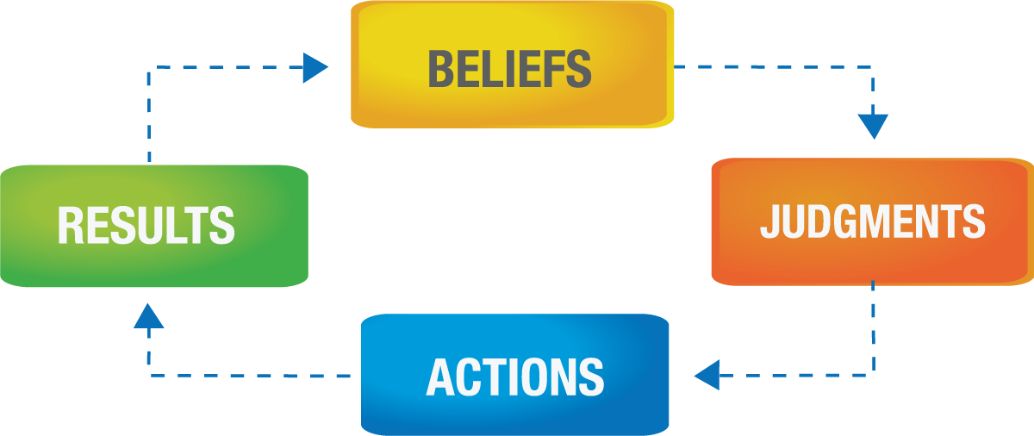
Changing Attitudes
Notes:
This is a self-fulfilling prophecy.

Slide 12
Chat: How has your selling behavior changed as a result of COVID-19?
Notes:
Type your answers in the chat area…

Slide 13
Sandler Rules:
You can’t manage anything you can’t control.
Never manage your numbers; manage your behavior.
Notes:
CONSISTENCY is what connects your Behavior to Technique in the Success Triangle.

Slide 14
Revising Behaviors
Pressing Pause
Networking Events
In-Person Calls
Travel
Event Marketing
Lunch Meetings
New Behaviors
Video Conferencing
Social Selling
Cold Calling & Cold Emailing
Thought Leadership
Webinars & Online Events
Client Relationships
Notes:
You must adjust to the change.
The good news is that you can behave your way out of a funk.
There are ways to keep your business going. How quickly can you adjust?

Slide 15
Develop SMARTER Goals
Specific
Measurable
Attainable
Relevant
Time-Bound
Enjoyable
Rewarding
Notes:
Behaviors include your goals, plans and actions.
Have you taken the time to reevaluate your priorities?
Have reset your goals and daily actions needed to hit them?
Do you have the discipline, vitality, and guts to succeed in this uncertainty?

Slide 17
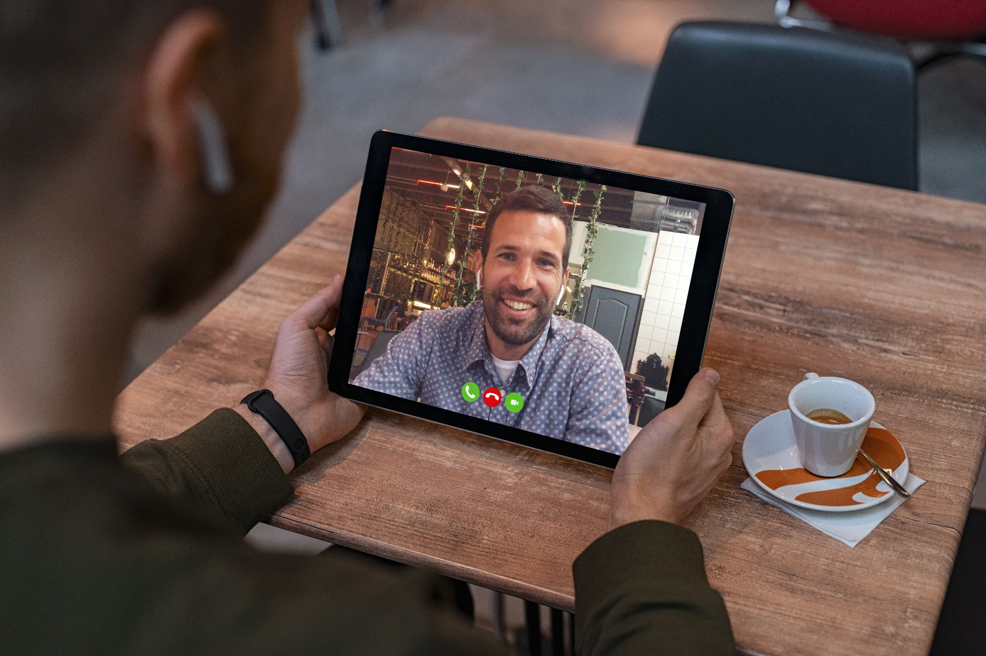
Developing Your Technique
Notes:
Learn how to do video conferencing, get comfortable on the phone, work from home, maintaining your health and work/life balance… HINT: Look at the picture. The guy on the tablet looks great. The person holding it is shooting the camera up his nose!
Current conditions are perfect for learning, practicing, and role-playing with your team to develop yourself to succeed when you get the chance.
RESULTS are what link Technique to Attitude… Be sure you only allow a POSITIVE link!

Slide 18
Chat: What are some sales skills that are more important today?
Notes:
Type your answers in the chat area…
New UFCs, New Pains, and new questioning strategies
Staying on the right side of the Trouble Line. – NEW DISTRACTIONS

Slide 19
Add to the Pipeline
Retention funnel – opportunities with existing accounts
Which clients do you want to keep?
How can you expand the business they currently do with you?
Which clients are you OK with losing?

Slide 20
Modify Your Connect Questions
Industry
Marketplace
Company
Buyer
Notes:
How is this situation affecting you?
Your company, your city, your industry?

Slide 21
Four Buying Emotions
Pain in the
Present
Gain in the Present
Pain in the Future
Gain in the Future
AKA “Fear”
Notes:
You may need to change your 30-second commercial, pain indicator questions, and sales pitches to fit a new reality and changing motivations.

Slide 22
Are you setting solid Expectations?
On All Phone Calls
At the Beginning and End of Every Virtual Meeting
In All Emails & Calendar Invites
When You Close a Sale!
Notes:
Confirm expectations and make sure nothing has changed since last communication.

Slide 23
Technique: Practice, Drill and Rehearse
The prospects will exhibit more excuses, stalls and objections. This is normal and can be expected.
Previous sales tactics may no longer work.
Practice the new talking points and questioning strategies so you are fully prepared. Opportunities will be fewer – don’t waste them!

Slide 24
Simon Says…
Tactics!
Would you like our weekly emailed sales tip?
Al.Simon@sandler.com

Slide 25
Thank You For Attending!
Over 300 Sales & Leadership Podcasts
Dozens of White Papers and Webinars
Exclusive Videos & Course Samples
Sandler Advisor Newsletters
And Much More!
Get OUR Free Resources at WWW.SIMONINC.sandler.com/sell
©2020 Sandler Systems, Inc. All rights reserved. S Sandler Training (with design) and Sandler are registered service marks of Sandler Systems, Inc
Notes:
Our way of helping. Get all the resources you need to succeed free for 1-year!

