Slide 1
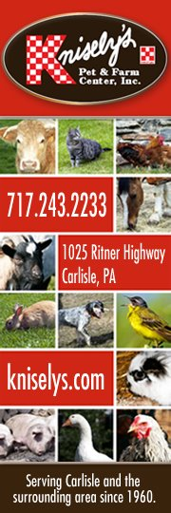
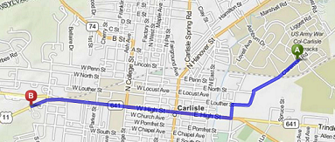
Welcome U.S. Army War College Families!
Knisely’s Pet & Farm Center and the Knisely Family warmly welcome you to Carlisle! We know that service members travel all around the world during the terms of their service to this great nation; we also know how important it is during your travels to be able to continue to provide your pet with the same high quality diet they are used to; that’s why we offer a wide selection of pet foods and supplies, both in stock and special order! Here at Knisely’s, your pets are as important to us as they are to you! Knisely’s isn’t JUST a pet store – We also have a large selection of Wild Bird Food, Feeders and Houses, as well as Lawn & Garden Supplies, Keystone Candles, Country Crafts, Iron Lawn Decorations, and many other items locally made right here in the Cumberland Valley!
Knisely’s Pet & Farm Center – Knowledge and Experience you can Trust, from Our Family to Yours!
Dog & Cat Brands
Over 20 Brands of Cat Food & 30 Brands of Dog Food In-Stock, with multiple varieties for each brand! If its not on the shelf, we can get it for you! Special Orders welcome with no additional fee!
Seasonal Products
Hanging Baskets, Planters, Vegetable Plants and Seeds, Annuals, Perennials, Herbs, Soil, Mulch, Straw, Grass Seed, Lawn & Garden Supplies, Solar Salt, Ice Melt, Pond Supplies, Indoor Furniture, Outdoor Wooden & Poly Furniture, and much more!
No Truck? No Problem! We Deliver! *^{Delivery} ^{Fee May Apply}
5
FREE
ANY PURCHASE OF $40 OR MORE!
$
00
OFF
Claremont
26 OZ. KEYSTONE JAR CANDLE
High St
Excludes Pet Foods, Sale Items, In-store Promotions, horse wormer, & delivery fees. Expires 12/31/2020
NO PURCHASE NECESSARY! Not applicable to prior purchases. Limited to Stock on hand. Expires 12/31/20
1025 Ritner Hwy

