Slide 1

Military Custody & Visitation
Sullivan & Tanner, P.A.
Raleigh, North Carolina

Slide 2

Tales from the Trenches
“An unknown number of the 140,000-plus single parents in uniform fight a war on two fronts – for the nation they are sworn to defend, and for the children they are losing because of that duty.”

Slide 3
Initial Enlistment
Single parents enlisting?

Slide 4
Single-Parent Enlistment
Q. My new client is Jane Doe. She is single, has two children, and was never married to the father, Louie Jones. Jane was referred by a local recruiter and she wants to enlist. She was told by someone that she has to give away her kids to get into the armed forces, and her plan is to give them to her mom in San Diego. What do I need to know?

Slide 5
The Issue:
DoD Instruction 1304.26: The Military Services may not enlist… unmarried individuals with custody of any dependents under the age of 18 [without a waiver]

Slide 6
The Regulations!
Army – AR (Army Regulation) 601-210;
Navy – COMNAVCRUITCOMINST (Navy Recruiting Manual – Enlisted) 1130.8F;
Air Force – AFRS (Air Force Recruiting Service) Instruction 36-2001;
Marine Corps – Marine Corps Order P 1100.72C, Chapter 3, Section 2; and
Coast Guard – COMDTINST (Commandant Instruction) M1100.2E.
The legal authority which applies throughout the Department of Defense is DoD (Department of Defense) Instruction 1304.26.

Slide 7

Solutions…
Custody Order
  NOT Power of Attorney
  NOT temporary
  NOT based solely on enlistment
What about Joint Custody?
What about Guardianship?

Slide 8

The Custody Order
Primary custody & Secondary Custody
  “Reasonable Visitation”
  Every other weekend (one overnight per week?)
  One long weekend per month
Joint/Shared Custody (50/50)
  Week on / Week Off
  2-2-3
Summer Visitation
  Each party gets 3 weeks
  Split
Holiday Visitation (Alternating)
  Mothers/Fathers Day
  Birthdays

Slide 9

Details, Details, Details…
Legal Custody/Decision Making
Exchanges
  Time
  Location
Right of First Refusal
Travel
Communication
Access to Information
Notice of Move

Slide 10
Let’s go to court!
Becoming involved in a lawsuit is like “being ground to bits in a slow mill; it’s being drowned by drops; it’s going mad by grains. Hundreds of thousands of people are exposed to such torture each year, some of them actually choosing to initiate the process. They invariably find the experience painful, protracted and expensive. When it has run its course, they often realize that it was futile. Yet there remains a queue of victims impatient for their turn....”
--Charles Dickens

Slide 11

Court Action
Advantages
  Get it off your chest!
  No back and forth
  Enforcement by contempt
  Difficult to change
Disadvantages
  Risk
  Bad blood
  $$$$$$$
  Difficult to change

Slide 12

The Voice of the Child

Slide 13
Custody Mediation

Slide 14
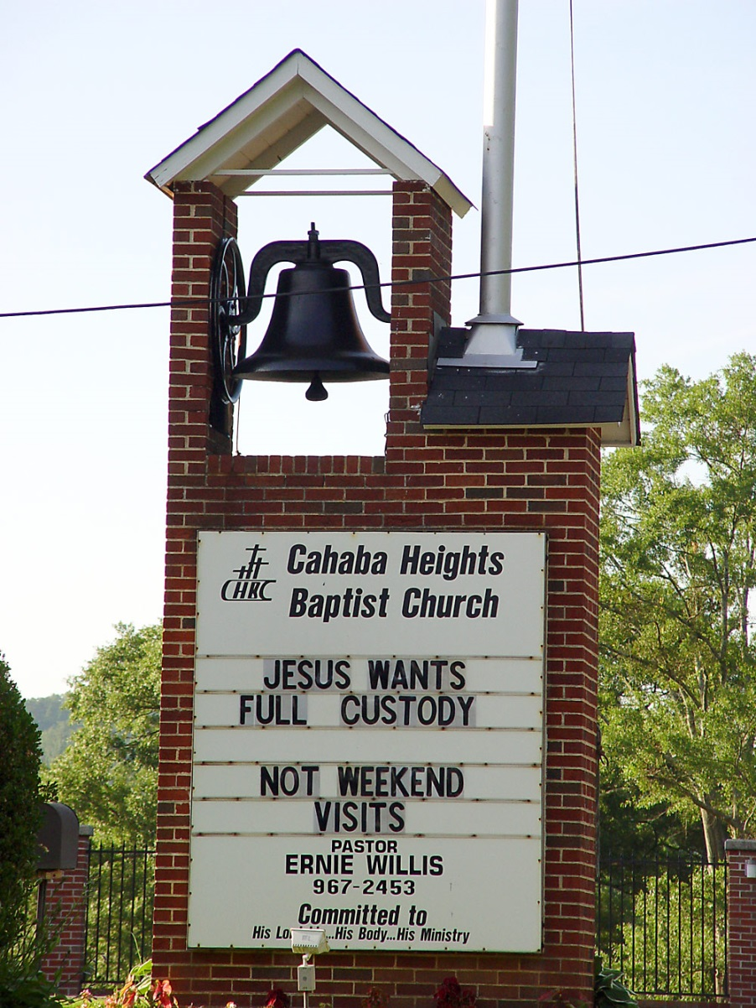
When it’s not working…
Document, Document, Document
Self-Help
Court Order v. Separation Agreement
  Contempt
  Breach
Modification
Parenting Coordinator

Slide 15
Factors for Custody Modification
Since the last custody order...
  Change of circumstances
  Substantial
  Unforeseeable
  Having an impact on child’s welfare
  Impact is adverse, harmful OR beneficial
  So as to require change of custody

Slide 16
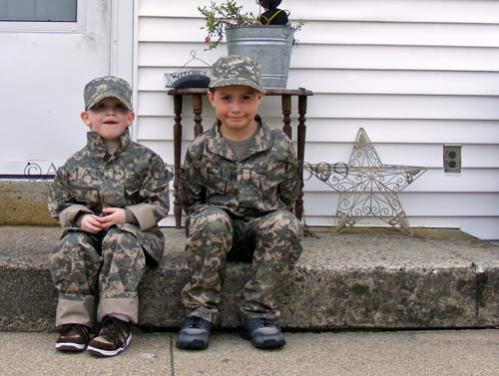
Factors for Custody Modification
OBJECTIVE AND VERIFIABLE
  Health
  Education
  Welfare

Slide 17
Custody After Initial Enlistment
Can a military parent gain custody?

Slide 18
Mich. Comp. Laws Ann. § 722.27
    (1)(c) If a motion for change of custody is filed while a parent is active duty, the court shall not consider a parent’s absence due to that active duty status in a best interest of the child determination.
    (3) … The parent’s duration of deployment shall not be considered in making a best interest of the child determination.
    (4) … Future deployments shall not be considered in making a best interest of the child determination.

Slide 19
MILITARY FACTORS
IRREGULAR CHILD CARE SCHEDULES
“FULL-TIME DUTY”
MOBILIZATIONS/TDY
DEPLOYMENTS
PCS MOVES

Slide 20
MILITARY FACTORS
IRREGULAR CH. CARE SCHEDULES, “FULL-TIME DUTY,” PCS MOVES, ALERTS, DEPLOYMENTS -vs.-
QUALITY OF SCHOOLS ON BASE
RECREATIONAL FACILITIES
DEPENDENT YOUTH ACTIVITIES
DAY CARE FACILITIES
TRAVEL TO OTHER STATES & COUNTRIES -- “ENRICHMENT”

Slide 21
Custody & the Military
Family Care Plan… for those with dependent children
  Designated caregiver
  POA
Intended to cover absence due to
  Deployment
  Mobilization (for Guard/Reserve)
  TDY

Slide 22
Custody & the Military
FCP isn’t a court order
Giving custody to a non-parent -
…when the other parent is not disqualified
  Abandonment
  Abuse
  Neglect
  Other “unfit” conduct
…or hasn’t relinquished custody or waived rights

Slide 23

Preventive Approach
Initial Custody Order should contain:
  PLAN A [“NOW” option]
  PLAN B [if deployment…]

Slide 24
Preventive Approach
Initial Custody Order should contain:
  PLAN A [“NOW” option]
  PLAN B [if deployment…]
Prompt Notice re Deployment
Prompt Notice re Address Change

Slide 25
Preventive Approach
Initial Custody Order should contain:
  PLAN A [“NOW” option]
  PLAN B [if deployment…]
Reasonable Access via Phone, Internet
Access during Mid-Tour Leave

Slide 26
Preventive Approach
Initial Custody Order should contain:
  PLAN A [“garrison” option]
  PLAN B [if deployment…]
Prompt Return at End of Deployment

Slide 27
Clauses to Consider
Since Jane Doe is a member of the U.S. Navy and may be deployed in the future on an unaccompanied tour (that is, an assignment where family members are not allowed), her former husband, John Doe, is hereby designated alternate custodian of Jack Doe, the minor child of the parties, in such an event. He shall hold and exercise all the rights and responsibilities of a custodial parent during such a deployment and shall promptly return the child to Jane Doe at the deployment’s end.

Slide 28
Clauses to Consider
If John Doe is unwilling or unable to serve as alternate custodian, Felicia Doe, the mother of Jane Doe, may apply to this court for appointment as secondary alternate custodian of Jack Doe. The parties herein, Jane and John Doe, hereby stipulate that Felicia Doe is a fit and proper person to accept the role of secondary alternate custodian.

Slide 29
Typical Scenario
Jane Doe prepares her FCP
Does not refer to the dad
She receives orders
  Deployment
  Mobilization for Guard/Reserve
  TDY
  Unaccompanied tour
She departs
Johnny left with her new husband
Johnny’s dad, John Doe, finds out!

Slide 30
Typical Scenario
WHAT HAPPENS NEXT?
Self-help
Dad gets a lawyer
Dad files in court for return of Johnny
Locating mom?
Service on mom?
Mom files for a stay of proceedings…

Slide 31
SCRA: THE BASICS
WHO?
  All active duty SMs and guard/reserve who care called to active duty for 30 days or more
WHEN?
  Passed 19 DEC 2003
WHY?
  Enable SMs to devote their entire energy to the defense needs of the Nation
WHAT?
  Protect against Default
  Stay of Proceedings

Slide 32
Stay of Proceedings
90 Day MANDATORY stay of proceedings if the SM files a proper request:
  A statement as to how the SM’s current military duties materially affect his or her ability to appear;
  A statement of a date when the SMwill be available to appear;
  A statement from the SM’s commanding officer that the SM’s current military duty prevents his or her appearance; and
  A statement that military leave is not authorized for the SM at the time of the statement.

Slide 33
Typical Scenario (cont’d)
When Johnny’s with dad – what next?
Child support –
  Locating mom
  Serving mom
  SCRA

Slide 34
Typical Scenario (cont’d)
Mom files for SCRA relief, asks for a stay
What’s the judge to do - - grant the stay???
  renders the whole case moot
  by the time the stay is lifted mom will be back home and the need for dad’s motion is gone…
Deny the stay, which violates federal law?

Slide 35
Diffin v. Towne, 787 N.Y.S. 2d 677 (Fam. Ct. 2004), aff’d, 47 A.D. 3d 988 (App. Div. 2008)
Mom awarded custody, FCP gives custody to new Husband, Mom deploys, dad files for custody
Mom files for a stay under SCRA arguing that the SCRA prevents the Judge from proceeding with temporary or permanent relief – thereby automatically vesting custody with new husband
Court sides with dad granting him temporary custody until mom’s return, citing grand court of equity: sword v. shield

Slide 36
Typical Scenario (cont’d)
Mom returns, asks for dad to return Johnny
Dad asks for “permanent custody”

Slide 37
Crouch v. Crouch, 201 S.W.3d 463 (Ky. 2006).
Mom granted custody in 1996
In 2003 Mom deploys and transfers custody by consent to Dad
Mom returns, Dad refuses to return child claiming the 2003 custody transfer was intended to be permanent
Appellate courts side with Mom, order was intended to be temporary …. 2 years and $50,000 later…

Slide 38
What If Other Parent Moves Away?
‘Bye, Mom! Me ‘n’ Dad are off to Fresno!

Slide 39
In re Marriage of Brandt, 268 P.3d 406 (Colo. 2012)
Mom has custody, lives in MD
Mom is deployed, sends child to live with Dad in CO pursuant to FCP
Dad files for custody in CO claiming neither parent nor child currently reside in MD
MD and CO Judges confer but cannot agree on jurisdiction
Appellate court in CO ultimately decides Mom’s temporary absence due to military orders doesn’t divest MD of jurisdiction

Slide 40
Clauses to Consider
Since Jane Doe is a member of the U.S. Navy and is being deployed to Iceland in the near future, the parties desire to establish an orderly temporary transfer of custody of Jack Doe, their minor child, during the term of the deployment. He shall hold and exercise all the rights and responsibilities of a custodial parent during such a deployment and shall promptly return the child to Jane Doe at the deployment’s end. The parties hereby stipulate that North Carolina is the ‘home state’ of Jack Doe, pursuant to the Uniform Child Custody Jurisdiction and Enforcement Act, and the Parental Kidnapping Prevention Act. This transfer of custody is a temporary arrangement only. It is not a change of home state for the child. The parties further stipulate that all aspects of the child’s living situation (e.g., residence, environment, living situation and education) in North Carolina are suitable and appropriate for the child.

Slide 41
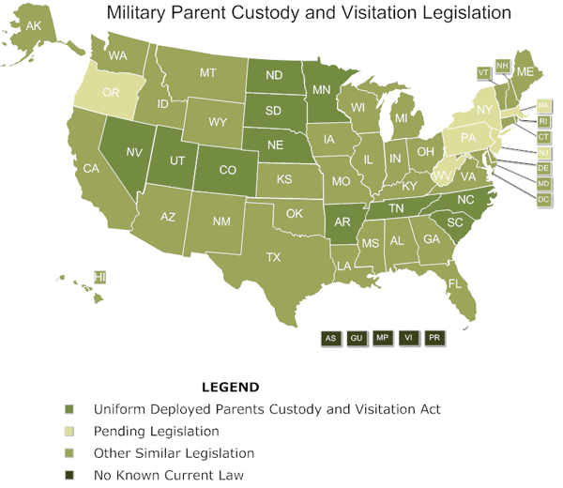

Slide 42
Mich. Comp. Laws Ann. § 722.27
(5) If the deploying parent and the other parent share custody, the deploying parent must notify the other parent of an upcoming deployment within a reasonable period of time.

Slide 43
Mich. Comp. Laws Ann. § 722.27
If a motion for change of custody is filed during the time a parent is on deployment, a parent may file and the court shall entertain an application for stay.
Any time before a final judgment
Initial Stay or Extension of a Stay
Parent and custodial child are not required to be present
Must be signed, written, certified

Slide 44
Mich. Comp. Laws Ann. § 722.27
The court shall not enter an order modifying or amending a previous judgment or order, or issue a new order that changes the child’s placement that existed on the date the parent was called to deployment, except that the court may enter a temporary custody order if there is clear and convincing evidence that it is in the best interest of the child.
The court may include a limit on the period of time that the temporary custody order remains in effect

Slide 45
Mich. Comp. Laws Ann. § 722.27
The parent shall inform the court of the deployment end date before or within 30 days after the deployment end date
The Court shall reinstate the custody order in effect immediately preceding the period of deployment
If a motion for change of custody is filed after a parent returns from deployment, the court:
  Shall not consider the absence due to deployment
  Shall not consider future deployments

Slide 46

Help is never far away…
Notes:
Help is never far away.
THANK YOU.

