Slide 1
COVID-19 Municipal Call
5-21-20

Slide 2
COVID-19 Municipal Call
Case Update
197 as of 5-20-20, 3 hospitalizations, 171 completed isolation, 2 deaths
Testing Sites
SLHS 315-261-6420
CLAXTON 315-713-6655
CLIFTON FINE 315-848-8049
Data
Reopening – forward.ny.gov
EOC Update
Notes:
187 as of 5-6-20, 3 hospitalizations, 135 completed isolation, 2 deaths

Slide 4
Weekly Cases

Slide 5
Cases by Age (as of 5-18-20)

Slide 6
Hospitalizations

Slide 7
May 2020 Testing

Slide 8
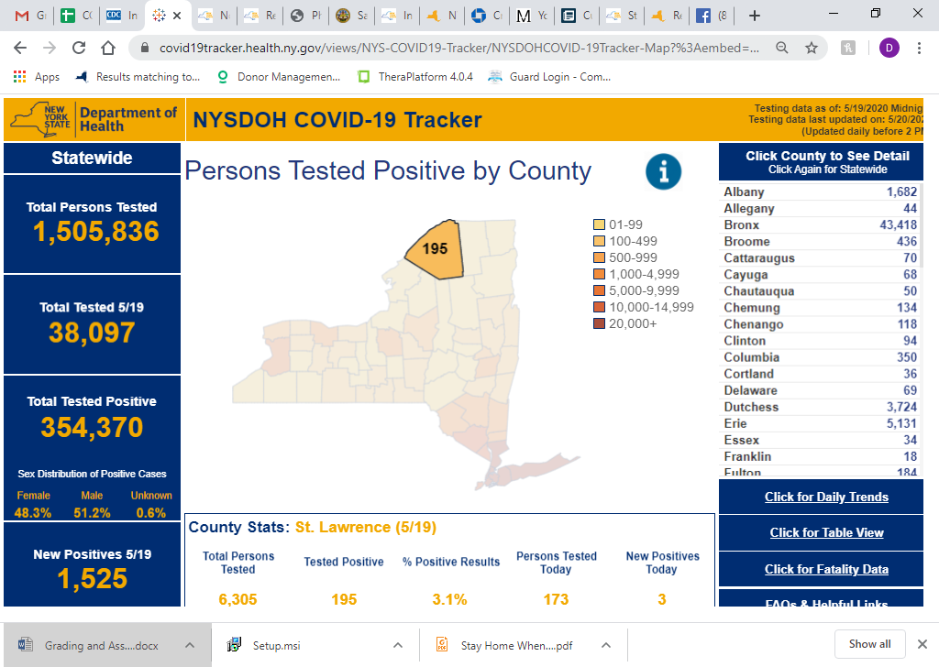
https://covid19tracker.health.ny.gov/views/NYS-COVID19-Tracker/NYSDOHCOVID-19Tracker-Map?%3Aembed=yes&%3Atoolbar=no&%3Atabs=n
Notes:
3724 test last week

Slide 9
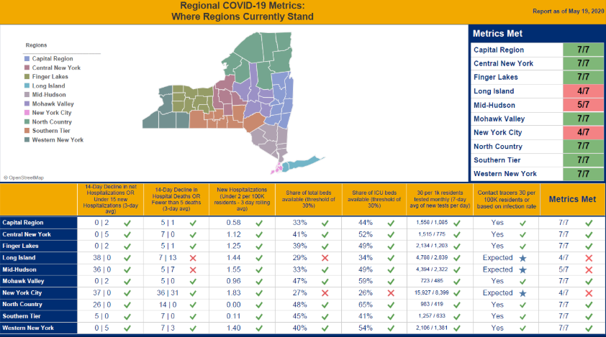

Slide 10
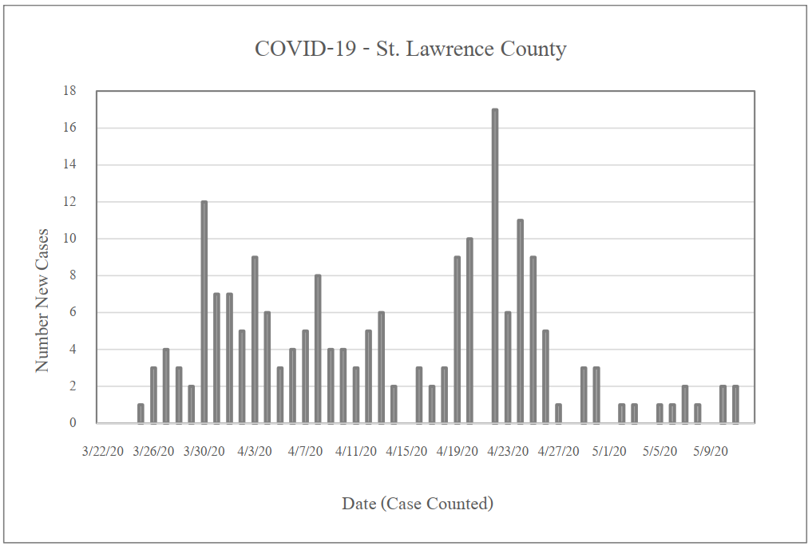
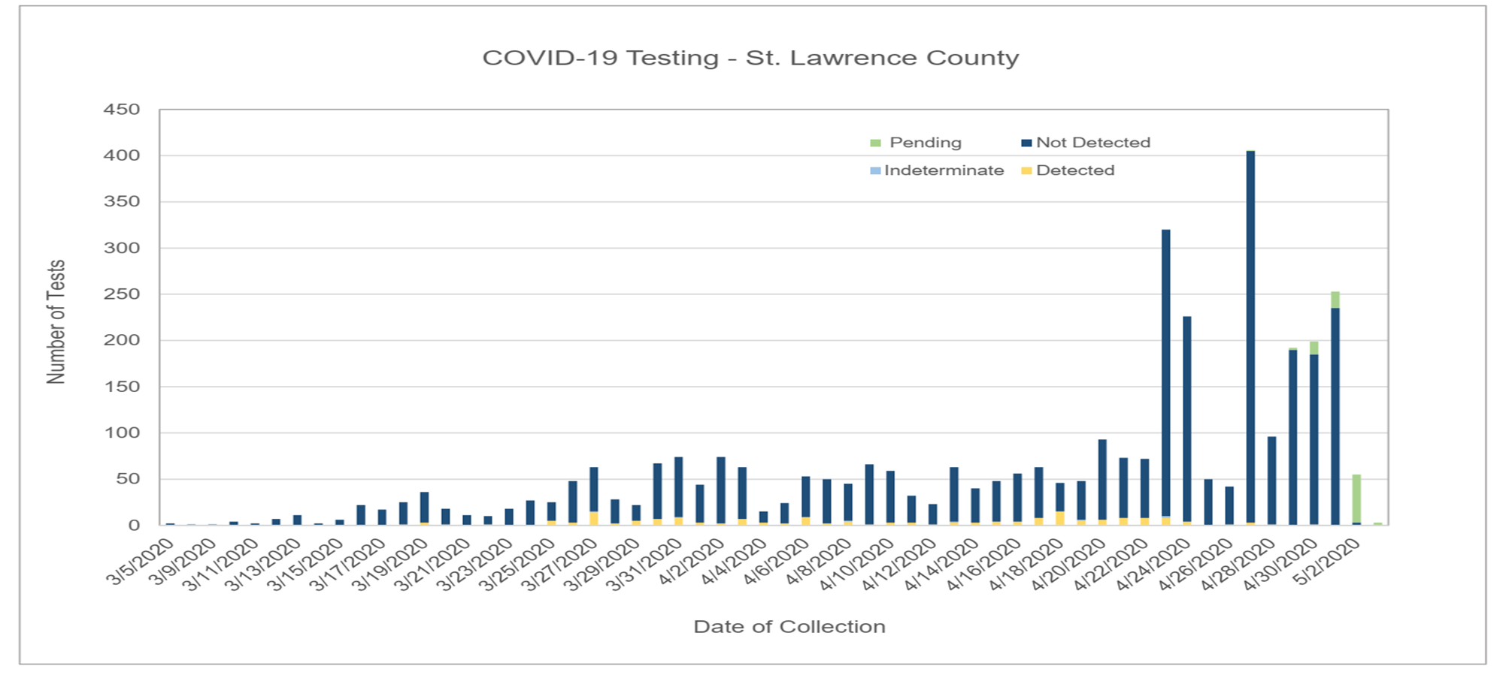
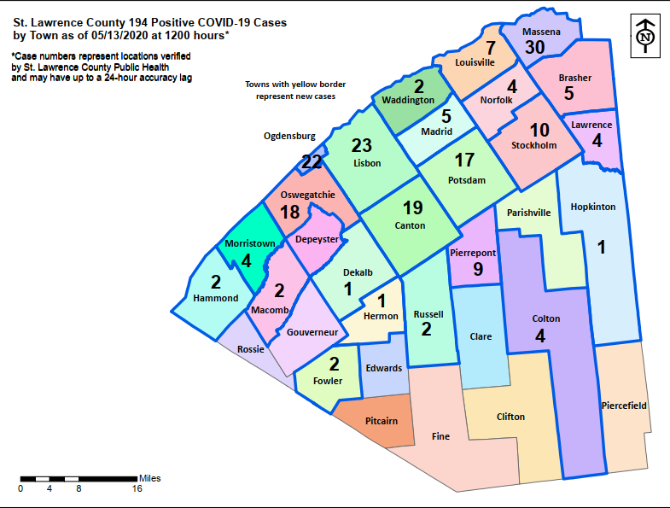
ST. LAWRENCE COUNTY COVID-19 DASHBOARD
May 14, 2020 Update

Slide 11
COVID-19 Resources
Reopening Guidance
NYS Forward Reopening Guide
Business Plan Rubric
NYS Forward Website
Guidance for Businesses and Employers
How to Protect Yourselves and Others
Stay Home When Sick
Hand Hygiene
New York State Dashboard
COVID-19 Tracker (Cases & Testing)
Regional Monitoring Dashboard
Testing Information & Interpretation
Testing Information
Interpreting COVID-19 Test Results
Statewide Antibody Testing FAQ’s
Cleaning Guidance for Businesses
Cleaning & Disinfecting Guidance – CDC
Cleaning & Disinfection Decision Tool – CDC
Houses of Worship
Public & Private Facilities
Schools
Food Manufacturing & Retail
Non-Healthcare Settings
Public Transportation
Retail Stores
DEC List of Cleaning Products
St. Lawrence County COVID-19 Testing Sites (Please CALL Ahead)
St. Lawrence Health System 315-261-6240
Claxton Hepburn Medical Center 315-713-6655
Clifton Fine Hospital 315-848-8049
Coronavirus Hotline & Help
NYS Hotline 1-888-364-3065
St. Lawrence County Public Health 315-386-2325
Ask a Question
File a Complaint (NYS PAUSE Violation)
Worker Protection Information
NYS Paid Sick Leave
Managing Stress & Anxiety
Face Mask Wearing & Guidance
Cloth Face Covering Information
How to Wear Cloth Face Coverings
Use of Cloth Face Coverings
Face Covering Do’s and Don’ts
Employers / Employees
General Public

Slide 12
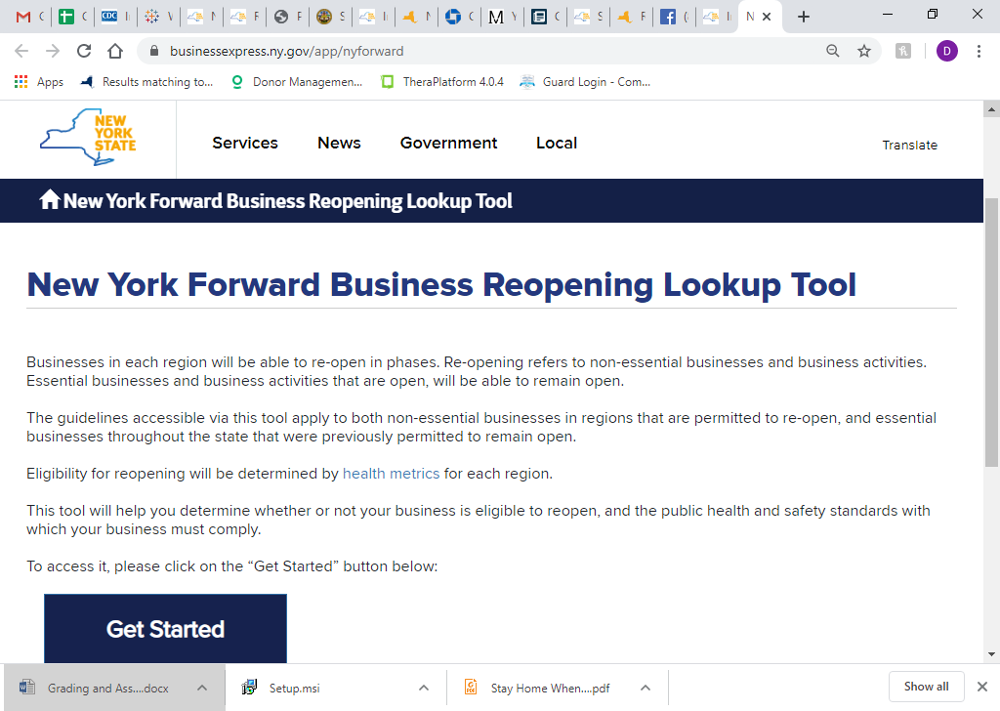
https://www.businessexpress.ny.gov/app/nyforward

Slide 13
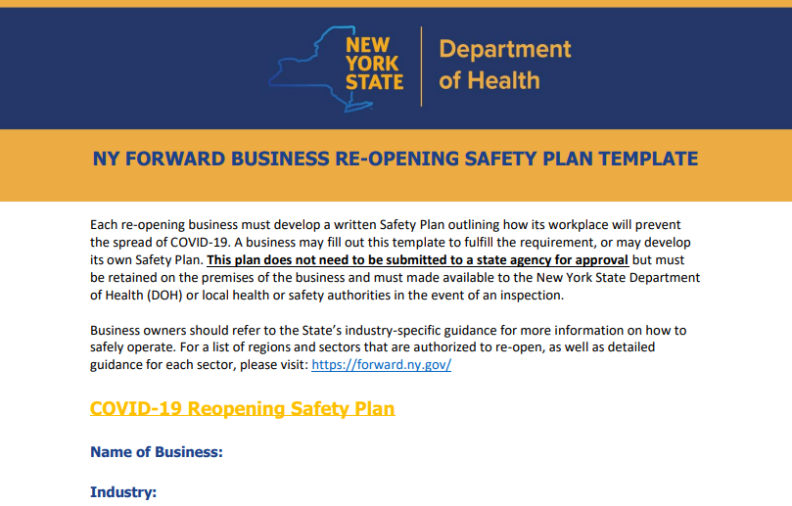

Slide 14
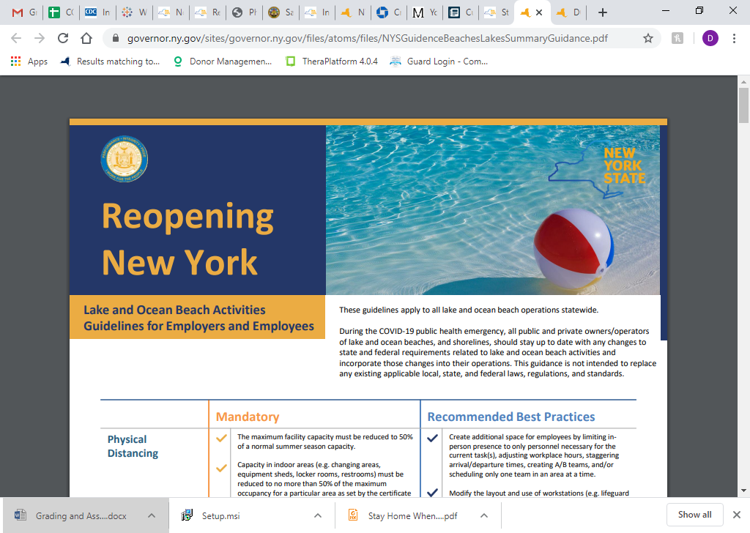

Slide 15
St. Lawrence County Public Health Department

Slide 16
Reopening Resources

Slide 17
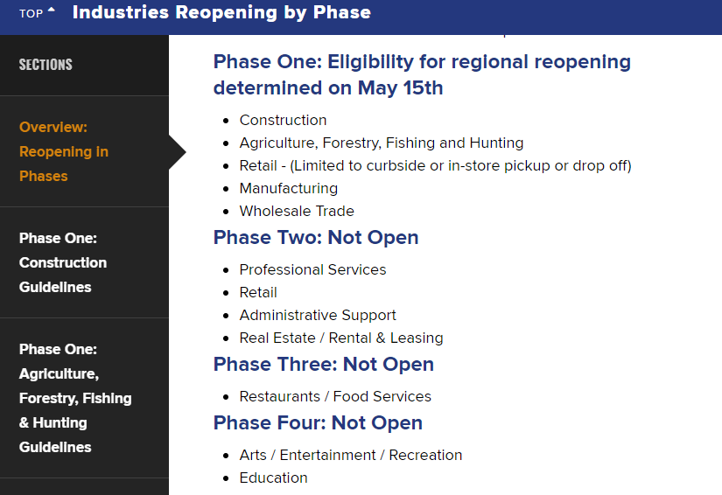

Slide 18
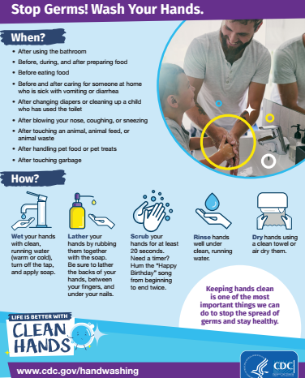
Reopening Resources

