Slide 1
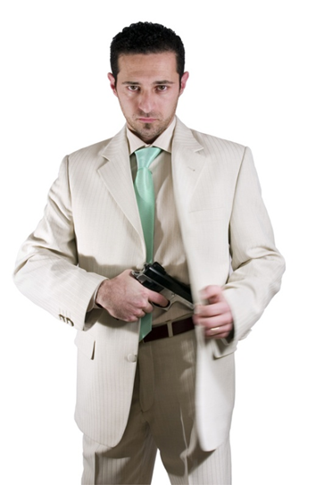
How Much Security is Enough? Active Shooter & Workplace Violence Prevention Training
By:
Dr. Scott Hill, CPP, CHPA
August 30, 2023
Lawrence County Safety
Council

Slide 2
Pinelake Health and Rehabilitation Center
On March 29 , at 10:00 a.m., Robert 45, armed with a handgun, a shotgun, and a rifle, began shooting in the Pinelake Health and Rehabilitation Center in Carthage, North Carolina, where his estranged wife worked. He did not find her. Eight people were killed; three were wounded, including one police officer. The shooter was apprehended after being wounded during an exchange of gunfire with police.

Slide 3
2021- Denver CO
On December 27, 2021, between approximately 5:25 p.m. and 6:11 p.m., an identified male, 47, armed with a handgun and a rifle, began shooting at people at various locations in Denver and Lakewood, Colorado. Five people were killed (two employees); two people (including one law enforcement officer) were wounded. The shooter was killed by law enforcement after an exchange of gunfire at another location.

Slide 4
Activity
What patterns do you hear over and over again about active shooters?

Slide 5
Security
In what ways is your environment challenging?
What is Maslow’s Hierarchy of Needs, why is it important to understand in regards to Security?
A healthcare facility has a financial, moral, and _________ responsibility to provide security. What about a church, college, or another business?

Slide 6
Statistics
The average active-shooter incident lasts 12 minutes. Thirty-seven percent last less than 5 minutes.
http://www.fbi.gov/stats-services/publications/law-enforcement-bulletin/2013/May/active-shooter

Slide 7
Statistics
Overwhelmingly, the offender is a single shooter (98 percent), primarily male (97 percent). In 40 percent of the instances, they kill themselves.
2021 – 60/61 FBI Mass Shootings - Male 98%
http://www.fbi.gov/stats-services/publications/law-enforcement-bulletin/2013/May/active-shooter

Slide 8
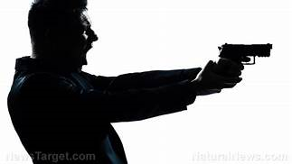
Discussion
Why is there almost always one male shooter?

Slide 9
U.S. Mass Shootings
2017- 348
2018- 336
2019- 417
2020- 611
2021- 690
2022- 647
2023- 546 – as of today
http://www.gunviolencearchive.org/past-tolls and MassShootingTracker

Slide 10
FBI Active Shooters
2017 31
2018 30
2019 30
2020 40 (33% Increase)
2021 61 (52.5% Increase)
The FBI defines an active shooter as one or more individuals actively engaged in killing or attempting to kill people in a populated area. (Not included self-defense, gang violence, drug violence, domestic, etc…)
Source FBIfile:///C:/Users/10191252/Downloads/active-shooter-incidents-in-the-us-2021-052422.pdf

Slide 11
Deadliest Active Shooter Event:
58 killed - October 1, 2017 - In Las Vegas, 64-year-old Stephen of Mesquite, Nevada, rains gunfire on a crowd of 22,000 concertgoers from the 32nd floor of the Mandalay Bay Resort and Casino, killing 58 people and injuring almost 500. He had 47 firearms. Witnesses say the gunshots last between 10 and 15 minutes. Officers breach Paddock's hotel room to find him dead. Authorities believe Paddock killed himself and that he acted alone.

Slide 12
Emergencies
Are you prepared for emergencies?
What do you do in the event of a Fire?
HVA, Risk Assessment, or Security Survey, SVA

Slide 13
Statistics
Two percent of the shooters bring IEDs as an additional weapon.
In 10 percent of the cases, the shooter stops and walks away. In 20 percent of the cases, the shooter goes mobile, moving to another location.
Forty-three percent of the time, the crime is over before police arrive. In 57 percent of the shootings, an officer arrives while the shooting is still underway.
http://www.fbi.gov/stats-services/publications/law-enforcement-bulletin/2013/May/active-shooter

Slide 14
Statistics
The shooter often stops as soon as he hears or sees law enforcement, sometimes turning his anger or aggression on law enforcement.
Patrol officers are most likely responding alone or with a partner. When responding alone, 75 percent had to take action.
A third of those officers who enter the incident alone are shot by the intruder.
http://www.fbi.gov/stats-services/publications/law-enforcement-bulletin/2013/May/active-shooter

Slide 15
After incident is over now what?
What are some items that will need to be addressed after a active shooter incident?
Be proactive

Slide 16
Pathway to Violence
6. Attack
5. Breach
4. Preparation
3. Research &Planning
2. Ideation
1. Grievance
Calhoun and Weston, “Contemporary Threat Management” (2003)

Slide 17
Common Grievances
What are common grievances in the healthcare world today??
Other entities?

Slide 18
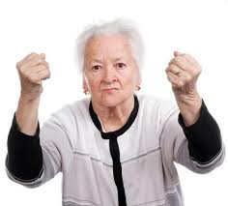
Common Motives
•Extreme anger
•Perception of being persecuted
•Paranoid ideation
•Depressed mood
•Antisocial and narcissistic traits
•Major loss related to employment or relationship
Hempel, A., Meloy, J., and Richards, T. Offender and offense characteristics of a nonrandom sample of mass murderers. J Am Acad Psychiatry and the Law, Vol. 27, No. 2., 1999.

Slide 19
Common Motives (continued)
•Externalization of blame
•Delusions/mental illness – persecutory beliefs, domination by others
Hempel, A., Meloy, J., and Richards, T. Offender and offense characteristics of a nonrandom sample of mass murderers. J Am Acad Psychiatry and the Law, Vol. 27, No. 2., 1999.

Slide 20
How much security is enough?
Remember 3 big words, R, A, and D!
Liability Issues and KRS

Slide 21
5 Elements to Prepare
Management Commitment and Cooperation
Policy/Procedure
Training
Drills
Response

Slide 22
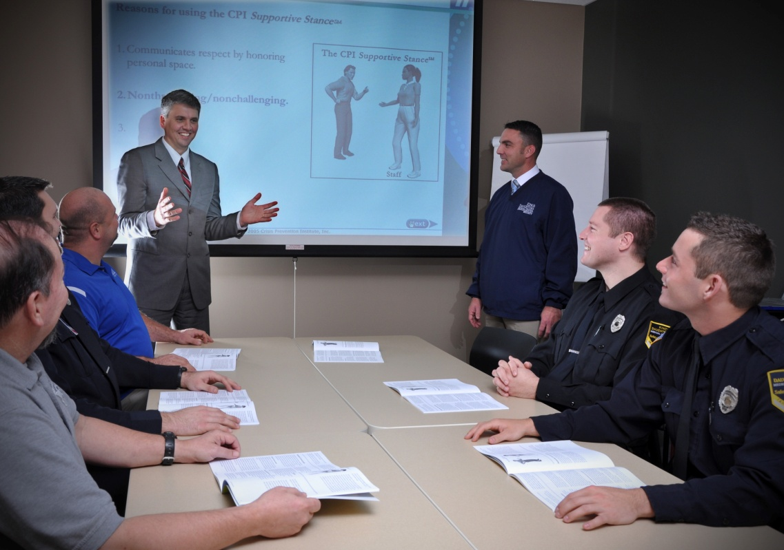
Training to Prevent
* Risk factors that can cause or contribute to threats and violence.
* De-escalation Training
* Early recognition of warning signs of problematic behavior.
* Where appropriate, ways of preventing or defusing volatile situations or aggressive behavior.
* Get off the X
http://www.fbi.gov/stats-services/publications/workplace-violence

Slide 23
FBI Pre-Attack Behaviors
77% spent a week planning their attack
Majority obtains firearms legally
Average shooter faced 3.6 stressors
25% Mental Disorder
Average shooter had 4 to 5 concerning behaviors over time that were observable. Behaviors related to mental health, problematic interpersonal interaction, and leakage of violent intent.
Only 41% of the time concerns were reported to LE, and 54% of the time nothing was done.

Slide 24
Secret Service January 2023
173 Incidents 2016-2020
Most of the attackers had exhibited behaviors that elicited concern, people were even afraid for self or others.
Many attackers had a history of physical aggression or intimidating behaviors, evidenced by prior violent criminal arrest/charges, domestic violence, or other acts of violence.
Half of the attackers were motivated by grievances perceived and was personal, domestic, or work related.
One-quarter of the attackers subscribed to a belief system involving conspiracies or hateful ideologies.
Many attackers experienced stressful events related to family/romantic relationships, personal issues, employment, and legal issues. Some had a specific triggering event.
Over half of the attackers experienced mental health symptoms prior to or at the time of their attacks, including depression, psychotic symptoms, and suicidal thoughts.

Slide 25
Training to Prevent (Continued)
De-escalation training (QTIP, Factors)
Times of Increased risk (Data)
Defensive Techniques
Escape Routes and positioning
Safe Room
Drills
http://www.fbi.gov/stats-services/publications/workplace-violence

Slide 26
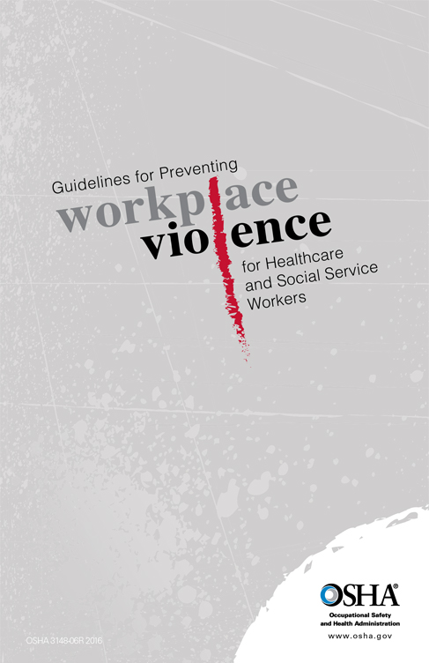
OSHA #3148
CPTED
Security Survey
De-Escalation

Slide 27
The Joint Commission
Sentinel Event Alert #59
25% of nurses reported being physically assaulted.
Healthcare workers are 4X’s more likely to be victimized than those in other industries.
75% of workplace assaults annually are in healthcare.
Only 30% of nurses report incidents of violence.
Why?

Slide 28
Conducting an active shooter drill
Table Top/controlled walk throughs or more realistic drill carefully planned.
Scenario – realistic but safe and appropriate
Follow IAHSS – recommendations/guidelines
Safety has to be first
Work with law enforcement (consider multiple responses)

Slide 29
Conducting an active shooter drill
Proper notification/signage
The Joint Commission and Evaluating
Consider appropriate location
Before, during, and after…….
Learn and get better!!

Slide 30
“Hospital, APD simulate active shooter situation”

Slide 31
What are the 4 A’s
???????????

Slide 32
Components of Training
Accept
Assess
Alert
Act
Source: DHS, Active Shooter How to Respond & Shots Fired for Healthcare

Slide 33
Components of Training
- Evacuating the area, help others as possible (Run)
- Hiding out, secure area, lights, blinds, silent (Hide)
- Acting against the shooter only as a last resort (Fight)
Secure, Preserve, Fight (Example)
Source: DHS, Active Shooter How to Respond & Shots Fired for Healthcare/https://www.campussafetymagazine.com/hospital/secure-preserve-fight-active-shooter/

Slide 34
Components of Training

Slide 35
Components of Training
Responding to Code…… and or Calling 911
Cooperating with law enforcement/show hands!
Adopting the survival mind set during times of crisis – Run, Hide, Fight, always help others whenever possible (Accept, Assess, Alert, Act)
Source: DHS, Active Shooter How to Respond & Shots Fired for Healthcare

Slide 36
“Security is incident driven, but it doesn’t have to be.”

Slide 37
Free Study Results
Iahssf.org – Research and publications
“Effective Controls on Emergency Department Violence.”

Slide 38
Stephen Covey Quote
“Be proactive instead of reactive, You make your own weather!”
“United We Stand Divided We Fall”
How does Latin Phrase “Esse Quam Videri” apply?

Slide 39
Questions
Dr. Scott Hill, CPP, CHPA
Scott.hill@kdmc.kdhs.us
606-408-0455
606.922.1746

