Slide 1
Enhancing Your Resume and Online Presence
Strategic Foundation and Understanding Behind-the-Scenes
Randi Rhone, CPRW Résumés by Randi, LLC 205-796-7496 www.resumesbyrandi.com www.linkedin.com/resumesbyrandi.com

Slide 2
https://youtu.be/pBu7y9ShGaU

Slide 3
Resume vs. Curriculum Vitae
Resume | Curriculum Vitae (CV)
Typical limit of 1-2 pages. | No length limit.
French meaning “to sum up”. | Latin for “course of life”.
Summarizes skills and experience. | Details entire course of career.
A Resume or CV is the main tool that compares and reveals how you stand out to others.

Slide 4
Three Types of Resumes
1. Chronological
Lists most recent position first
Company Name / What does company do / Title Responsibilities – Dates employed
Preferred by employers
Most common resume type
2. Functional
Focuses on skills and experience
Used by people changing careers or gaps in history
3. Combination
List skills and qualifications first, followed by work history.
Notes:
Just acknowledging 3 types
Today’s focus - chronological
Most people like this format best.
#1 Who are you? #2 Where are you?
Other formats put suspicion in mind of person reading – what are you trying to hide?
Gaps in employment are okay! Explain/ Communicate WHY
There are strategic ways to keep it chronological and avoid red flags if gaps or career transition.

Slide 5
How to Make a Resume Standout
Know Your Audience
Employer? Recruiter? HR Representative? (don’t understand acronyms)
< 30 seconds
Applicant Tracking System (don’t like graphics, acronyms)
You’re not the only person sharing your resume = 250 average per job
Target your resume
Keep it concise
Make it visually appealing
Notes:
Think about the number of resumes most companies receive ....
250 – average number resumes per job opening, 4-6 interviews
Resumes aren’t typically read like a book (left, right from beginning to end).
Know what your audience is looking for and give context for them to pick this up in a nanosecond.
You never know who on the other end is reading your resume.
Ladders job board study - hiring managers reported average time less than 2 minutes reading a resume, if resume makes it through 30-second scan.
Avoid the Wild and Crazy attention-getting resume – recruiters dislike them.
Things that are unusual attract attention – but if you don’t know how the reader will react, why run the risk of rejection unnecessarily?
Keep your resume in good taste.

Slide 6
How to Make a Resume Standout
Get to know what exactly makes you great and learn to communicate it!
Personally and professionally it is important to know what makes you different
Stumped?
Personality Assessments
Myers-Briggs Type Indicator (MBTI) Career Aptitude Test: $15 to $40
DiSC Behavior Inventory: $64.50
CliftonStrength Assessment: $19.99 and learn your top 5 strengths
Compare, match, and communicate your strengths and experiences to the target job on your resume

Slide 7
Organizing Your Resume
Top, Center of Resume is the MOST important
Summary
Work History / Experience
Professional Affiliations / Community Leadership
License / Certifications
Education
Notes:
Easy to read, easy to skim
More white space
Great headers
Shapes
Conservative with color pallet (grays, blues, black, green)
Match what audient is looking for; marketing may need more pop vs. finance or conservative industry.

Slide 8
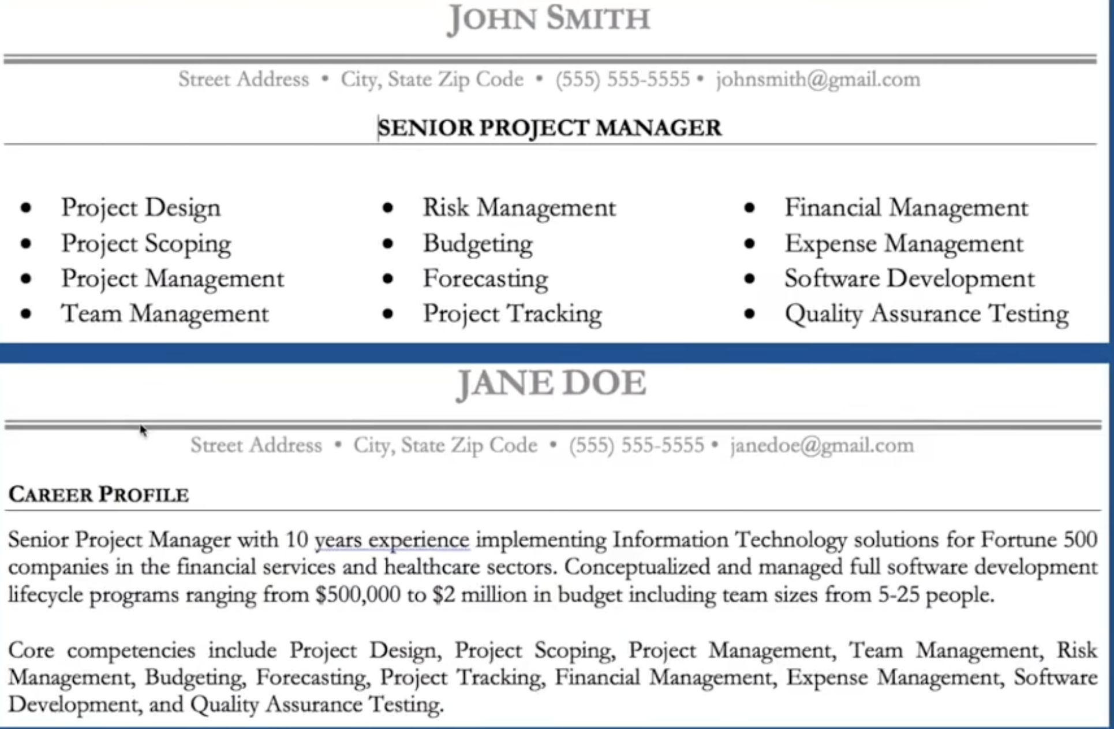
Sample: Top, Center of Resume
Notes:
Samples –
1. Look at top of each resume sample
2. Think about how they make you feel
3. John Smith – Put me to sleep. Probably not going to read the bullet points.
4. Jane Doe – Better idea what she has to offer. I want to keep reading to see what she is about.
5. You get to control the narrative – John Smith or Jane Doe

Slide 9
Summary
Define your goals clearly and concisely
What are your top 1-2 skills that apply?
How will you contribute and make an impact?
Briefly describe the position you seek
Simple formula:
One adjective (energetic, hard-working, efficient) + Job title (Manufacturing Engineer, Finance Manager) + Years of industry experience / (2+, 7+) + How you’ll help (provide expert XYZ .... Tie this to what job description is also communicating) + Top achievement (...streamlined manufacturing process, which boosted productivity and saving $[Amount].).
Notes:
A summary shows your best accomplishments that fit the job.
Tie this all to the job you are targeting.
Write a summary that connects your skills to the specific target job and easier for the resume reviewer to see

Slide 10
Professional Experience
Company Name / Description / Job Title / Dates Employed
Start each bullet with an action verb
Tie examples to target job to connect with reader
Avoid only listing duties and responsibilities
Be specific and communicate results: numbers, %
Focus on Your Accomplishments and Benefits
Ask Yourself: “How did I add value?” to each duty / responsibility listed.
It’s not just good showing what you did BUT what happened as a result of what you did
Explain changes in your job history
Notes:
Include resume extras like conferences, publications, and additional activities. They’ll strengthen your case for changing careers.

Slide 11
Sample: Work Experience
#1 – Manage Customer Service department with 10 employees.
This is okay, but here’s what is missing ....
Are you a good manager?
Do people get promoted?
Do people like you?
Are your customers happy?
Have you done anything to streamline processes?
#2 – Raised customer satisfaction 33% by designing and implementing processes that reduced time to answer customer inquires by 50%.
This is better! You put something in place to make a happier client!

Slide 12
Community Leadership
Volunteer experiences can give weight to your skill set and add to resume.
Getting involved in helping others can really add meaning to your work and help you meet potential customers or employers.

Slide 13
References
Choose wisely
List references on a separate page
Ask permission to use your reference and share for what purpose
If you ask a reference for a letter of recommendation, always provide them with a copy of your resume to reference
Recommendation letters need to be originals
Notes:
Choose wisely.
Avoid family members. Uncle Bob with your same last name and President of the Bank also not a good idea.
Start gathering now.
Minimum of 3 references good start.
Keep references separate from a resume. “References Available Upon Request” no longer best practice to put on resume.
Heading should match your resume heading in case it gets separated from your resume. Document meant to compliment your resume.
If you ask a reference for a letter of recommendation, always provide them with a copy of your resume to reference.
Recommendation letters need to be originals.
SAMPLE ON NEXT SLIDE

Slide 15
Resume Do’s
Explain employment gaps / changes in jobs
Recruited to ..... / Laid off ..... /
Keep your resume to one page if possible
Always use a professional email address – gmail
Make Headers / Contact Info Larger than body of resume
Keep a consistent format
Use easy-to-read fonts and colors:
Arial, Times New Roman, Tahoma, Verdana
Black, Blue, Gray, Green
Save / email / share your resume as a PDF
Notes:
Use the bullets or other symbols to highlight accomplishments.
This breaks up the key information and pulls out selling points that could be missed otherwise.
Refrain from using “I,” “the,” and “an.”
Use a ruler to carefully proofread each line.
Ask peers review/critique to gain a variety of opinions.
Ask these people specific questions:
Do you have any ideas how to make this a stronger document?
Could you look for any errors in this?
Does this look well-organized and is it easy to follow? Not – How do you like this?
Take feedback in stride and incorporate only those items you feel are appropriate.

Slide 16
Resume Killers
Spelling Errors, Typos, Poor Grammar
Poor Presentation (poor formatting, wordy, incorrect information)
Unprofessional Email Address
Unqualified for the Job
Notes:
A resume also highlights your written communication skills, so make sure it is error-free.
Don’t use unusual fonts that may be hard to read – even if you like the looks of them – KEEP IT SIMPLE.

Slide 17
Without Enhancing Your Resume ...
You can become a commodity in the marketplace
Have a disadvantage compared to others
Lose significant career opportunities
Limit your reach

Slide 18
LinkedIn: What is it? Why use it?
875 million members; 75 million+ business have LinkedIn accounts
The United States has the most LinkedIn members, followed by India and China
Your online reputation is becoming increasingly important!
People are going to check you out
Control the online community
Create an Internet Presence with a Virtual Resume, Network, Jobs

Slide 19
Strategic Guidelines to Enhance Your Profile
All Star Profile
Photo – professional, headshot, rename photo for SEO before uploading
Add Profile Section - What You Do for Your Company?
Headline: Descriptive vs. Job Title
Add Contact Information to About Section too
Brand Your Profile www.linkedin.com/yourname
Utilize the Skills Section and other key words
Build a Network of Connections
Recommendations: People LOVE to see what others have to say about you
Follow Target Companies

Slide 20
Maintain Your Online Presence
Schedule time for managing your online presence
“Google yourself” or set up a Google Alert
Update Resume / LinkedIn Experience regularly
Ask for LinkedIn Recommendations (2-3 recent)
Take advantage of LinkedIn Learning / Quizzes
Follow, engage, and respond to people on LinkedIn
Produce helpful and informative content tied to your professional expertise.
Recognize when you need help — and ask for it

Slide 21
Conclusion
Resumes (history, achievements) evolve over time
A strategic resume will help you gain traction – if not, it’s time to re-evaluate
A good resume / LinkedIn Profile will provide you with new opportunities, connections, and/or conversations
Your interview “performance” secures the job
Notes:
Set a reminder on your phone to update quarterly or once a year.
Helps you get your foot in the door.
Once you are in the door, your interview performance will secure the opportunity.
The goal of your resume should help you gain traction. If it’s not accomplishing that, you need to re-evaluate how it’s set up.

