Slide 1
Speaker Profile
Michael Manney
SENIOR DIRECTOR – CORPORATE SUSTAINABILITY & ESG
B.S. Packaging – Michigan State University
Started with PCA in 2011.
mmanney@packagingcorp.com

Slide 2
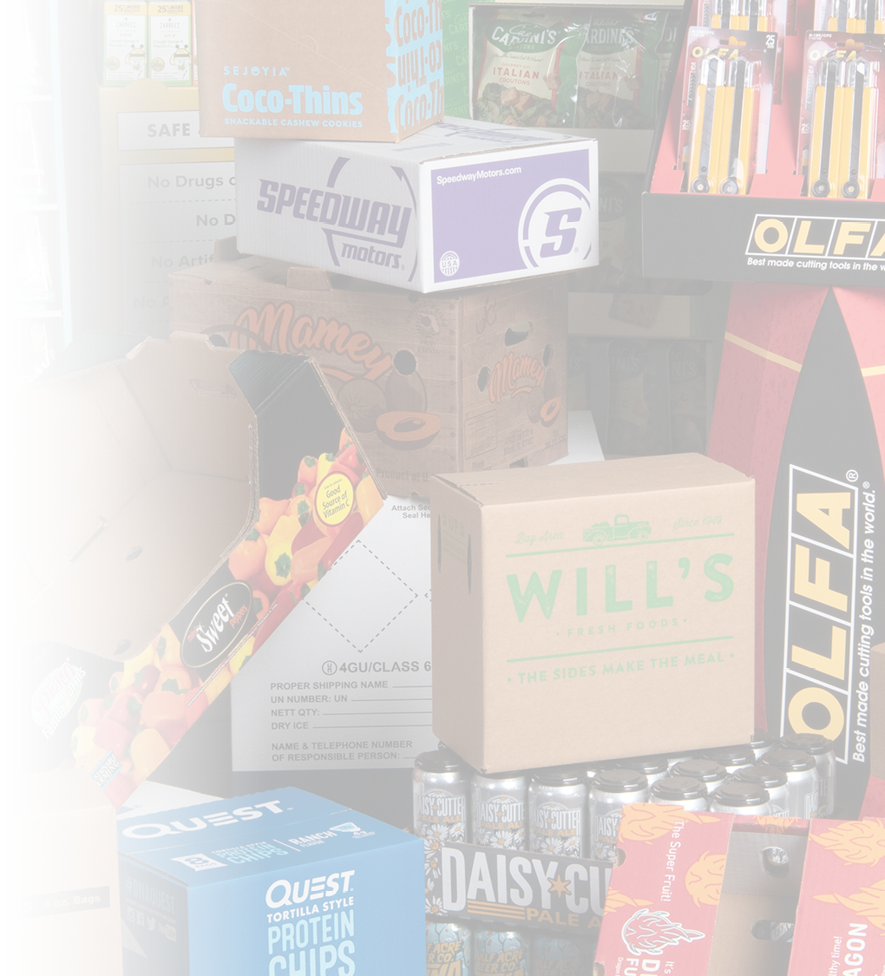
Company Overview

Slide 3
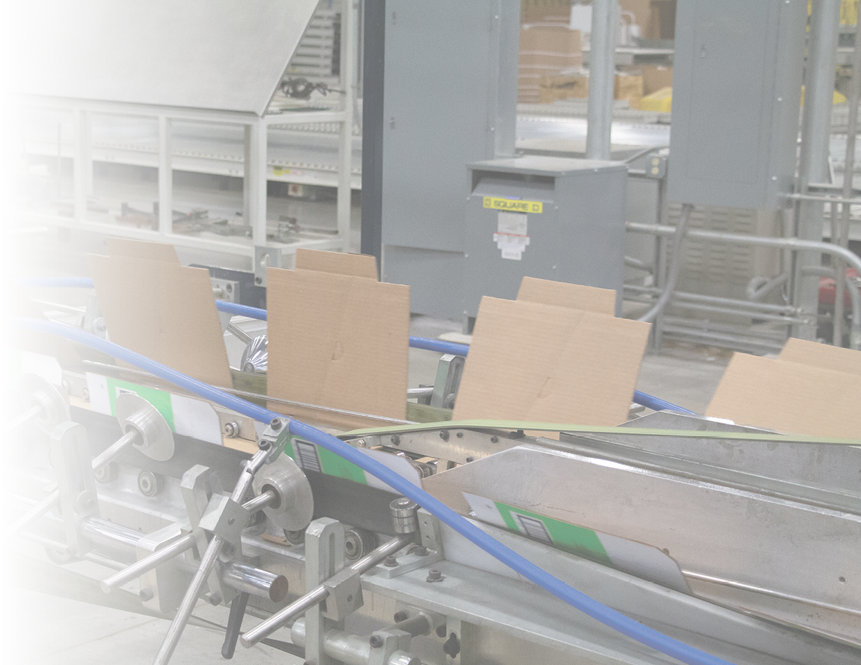
About PCA
We are the third largest manufacturer of containerboard and corrugated packaging.
Boise Paper is a leading producer of uncoated freesheet.
Annual uncoated freesheet production
500
thousand tons
Annual containerboard production
4.6
million tons
Employees
15,100
Box shipments
63.4
billion square feet
Annual revenue
$8.5
billion

Slide 4
PCA History
PCA acquires Boise Inc., a manufacturer of a wide variety of packaging and paper products.
PCA makes its largest acquisition to date — two containerboard mills and 19 corrugated container plants — from Georgia-Pacific.
The Ohio Boxboard Company and the American Paper Box Company (later called American Box Board Company) are founded.
The North Star Mill is founded in Quincy, Illinois. It later becomes part of Central Fiber Products Company.
Packaging Corporation of America is formed with the consolidation of the Central Fiber Products Company, the American Box Board Company and the Ohio Boxboard Company.
PCA becomes a publicly traded company on the NYSE (“PKG”).
PCA acquires TimBar Corporation, an independent corrugated products producer with six production facilities and two fulfillment centers.

Slide 5
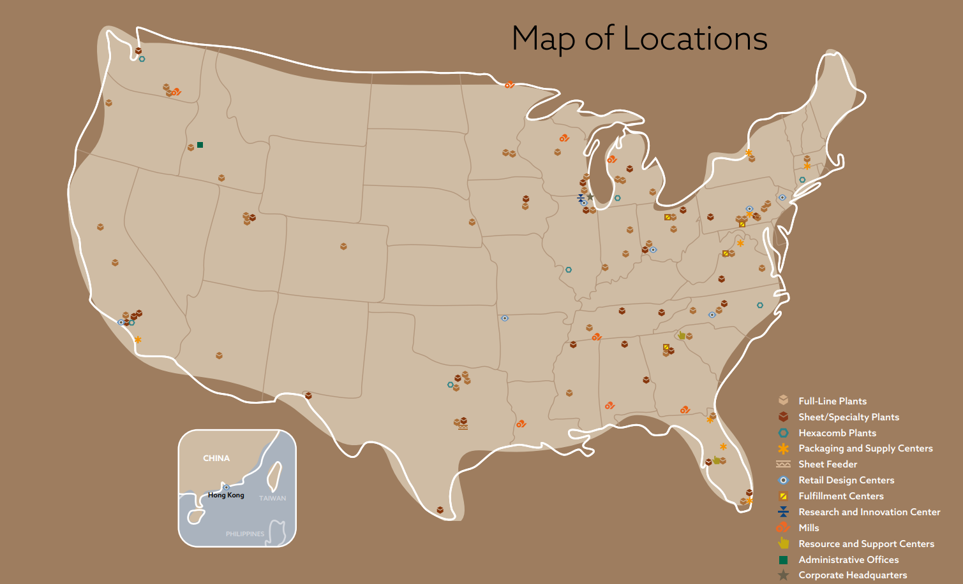

Slide 6
U.S. Market Share — Corrugated Packaging Volume
16% market share
Best ratio of plants-to-market share in the industry
Customers benefit from working with a world-class organization with a truly local focus
Source: FBA, Company Annual Reports/PCA Estimates
Updated March 2023

Slide 7
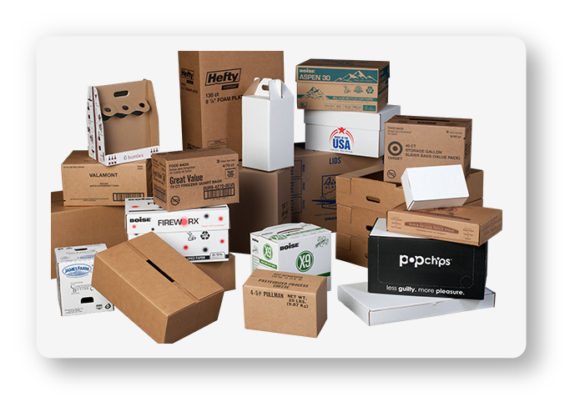
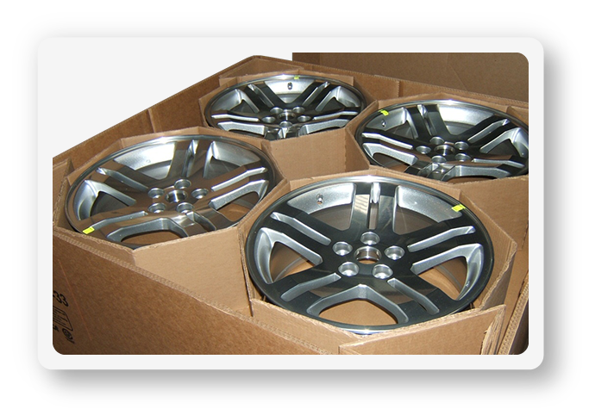
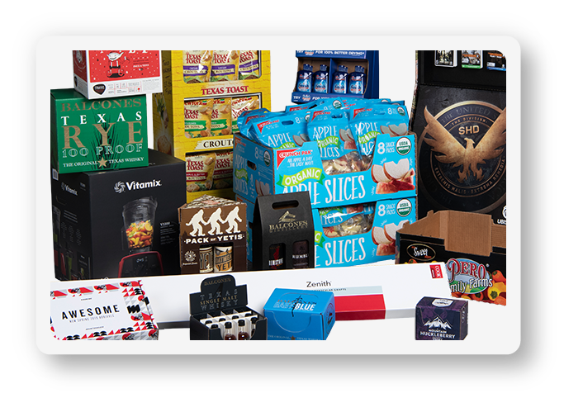
Custom Corrugated Packaging
Versatile, functional, cost-effective and sustainable.
Contain
Protect
Promote

Slide 8
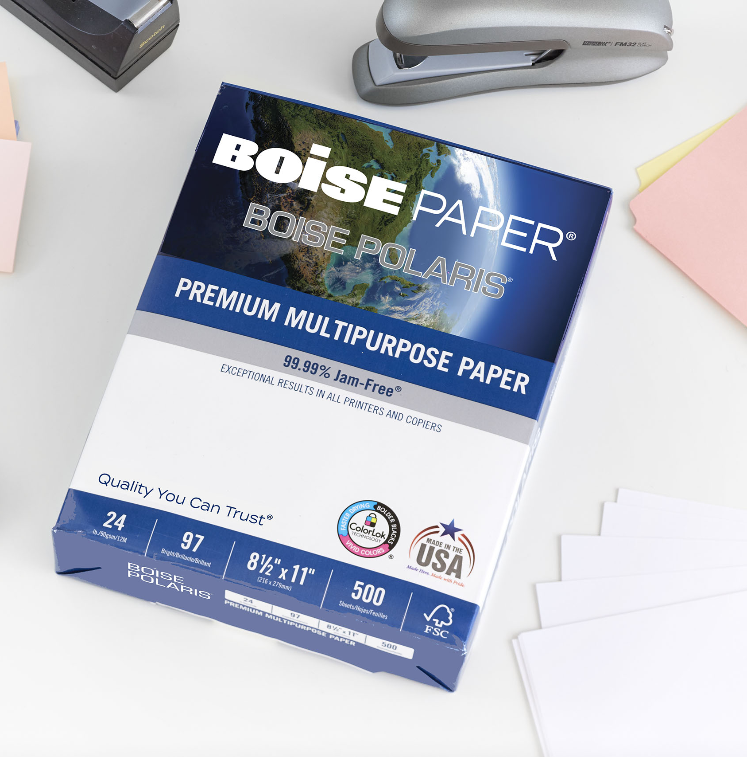
Papers that make business work
Durable printing solutions for better communication.
Premium
Recycled
Everyday

Slide 9
ESG Rating/Rankings
CDP Climate change = C
Ecovadis = 52/100, Bronze
JUST Capital = 367/951 ranking
Newsweek, America’s Most Responsible Companies: 350/500 ranking
Investor’s Business Daily 100 Best ESG Companies: 25/100 ranking

Slide 10
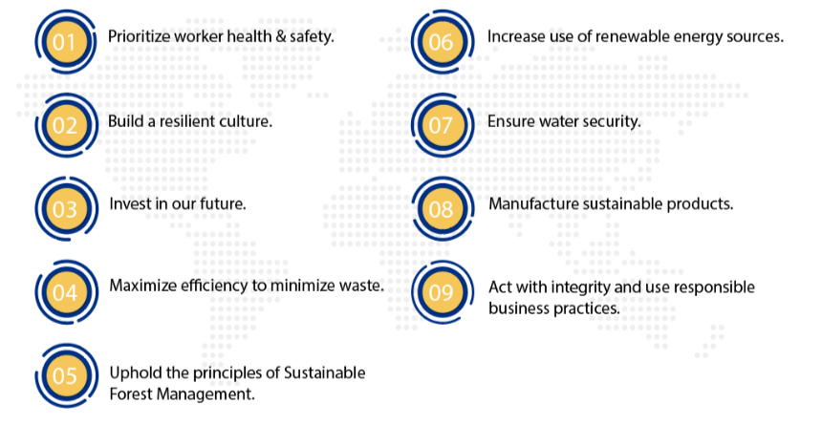
Sustainable Business Principles

Slide 11
PCA’s Approach to ESG
Sustainable Business Principle | List of ESG Topics
Prioritizing Worker Health & Safety | Employee wellbeing, Labor rights, Noise pollution, Occupational health & safety, Public health, Sustainable building management, Unionization
Building a Resilient Culture | Access to health care & medicine, Business continuity, Climate change risks & management, Community support & development, Corporate culture, Employee acquisition, talent management & retention, Employee development, Employee engagement & satisfaction, Employee incentives & benefits, Fair & equitable compensation, Fair & inclusive workplace, Financial access, literacy & advice, Future of work, Geopolitical risks, Physical disasters & failures, Shifting demographics, Social inclusion, Socio-economic risks, Workforce & organizational change management
Investing in our Future | Advanced technologies & innovations, Artificial intelligence, Business model innovation, Community engagement, Customer satisfaction, Digital transformation, Intellectual property, Local economy support, Long-term value creation, Philanthropy & volunteering, Project closure, decommissioning & environmental restoration, Project-based social & environmental impact assessment,
Manufacturing Sustainable Products | Certification, labeling & information transparency, Changing consumption patterns, Consumer nutrition & wellbeing, Innovation management, Materials management, Plastics management, Product & service safety & quality, Responsible procurement, Supply chain management
Maximizing Efficiency to Minimize Waste | Employee transportation, Energy use, conservation & reductions, Harmful substances management, Hazardous waste management, Non-hazardous waste management, Recycling, waste recovery & reduction, Transition to a circular economy
Promoting Sustainable Forestry | Biodiversity, Biotechnology & ethical considerations, Indigenous populations, Managing land use & reducing deforestation, Market access, Protection of natural land cover
Securing Water | Spills, Water, Water pollution
Transitioning to Cleaner Energy Sources | Air emissions, Alternative fuels, GHG emissions & reductions, Smarter & greener transportation, Transition to renewable energy
Acting with Integrity | Board effectiveness, Business ethics, Children's rights, Compliance management, Corporate criminal liability, Corporate reputation, Cybersecurity & information security, Data privacy management, ESG Governance structure, Executive compensation, Fair competition, Grievance mechanisms & remediation, Human rights, Investor relations, Marketing & selling practices, Non-financial reporting, Public policy practices, Responsible pricing, Responsible tax practices, Stakeholder engagement
SOCIAL
ENVIRONMENTAL
GOVERNANCE

Slide 12
Skating to where the puck is going to be…
EARTH
regenerative
regenerative
Waste-to-Energy
Energy from Nuclear and Renewables
MAKE
TAKE
Natural System
Human System
Human System
Natural System
Compost
Recycle
Reuse

