Slide 1
On the Economic, Business & Political Landscape Roger Tutterow, Ph.D. Coles College of Business Kennesaw State University rtuttero@kennesaw.edu
Manufacture Alabama
2023 Annual Meeting September 14, 2023
Point Clear, AL

Slide 2
Topic #1:
After 10 years of growth, COVID-19 sidelined the economy . . . what parts of the “new normal” will remain . . . And where do we stand on the “R word”?

Slide 3
Tale of 4 Recessions
(Source: Bureau of Economic Analysis )

Slide 4
Contributions to GDP Growth (source: Bureau of Economic Analysis)
 | GDP = | Consumption | Gross Investment | Net Exports | Government
2021: Q2 | 7.00% | 7.84% | 0.30% | -0.60% | -0.54%
2021: Q3 | 2.70% | 1.98% | 1.78% | -1.08% | -0.02%
2021: Q4 | 7.00% | 2.14% | 5.14% | -0.16% | -0.16%
2022: Q1 | -1.60% | 0.91% | 0.98% | -3.13% | -0.40%
2022: Q2 | -0.60% | 1.38% | -2.83% | 1.16% | -0.29%
2022: Q3 | 3.20% | 1.54% | -1.80% | 2.86% | 0.65%
2022: Q4 | 2.60% | 0.70% | 0.79% | 0.42% | 0.65%
2023: Q1 | 2.00% | 2.79% | -2.22% | 0.58% | 0.85%
2023: Q2 | 2.10% | 1.14% | 0.57% | -0.22% | 0.58%
 | Gross Investment | Nonresidential | Residential | Inventory
2021: Q2 | 0.3% | 1.29% | -0.24% | -0.75%
2021: Q3 | 1.78% | 0.10% | -0.29% | 1.96%
2021: Q4 | 5.14% | 0.17% | -0.05% | 5.01%
2022: Q1 | 0.98% | 0.98% | -0.15% | 0.15%
2022: Q2 | -2.83% | 0.01% | -0.93% | -1.91%
2022: Q3 | -1.80% | 0.80% | -1.42% | -1.19%
2022: Q4 | 0.79% | 0.52% | -1.20% | 1.47%
2023: Q1 | -2.22% | 0.08% | -0.16% | -2.14%
2023: Q2 | 0.57% | 0.80% | -0.14% | -0.09%

Slide 5
Industrial Production: From Peak By Component (source: Federal Reserve)

Slide 6
Industrial Production: Month over Month (source: Federal Reserve)

Slide 7
Consumer Sentiment (source: University of Michigan, Survey Research Center)

Slide 8
Retail Sales (source: U.S. Bureau of the Census, annual rate of growth)

Slide 9
Retail Sales: Month over Month (source: U.S. Bureau of the Census)

Slide 10
Auto & Light Truck Sales
(Source: Department of Commerce, in millions)

Slide 11
Leading Economic Indicators (source: Conference Board, 6 month change)

Slide 12
Topic #2:
1st major challenge – supply chain imbalances

Slide 13
Freight: Shipments & Rate (source: Cass Freight Index, Seasonally Adjusted)

Slide 14
Global Supply Chain Pressure (Source: Federal Reserve Bank of New York)

Slide 15
Topic #3:
2nd major challenge – tight labor markets!

Slide 16
Change in Payroll Employment
(Source: Bureau of Labor Statistics, in thousands)

Slide 17
Change in Payroll Employment
(Source: Bureau of Labor Statistics)

Slide 18
Employment Below Peak
(Source: Bureau of Labor Statistics)

Slide 19
Payrolls Growth (annualized 3-month growth rate)
(Source: Bureau of Labor Statistics)

Slide 20
Employment (Source: Bureau of Labor Statistics)

Slide 21
Recovery from Bottom
(Source: Bureau of Labor Statistics)

Slide 22
Employment: Alabama [thru 2/20] (source: Bureau of Labor Statistics)

Slide 23
Employment: Alabama [thru 7/23] (source: Bureau of Labor Statistics)

Slide 24
Payroll Employment: “But For” Pandemic (source: Bureau of Labor Statistics, in thousand of jobs)

Slide 25
Labor Force Participation (Source: Bureau of Labor Statistics)

Slide 26
JOLTS: Openings
(Source: Bureau of Labor Statistics)

Slide 27
Topic #4:
3rd major challenge – inflation returns!

Slide 28
Inflation: Transitory or Persistent? (source: Bureau of Labor Statistics)
CPI by 0.2% in July – after being up 0.2% and 0.1% in June and May. Overall CPI up 3.2% over last 12 months.
Core CPI up 0.2% in July – after being up by 0.2% and 0.4% in June and May. Core up 4.7% over same period.
Energy component rose by 0.1% in July. The energy component is down 12.5% over the last 12 months.
PCE up 3.3% for 12 months ending in July, core PCE up 4.2% over the same period.

Slide 29
Energy Cost: Oil & Natural Gas

Slide 30
Construction Cost w/o Energy
(Source: Bureau of Labor Statistics (PPI) & Associated Builders & Contractors)

Slide 31
Topic #5:
Fed still tightening . . . But peak rates are close

Slide 32
Federal Funds Rate 9 Up, 3 Down, back to ZLB – Now back up.

Slide 33
Market’s Expectation for FFR (Source: CME Group)

Slide 34
Market’s “Expected FFR”

Slide 35
10-Year Treasury Bonds (source: Board of Governors of Federal Reserve)

Slide 36
Fed: Securities Held Outright (in millions, source: Board of Governors of Federal Reserve)

Slide 37
Mortgages vs 10-Year T-Bonds (source: Board of Governors of Federal Reserve)

Slide 38
Mortgage Activity: Purchase & Refinance (Source: Mortgage Bankers Association)

Slide 39
CRE Loan Standards: Net Tightening (Source: Federal Reserve System, Senior Officers Lending Survey)

Slide 40
CRE Loan Demand: Net Change (Source: Federal Reserve System, Senior Officers Lending Survey)

Slide 41
C&I Loan Standards: Net Tightening (Source: Federal Reserve System, Senior Officers Lending Survey)

Slide 42
C&I Loan Demand: Net Change (Source: Federal Reserve System, Senior Officers Lending Survey)

Slide 43
90+ Days Delinquent by Loan Type (source: Federal Reserve Bank of New York Credit Panel/Equifax)

Slide 44
Charge Off Rates at Banks (source: Board of Governors of the Federal Reserve System)

Slide 45
Some Comments on Banks
2008 was about credit risk, 2023 is about interest rate risk. But, what if they intersect?
Assets & Liabilities mismatched – was SVB that unique?
Fed, FDIC & US Treasury response.
Are the other risk to banks?

Slide 46
Topic #6:
Did Covid signal the death of “big box” and office?
And is housing market getting “frothy” again?

Slide 47
Construction Spending (Source: U.S. Bureau of Census)

Slide 48
Non-Residential Construction

Slide 49
Non-Residential Construction

Slide 50
US Housing Permits: SF and Total

Slide 51
US Housing Permits: Multi-family

Slide 52
AL Housing Permits: SF and Total (source: U.S. Bureau of Census)

Slide 53
AL Housing Permits: Multi-family (12 month moving average)

Slide 54
NAHB: Housing Market Index

Slide 55
Case Shiller: National Index (source: Standard & Poor’s Case-Shiller)
(source: Standard & Poor’s Case-Shiller)

Slide 56
Case Shiller: Pandemic Surge (source: Standard & Poor’s Case-Shiller)
(source: Standard & Poor’s Case-Shiller)

Slide 57
Home Prices: Alabama (versus housing peak, w/post-pandemic surge)

Slide 58
Housing Affordability: Mortgage Rate Effect (source: S&P Case-Shiller, Freddie Mac)

Slide 59
Topic #7:
Shared governance in 2023 . . . But can each party govern themselves?

Slide 60
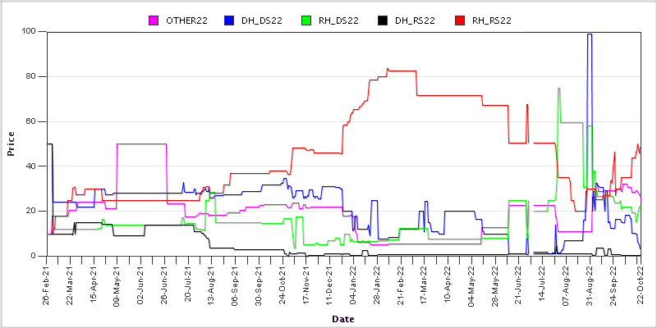
Iowa Electronic Markets: Congress (source: University of Iowa)

Slide 61
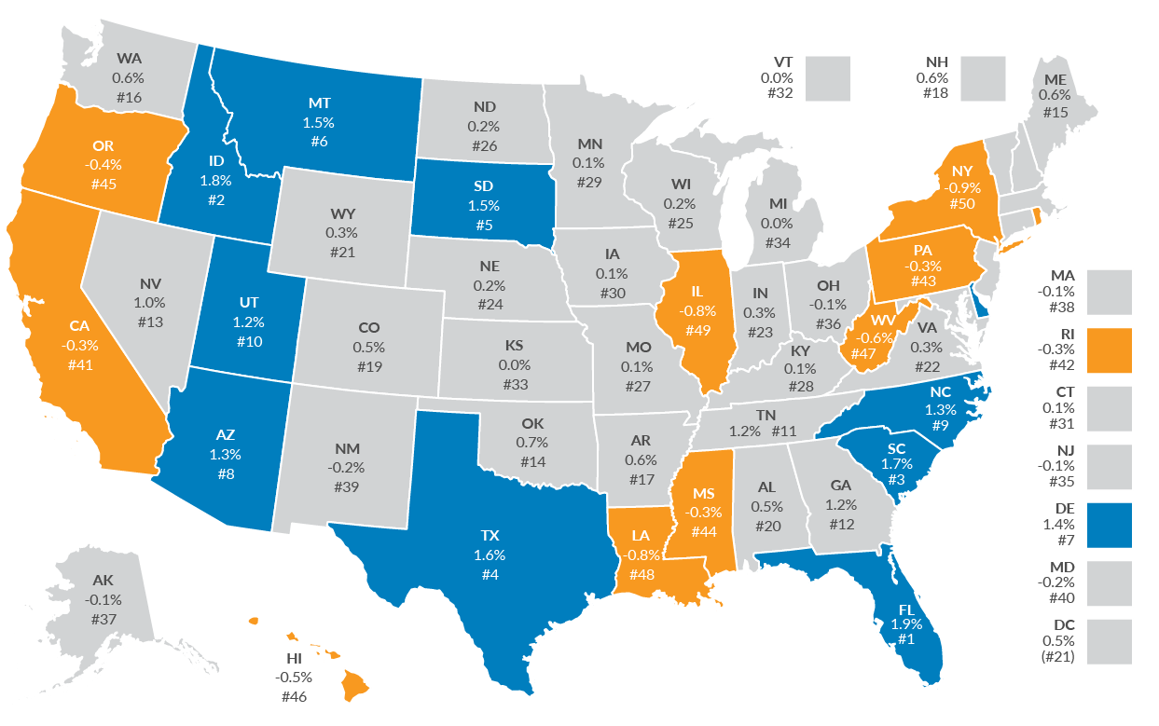
Internal Migration (source: Tax Foundation, 2022)

Slide 62
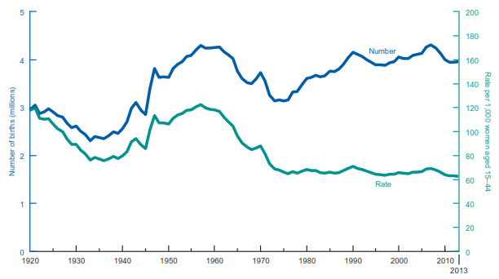
The Demographics: Boom & Bust (source: U.S. Census Bureau)

Slide 63
On the Economic, Business & Political Landscape Roger Tutterow, Ph.D. Coles College of Business Kennesaw State University rtuttero@kennesaw.edu
Manufacture Alabama
2023 Annual Meeting September 14, 2023
Point Clear, AL

