Slide 1
OSHA Update
Tanya K. Parker
Industrial Hygienist Occupational Safety and Health Administration

Slide 2
OSHA’s Vision (1)
Safety as a Core Value
We want to see safety and health as a core value in every workplace.
Safety is a fundamental right for every worker.
Safety must be an enterprise-wide value.

Slide 3
OSHA’s Vision (2)
Equity
Embedding equity in everything we do.
Ensure OSHA protections apply equally to all workers.
Help ensure underserved workers are in safe, healthy environments and feel safe in their work environment.

Slide 4
Enforcement (Current Actions )
Updated Severe Violator Enforcement Program
Strengthens enforcement, improves compliance, reduces injuries and illnesses
Includes all hazards and OSHA standards, focuses on repeat offenders in all industries
Trenching
39 fatalities in 2022, compared to 15 in 2021
Implemented enhanced enforcement initiative in July 2022
Will issue criminal referrals when and where appropriate

Slide 5
Enforcement (Current Actions continued)
Heat
Launched Heat NEP in April 2022.
Allows inspectors to preemptively inspect in more than 70 industries.
A total of 4,575 heat-related inspections opened between 4/8/22 – 9/30/23.
Falls NEP
Prevent falls for people working at heights in all industries – including tree trimming, utility line work and window cleaning.
Allows inspections whenever they observe someone working at heights.

Slide 6
Enforcement (Types of Inspections)
Programmed Inspections
Unprogrammed Inspections
High-hazard workplaces and recalcitrant owners and employers
Based on neutral criteria
Local, regional and national special emphasis programs
Initiated in response to:
Imminent danger situations
Fatalities and catastrophes
Worker complaints
Referrals

Slide 7
Inspection Process
Phases of an inspection:
Present credentials
Opening conference
Walkaround
Closing conference
Results
Appeals

Slide 8
Heat Rulemaking
Potential standard addresses indoor and outdoor work environments.
Applies to general industry, construction, maritime and agriculture.
OSHA held SBREFA panels in September 2023 to gather views on potential effects on small businesses. The agency is reviewing comments received.
Updates on the heat rulemaking will be available at www.osha.gov/heat-exposure/rulemaking.

Slide 9
Improved Tracking of Workplace Injuries and Illnesses (1)
What’s new:
Establishments with 100 or more employees in specific high-hazard industries must submit more detailed information from Form 300 – Log of Work-related Injuries and Illnesses Incident Report.
Establishments must include their legal company name when making electronic submissions.
More injury data publicly available – personally identifiable information will not be published.

Slide 10
Improved Tracking of Workplace Injuries and Illnesses (2)
Key dates:
Rule takes effect Jan. 1, 2024.
CY2023 records can be electronically submitted beginning Jan. 2, 2024.
CY2023 records must be electronically submitted by March 2, 2024

Slide 11
Personal Protective Equipment Fit Rulemaking
Issued NPRM on July 17, 2023, to revise PPE standard in construction that requires PPE must fit workers properly.
Improperly fitting PPE is particularly important for construction workers of various sizes, including some women.
Revision would make construction standard consistent with general industry and maritime standards.

Slide 12
Silica Exposure in Engineered Stone Industry
Launched initiative in September to focus enforcement and compliance assistance efforts on workers in the engineered stone fabrication and installation industries.
Prioritizes inspections of covered industries where workers are exposed to high levels of silica.
Inhaling small crystalline silica particles can cause silicosis, a debilitating and sometimes fatal, lung disease.

Slide 13
Mental Health
Mental health, workplace stress and suicide are real, work-related hazards.
Suicide is among the leading causes of death among working-age adults in the U.S.
Suicide rate among construction workers is 3 ½ times higher than the general population.

Slide 14
OSHA and Mental Health
Published a suicide awareness publication in English and Spanish on what to do if a co-worker may be at risk of suicide.
Mental health is the focus of this year’s Safe + Sound Campaign.
Developed partnerships and alliances to help workers and employers prevent suicides.
Training, guidance, other resources available on OSHA’s page on workplace stress - osha.gov/workplace-stress.

Slide 15
Worker Rights
By law, every worker has the right to:
A safe workplace.
Speak up about safety and health concerns without fear of retaliation.
Receive training in a language they understand.
Required safety equipment.
Report an injury or illness, request an OSHA inspection and speak to the inspector.

Slide 16
Employer Responsibilities
Provide a workplace free of known safety and health hazards.
Train workers in a language they understand.
Prominently display the OSHA poster, “Job Safety and Health: It’s the Law.”
Many employers with more than 10 workers are required to keep a record of serious work-related injuries and illnesses.

Slide 17
Whistleblower Protections
OSHA enforces more than 20 whistleblower statutes that protect workers from retaliation for reporting violations.
Employers cannot retaliate against workers for engaging in activities protected by whistleblower laws.
Examples: firing, laying off, demoting, denying overtime or promotion, or reducing pay or hours.

Slide 18
Ways to File a Whistleblower Complaint
Online Whistleblower Compliant Form
Fax/Mail/Email
Telephone
In person
* OSHA accepts complaints in any language. Contact your local OSHA regional or area office for assistance. Visit whistleblowers.gov for more information.

Slide 19
Training
Many OSHA standards require training.
Employers must train workers in a language they understand.
Outreach Training 10- and 30-hour courses – basic hazard awareness classes delivered by OSHA-authorized trainers.
OSHA Training Institute Education Centers – deliver training to public and private sectors in all industries.
Susan Harwood Training Grants – awarded to non-profit organizations to develop training programs.

Slide 20
Compliance Assistance
On-Site Consultation Program offers small businesses confidential occupational safety and health services.
Consultants help employers find and fix workplace hazards.
Get advice on complying with OSHA standards.
Help establish/improve safety and health programs and train workers.
Separate from enforcement; no penalties or citations issued.

Slide 21
Cooperative Programs
On-Site Consultation Program
Safety and Health Achievement Recognition Program (SHARP)
Alliance Program
Strategic Partnership Program
Voluntary Protection Programs (VPP)
OSHA Challenge

Slide 22
Compliance Assistance Specialists
Help employers comply with OSHA standards, understand employer responsibilities and workers’ rights.
They are available for seminars, workshops, and speaking events.
Raise awareness of OSHA initiatives.
Help implement OSHA’s cooperative programs.
Visit osha.gov/complianceassistance/cas to find nearest CAS.

Slide 23
Labor Liaisons
Each OSHA region has a labor liaison.
Help workers and worker advocates:
Establish a relationship with OSHA.
Establish or update a workplace safety and health program.
Visit osha.gov/workers/liaisons to find a Labor Liaison in your region.

Slide 24
Combustible Dust
National Emphasis Program
Revised Combustible Dust National Emphasis Program
DIRECTIVE NUMBER: CPL 03-00-008
Effective 1/30/23

Slide 25
Combustible Dust
Combustible material that can burn rapidly when in a finely divided form
Suspended in air (under certain conditions)
Can be explosive
Wide variety of materials
Food – sugar, flour, spices
Grain, wood, paper
Metals – aluminum, iron, zinc

Slide 26
Combustible Dust Hazards
Fire
Combustible dust in contact with an ignition source of sufficient energy
Mechanical heating, hot work, electrical equipment, open flames
Flash Fire
Occurs when combustible dust in the proper concentration is dispersed in a cloud, and then ignited,
Occur both inside and outside process equipment

Slide 27
Combustible Dust Hazards
Deflagration
Type of flash fire strong enough to cause damage to equipment/structures
Inside and outside process equipment
Explosion
Caused when a flash fire is confined, the pressure that develops
Bursting or rupture of an enclosure or container

Slide 28
Additional Hazards*
Housekeeping – 29 CFR 1910.22
Ventilation – 29 CFR 1910.94
PPE – 29 CFR 1910.132
Storage areas (housekeeping) – 29 CFR 1910.176
Electrical – 29 CFR 1910.307
Powered Industrial Truck – 29 CFR 1910.178
*Not all-inclusive

Slide 29
Additional Hazards*
Welding, Cutting & Brazing – 29 CFR 1910.252 - 254
Warning signs – 29 CFR 1910.145
Hazard Communication – 29 CFR 1910.1200
Egress – 29 CFR 1910.33 - 37
Fire Safety – 29 CFR 1910.156 - 157
Spray Finishing – 29 CFR 1910.107
*Not all-inclusive

Slide 30
Combustible Dust Hazard Analysis (DHA)
National Fire Prevention Association (NFPA 652-2019) Annex B
Decisions
Housekeeping procedures
Engineering controls
Administrative controls
PPE specifications
Employee training needs

Slide 31
Combustible Dust Hazard Analysis (DHA)
Determine the material and properties
Is there any combustible material present?
Where are the material present?
Evaluate the hazard
Is it present in areas or conditions that could lead to fire/explosion
Accumulation – horizontal and vertical surfaces

Slide 32
Combustible Dust Hazard Analysis (DHA)
Identify and implement safeguards
How to prevent and mitigate a dust explosion/fire
Fire hazard controls
Dust collection
Housekeeping
Document DHA

Slide 33
Workplace Violence
Enforcement Procedures and Scheduling for Occupational Exposure to Workplace Violence
CPL 02-01-058
Effective Jan 10, 2017

Slide 34
Workplace Violence
Any act or threat of violence, harassment, intimidation, or other threatening disruptive behavior that occurs at the work site.
Bureau of Labor Statistics
761 fatalities - increase by 7.9% from 2020 to 2021.
Intentional injuries by person (self inflicted and other person)
481 fatalities – homicides

Slide 35
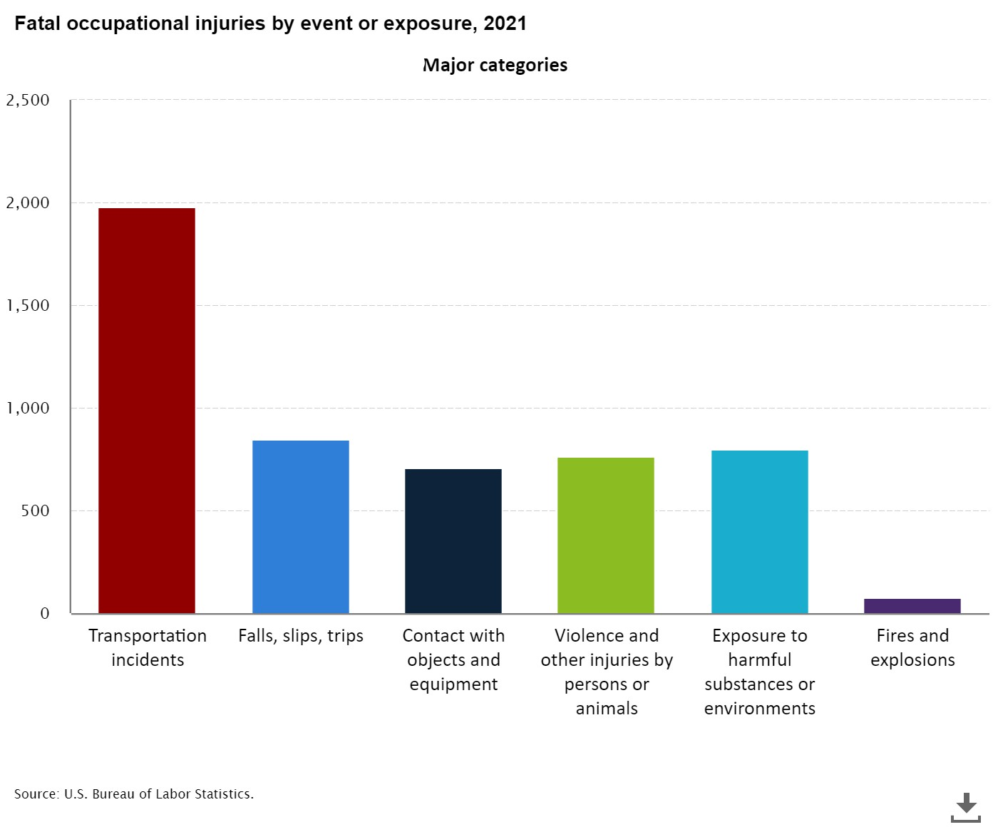
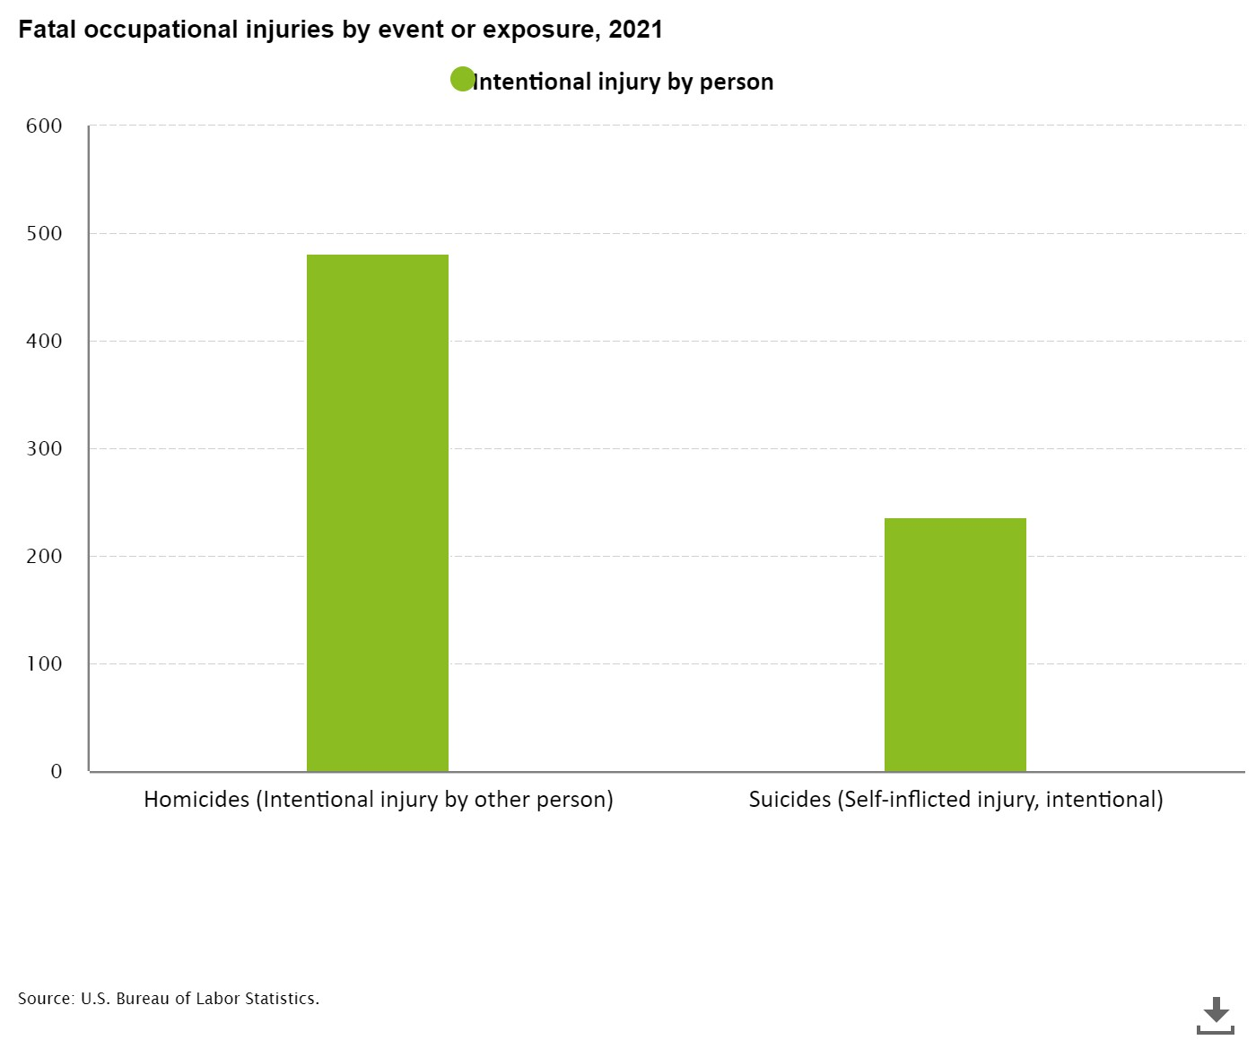

Slide 36
Workplace Violence
High risk industries
Health Care and Social Services
Late night retail
Taxi Drivers
Correctional officers

Slide 37
Workplace Violence – Classifications
Type 1 – Criminal Intent
violent acts by people entering to commit a crime
Late night establishments
Type 2 – Customer/Client/Patient
Violence directed at employees by customer, clients, inmates, patients, etc.
Healthcare, detention centers, prison, taxi transport

Slide 38
Workplace Violence – Classifications
Type 3 – Co-worker
Violence targeted towards co-workers, supervisors or management by current or former employee, supervisor or manager.
Type 4 – Personal
Violence by non-employee who knows or has a personal relationship with an employee at the workplace

Slide 39
Standard Requirements
Section 5(a)(1) – General Duty Clause of OSH Act of 1970
Recordkeeping – 29 CFR 1904
Medical Services – 29 CFR 1910.151
First Aid & Medical Attention – 29 CFR 1926.23
Employee Emergency Action Plan – 29 CFR 1926.35
Notes:
No current OSHA regulations
5a1 – employers are required to provide their employees with a place of employment that is “free from recognized hazards that are causing or are likely to cause death or serious physical harm”.

Slide 40
What Can You Do?
Workplace Violence Prevention Program
OSHA Publication 3148
Healthcare and Social Services Facilities
OSHA Publication 3153
Late-Night Retail Establishments
OSHA Fact Sheet, Preventing Violence Against Taxi and For-Hire Drivers
*Not all - inclusive
Notes:
Control measures may depend in the setting

Slide 41
What Can You Do?
OSHA Publication 3976
Taxi Drivers – How to Prevent Robbery and Violence
OSHA Fact Sheet (2002)
Workplace Violence
OSHA eTool – Hospital
OSHA Safety and Health Topics

Slide 42
OSHA
Follow Us!

Slide 43
OSHAT
www.osha.gov
800-321-OSHA (6742)

