Slide 1
The AI revolution will Reshape how Organizations Connect, Share, & Use Information About SQP
Chuck Pettinger, Ph.D.
Safety Science Officer

Slide 2
We provide people-centered applications and data science for continuous improvement and
injury-free operations.

Slide 3
Agenda
The AI revolution and why its predicted to have a larger impact
Defining AI and its related sub-fields
How AI is currently being used to impact organizational effectiveness
Take part in our research project!!

Slide 4
The AI Revolution and why it is going to have a broad-based larger impact than past revolutions
Notes:
Going to have a conversation about why it's important for organizations to effectively connect information
Introduce how AI is catalyzing a revolution in how this can be done
The limitations of current approaches
Discuss the challenges of siloed data and fragmented systems
Explain how poor connections between data makes it hard to get a big picture view
Provide examples of wasted time/money and missed opportunities due to poor connections

Slide 5
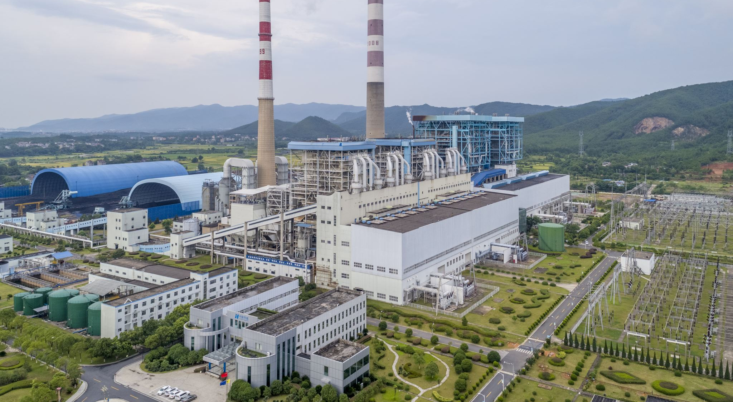
Previous revolutions were reserved for elite countries who could harness steam, flight, & nuclear power

Slide 6
Computers & the Internet Revolution was about broadcasting information to people.

Slide 7
The AI Revolution allows everyone to use technology that was previously reserved for only well-funded organizations/countries.

Slide 8
A Connected World
As of 2020:
4 Billion connected people
25 million apps
50 trillion GBs of data
25 billion embedded connected systems

Slide 9
Defining AI and its related sub-fields

Slide 10
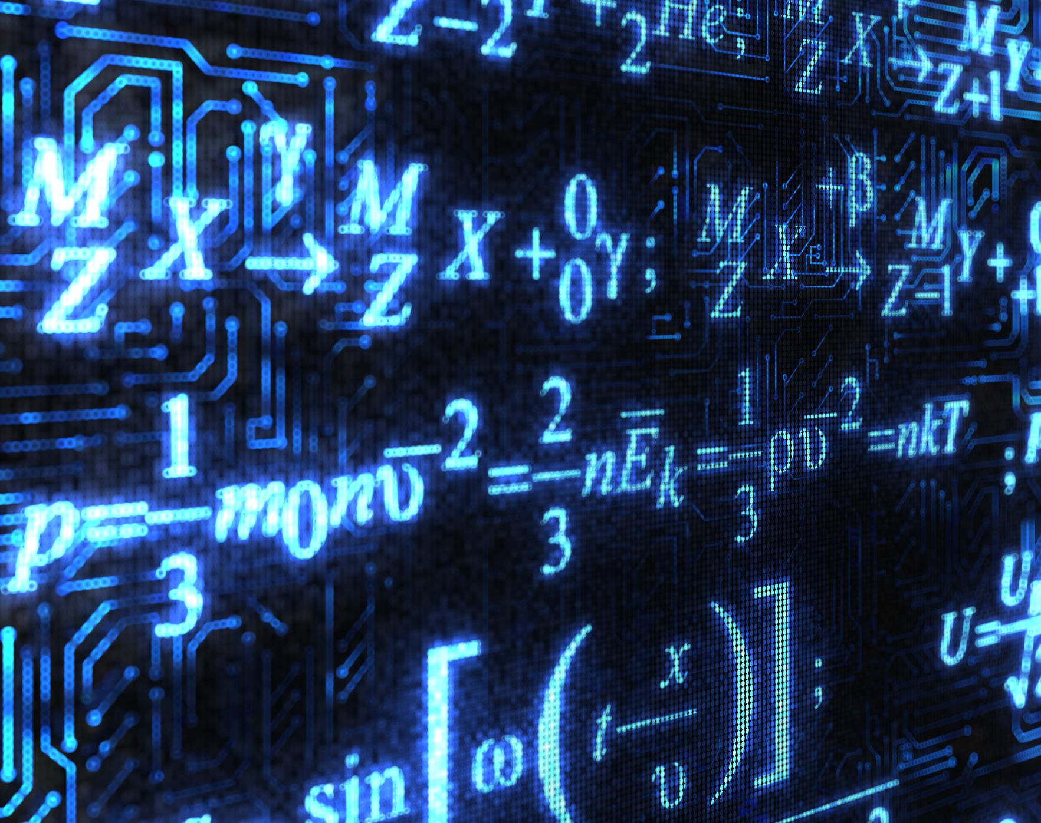
AI – Artificial Intelligence
AI refers to computer systems or machines that can perform tasks that normally require human intelligence.
AI Systems are designed to:
Think and act rationally
Employ mathematical models and algorithms
This allow them to perceive, learn, reason, & plan
And they can do this in ways similar to humans
Notes:
AI aims to enable machines to emulate human cognitive abilities like learning, problem solving, perception, prediction and decision making to perform a multitude of tasks and provide insights and value. The ultimate goal is to create intelligent machines capable of assisting humans in both physical and mental capacities.
Started out using rules and logic but now uses leaning based intelligence (using data to continue to learn)
Rather than following explicitly programmed rules, AI systems learn from data and experiences, identify patterns and make decisions with varying levels of autonomy. This enables capabilities such as prediction, recommendation, decision making and language understanding.
AI systems can analyze large volumes of structured and unstructured data much faster than humans. This enables the discovery of insights and patterns that may not be visible to the human eye.

Slide 11
AI – Sub-Fields:
AI incorporates:
Machine Learning (ML)
Natural Language Processing (NLP)
Computer Vision
Notes:
AI incorporates sub-fields like machine learning, natural language processing, robotics, computer vision, expert systems, speech recognition and others to enable capabilities like problem solving, knowledge representation, planning, learning, perception, motion and manipulation.
Computer vision and video recognition are two related but distinct fields of study. Computer vision is a field of artificial intelligence that enables computers to derive meaningful information from digital images, videos, and other visual inputs and take actions or make recommendations based on that information 1. It uses machine learning and neural networks to teach computers to see defects and issues before they affect operations

Slide 12
Machine Learning
Mathematical models & algorithms:
Algorithms detect patterns in data
Models are derived based on patterns
Model can then make predictions
Algorithms learn and optimize models
ML replaced by Deep Learning Models
Notes:
Machine learning is a key technical approach that enables AI systems to learn and improve from experience. It allows AI applications to become more accurate and perform tasks more intelligently over time without needing to be explicitly reprogrammed as new data is received. The ability of AI systems to learn is what makes them intelligent.
It involves developing mathematical models and algorithms that can learn and improve based on exposure to data. The learning can be supervised (labeled data), unsupervised (unlabeled data) or reinforcement learning.
The algorithms detect patterns in data to build models that can make predictions or decisions without being explicitly programmed to perform the task. As the algorithms are exposed to more data, they learn and optimize their models.
Common machine learning models include neural networks, decision trees, support vector machines, clustering, Bayesian networks and regression models. These can be used for tasks like classification, prediction, anomaly detection, regression and more.
A deep learning model, or a DL model, is a neural network that has been trained to learn how to perform a task, such as recognizing objects in digital images and videos, or understanding human speech. Deep learning models are trained by using large sets of data and algorithms that enable the model to learn how to perform the task.
Deep learning models are used for various applications in different fields, such as computer vision, natural language processing, speech recognition, and more. Some examples of deep learning models are:
Convolutional neural networks (CNNs), which are used for image classification, object detection, face recognition, and more. CNNs use layers of filters that extract features from the input images and learn to recognize patterns and shapes.
Recurrent neural networks (RNNs), which are used for natural language processing, speech recognition, text generation, and more. RNNs use loops that allow information to persist and learn from sequential data.
Generative adversarial networks (GANs), which are used for image generation, style transfer, super-resolution, and more. GANs use two competing networks: a generator that creates fake images and a discriminator that tries to distinguish between real and fake images.

Slide 13
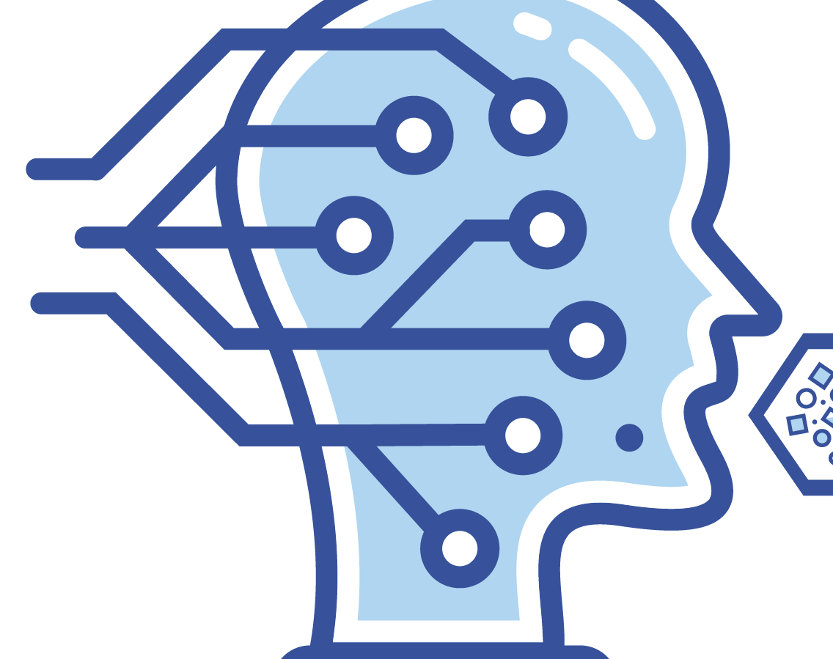
Natural Language Processing
Gives machines the ability to read, understand and derive meaning from human languages.
Text Analysis
Speech Recognition
Text Generation (Chatbots & Chat GPT)
Sentiment Analysis
Automatic Summarization
Notes:
Machine Translation - NLP enables machines to translate text or speech from one language to another, like Google Translate. This involves understanding the source language and mapping it to the target language.
Text Analysis - NLP techniques allow text mining from documents, social media, emails etc. to understand sentiment, recognize entities, keywords, themes, etc. This is used in search, recommendation engines and social media monitoring.
Speech Recognition - NLP enables machines to convert speech to text by identifying words and phrases from spoken language. This is used in voice assistants like Siri.
Text Generation - NLP can generate coherent, meaningful text for a given context using the appropriate vocabulary and grammar, like auto-generating emails.
Chatbots - NLP enables bots to understand user intent and have natural conversations. From customer service to making reservations, chatbots rely on NLP.
Information Retrieval - NLP improves document search, information finding and question answering based on semantic analysis of text rather than just keywords.
Sentiment Analysis - NLP can determine opinions and attitudes within text using context clues. This is used for monitoring brand/product perception.
Automatic Summarization - NLP can pick out the most salient and relevant points from a long text to create summaries. This is useful for extracting key insights.

Slide 14
Computer Vision
Enables machines to interpret, understand,
and derive meaning from images & videos.
Surveillance Systems
Autonomous Vehicles
Industrial Safety
Fire and Smoke Detection
Wearable Safety Devices
Notes:
- Surveillance Systems - Computer vision enables automatic detection of suspicious activities, objects and people through video feeds for public safety and security. Face recognition and motion tracking algorithms can identify persons of interest and detect anomalies.
- Autonomous Vehicles - Computer vision algorithms allow self-driving cars to interpret scenes, detect objects, read signs, recognize pedestrians and take decisions to navigate safely. Tasks like lane detection, obstacle avoidance and blind spot monitoring rely on computer vision.
- Industrial Safety - In factories and warehouses, computer vision performs tasks like automatic visual inspection, anomaly detection, employee activity monitoring and hazard identification to improve workplace safety.
- Fire and Smoke Detection - Computer vision techniques can identify fire, smoke and dangerous conditions through video feeds and imagery much faster than humans. This enables quicker response.
- Rescue and Disaster Management - Computer vision enables efficient scanning of disaster-struck areas using aerial images and videos. It assists in facial recognition of missing people and tracking of survivors.
- Wearable Safety Devices - Smart helmets and goggles are being integrated with computer vision algorithms for tasks like blind spot identification, driver fatigue detection and distracted driving alerts.
In summary, computer vision provides ubiquitous, accurate and real-time automated visual monitoring in safety-critical environments to prevent accidents, injuries and losses. It complements and enhances human vision.

Slide 15
How AI is being currently used in organizations and the future evolutions

Slide 16
Example #1: Predictive Models

Slide 17
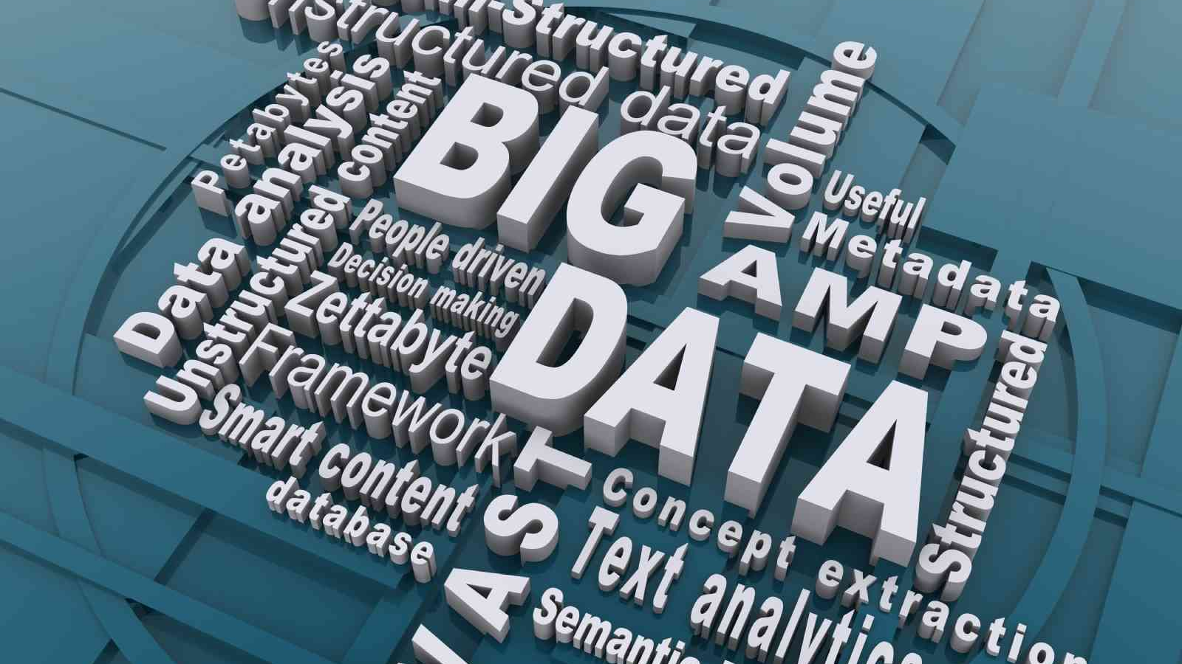

Slide 19
When catastrophe strikes, we look for a signal in the noise anything that might explain the chaos that we see all around us and bring order to the world again.

Slide 20
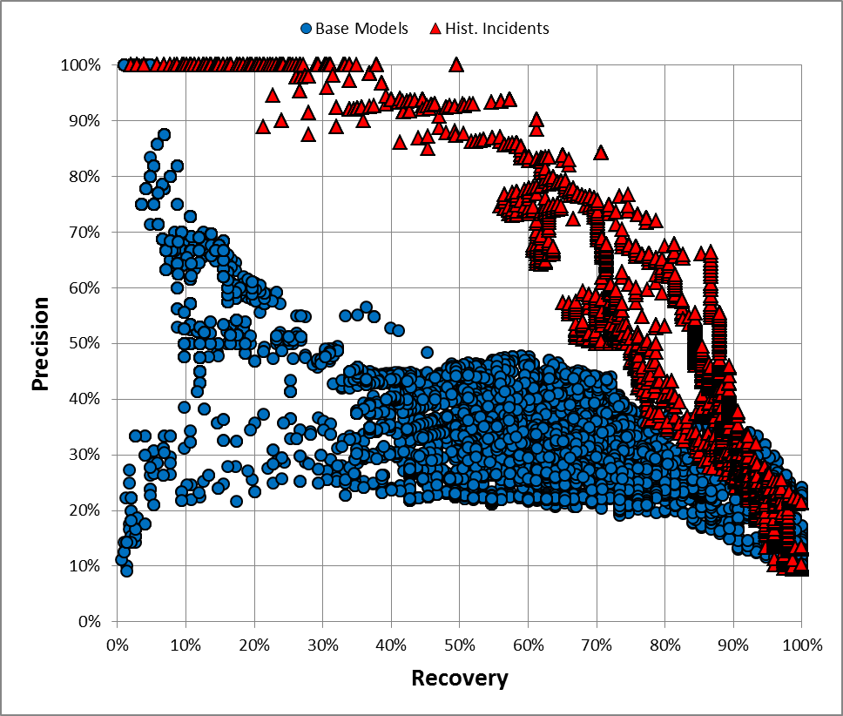
100% Accuracy
More
Correct Flags
Less
Correct Injuries
Less
More

Slide 21
Example #2: Natural Language Processing and Conversations

Slide 22
“The Typical Pre-Job”
Who is he doing this for?
Is this serving the intended purpose?
How does this happen?
Notes:
Other Questions:
How important are PTPs?
1) Is this conversation good or bad?
2) What is your definition of good?
3) Why is this guy doing it this way?
4) How many of these are like this one?
5) Do your ops guys find these interesting…do they even pay attention to these?
6) How would we typically try to make these better?
7) How would we know if it worked?

Slide 23
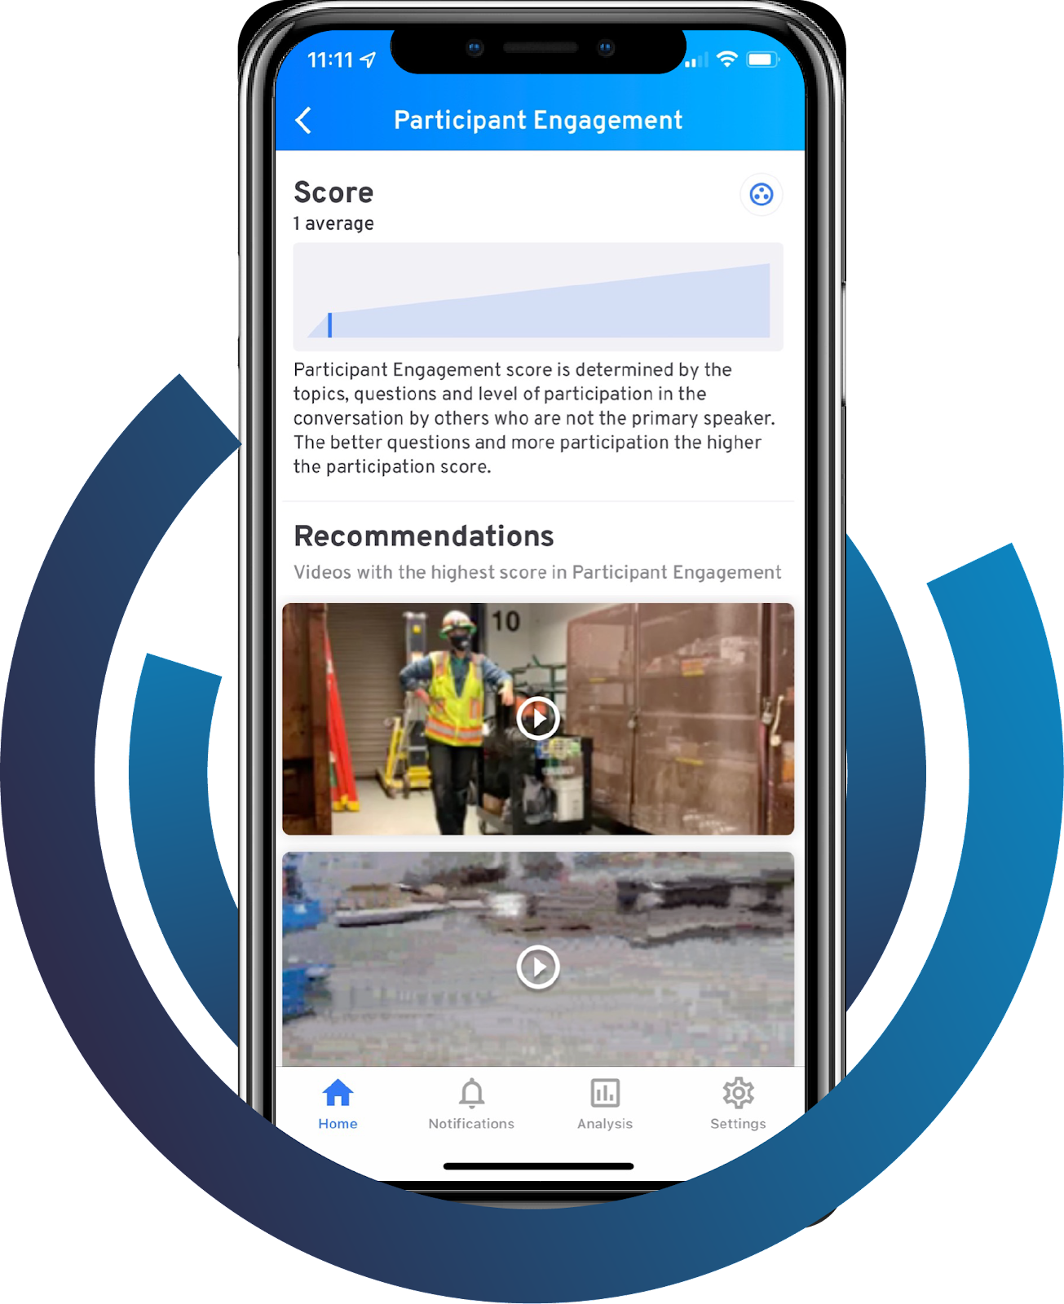
What we Discovered with NLP
Based >300K Conversations:
JHAs were not what we expected
Activity is broken
Conversations were limited
Significant lack of alignment
Notes:
This is what we learned and we know technology would help…..

Slide 24
ENGAGEMENT
PLANNING
There’s back and forth.
The conversation is a two-way dialogue, not a one-way lecture.
They cover all the bases.
Everyone understands the
expectations for the day’s work.
Leader Engagement: The person leading the conversation is asking the crew questions that prompt thoughtful responses, not canned replies.
Participant Engagement: Multiple crew members are answering questions, asking new ones, and responding to each other.
Planning and Work: As well as talking about hazards, the leader also covers the day’s work and expectations.
Question Quality: The leader’s questions are framed to elicit meaningful responses that move the conversation forward and establish common understanding.
The Simple Seven
They move past compliance to care.
Effort is made to foster trust, convey respect, and promote authentic sharing.
They discuss risk, big and small.
Above all, everyone talks about
what’s needed to keep each other safe.
Active Caring: The safety leader demonstrates genuine interest in the conversation, uses words like “please” and “thank you,” and makes people feel comfortable speaking up and participating without fear of judgement.
Real Hazards: The leader addresses the hazards and controls related to the day's work and encourages others to add to the discussions and report unsafe conditions or behaviors.
High Hazards: Everyone is made aware of the hazards and controls associated with potential serious injuries and fatalities.
CARE
HAZARDS
Notes:
Previous research

Slide 25
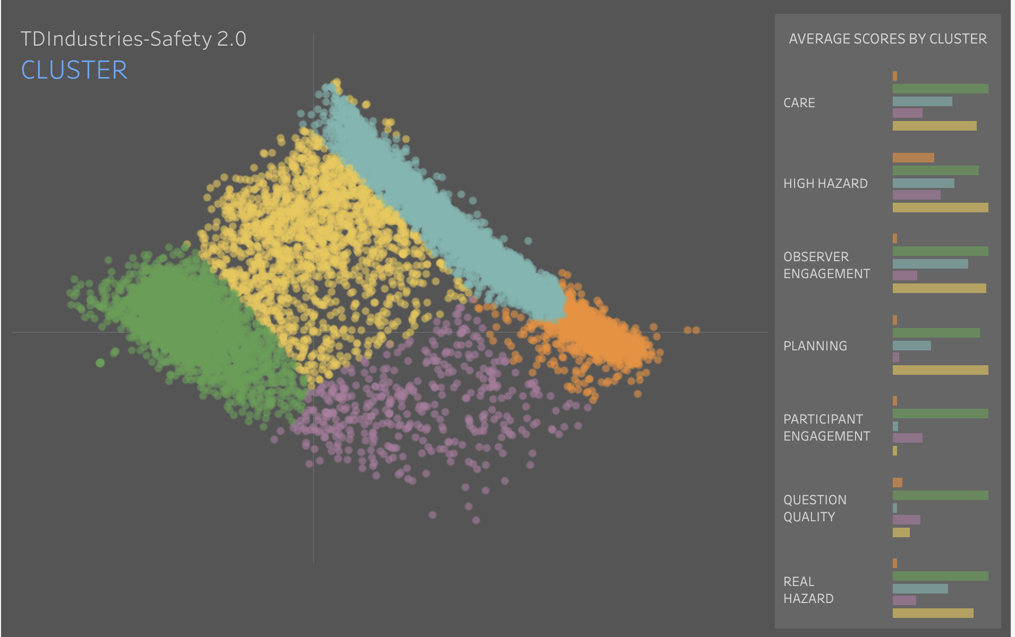
Listen and Organize over 300K Conversations
Strongest
Preachers-Low Planning
Individual conversations paint an otherwise unseeable picture of our culture
Unclear On Activity Purpose
Preachers- Higher Planning
Weak on Most Elements
Notes:
.

Slide 26
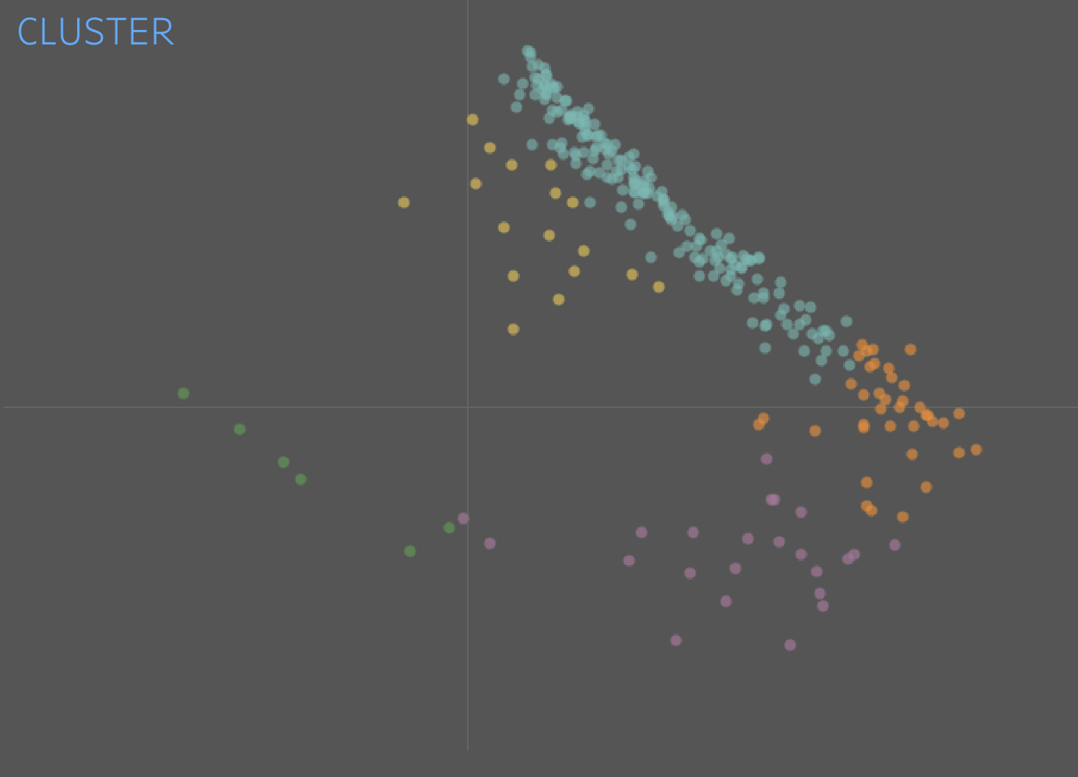
1st 6 Months

Slide 27
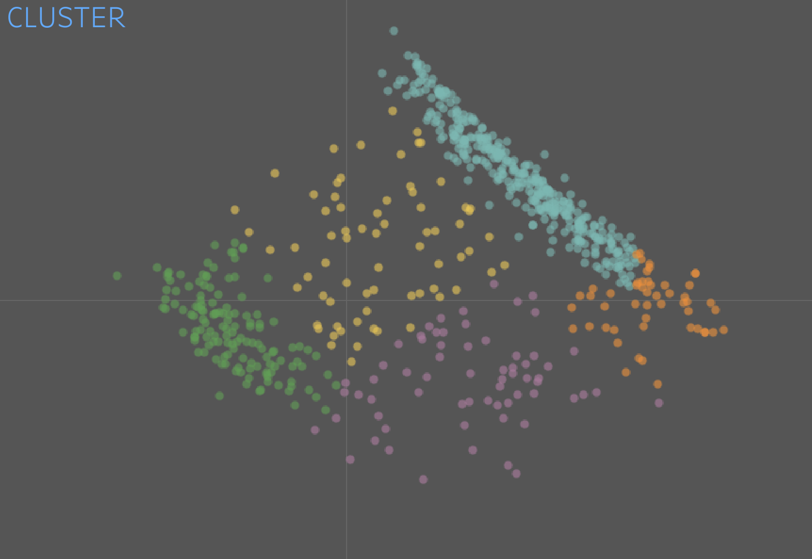
2nd 6 Months

Slide 28
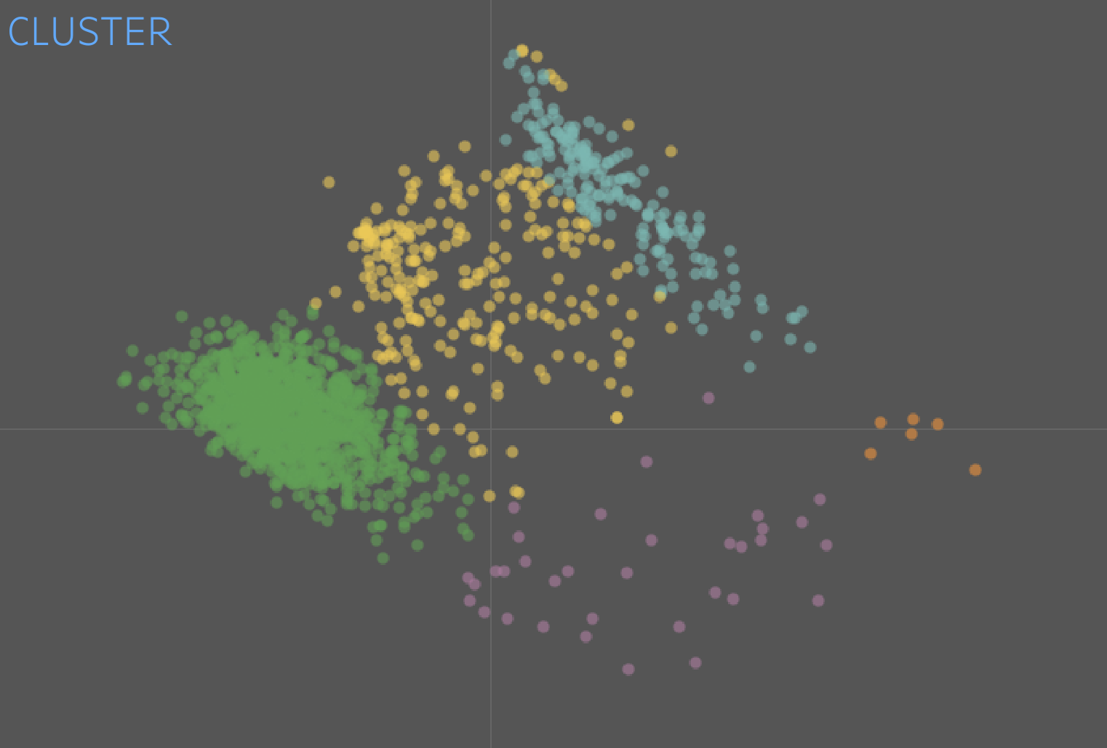
Last 6 Months

Slide 29
Example #3: Natural Language Processing Benchmarking

Slide 30
Captive Insurance Does engagement and providing members with SIF & top 5 hazard categories have an impact on claims?
Normalized frequency and quality of engagement across members.
Create member data pipeline with benchmark of risk and SIF indicators.
Facilitate member discussion of SIF and risk indicators.

Slide 31
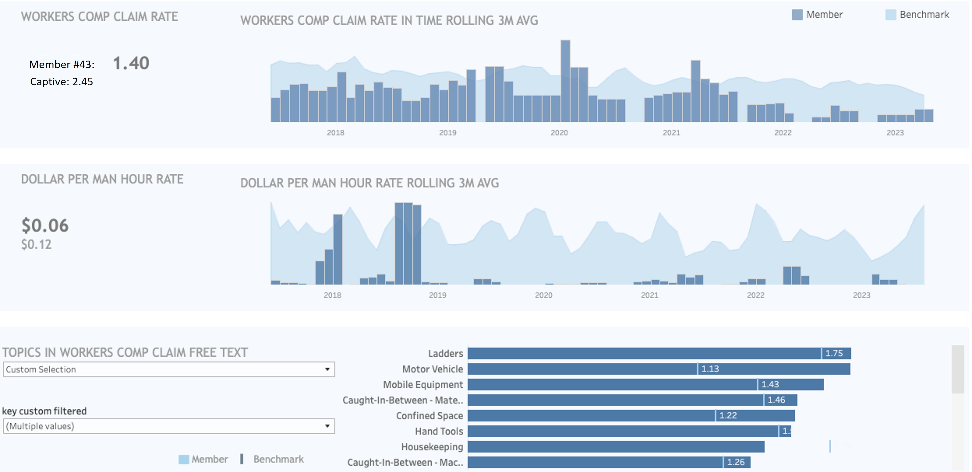

Slide 32
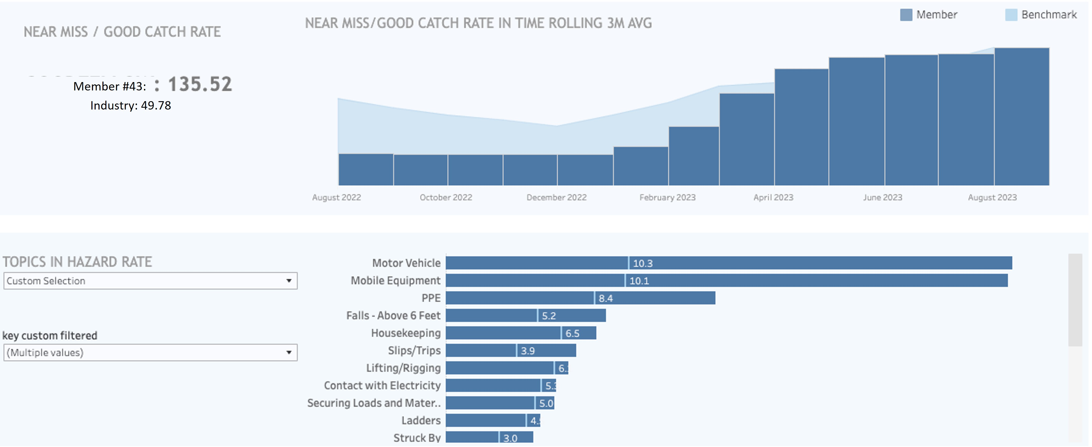

Slide 33
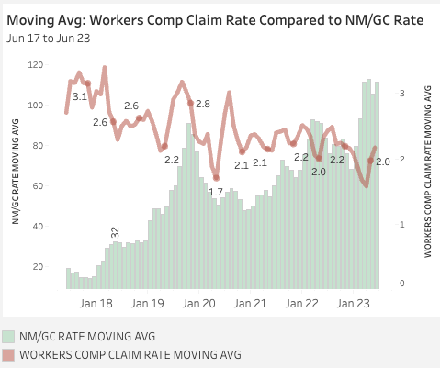
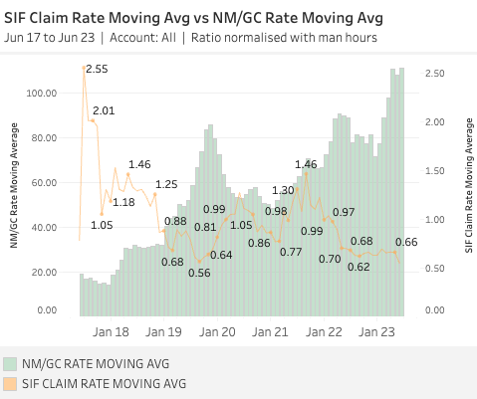
Did it Make an Impact?

Slide 34
Example #4: NLP and Generative Text

Slide 35
Q:
Are Most Written PTP’s Documents Useful?
Notes:
Many, probably most, organizations are embedded in the idea of written documentation. Some organizations believe that the document with some signatures provides evidence of leaders and teams engagement in the work of the day. You will see that is not always the case. We are going to show you how to help leaders and teams have better conversations through more information-on demand.

Slide 36
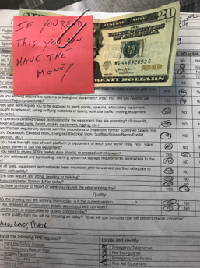
The Challenge
Perceived waste of time
People don’t like to write
Often pencil whipped
Mix language issues
Notes:
A safety supervisor put this note and a $20 bill on the PTP document. The note says "If you read this you can have the money." He put the signature side of the form face up on the table.

Slide 37
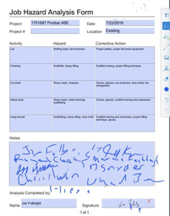
The Challenge
If work is similar, how much re-writing is a waste of time?
Are we really getting critical thinking?
Does everyone really participate in the writing?
Why not give people the information and then let them focus on the conversation?
Notes:
The organizational challenge is building community. The organization must lead, let the field know what is the desired performance. The desired workplace community has good information, high level of engagement, active participation with questions and alternative views sometimes. What can we do to help leaders and teams become more engaged and effective?

Slide 38
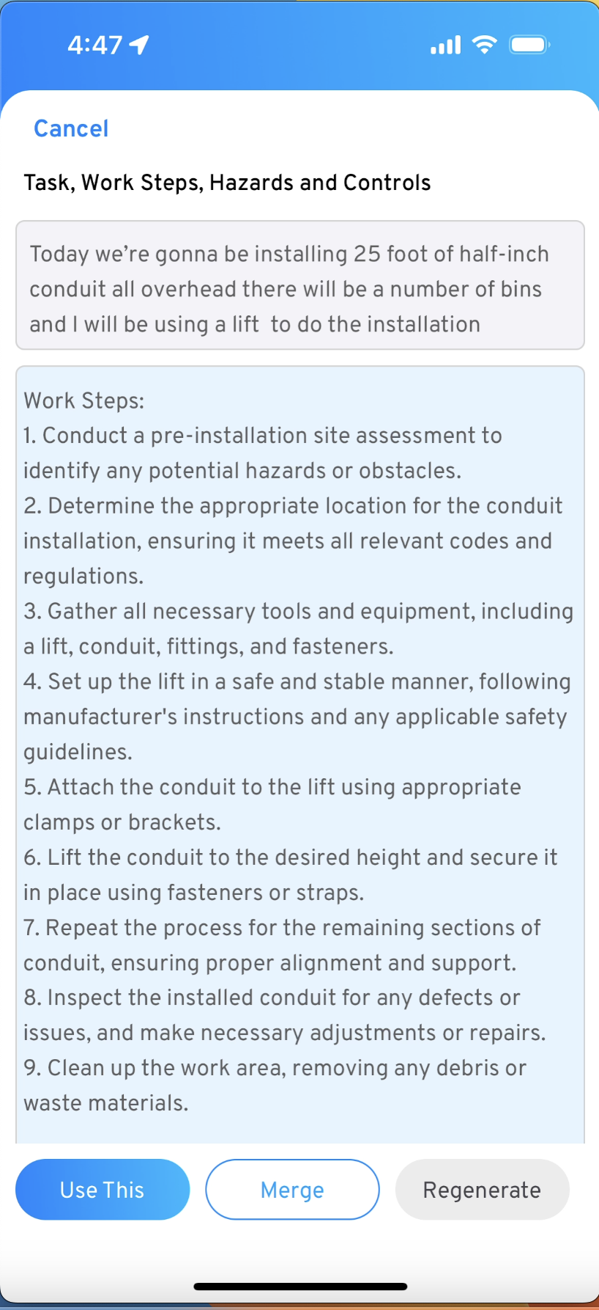
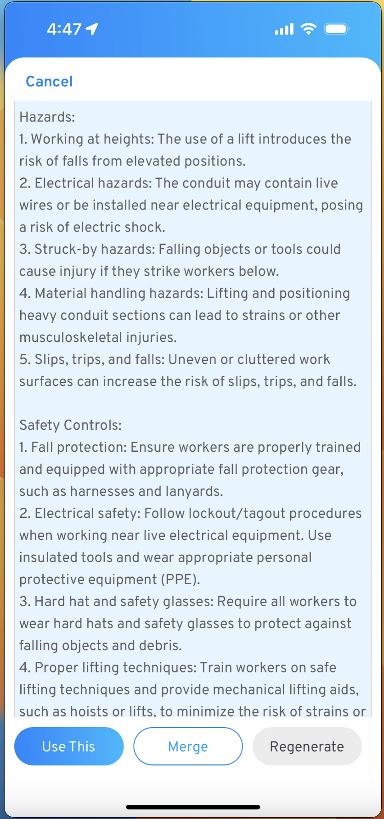
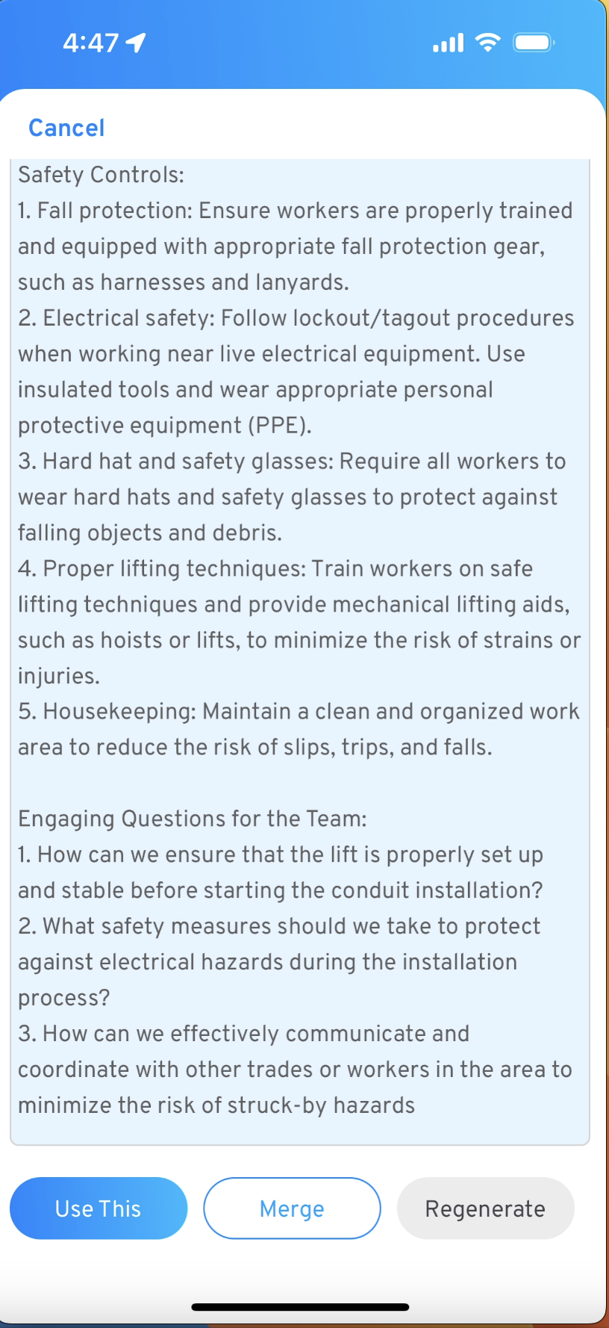

Slide 39
Preliminary Feedback on the AI Generated Results
Filled in the gaps
Catches what we may have missed previously
Provided in multiple languages
Does not slow you down for repetitive work
Integrated into existing PTP documents
Compliments critical thinking steps
More professional / legible / useable

Slide 40
Recommendations from Contractor
Use this as a force multiplier – not enough safety people
Competently describe the entire scope of work
Consider using in conjunction with video of PTP conversation
Read the AI results and compare with your current written documents
Build community/inclusivity by including multiple languages

Slide 41
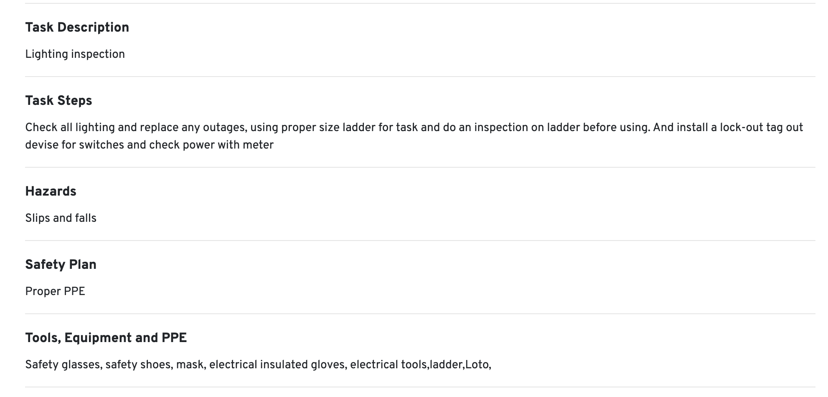
Example: Typical Written PTP
Notes:
.

Slide 42
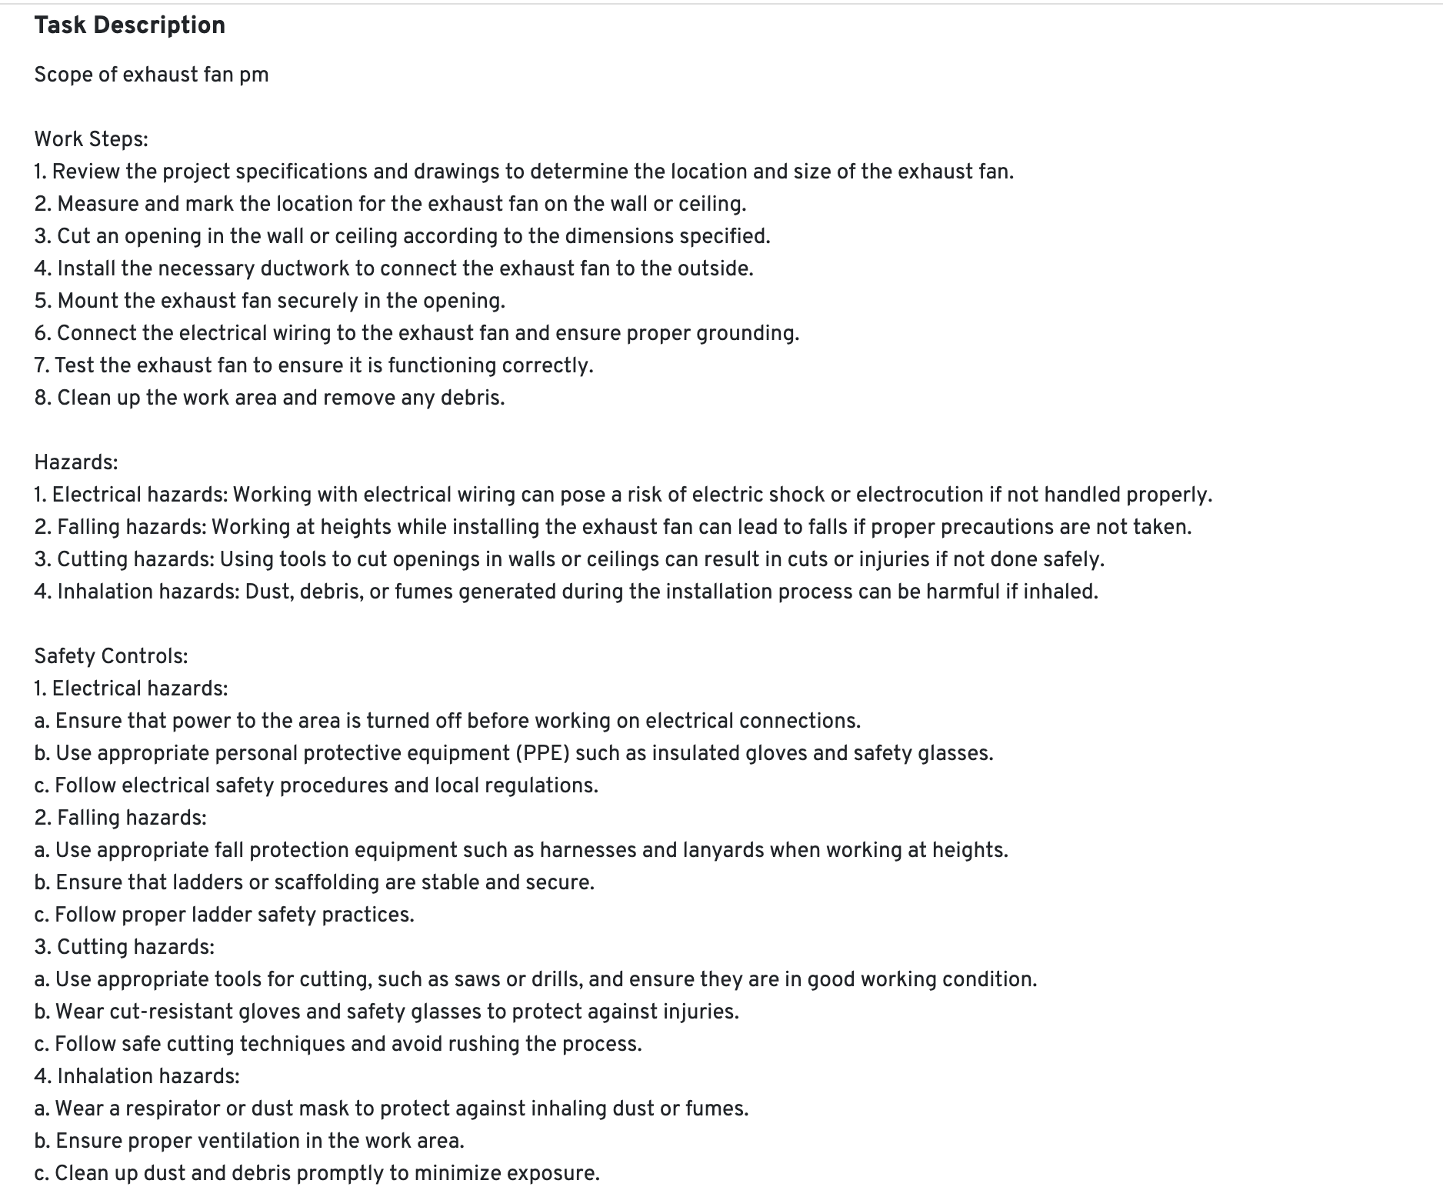
Example: PTP Assist
Notes:
.

Slide 43
Other AI Assist Benefits
Toolbox Talks – customized to the work
Review regulations – for infrequent tasks
Customized to industry – make it relevant to your industry
Safety Observations – no checking dozens of boxes

Slide 44
Take part in our research project!

Slide 45
Research Questions:
Is the information provided from the AI beneficial?
What barriers or challenges did you encounter?
What does the field team prefer?
What did you learn that was not expected?
Did the crew save time?

Slide 46
Want to Participate in our Research?
Absolutely Free for 6 months
Customized to your PTP process
Zero obligation
Up to 100 written PTP Assists / month
Access to benchmarking and results
More information on
AI Assist

Slide 47
Follow us!
LinkedIn
FactorLab.com

Slide 48
Chuck Pettinger, Ph.D. – 540.230.7233 – Chuck@FactorLab.com
Q/A

