Slide 1
Water Update
Tom DeLawrence
Balch & Bingham LLP
tdelawrence@balch.com
(205) 226-3434

Slide 2
Introduction
1. Waters of the United States (“WOTUS”)
2. County of Maui v. Hawaii Wildlife Fund (Functional Equivalent Test)
3. Per-and polyfluoroalkyl substances (PFAS)

Slide 3
WOTUS
Jan. 18, 2023: EPA/Corps issue Revised Definition of WOTUS rule
May 25, 2023: Sackett v. EPA, 143 S. Ct. 1322 (2023)
Aug. 29, 2023: EPA/Corps issue “conforming” WOTUS rule

Slide 4
Sackett - SCOTUS Concerns
“Crushing consequences”
Civil penalties - $60,000+/day/violation
Criminal penalties/imprisonment
States’ rights
Vagueness
“most laws do not require the hiring of expert consultants to determine if they even apply to you”
Limited ability to obtain clarity (AJDs)
Expense
Time

Slide 5
Sackett – At Issue
Idaho wetland > 30-ft road > unnamed tributary > non-navigable creek > Priest Lake
What constitutes a jurisdictional wetland?
What are “the waters” of the U.S.?

Slide 6
Sackett - Wetlands
Significant nexus – eliminated
Certain wetlands are “includ[ed]” in the WOTUS definition (§ 1344(g)(1))
Adjacent=continuous surface connection
“indistinguishable from WOTUS”; no clear demarcation
“difficult to determine where the ‘water’ ends and the ‘wetland’ begins”
“temporary interruptions” in surface connection may sometimes occur → low tides or dry spells
Note: Illegally constructed barrier

Slide 7
Sackett - Waters
Significant nexus - eliminated
Sackett: “[W]e conclude that the Rapanos plurality was correct: the CWA’s use of “waters” encompasses “only those relatively permanent, standing or continuously flowing bodies of water ‘forming geographic[al] features’ that are described in ordinary parlance as ‘streams, oceans, rivers, and lakes.’”
Rapanos: “All of these terms connote continuously present, fixed bodies of water, as opposed to ordinarily dry channels through which water occasionally or intermittently flows.”

Slide 8
Sackett – Waters (cont’d)
FN5: “By describing “waters” as “relatively permanent,” we do not necessarily exclude streams, rivers, or lakes that might dry up in extraordinary circumstances, such as drought. We also do not necessarily exclude seasonal rivers, which contain continuous flow during some months of the year but no flow during dry months—such as the 290-day, continuously flowing stream postulated by [the] dissent. Common sense and common usage distinguish between a wash and seasonal river.”
“[C]hannels containing permanent flow are plainly within the definition, and . . . the dissent’s “intermittent” and “ephemeral” streams—that is, streams whose flow is “[c]oming and going at intervals … [b]roken, fitful,” or “existing only, or no longer than, a day; diurnal … short-lived”—are not.”
FN6: “Stream” definition = continuous or steady flow; continued current
Intermittent and ephemeral waters constitute “streams” when flowing, “[b]ut no one contends that federal jurisdiction appears and evaporates along with the water in such regularly dry channels.”

Slide 9
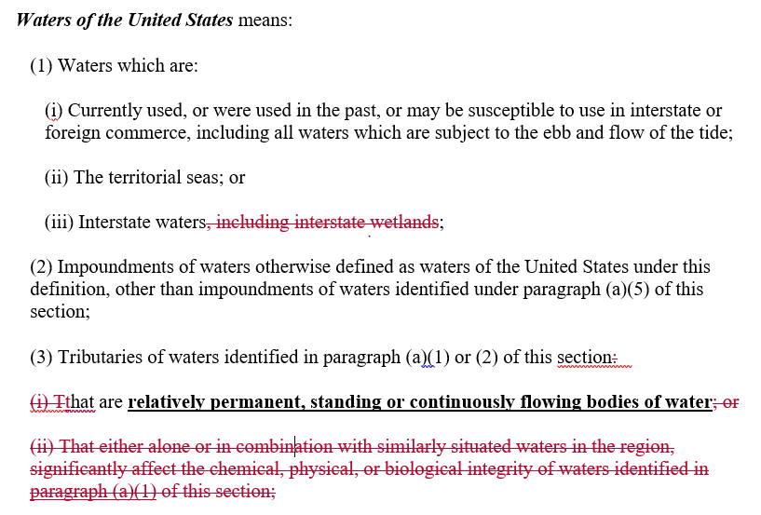
Conforming WOTUS Rule

Slide 10
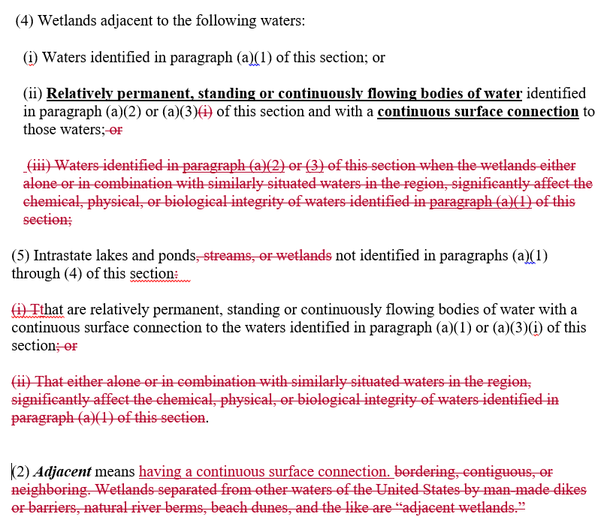
Conforming WOTUS Rule

Slide 11
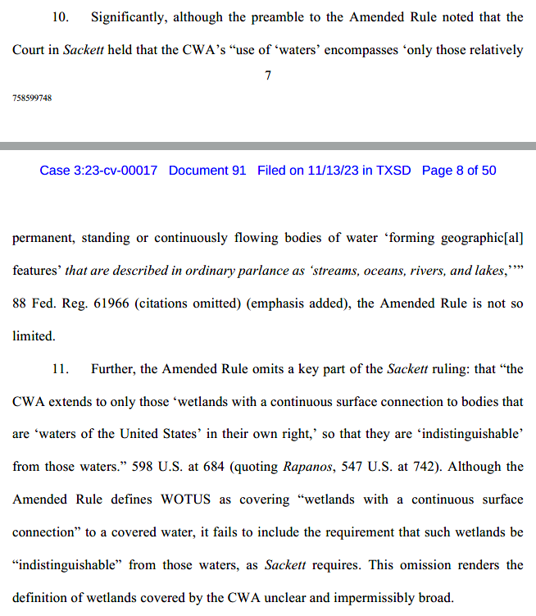
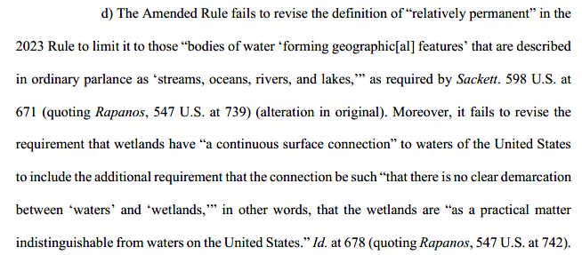
Legal Challenges

Slide 12
County of Maui, Hawaii v. Hawaii Wildlife Fund (USSC 2020)
Non-exhaustive 7-factor test
Transit time
Distance traveled
The nature of the material through which the pollutant travels
The extent to which the pollutant is diluted or chemically changed as it travels
The amount of pollutant entering the navigable waters relative to the amount of the pollutant that leaves the point source
The manner by or area in which the pollutant enters the navigable waters
The degree to which the pollution (at that point) has maintained its specific identity

Slide 13
Maui – Subsequent Activity
Maui remand (D. Hi. 2021): Functional equivalent discharge (FED) found; NPDES permit needed
BWRK v. Drummond (D.C. Ala. 2022): FED found on summary judgment; no appeal
Stone v. High Mt. Mining Co., Ltd. Liab. Co. (D. Colo. 2022): FED found after bench trial; appealed to 10th Cir.
Cottonwood Envtl. Law Ctr. V. Edwards (D. Mont. 2021): FED not found after jury trial; appealed to 9th Cir.
Conservation Law Found., Inc. v. Town of Barnstable (D. Mass. 2022); Defendant’s motion to dismiss granted; No FED; no appeal
EPA/States? NPDES permits?
Sackett impact?

Slide 14
PFAS – Quick Overview
Water Infrastructure Finance and Innovation Act (WIFIA)
Sept. 2023: $7.5B in program financing available; 7th round of funding
Bipartisan Infrastructure Law funds still available
Toxic Pollutants and Priority Pollutants
NGOs Petitioned EPA to update its list for the first time in 47 years
Requested addition of 1,000+ toxic chemicals
Discharge Monitoring (Dec. 2022 EPA Memorandum)
NPDES Monitoring
POTW Monitoring

Slide 15
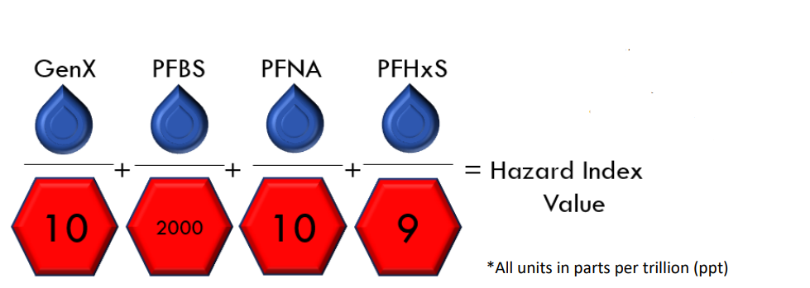
PFAS – Quick Overview
Proposed PFAS National Primary Drinking Water Regulation

Slide 16
Questions?
Tom DeLawrence
Balch & Bingham LLP
tdelawrence@balch.com
(205) 226-3434

