Slide 1
Land Division Update
Stephen A. Cobb, Chief
Land Division
Manufacture Alabama Safety and Environmental Conference
November 16, 2023
Ross Bridge Resort

Slide 2
Land Division Update
Personnel Update
CCR Update
Program Modernization
Compliance Activities
Rulemaking Update

Slide 3
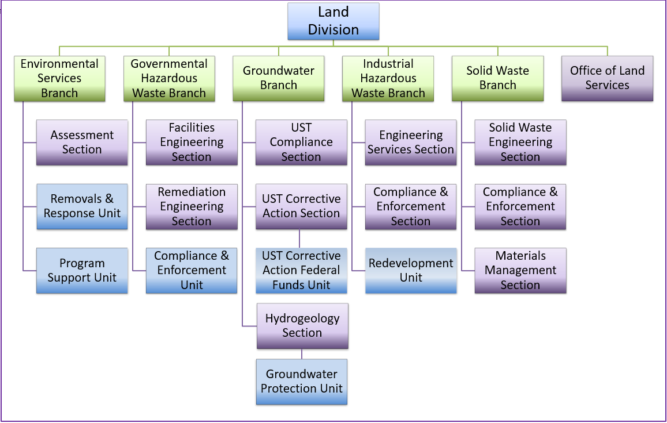
Land Division Organizational Chart

Slide 4
Land Division Branch Chiefs
Clethes Stallworth, Chief – Environmental Services Branch
334-271-7743 – cs@adem.alabama.gov
Ashley Mastin – Governmental Hazardous Waste Branch
334-271-7789 – atmastin@adem.alabama.gov
Chip Crockett, Chief – Groundwater Branch
334-271-7832 – vhc@adem.alabama.gov
Sonja Favors, Chief – Industrial Hazardous Waste Branch
334-270-5627 – smb@adem.alabama.gov
Jason Wilson, Chief – Solid Waste Branch
334-271-7755 – jwilson@adem.alabama.gov

Slide 5
Recent Personnel Changes
Program Support
Unit Chief
Otis Todd
334-271-7741
Remediation Engineering Section Chief
Justin B. Rigdon
334-271-7797
jbrigdon@adem.alabama.gov
otodd@adem.alabama.gov

Slide 6
CCR Authorization Update
Authorization Package submitted to EPA
- December 29, 2021
Completeness Determination from EPA Headquarters
- Status: Proposed Denial
ADEM filed suit to compel action on 4/3/2023
Proposed Denial published in Federal Register on 8/3/2023
Comment period ended on 10/13/2023
ADEM response submitted to docket on 10/13/2023
Next Steps
EPA Final Decision on Program Approval
Continuation of Program Implementation
CCR facilities are subject to both state and federal rules
- Until Program Approved by EPA

Slide 7
CCR Implementation Update
CCR Permitting
CCR Permits for all currently regulated facilities have been issued
Closure activities proceeding for all closing CCR Units
CCR Corrective Measures
Revised ACMs for all facilities have been received
ADEM currently working through second review of ACMs
Groundwater remediation evaluations are ongoing
Notes:
The initial Assessment of Corrective Measures (or ACM) has been submitted for all of the subject facilities. All of the proposals include the element of source control via capping of the unit. After closure of the unit is complete, monitored natural attenuation (or MNA) would be the primary remedy. With MNA, processes that already occur in nature are allowed to take place, while being monitored, so that groundwater is gradually remediated over time. If remediation goals are not achieved, then the remedy will be revised to address site specific conditions.
After reviewing the initial ACMs, the Department issued comments to the facilities in November of 2019. The Department’s comments addressed the fact that in many cases the groundwater investigation was still underway, and therefore, selection of a remedy was premature. In addition, the adaptive technologies provided as part of the proposed remedies were too abstract or vague. To date, the Department has only received one revised ACM, in part because groundwater investigations were still underway at a number of facilities. The investigations are expected to be complete in the near future.

Slide 8
Program Modernization: AEPACS
Land programs currently operating in AEPACS:
Recycling Program (Registrations and Grant Fund)
Scrap Tire Program (Registrations/Permits & Grant Fund)
Unauthorized Dump/Scrap Tire Sites
Scrap Tire County Right of Way Program
Unauthorized Dump County Right of Way Program (NEW)
UST Program (Compliance & Corrective Action)
Development of other Land program components scheduled for 2023/2024:
Beneficial Use, rest of Solid Waste, 8700-12, Hazardous Waste Transporters, and Medical Waste.

Slide 9
Program Modernization: RCRAInfo Industry Application
Current ADEM ePermit portal permanently closing on November 30, 2023
ADEM opted in to the RCRAInfo myRCRAid Module on October 31, 2023
National EPA Hazardous Waste Database
Module will allow external users to electronically submit notifications for regulated waste activity (8700-12)
External users will create an account to submit:
8700-12
Biennial Report
eManifest
*If currently using application for Biennial Report or eManifest, then an account will not need to be created*

Slide 10
Hazardous Waste Enforcement Update
Various efforts have been employed to reduce the number of significant non-compliers (SNCs) in program
Quarterly outreach to TSDFs and Large/Small Quantity Generators
via email
Numerous presentations at various conferences around state
Video calls/discussions
Development of videos for website posting
#1 Common Inspection Finding Leading to SNC Determination
TSD Storage > 1 year or storage in unpermitted areas
LQG Storage > 90 days
SQG Storage > 180 days
Compliance Assistance Videos can be found on ADEM’s website

Slide 11
Solid Waste Enforcement Update
SW Compliance Issues
Failure to Cover
Lack of over at end of day/week
Exposing waste during new cell construction/liner tie-in
Leachate
Failure to properly collect/dispose
Depth on liner > 12 inches
Discharge to a water of the State
Disposal in Unpermitted area
Cell certification
Lack of disposal boundary markers
Disposal of Hazardous Waste
Fire

Slide 12
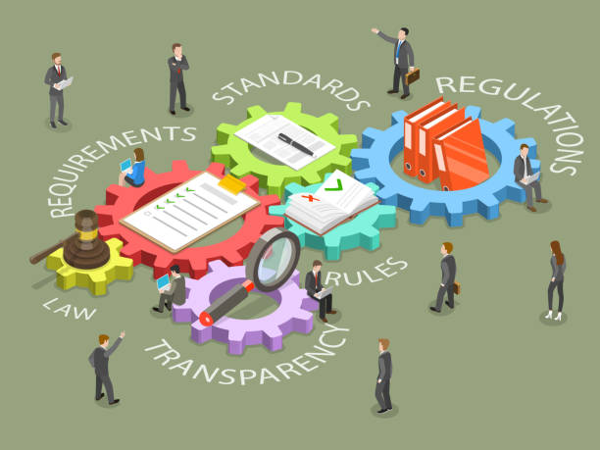
Rulemaking Update
Hazardous Waste Program (Division 14)
Environmental Covenants (Division 5)
Brownfields (Divisions 1 and 15)
Future Rulemaking

Slide 13
Division 14 (Hazardous Waste)
Rule Effective Date: June 12, 2023
Rule adoption included the following FRs:
Modernizing Ignitable Liquids Determinations
85 FR 40594
Published: July 7, 2020; Effective: September 8, 2020
Conforming Changes to Canada Specific HW Import-Export Recovery and Disposal Operation Codes
86 FR 54381
Published: October 1, 2021; Effective: October 31, 2021
Other updates
Technical Corrections to existing rules

Slide 14
Division 5 (Environmental Covenants)
Public Notice August 23, 2023
Public Hearing held on October 12, 2023
Projected EMC Consideration December 2023
Proposed Changes: Update language to comply with updated/revised state law

Slide 15
Division 15 (Brownfields)
Public Notice October 25, 2023
Public Hearing scheduled for December 14, 2023
Projected EMC Consideration February 2024
Proposed Changes: revisions to enhance job creation and economic and to comply with updated/revised state law.

Slide 16
Division 1 (Brownfields/General Administration)
Public Notice October 25, 2023
Public Hearing scheduled for December 14, 2023
Projected EMC Consideration February 2024
Proposed Changes: revisions to incorporate changes to Fee Schedule H-Brownfield Redevelopment and Voluntary Cleanup Program. These changes are necessary to comply with recent statutory changes.

Slide 17
Future Rulemaking
Planned General Updates include:
Medical Waste - Div. 335-17
Scrap Tire Regulations – Div. 335-4
Recycling Regulations - Div. 335-13

Slide 18
Contact Information
Stephen A. Cobb, Chief
Land Division
(334) 271-7730
sac@adem.alabama.gov

