Slide 1
ADEM AIR UPDATE
Ron Gore
Alabama Department of Environmental Management
November 2023

Slide 2
NAAQS
Tighter PM-Fine Standard Coming
Before end of year?
As low as 9 ug/m³
2 or 3 years before non-attainment areas named.
Tighter Ozone Standard
EPA delaying for several years.
Secondary ozone and NO_{x}/SO₂ standards?

Slide 3
Counties with PM2.5 Monitors
Lauderdale
Limestone
Madison
Jackson
Colbert
Franklin
Lawrence
Morgan
DeKalb
Marshall
Marion
Winston
Cullman
Etowah
Cherokee
Walker
Blount
Lamar
Fayette
Calhoun
Jefferson
St.
Clair
Cleburne
Talladega
Pickens
Tuscaloosa
Shelby
Clay
Randolph
Greene
Bibb
Coosa
Tallapoosa
Chambers
Hale
Chilton
Sumter
Perry
Elmore
Lee
Autauga
Dallas
Montgomery
Macon
Marengo
Russell
Choctaw
Lowndes
Bullock
Wilcox
Barbour
Clarke
Butler
Pike
Monroe
Crenshaw
Henry
Washington
Conecuh
Coffee
Dale
Escambia
Covington
Houston
Mobile
Geneva
Baldwin
Annual PM2.5 > 9.5 µg/m3
Annual PM2.5 ≤ 9.5 µg/m3
*Based on monitors within each county.

Slide 4
Counties with Design Values above
9 µg/m3 for 2020-2022
Lauderdale
Limestone
Madison
Jackson
Colbert
Franklin
Lawrence
Morgan
DeKalb
Marshall
Marion
Winston
Cullman
Etowah
Cherokee
Walker
Blount
Lamar
Fayette
Calhoun
Jefferson
St.
Clair
Cleburne
Talladega
Pickens
Tuscaloosa
Shelby
Clay
Randolph
Greene
Bibb
Coosa
Tallapoosa
Chambers
Hale
Chilton
Sumter
Perry
Elmore
Lee
Autauga
Dallas
Montgomery
Macon
Marengo
Russell
Choctaw
Lowndes
Bullock
Wilcox
Barbour
Clarke
Butler
Pike
Monroe
Crenshaw
Henry
Washington
Conecuh
Coffee
Dale
Escambia
Covington
Houston
Mobile
Geneva
Baldwin
Annual PM2.5 > 9 µg/m3
Annual PM2.5 ≤ 9 µg/m3
*Based on monitors within each county.

Slide 5
METROPOLITAN STATISTICAL AREAS
Lauderdale
Madison
Colbert
Limestone
Anniston/Oxford
Lawrence
Morgan
Birmingham
Montgomery
Blount
Etowah
Columbus
Walker
St. Clair
Calhoun
Jefferson
Tuscaloosa
Pickens
Tuscaloosa
Shelby
Florence/
Muscle Shoals
Greene
Bibb
Chilton
Decatur
Hale
Mobile
Autauga
Elmore
Lee
Dothan
Macon
Russell
Lowndes
Montgomery
Huntsville
Gadsden
Henry
AU/Opelika
Washington
Daphne-
Fairhope-
Foley
Geneva
Houston
Mobile
Baldwin

Slide 6
MICROPOLITAN STATISTICAL AREAS
Talladega/Sylacauga
Limestone
Madison
Jackson
Ozark
Franklin
Marshall
DeKalb
Enterprise
Cullman
Scottsboro
Selma
Albertville
Talladega
Troy
Coosa
Chambers
Tallapoosa
Alexander City
Valley
Dallas
Cullman
Fort Payne
Pike
Barbour
Quitman
Eufaula
Coffee
Dale
Russellville
Houston
Mobile

Slide 7
COMBINED STATISTICAL AREAS
Columbus-AU-Opelika¹
Lauderdale
Madison
Jackson
Colbert
Limestone
Atlanta-Athens- Clark County-Sandy Springs²
Franklin
Lawrence
Morgan
Marshall
DeKalb
Huntsville-Decatur-
Albertville³
Cullman
Blount
Chattanooga-Cleveland-Dalton⁴
Walker
St. Clair
B’ham-Cullman-Talladega
Jefferson
Talladega
Mobile-Daphne-Fairhope
Shelby
Bibb
Chilton
Coosa
Tallapoosa
Chambers
Montgomery-Alexander City
Florence-
Muscle Shoals-
Russellville
Autauga
Elmore
Lee
Macon
Russell
Dothan-
Enterprise-
Ozark
Lowndes
Montgomery
Dale
Henry
Coffee
Geneva
Houston
Mobile
Includes 6 GA counties
Includes 40 GA counties
Includes 1 TN county
Includes 6 GA and 7 TN counties
Baldwin

Slide 8
Worst Case NAA Boundary Scenario
For Proposed Annual PM2.5 at 9 µg/m3
Lauderdale
Limestone
Madison
Jackson
Colbert
Franklin
Lawrence
Morgan
DeKalb
Marshall
Marion
Winston
Cullman
Etowah
Cherokee
Walker
Blount
Lamar
Fayette
Calhoun
Jefferson
St.
Clair
Cleburne
Talladega
Pickens
Tuscaloosa
Shelby
Clay
Randolph
Greene
Bibb
Coosa
Tallapoosa
Chambers
Hale
Chilton
Sumter
Perry
Elmore
Lee
Autauga
Dallas
Montgomery
Macon
Marengo
Russell
Choctaw
Lowndes
Bullock
Wilcox
Barbour
Clarke
Butler
Pike
Monroe
Crenshaw
Henry
Washington
Conecuh
Coffee
Dale
Escambia
Covington
Houston
Mobile
Geneva
CSA Worst Case Scenario
Baldwin
Annual PM2.5 > 9 µg/m3 for
2020-2022 DVs

Slide 9
PSD modeling
Complexity
Almost impossible to meet SO₂ and NO_{x} standards

Slide 10
Title V Petitions
Increased calculations, justifications, references, etc.
More monitoring

Slide 11
Enforcement Orders
Involvement by NGO’s
More upfront involvement by public
Mandatory Supplement Environmental Projects
Assessment of health and effects of excess emissions
HIGHER PENALTIES!

Slide 12
Cumulative Impact & Fenceline Monitoring
Coming

Slide 13
Emission Reporting Proposal by EPA
Huge resource requirements

Slide 14
ADEM Lawsuits vs. EPA
Coal ash
Interstate transport of Ozone

Slide 15
NO_{x} Emissions in Alabama
2022

Slide 16
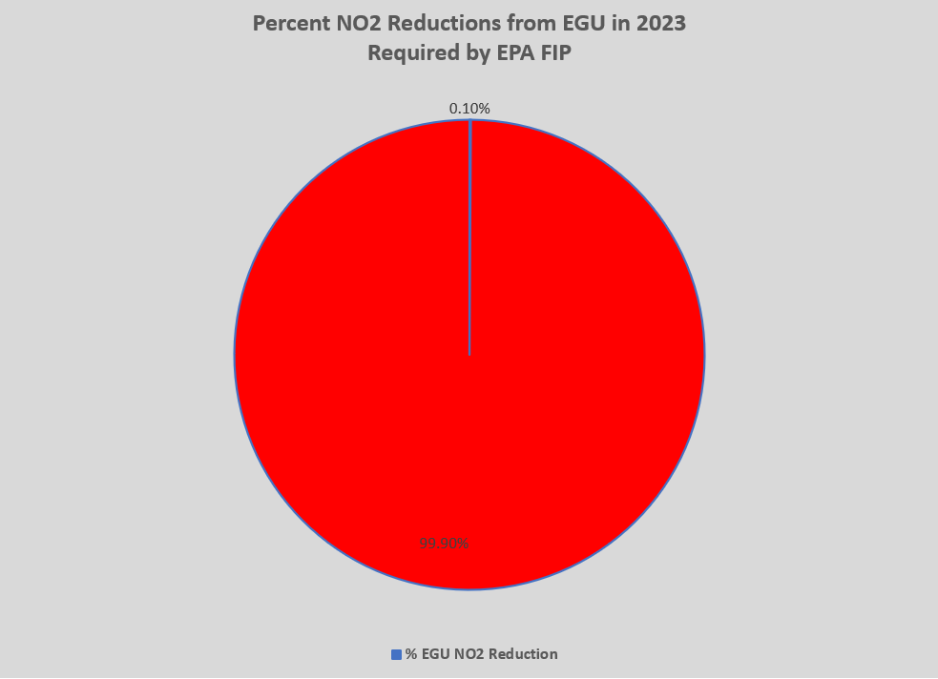

Slide 17
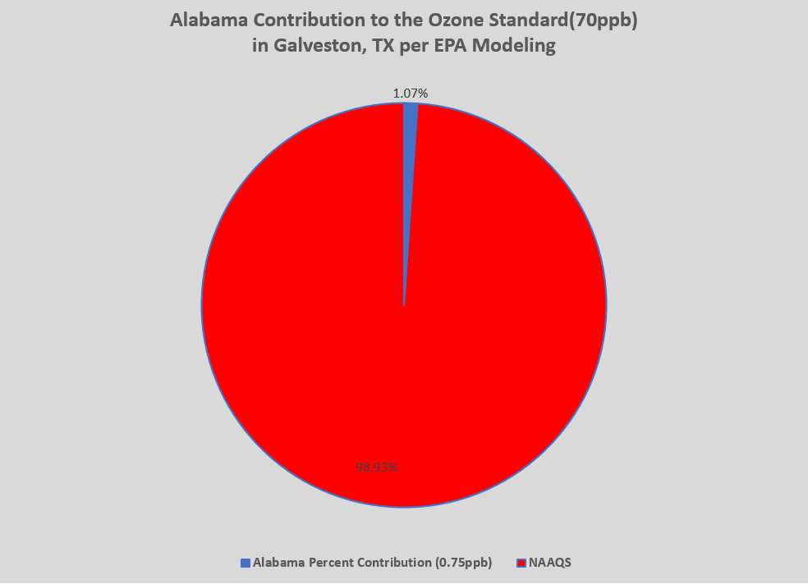

Slide 18
