Slide 1
Regulatory Updates – Air Quality
Brad Arnold
SOLA Environmental
Prepared for:
Manufacture Alabama
November 16, 2023
1
1

Slide 2
Topics of Discussion:
The Challenges of the Regulated Community
New and Proposed Rulemakings
National Ambient Air Quality Standards (NAAQS)
PM_{2.5} Annual Standard
Ozone 2015 Standard
Air Emissions Reporting Requirements (AERR) Proposed Updates
MM2A Proposed Action
Updated AERMOD for Air Dispersion Modeling Analyses
2

Slide 3
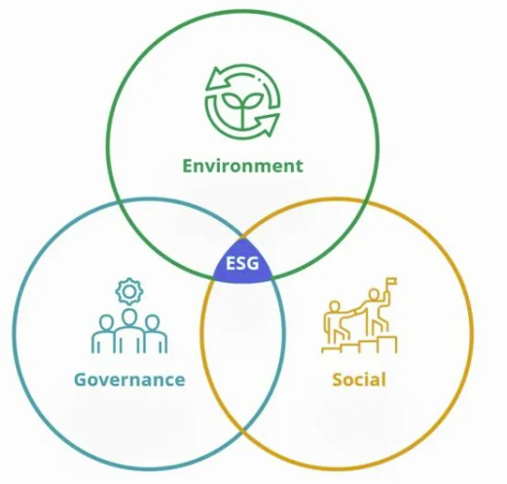
The Challenges of the Regulated Community
Political Seesaw
ESG Interest Growing
Staffing Challenges

Slide 4
PM_{2.5} NAAQS – Rule Schedule
Retained by prior administration as 12 μg/m³ on December 18, 2020.
Executive Order issued by current President to ‘immediately review all actions of prior administration’
Proposed PM NAAQS Rule - 9.0 to 10.0 μg/m^{3*}
Signed January 6, 2023
Published in the FR on January 27, 2023
Public Comment Period
Comments were due March 28, 2023
Georgia EPD submitted comments
Final PM NAAQS Rule – Late 2023?
Action date listed as October 16th, 2023 on EPA’s Events Calendar
*Comments solicited on range as low as 8 μg/m³ and as high as 11 μg/m³

Slide 5
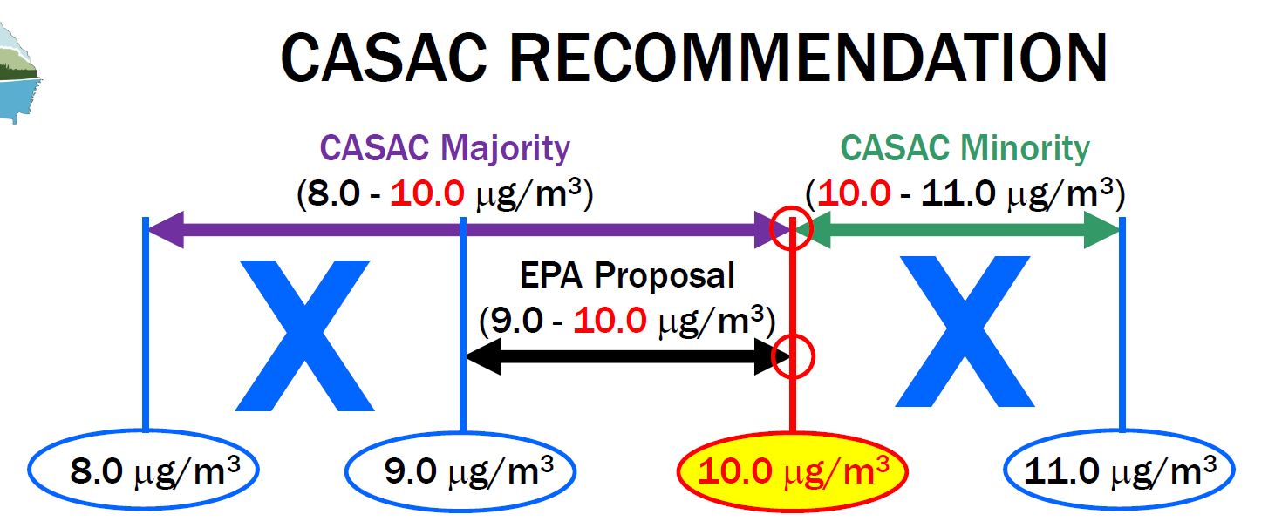
PM_{2.5} NAAQS – CASAC Recommendation

Slide 6
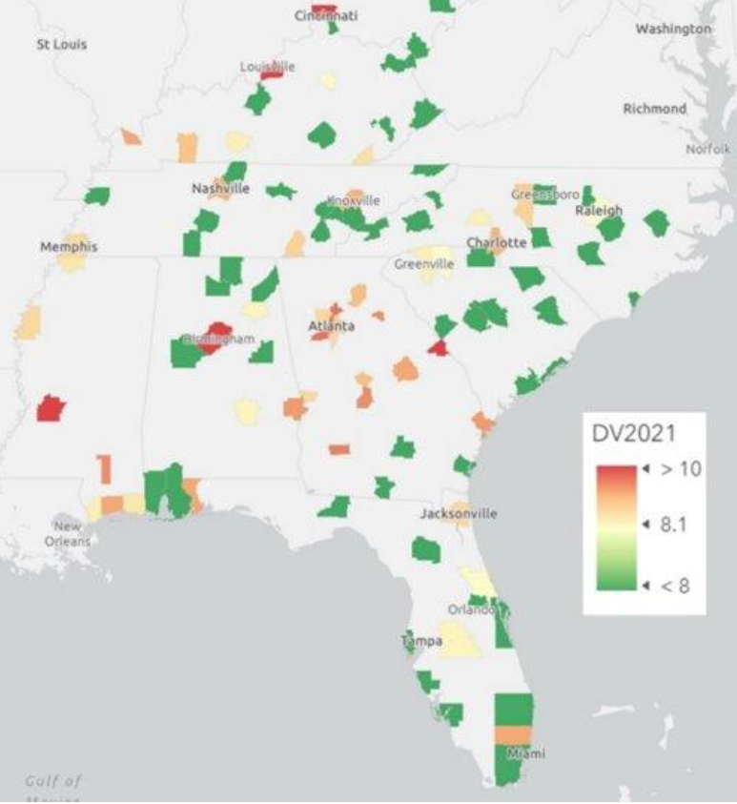
PM_{2.5} NAAQS – Alabama Designations?

Slide 7
PM_{2.5} NAAQS – Implementation Schedule
State’s Designation Recommendations
One year after effective date of new NAAQS
Late 2024 or early 2025 and based on 2021-2023 PM_{2.5} data
EPA’s Final Designations
Two years after effective date of new NAAQS
Late 2025 or early 2026 and Based on 2022-2024 PM_{2.5} data
All areas designated nonattainment must submit an Attainment State Implementation Plan to EPA
Due 18 months after effective date of designations

Slide 8
Ozone NAAQS – Rule Schedule
December 2020 retention and January 2021 EO directing to review retention
June 2023: CASAC assessment issued, calling for a more stringent, protective ozone standard
August 21, 2023: EPA responds to CASAC assessment by announcing a new Ozone NAAQS review
Sometime in 2024: public workshops and Integrated Review Plan
New ozone standard in 2026?

Slide 9
AERR Rule – Proposed Updates
Proposed Update Timeline
July 25, 2023: EPA announced proposed updates to the Air Emissions Reporting Requirements (AERR) rule.
EPA has extended the period to submit written comments on the proposed AERR to November 17, 2023.
Significant Proposed Changes
Requires Hazardous Air Pollutant (HAP) emissions data for point sources (starting in 2027).
Requires inclusion of mobile sources.
Associated Challenges?
According to EPA, the Updated AERR will cost over $3 billion over the next 10 years, impact over 120,000 facilities including approximately 43,000 small businesses.
EPA is proposing that owners/operators use the “best available” estimation techniques – which is ambiguous in the proposed update.

Slide 10
MM2A – Redo of the Undo?
Original Policy
In 1995, EPA issued the “Once In, Always In” Policy and determined that any facility subject to major source hazardous air pollutant (HAP) emissions standards would always remain subject to those standards.
Policy Withdrawal
January 25, 2018: EPA issued a guidance memorandum withdrawing the policy for the permanent classification of major sources of HAPs.
Proposed Amendment to Withdrawal
Would require sources, that choose to reclassify from major sources to area sources, to establish federally enforceable permit conditions that contain safeguards to prevent emission increases above the levels allowed by the major source NESHAP a source was subject to prior to reclassification
Sources that took advantage of the policy withdrawal already would have three years to add these federally enforceable limits to their permit.

Slide 11
AERMOD Update – Released October 23, 2023
New Tier 3 NOx Chemistry Algorithm
Addition of a new Tier 3 NOx chemistry algorithm called the General Reaction Set Method (GRSM). GRSM has been shown to address some model over-predictions within 3 km of the source, but may over-predict beyond 3 km.
New Option to Model Mobile Sources
Addition of RLINE as a new source type for modeling mobile sources.
Expected Changes to Appendix W
EPA is also proposing to update its guidance on developing background concentrations for use in cumulative modeling (as presented in Section 8.3 of the Guideline on Air Quality Models), with the primary change being to delete the mention of a “significant concentration gradient” as that concept has proved to be confusing and unclear. EPA is also publishing new draft guidance on developing background concentrations.

Slide 12
Questions / Contact Information
Brad Arnold
Principal/Owner
SOLA Environmental, LLC
brad.arnold@sola-environmental.com
256-466-4027

