Slide 1
Agenda
What is the Alabama Talent Triad
Talent Triad Benefits
Launch Dates
Next Steps
Q&A
Employer Features

Slide 2
What is the Alabama Talent Triad?
Bridging the Gap for More Qualified Candidates

Slide 3
Key Benefit …
Increasing the Labor Force Participation Rate through …
Skills-based hiring
Increasing your pipeline of candidates
After program completion
While in process
Recommending the right candidates
Finding new candidates across industries
Centralization, Amplification, and Personalized Recommendations of:
Work-based learning opportunities
2- and 4-year programs
Dual enrollment
Innovative programs
Available scholarships

Slide 4
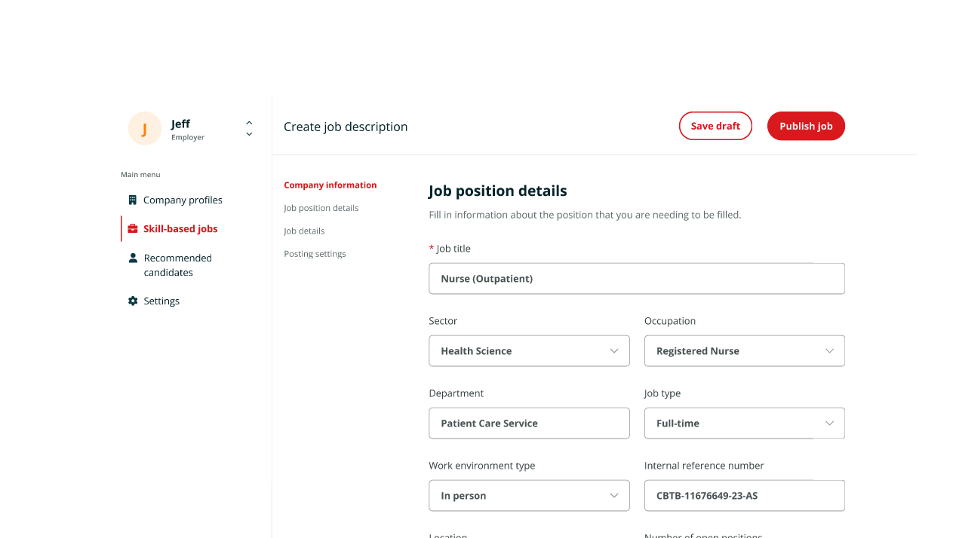

Slide 5
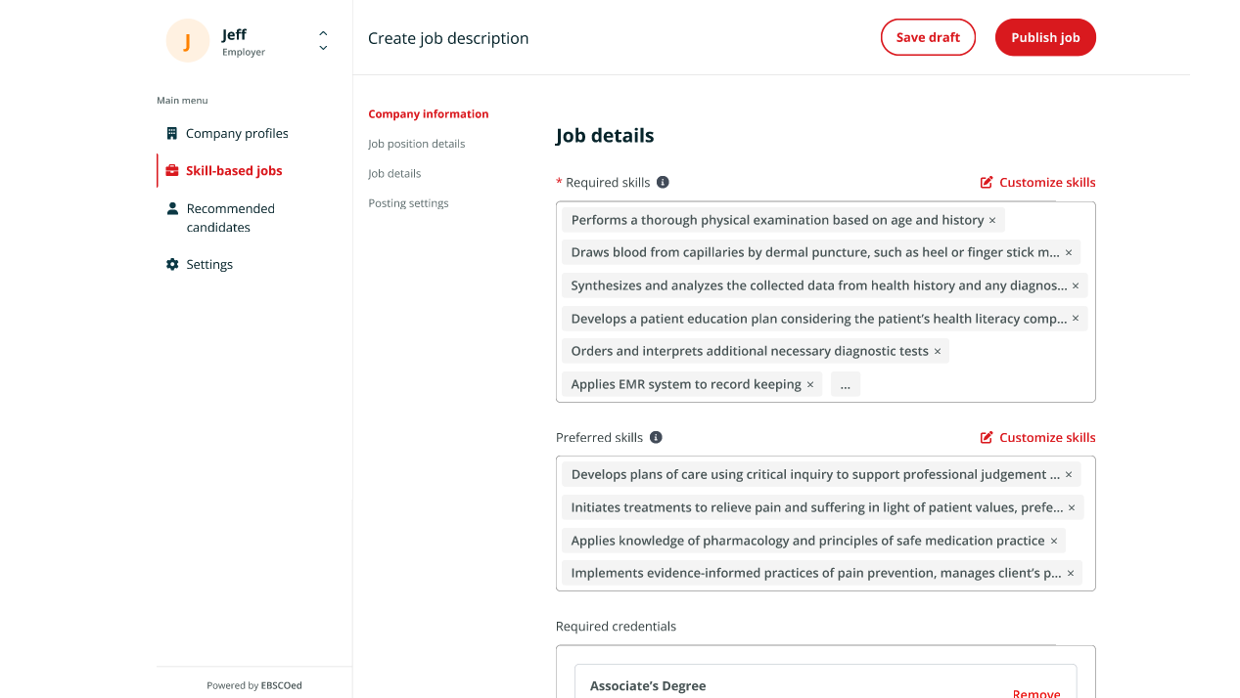
Required & Preferred Skills

Slide 6
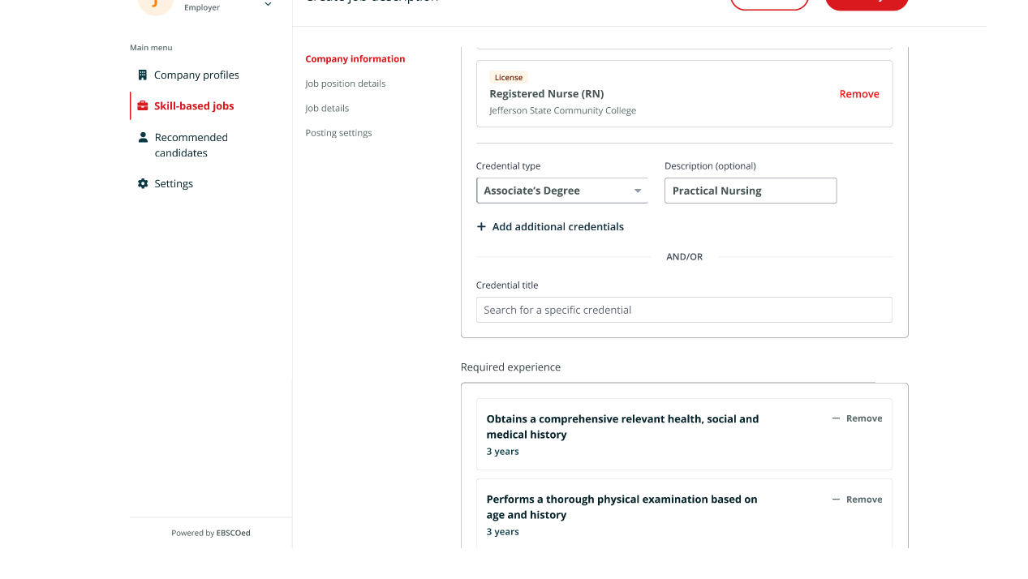
Required and Preferred Credentials

Slide 7
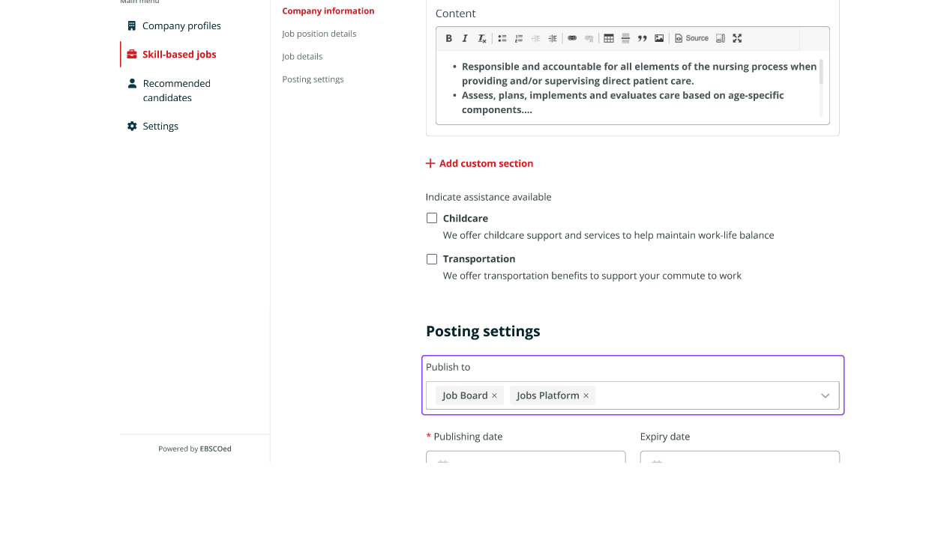
Employer Benefits & Assistance

Slide 8
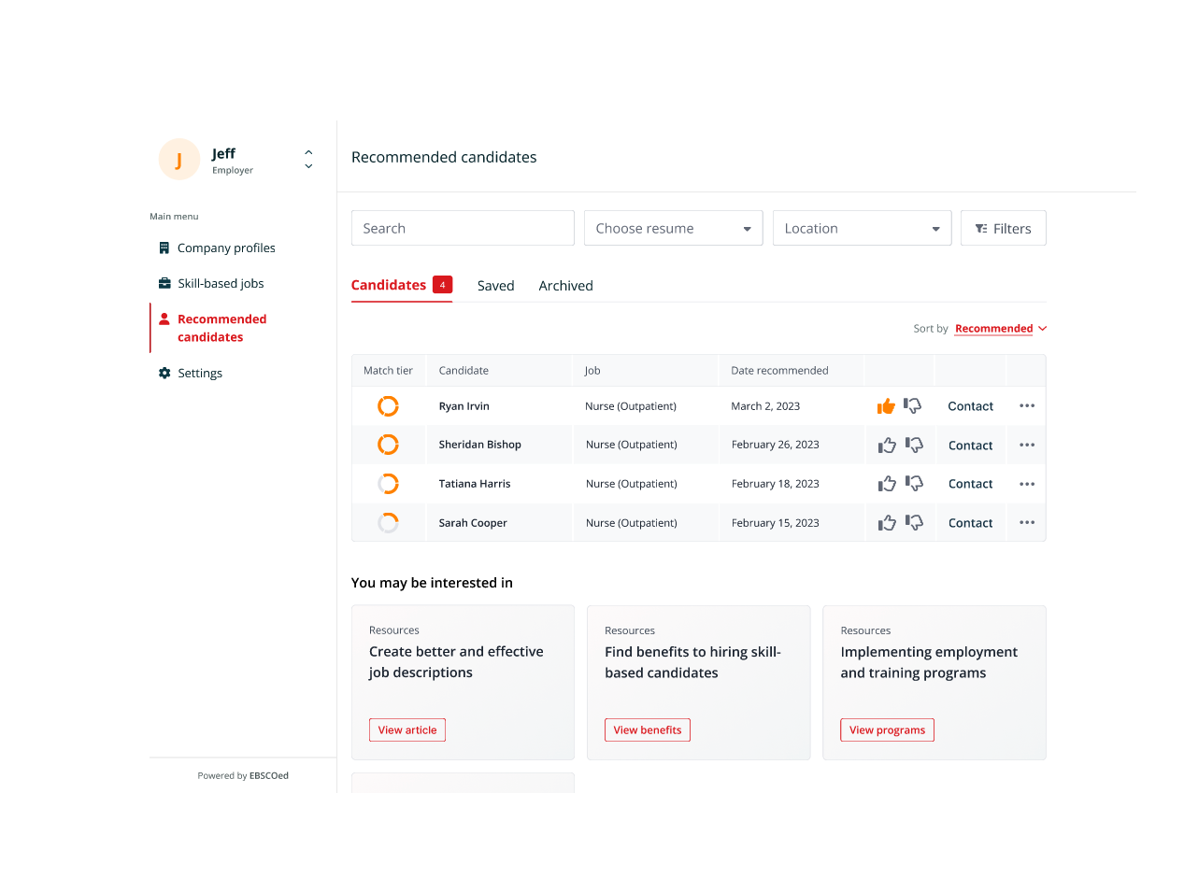
Recommended Candidates

Slide 9
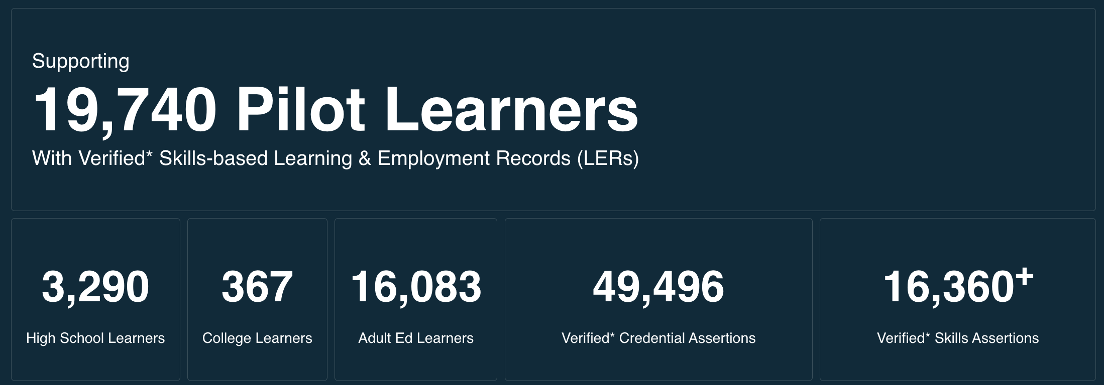
Soft Launch: Oct 24, 2023
Statewide Launch: Dec 6, 2023

Slide 10
What’s Next …
Continuous Engagement
Employers - https://www.trailblazer-alabama.com/
Jobseekers & Students - https://www.alabamatalenttriad.com/learners
Programs, scholarships, initiatives – Amplification via the Talent Triad
Marketing
Within Alabama
Within border states
Interoperability
Student Information Systems
Licensure Boards
Job Boards
HRIS’s

Slide 11
Q&A

