Slide 4
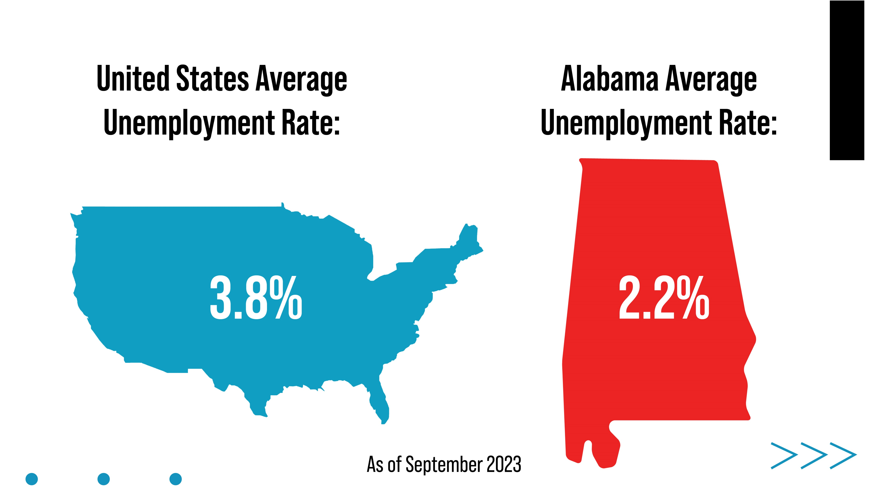

Slide 7
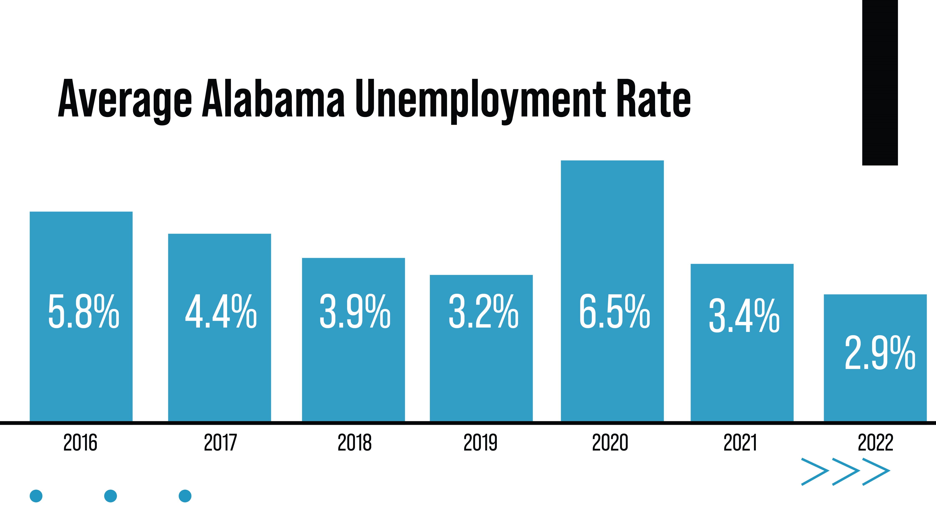

Slide 8
Local Area Unemployment Statistics
September 2023 Preliminary Data: Southeastern Area Comparison
Unemployment Rates
Labor Force Participation Rates
Over the month, Alabama’s unemployment rate increased to 2.2%.
Alabama’s unemployment rate was lower than Kentucky by 1.9, North Carolina by 1.2, Georgia by 1.2, Tennessee by 1.0, Mississippi by 1.0, South Carolina by 0.7, and Florida by 0.6 percentage points.
Over the month, Alabama’s LFPR was unchanged at 57.0%.
Alabama’s LFPR was higher than Mississippi by 2.9 percentage points and equal to South Carolina.
Alabama’s LFPR was lower than Georgia with 61.5 %, North Carolina with 60.9%, Florida with 59.8%, Tennessee with 59.4%, and Kentucky with 57.4%.
Source: Alabama Department of Labor, Labor Market Information Division, Local Area Unemployment Statistics Unit

Slide 9
The civilian labor force reached a new record high of 2,309,963, with 25,622 more people joining the labor force over the year.

Slide 10
Record low unemployment tax:
In 2023, Alabama dropped into the lowest rate schedule (Schedule A) for the first time since 1997. The average tax rate for 2023 is slightly more than a half percent (0.55%), the lowest in recorded history. The average rate last year was 1.2%.

