Slide 1
EPA Enforcement and Compliance Assurance Division Updates
Lynorae Benjamin, Acting ECAD Deputy Director
November 15, 2023

Slide 2
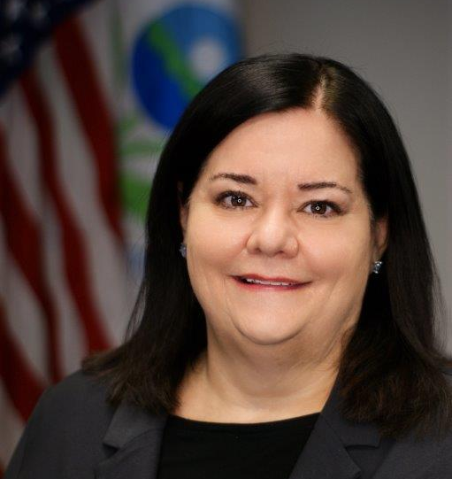
Region 4 Leadership
Jeaneanne M. Gettle
Acting Regional Administrator
Carol L. Kemker
Acting Deputy Regional Administrator
John Nicholson
Chief of Staff

Slide 3
Enforcement and Compliance Assurance Division
Keriema Newman, Acting Director
Kimberly Bingham, Acting Deputy Director
Lynorae Benjamin, Acting Deputy Director
Policy, Oversight & Liaison Office
Nicole Radford, Project Coordinator
Planning and Coordination
State Review Framework Implementation
Coordination of regional input to national policy development
Tips and Complaints
Technical and program Support to CID
Cross Division Support
Technical Support Branch
Shawneille Campbell – Dunbar
Air Enforcement Branch
Todd Russo
Chemical Safety and Land Enforcement Branch
Vacant
(30-Day Rotations)
Water Enforcement Branch
Mary Jo Bragan
Training & Capacity Building Section
Robert Bookman
North Air Enforcement Section
Jason Dressler
Pesticides Enforcement Section
Alan Annicella
Waterways and Wetlands Enforcement Section
Ahmad Dromgoole
Inspector Training
Fed. & State Credentialing
Compliance Assistance Planning & Coordination
CAA
RMP
EPCRA
FIFRA
Wetlands
Resource Extraction
Stormwater
CAFO
MPRSA
UIC
South Air Enforcement Section
Todd Groendyke
RCRA Enforcement Section
Araceli Chavez
Wastewater Enforcement Section
Jairo Castillo
Targeting, Data & Measures Section
Jim Couch
CAA
RMP
EPCRA
RCRA
TSCA Enforcement Section
Bryce Covington
TSCA Lead
TSCA NEC
TSCA PCBs
AHERA
SNC
Conventional Systems
Collection Systems
Pretreatment
OPA
Data Management
Strategic Planning
Inspection Targeting
Data Analytics & Results Measures
Drinking Water Enforcement Section
Bryan Myers
Updated 11/2023
Drinking Water NECI

Slide 4
Priorities
State Partnerships
Environmental Justice
Climate Change
National Enforcement Compliance Initiatives

Slide 5
Percentage of Inspections in Overburdened Communities
% EJ Inspections
Year

Slide 6
R4 ECAD Accomplishments
 | Completed In FY 2022 | Commitments & Projections for FY 2023 | FY 23 (final)
Compliance Monitoring Activities (excludes CWA 311 FRP/SPCC and UST) | 1375 | --- | 1241
Inspections | 583 | 494 | 787
% EJ Inspections | 67.5% | 45% | 71.4%
Offsite Compliance Monitoring | 792 | --- | 454
Total Conclusions (excludes CERCLA/UST) | 133 | 109 | 155
Judicial (Referrals) | 6 | 2 | 1
Penalty Orders | 109 | 87 | 122
Administrative Compliance Order | 22 | 20 | 28

Slide 7
National Enforcement Compliance Initiatives for FY 2024 -2027
Mitigating Climate Change (new)
Addressing Exposure to PFAS (new)
Protecting Communities from Coal Ash Contamination (new)
Reducing Air Toxics in Overburdened Communities (modified from prior cycle)
Increasing Compliance with Drinking Water Standards (continued from prior cycle)
Chemical Accident Risk Reduction (continued from prior cycle)

Slide 8
Mitigating Climate Change
Reduce emissions of greenhouse gases, use of hydrofluorocarbons (HFCs) and addresses methane emissions
Specifically targeting HFC imports, landfills and oil and gas facilities
Helps achieve Agency goals to reduce climate disruption and increases in global temperatures
Implemented through an integrated effort with active regional/program office involvement to ensure the initiative benefits from cross-office sharing of lessons learned from working with states and tribes confronting climate change

Slide 9
Addressing Exposure to PFAS
Implementation Focus:
PFAS Strategic Roadmap
Holding parties responsible for PFAS contamination, manufacturing PFAS and used PFAS in their manufacturing process
Federal agencies that released PFAS
Other industrial parties who significantly contributed to the release of PFAS contamination into the environment
EPA will work with its state partners on this initiative and seek to enhance and supplement PFAS enforcement already undertaken by many state regulators and retain direct responsibility for most federal environmental programs in Indian country

Slide 10
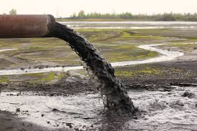
Protecting Communities from Coal Ash Contamination
Focus on noncompliance with the RCRA CCR Program to reduce the risks coal Ash facilities pose to water quality, air quality and nearby communities.
Focus resources on regulated facilities that present significant risk to human health or the environment, with special attention on overburdened and vulnerable communities.
Identify and reduce the most significant risks to drinking water, surface waters and groundwater resources, and air quality, from coal ash disposal.

Slide 11
Reducing Air Toxics in Overburdened Communities
Focus on overburdened communities that are facing high levels of air pollution from Hazardous Air Pollutants (HAPs).
Integrates EJ considerations in our civil and criminal enforcement programs to ensure these considerations are embedded in the Agency’s core work
Target with data from EPA databases, citizen complaints, facility reported data, monitoring and testing reports and ambient air monitors.
The Air Enforcement Branch will coordinate with the EJ Office, local community groups and our state partners to identify sources of concern in Region 4 overburdened communities.

Slide 12
Increasing Compliance with Drinking Water Standards at Community Water Systems
Initially launched in 2020 with the goal of ensuring clean and safe drinking water at PWS.
Continue to increase our field presence, take impactful enforcement to reduce noncompliance, prevent violations by improving climate resiliency, and offer more compliance assistance to prevent and address public health risks.
Continue to work with states, tribes, territories, local governments, and the regulated community to ensure delivery of safe water to communities.
Continue to employ a variety of tools to monitor and promote compliance.

Slide 13
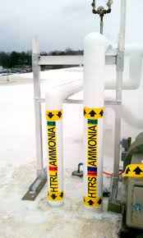
Chemical Accident Risk Reduction
Reduce risks to human health and the environment by decreasing the likelihood of chemical accidents.
Address noncompliance at facilities using anhydrous ammonia and hydrogen fluoride.
Develop and implement plans to build and enhance the program through increasing the number of credentialed inspectors, continue to develop strong working relationships with the OSHA, and work with other federal partners to facilitate inspections and evaluations of the RMP universe.

Slide 14
Contact Information:
Keriema S. Newman, Acting Director, Enforcement and Compliance Assurance Division P: 404.562.8859 E: newman.keriema@epa.gov
Kimberly L. Bingham, Acting Deputy Director, Enforcement and Compliance Assurance Division
P: 404.562.9038 E: bingham.kimberly@epa.gov
Lynorae L. Benjamin, Acting Deputy Director, Enforcement and Compliance Assurance Division
P: 404.562.9040 E: benjamin.lynorae@epa.gov

