Slide 1
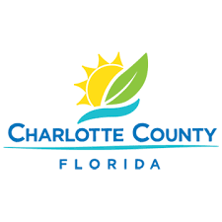
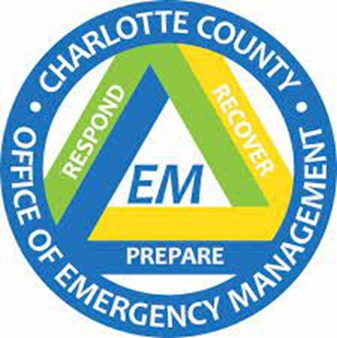
RESPONSE to RECOVERY
Hurricane IAN
Carrie Walsh, Charlotte County Human Services Director

Slide 2
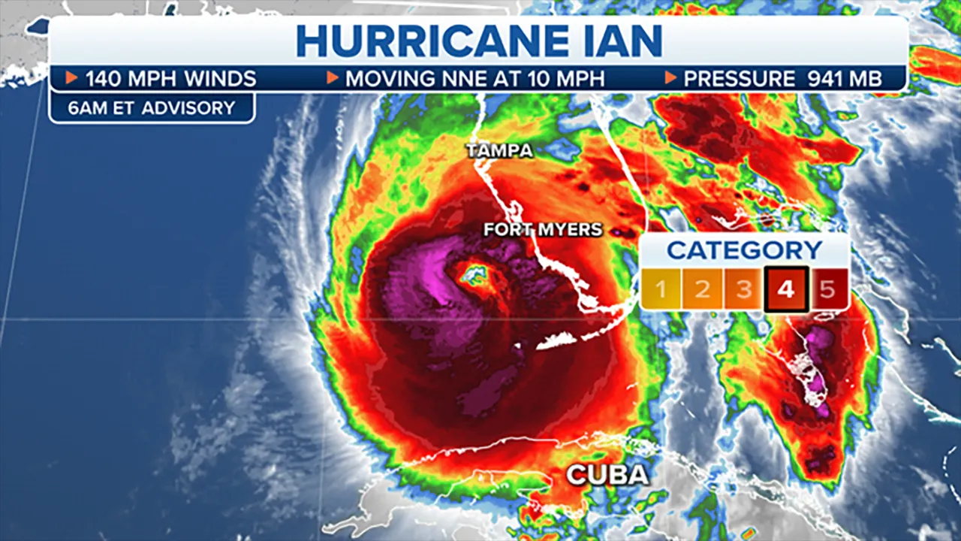
According to the National Weather Service in Key West, Fla., Ian had hurricane-force winds spanning 90 miles, and tropical-storm-force winds spanning 350 miles. Charley's hurricane-force winds extended 50 miles, with 170 miles of tropical-storm-force winds.
Notes:
RESPONSE
Landfall 9/28/22
Life/Safety
Search & Rescue
Emergency Services
Mutual aid

Slide 3
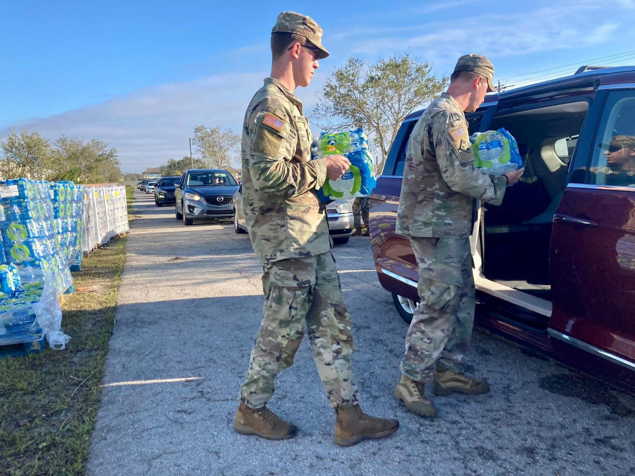
Mass Care duties start well before the storm hits. The Mass Care team set up and run emergency storm shelters and run the call center at the EOC.
Immediately after the storm passes, Emergency Services are performing life and safety activities, and the Mass Care Committee is planning and putting in “mission requests” with the State and National Guard to set up mass feeding sites and Points of Distribution (PODs) for supplies, like water, tarps, ice and food.

Slide 4
Mass Care Points of Distribution (PODs)
West County-Tringali Park
Mid-County-Charlotte Sports Park
South County-Muscle Car City
Notes:
46,540 cases of water
316, 500 MREs
25,932 bags of ice
15,548 tarps

Slide 5
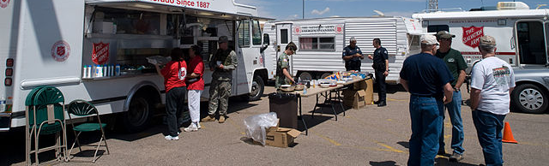
Community Feeding Partners
1,000,000+
Meals Served
Salvation Army
Red Cross
Local churches
Operation BBQ Relief
DeliverLean
Regional YMCAs
Citizens
Local restaurants & businesses
Civic organizations
World Central Kitchen

Slide 6
Charlotte County Recovery at a Glance as of Oct. 31, 2022
Since the federal disaster declaration for Hurricane Ian, Charlotte County residents have received more than $110.9 million in federal funds as of Oct. 31, 2022:
$57.1 million in FEMA grants to homeowners and renters.
$53.8 million in U.S. Small Business Administration (SBA) low-interest disaster loans approved for homeowners, renters, and businesses.
23,952 homeowners and renters have been approved for $57,169,887 in federal grants through FEMA’s Individuals and Households Program. This includes:
$35,774,215 in Housing Assistance grants for home repair, home replacement, and/or rental assistance.
$21,395,672 in Other Needs Assistance grants to replace essential household items and for other critical disaster-related expenses.
2,396 homeowners and renters have been approved for rental assistance.
13,575 home inspections issued; 13,291 completed.
Disaster Survivor Assistance (DSA) visited 7,238 households in Charlotte County.

Slide 7
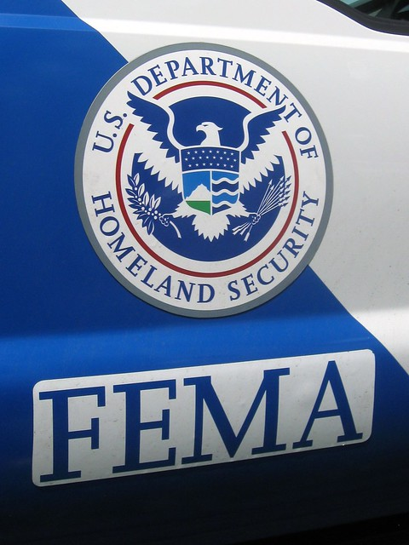
Disaster Recovery Center
Disaster recovery centers provide disaster survivors with information from Florida agencies, FEMA and the U.S. Small Business Administration. Survivors can get help applying for federal assistance and disaster loans, update applications and learn about other resources available.
Online at www.DisasterAssistance.gov
Calling 800-621-3362
Tringali Recreation Center, 3460 N. Access Road, Englewood

Slide 9
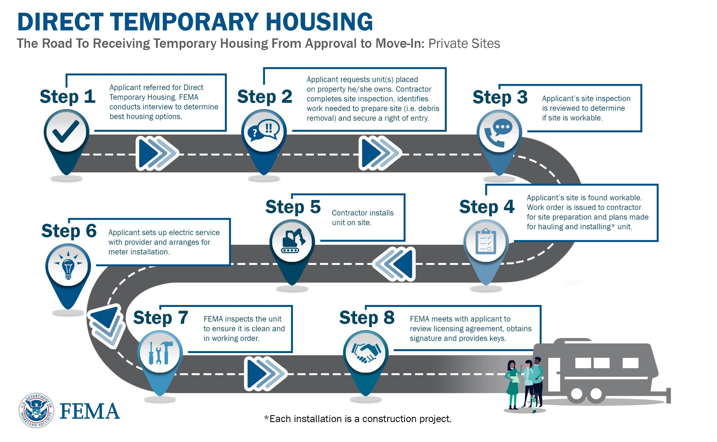

Slide 11
What is a COAD?
A Community Organization Active in Disaster (COAD) is a community organization, based within a community or geographic area, made up of representatives from public, private, volunteer, and nonprofit agencies and organizations who may be active in all phases of a disaster: mitigation, prevention, preparedness, response, and recovery.
A COADs goals include:
Establish and strengthen area-wide communication, coordination, cooperation, and collaboration
Enhance the community’s ability to prepare, respond, recover, and mitigate
Alleviate the suffering caused by disasters
Develop a coordinated approach to resources and human services
Develop plans, training, and exercises for disaster operations

Slide 12
What is an LTRG?
A long-term recovery group (LTRG) is a cooperative body that is made up of representatives from faith-based, non-profit, government, business and other organizations working within a community to assist individuals and families as they recover from disaster.
LTRGs are as varied in their structure as are the communities in which they work. The personality and operation of each group is unique and reflects local needs, available resources, cultural diversity, leadership style, and community support. No matter how a group is structured or what it calls itself the goal is the same: to unite recovery resources with community needs in order to ensure that even the most vulnerable in the community recover from a specific disaster.

Slide 13
LONG TERM RECOVERY GROUP TASKFORCES
HOUSING RECOVERY
HEALTH & HUMAN SERVICES
COMMUNITY PLANNING & CAPACITY BUILDING
ECONOMIC RECOVERY
INFRASTRUCTURE
NATURAL & CULTURAL RESOURCES

Slide 14
Long Term Recovery Intake Survey
https://portal.neighborlysoftware.com/CHARLOTTECOUNTYLTR/Participant
Funded by the Charlotte Community Foundation
Basis for disaster case management
An email/login is required

Slide 15
Interest in joining the
Long Term Recovery Group?
941.833.6501
Carrie.walsh@charlottecountyfl.gov

