Slide 1
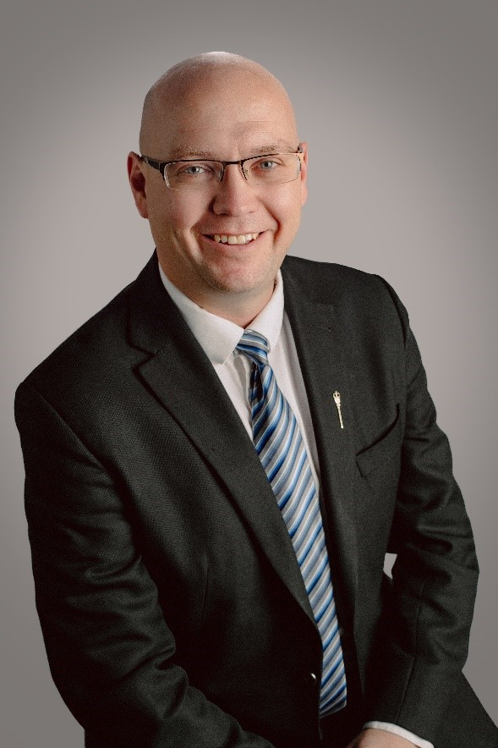
Welcome to the Zoom Town Hall with MLA Searle Turton
MLA Searle Turton Spruce Grove-Stony Plain Constituency
Member of Standing Committee on Privileges and Elections, Standing Orders and Printing

Slide 2
Agenda
Welcome and Introductions – Richard Wong, Chair Greater Parkland Regional Chamber of Commerce
The Chamber
An Update – Searle Turton MLA – 15 Minutes
Q&A – 40 Minutes
Review and Close – 5 Minutes

Slide 3
Greater Parkland Regional Chamber of Commerce
Who Are We? – The Greater Parkland Regional Chamber of Commerce representing the Spruce Grove, Stony Plain and Wabamun districts
What We Do? – Advocate, Promote, Operate Visitor Centres
Why? Our Purpose – To promote business interests of the region as defined by the Board and the Members
How We Do It? - Core Values – Growth, Accountability, Respect, Collaboration, Communication, Collective Wisdom, Leadership and Integrity
Where Are We Going – Our Vision & Brand Promise is to be recognized as the Trusted Source and Business Voice for our Members in the Tri-Region

Slide 4
Thank you for participating in our Zoom Town Hall
For more information about the Chamber and Membership please call our office at 780.963.4545

