Slide 2
Increasing Your Confidence & Business Smarts
START • GROW • EXPAND • RECOVER

Slide 3
Set-Aside for Certification Programs and Socio-Economic Categories
Targeted set-asides and acquisition goals:
Small Businesses (23%)
Women-Owned Small Businesses (5%)
Small Disadvantaged Businesses (including 8(a) certified) (5%)
HUBZone Businesses (3%)
Service-Disabled Veteran-Owned Small Businesses (3%)
Notes:
Targeted Set-asides and Acquisition Goals
Women-owned small businesses - (5%)
Small disadvantaged businesses including 8(a) certified - (5%)
HUBZone - (3%)
Service-disabled veteran-owned small businesses - (3%)
Overall small business goal of 23%
Set-asides are reserved for small business between the Micro-purchase Threshold and the Simplified Acquisition Threshold.

Slide 4
All Small Mentor-Protégé Program (ASMPP)
Access business development assistance
Build capacity and grow
Establish joint ventures
Notes:
Presenter Tip: Discuss the aspects of the All Small Mentor-Protégé Program and how this may benefit the small business through joint ventures, mentoring, training and management/technical assistance.
The purpose of the All Small Mentor-Protégé Program (ASMPP) is to provide small business development assistance and enhance the ability of these small business Protégés to successfully compete for federal contracts.
The Protégé pairs with a Mentor company (usually a large business) to access this developmental assistance and build capacity to grow and compete on contracts.
Must self-certify as small in the North American Industry Classification System (NAICS) code in which they are seeking ASMPP business development assistance.
May seek a Mentor-Protégé Agreement (MPA) in a secondary NAICS code in which it has done business.
SBA will not authorize MPAs for which no work has been documented in that secondary NAICS code.

Slide 6
Helpful Links
Application Links
8(a): https://certify.sba.gov/
WOSB/EDWOSB: https://certify.sba.gov/
ASMPP: https://certify.sba.gov/
HUBZone: https://eweb.sba.gov/gls/dsp_login.cfm?sb=Y
Other Links
SBA Government Contracting: https://www.sba.gov/federal-contracting
SBA Bonding Program: https://www.sba.gov/funding-programs/surety-bonds
Lender Match: https://www.sba.gov/funding-programs/loans/lender-match
Portland District Office: https://www.sba.gov/offices/district/or/portland
Notes:
Presenter Tip: Provide location and national resource information including how to contact the local district office. Provide contact information for PCR or Area PCR under Local Resources.

Slide 7
Resources
Procurement Technical Assistance Centers (PTACs)
In Oregon: www.gcap.org
In Washington: www.washingtonptac.org
Women’s Business Center at Mercy Corps NW: https://www.mercycorpsnw.org/business/womens-business-center/
Small Business Development Centers (SBDCs)
Find your local center at: https://www.bizcenter.org/ in Oregon or http://wsbdc.org/ in Washington
SCORE
Find a mentor at: https://www.score.org/find-mentor
Notes:
Presenter Tip: Provide location and national resource information including how to contact the local district office. Provide contact information for PCR or Area PCR under Local Resources.

Slide 8
Contact Information
Joe Smetak, Business Opportunity Specialist
U.S. Small Business Administration – Portland District
503-326-6692
Joseph.smetak@sba.gov
www.sba.gov/or
Notes:
Presenter Tip: Provide location and national resource information including how to contact the local district office. Provide contact information for PCR or Area PCR under Local Resources.

Slide 9
2020 Construction Season
Southwest Region Construction
Christopher H. Tams, Construction Engineer
February 05, 2020

Slide 10
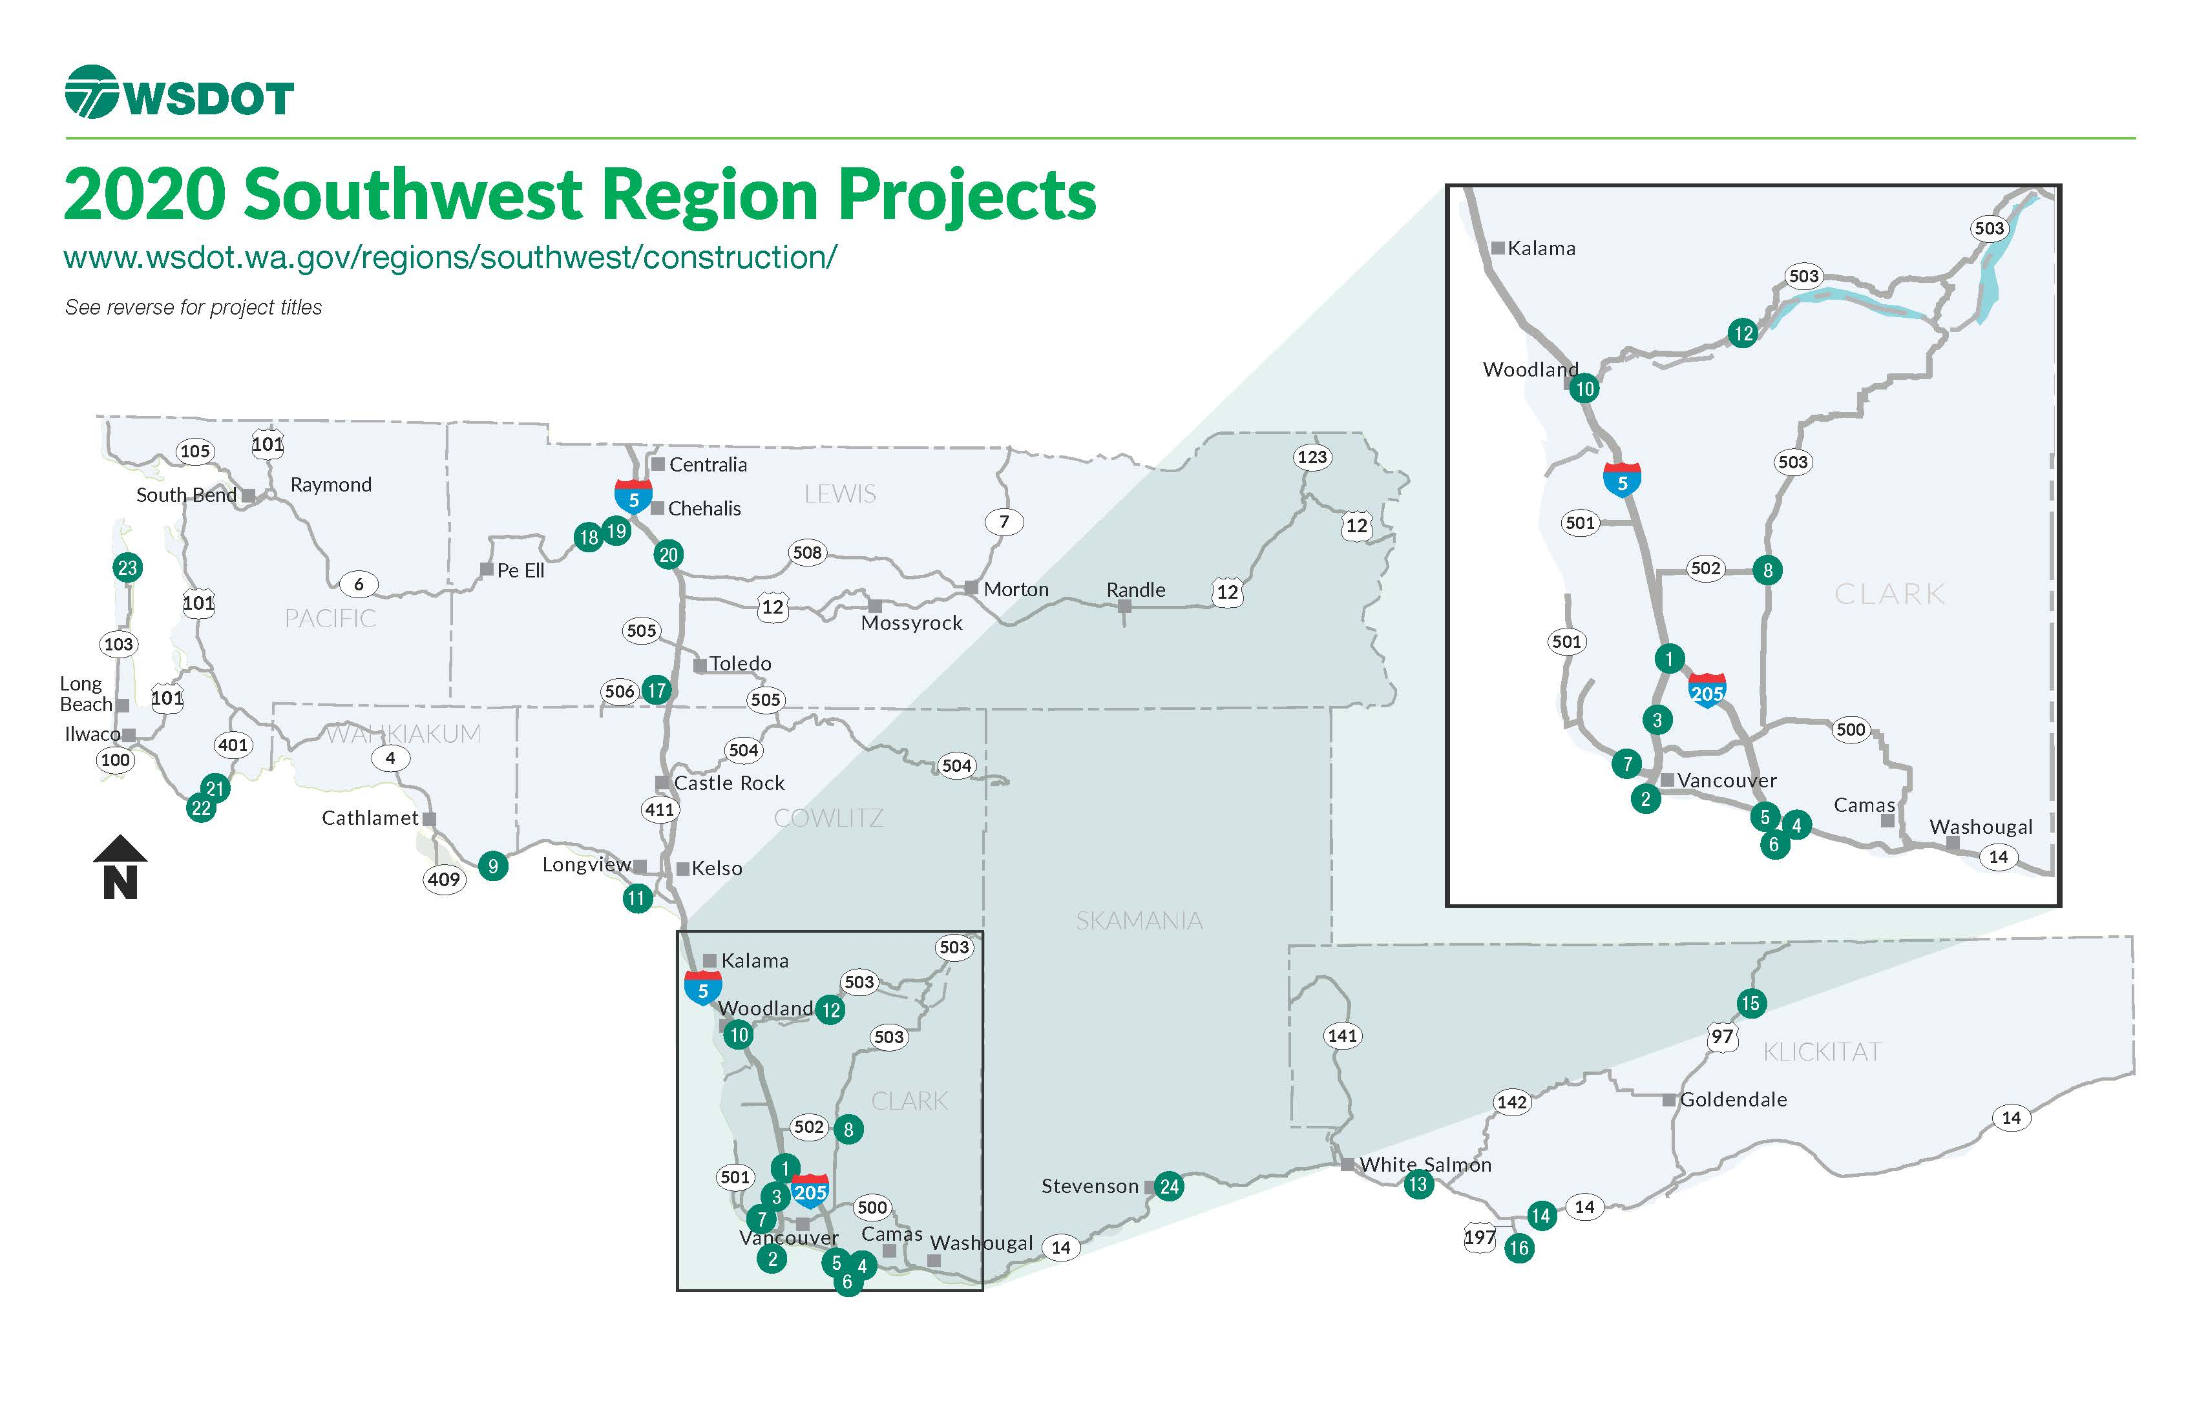
2020 Construction Map
Region Projects

Slide 11
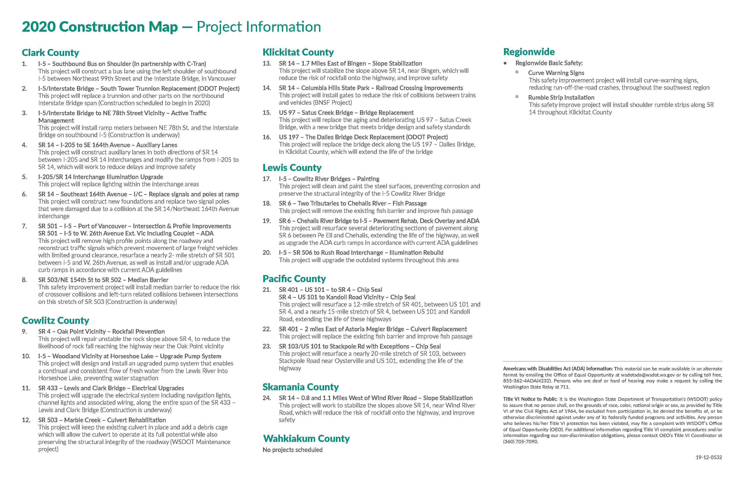
2020 Construction Map
Project Titles

Slide 12
Overview of
Services

Slide 13
Washington PTAC Program, Vancouver ● PTAC funds are discretionary and allocated each year by Congress in the Defense Appropriations Bill ● The Department of Defense, Defense Logistics Agency enters into cooperative agreements with PTAC across the United States ● Matching funds are provided by Thurston County EDC and the other sub-centers ● There are 93 PTACs in U.S. employing over 400 counselors

Slide 15
FREE Assistance includes: • Finding opportunities to bid • Interpreting solicitations and regulations • Certifications & registrations, such as; sam.gov and any social/economic certifications • Marketing to government buyer and much more We provide these services through: • One-on-one Counseling Sessions • Matchmaking events • Training (in-person or online) • Optional Bid Match service (fee-for service: $165/year)
Washington PTAC Program
The Procurement Technical Assistance Center assists Washington State businesses in selling to federal, state and local governments.

Slide 16
Government Presence in Washington
Federal:
Civilian agencies: GSA, Forest Service, USPS, EPA, FAA, etc.
DoD: Fairchild AFB, U.S. Army Corps of Engineers, JBLM, Yakima Training Center, etc.
DOE: Hanford site
Local: Counties, Cities, Ports, School Districts, etc.
State: Colleges & Universities, DOT, prisons, etc.

Slide 17
How can PTAC assist you…
Prepare you and your business
Market to your target agencies and understand how they buy
Complete requirements and registrations to be eligible to bid
Help avoid costly errors
Provide research tools & support to get ahead of the game

Slide 18
#1. Prepare you and your business
Are you ready for government contracting?
Are you prepared to learn and follow rules relating to Federal acquisitions?
Are you willing to do ongoing, detailed research to find procurement opportunities?
Can your business financially support performance for contract up front costs?
Are you willing to be a subcontractor to companies that are prime contractors?
Are you and your company in good standing with the government?

Slide 19
Active Contracts
Local Opportunities
Government Wide
GSA Schedule/VA
Open Market > $25k
Open Market < $25k
& Micro-purchases
Primes with Federal Subcontracting Plans (SBA) https://www.sba.gov/document/support--directory-federal-government-prime-contractors-subcontracting-plans
#2. Market to your target agencies and understand how they buy
WA state & local agencies: https://www.des.wa.gov
Future Competitions posted on www.beta.sam.gov
Contract with local emergency management agencies
Contact your local PTAC/Use BidMatch Service
Conduct market research
Obtain GSA if research validates
Search and Monitor on www.beta.sam.gov
Optimize Vendor Profiles SAM/SBA Profile
Connect with end users
Ask Contracting officers and Small Business Liaisons

Slide 20
Screen for eligibility and assist in acquiring social/economic certifications for state and federal. Federal Government has Minimum Goals:  23% of prime contracts for small businesses  5% of prime and subcontracts for SDB’s  5% of prime and subcontracts for WOB’s  3% of prime contracts for HUBZone  3% of prime and subcontracts for SDVOSB’s Goals are passed down to large prime contractors
#3. Complete requirements and registrations to be eligible to bid
www.sam.gov
GSA Schedule

Slide 21
#4. Help avoid costly errors
Review solicitation for requirements
Review proposal to make sure you are responsive
Assist in reviewing
FAR-Federal Acquisition Regulation
DFAR-Defense Federal Acquisition Regulation Supplement
CFAR-Code of Federal Regulations
Assist in getting paid; WAWF

Slide 23
#5. Provide research tools & support to get ahead of the game Research Tools
FedBizOpps – www.fbo.gov which moved to www.beta.sam.gov What the Federal Government has bought in the past, and what they are buying now
www.USASpending.gov and/or Federal Procurement Data System (FPDS) – www.fpds.gov What government has bought in the past and who they’ve purchased from
Washington Electronic Business Solutions (WEBS) https://fortress.wa.gov/ga/webs What Washington State government has bought in the past, and who they purchased from
SBA Profile http://web.sba.gov/pro-net/search/dsp_dsbs.cfm Find your competition and/or business alliances/partners
Forecast to win, visit http://apfs.dhs.gov

Slide 24
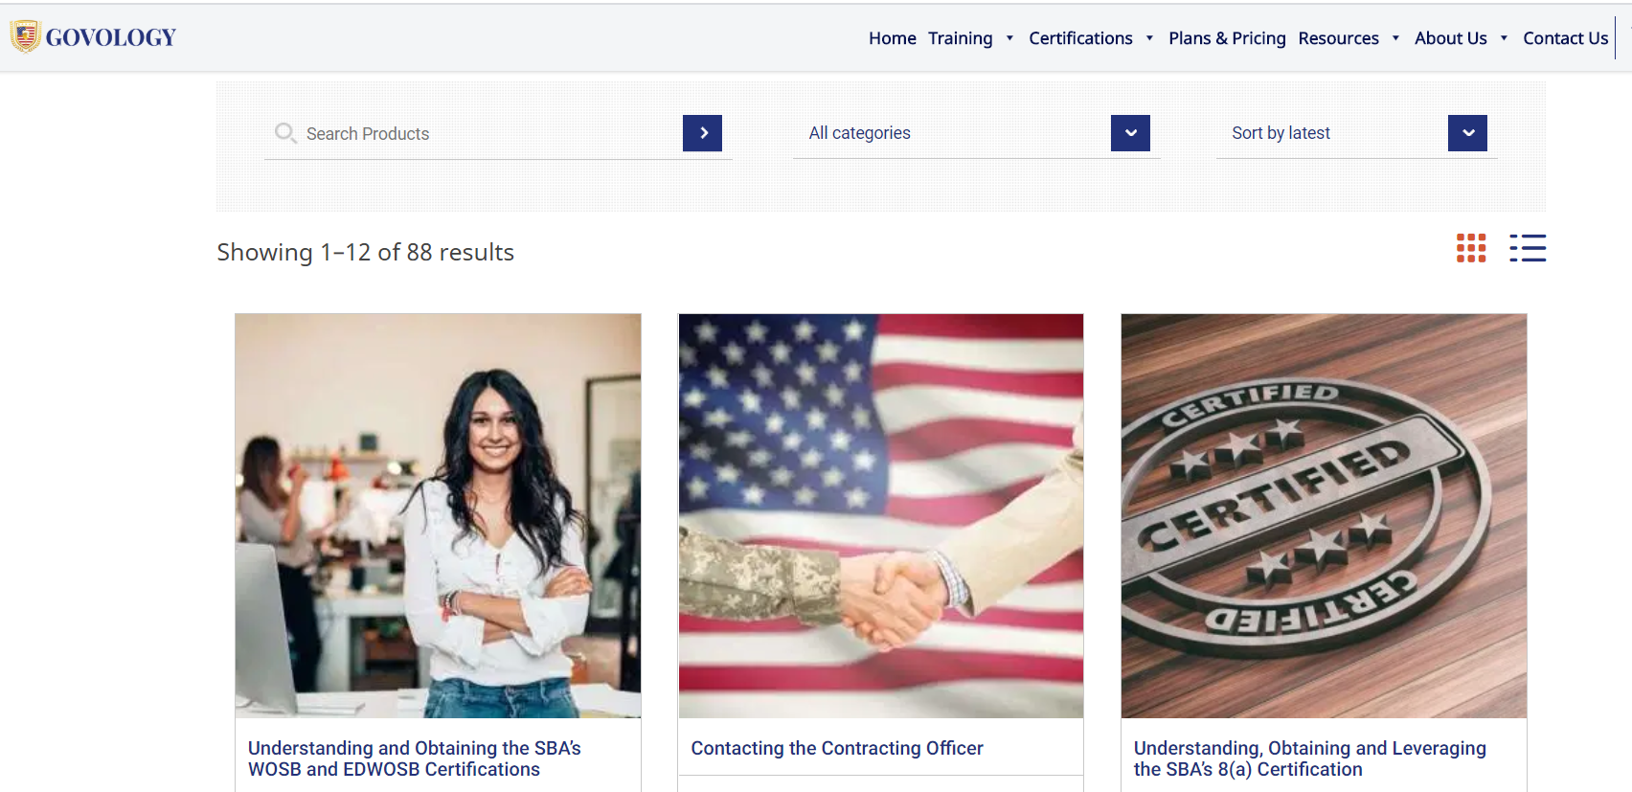
#5. Govology.com
For WA PTAC clients

Slide 25
Attend events www.washingtonptac.org/events www.allianceNWconference.org (March 2020) and other Procurement Conferences Get involved with industry associations Attend Industry Days Register with prime contractors Attend their outreach events and other events that they attend Agency Site Visits Attend pre-bid conferences/site visits Connect on LinkedIn Get to know the Small Business Liaison/Specialist (Federal agencies) Ask for referrals
Network
Network
Network

Slide 26
Jeannet Santiago swwa@washingtonptac.org www.washingtonptac.org
Questions, Comments, Discussion?

