Slide 2
Welcome to LINK
NAIOP & Allsteel are proud to present LINK, a shared common space designed to bring Commercial Real Estate professionals together in a state of the art collaborative environment. Located in Allsteel’s newly transformed showroom, where comfort and design inspire creativity and workplace efficiency, LINK is a groundbreaking opportunity and new place for networking, connecting, and working exclusive to NAIOP Members only.

Slide 3
^{Ways to}
^{experience LINK...}
Need a place to grab a coffee with a peer? ^{Come to Link.}
Need a place to work for a couple hours? ^{Drop in at Link.}
Looking for smaller networking opportunities? ^{Check out Link.}
Want to attend more exclusive NAIOP events? ^{Join us at Link.}
NAIOP Members are invited to experience LINK free of charge for the introductory period ending May 31.
Welcome to LINK
NAIOP & Allsteel are proud to present LINK, a shared common space designed to bring Commercial Real Estate professionals together in a state of the art collaborative environment. Located in Allsteel’s newly transformed showroom, where comfort and design inspire creativity and workplace efficiency, LINK is a groundbreaking opportunity and new place for networking, connecting, and working exclusive to NAIOP Members only.

Slide 5
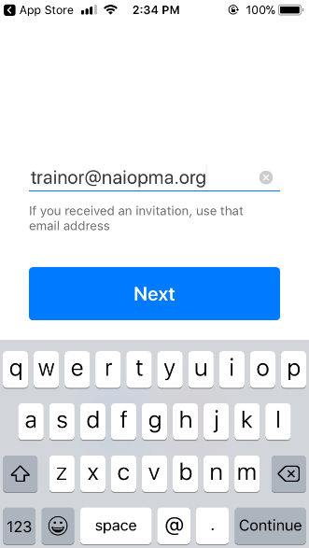
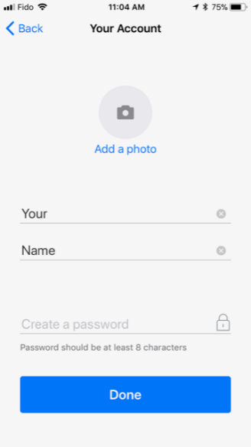
Instructions on Downloading Optix, the NAIOP LINK Lounge Reservation App
Step 1: Download the Optix APP in the app store.
iOS Android
Step 2: Open the app and enter in your e-mail address.
Step 3: Fill in your First and Last Name and create a password.
* Don’t forget to complete your profile

Slide 6
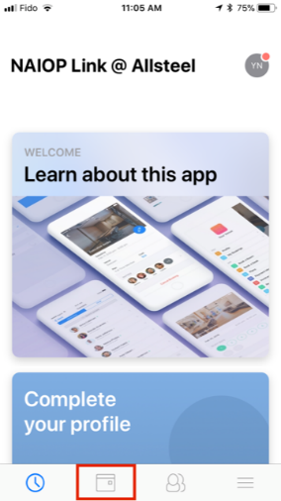
Instructions on how to make a reservation at the NAIOP LINK Lounge Powered by Allsteel
Once you have successfully downloaded the Optix app and joined/logged into the NAIOP LINK @Allsteel Group you will see the image to your left. If you do not see this image, please use the search bar to search for the NAIOP LINK @ Allsteel Group.
Step 1: To reserve space at the LINK Lounge please select the Calendar Icon, the second icon on the bottom of the screen.

Slide 7
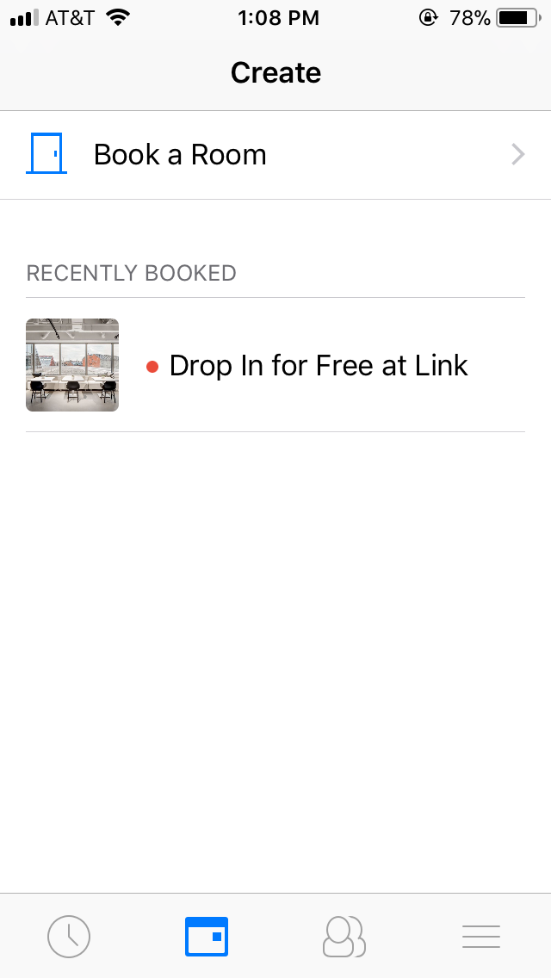
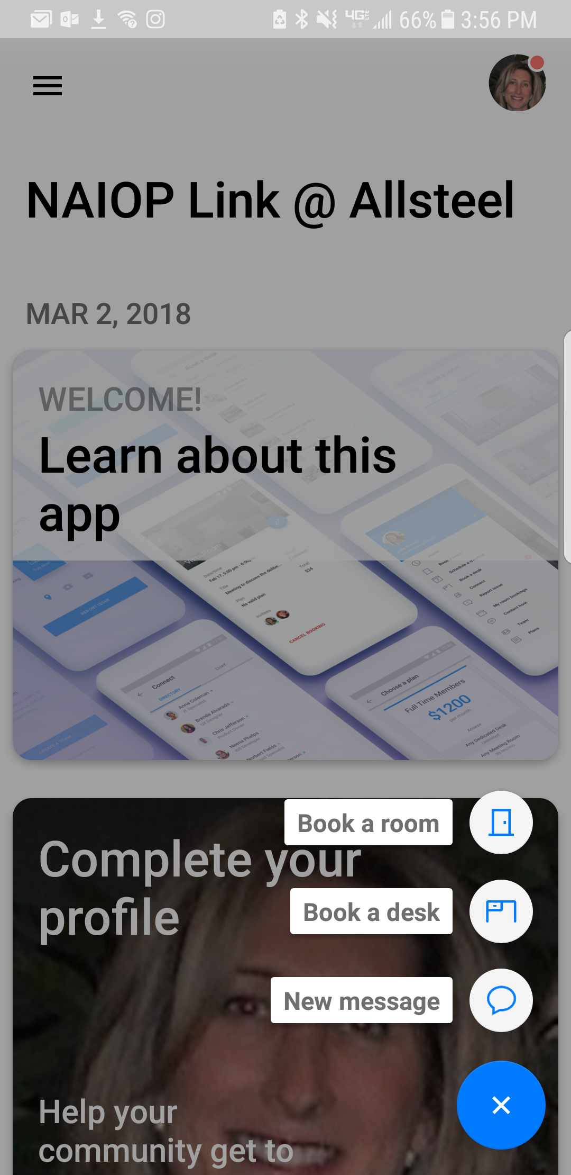
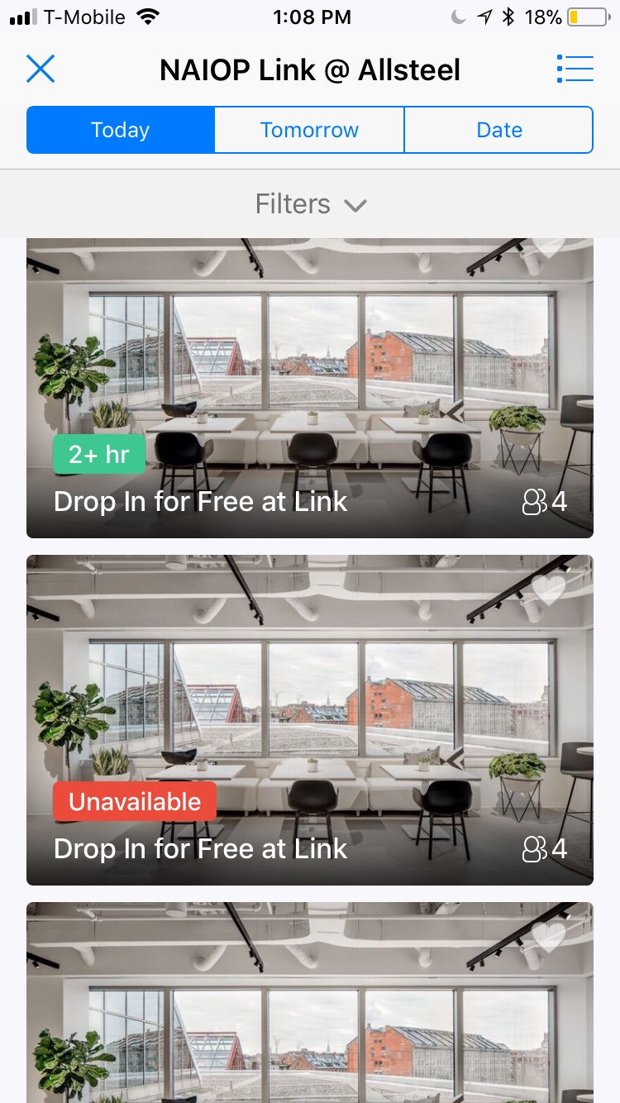
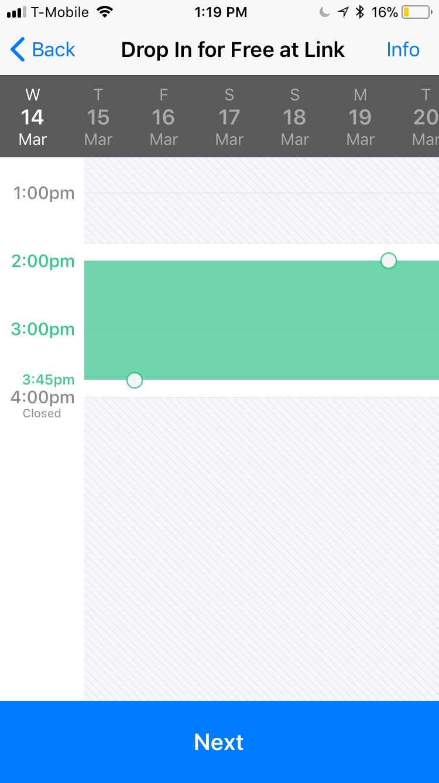
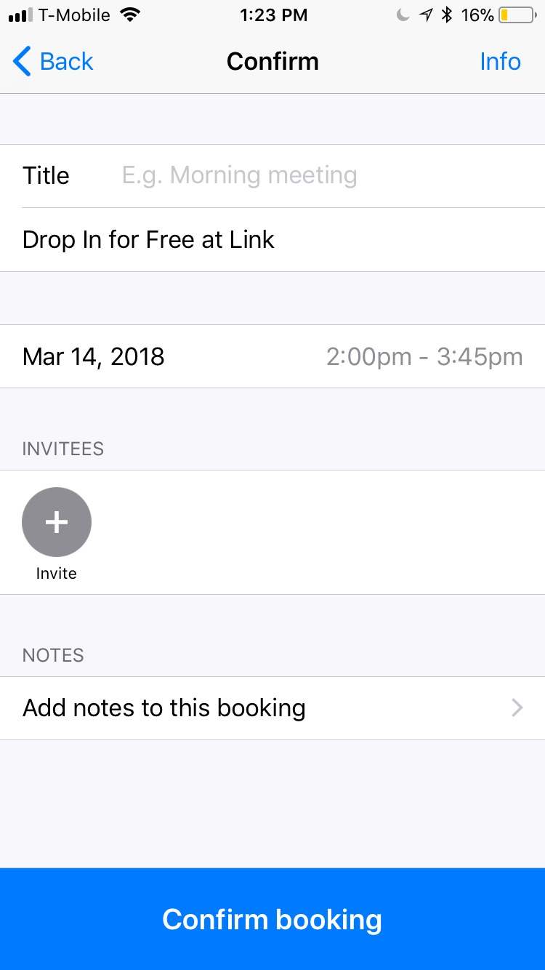
IOS Screen
Android Screen
Step 2: Select the “Book a Room” option. Please Note: By following these steps you are reserving space at the Link Lounge, not a physical room. You are welcome to sit anywhere within the specified lounge space.
Step 3: Select the date you would like to “Book a Room”.
Step 4: Slide the box to select the time you would like to reserve.
Step 5: Name you meeting or add a guest before selecting “Confirm Booking” to finish reserving your space.
Please Note: Members are limited to 3 guests per reservation.

