Slide 1
This is Doncaster
Overview Session
@OpportunitiesDN
#ThisIsDoncaster

Slide 2
Where is Doncaster…
Which country?
Which county?
Which region?

Slide 3
Watch the ‘This is Doncaster’ video from the beginning until 0:30.
https://www.opportunitiesdoncaster.co.uk/this-is-doncaster/
What did you notice?
Did anything surprise you?
Are we confident in our understanding of what a ‘key sector’ is?

Slide 4
Can you remember what they key sectors are?
Do you know any Doncaster businesses which are in these sector?
Creative and Digital | Transport and Logistics | Arts, Culture and Media | Construction
Public Sector | Health and Social Care | Leisure and Tourism | Financial and Professional Services
Retail and Wholesale | Education | Engineering and Manufacturing | Sport
Let’s find out if you were correct!
Watch the video from 0:30 – 5:23
https://www.opportunitiesdoncaster.co.uk/this-is-doncaster/
Don’t forget to make notes on questions 1 and 2 of your ‘Reflection’ resource

Slide 5
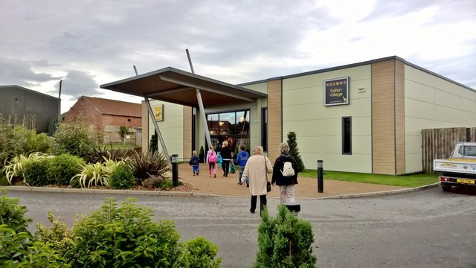
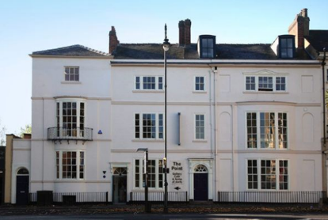
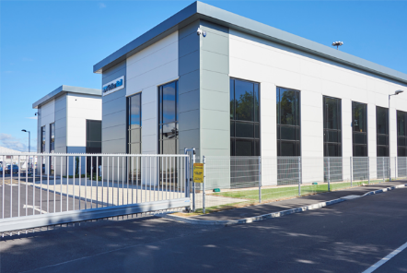
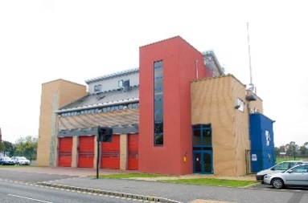
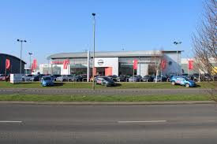
Do you recognise the premises of any of these Doncaster businesses?

Slide 6
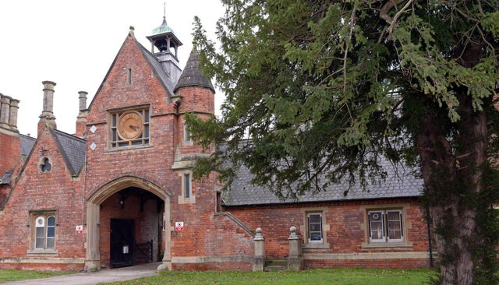
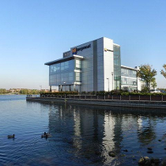
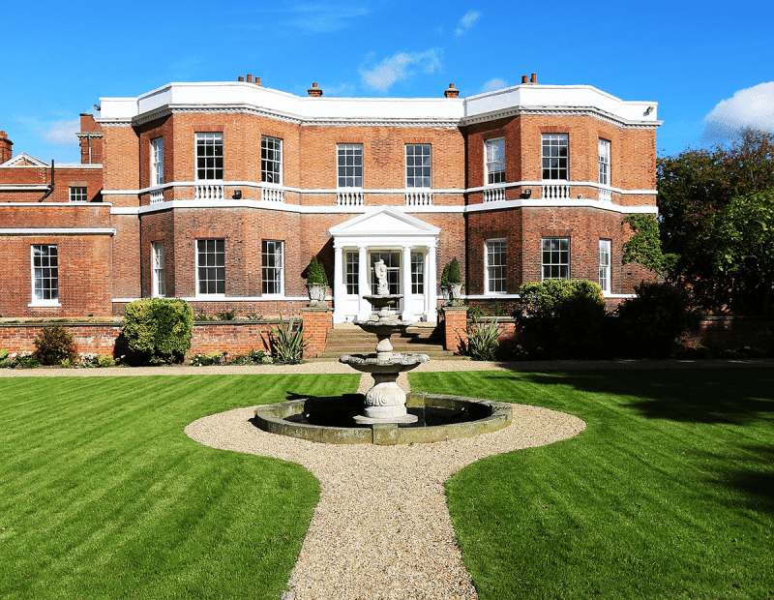
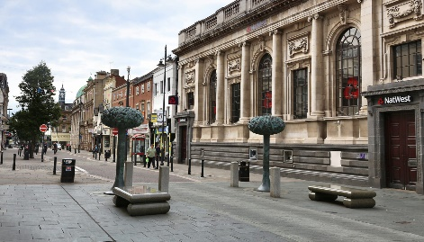
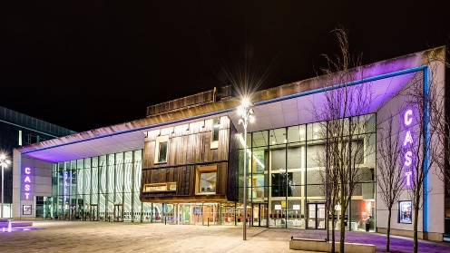
Do you recognise the premises of any of these Doncaster businesses?

Slide 7
Now, think about some of the businesses in your local area…
Use Google Maps to help you: https://www.google.co.uk/maps/
Are the ‘key sectors’ represented in your local area?
What could this mean for the current and future local work force?
Creative and Digital | Transport and Logistics | Arts, Culture and Media | Construction
Public Sector | Health and Social Care | Leisure and Tourism | Financial and Professional Services
Retail and Wholesale | Education | Engineering and Manufacturing | Sport

Slide 8
Watch the remainder of the video (5:23 until end):
https://www.opportunitiesdoncaster.co.uk/this-is-doncaster/
Make notes in response to questions 3 and 4 on your ‘Reflection’ resource.
Don’t forget, the interests and questions you record on here could inform your future Careers activity and your personal 1:1 Careers Guidance and Advice sessions.

Slide 9
Which further study pathways interested you?
Which sectors did you find interesting?
In your opinion, what makes Doncaster a great place to live, work and socialise?
Reflection
Which job roles did you think sounded interesting?
Did you have any questions about today’s session?

