Slide 1

SCAFFOLD SAFETY
101
PRESENTED BY
YOUNGER SCAFFOLD

Slide 2
This program is designed as an introduction to
“Residential Plasterers Scaffold”
All employees should go through this program prior to working on scaffold.
The goal of this program is to provide the scaffold user information on how scaffold is to be properly erected and inspected.

Slide 3
OSHA Regulations
All scaffold is to be designed by a
“Qualified Person”.
    One who, by possession of a recognized degree, certificate or professional standing, or who by extensive knowledge, training and experience, has successfully demonstrated his/her ability to solve or resolve problems related to the subject matter, the work, or the project.
All scaffold is to be erected and inspected by a
“Competent Person” before workers are allowed to work on the scaffold.
    One who is capable of identifying existing and predictable hazards in the area surrounding or working conditions which are unsanitary, hazardous or dangerous to employees, and who has the authorization to take prompt corrective measures to eliminate them.

Slide 4
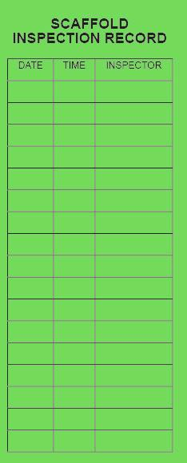
All scaffold shall be inspected by a “Competent Person” before workers are allowed to work on the scaffold.
The easiest way to know if the scaffold has been inspected is by looking at the back side of the scaffold tag. If there are no initials with todays date, it has not been inspected.

Slide 5
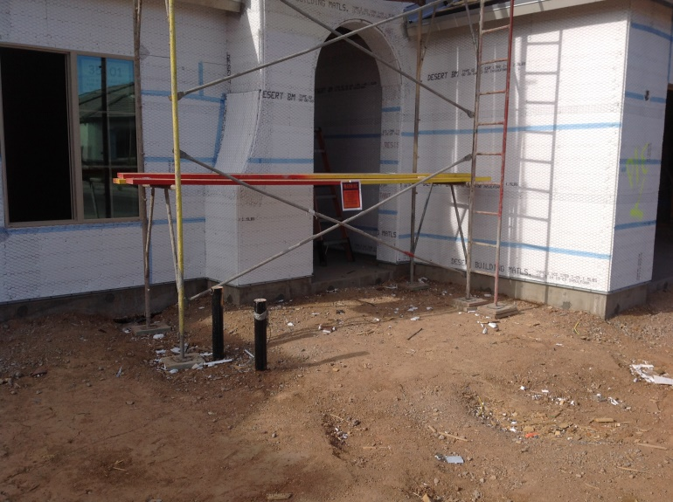
Now that you have looked at the scaffold tag… Let’s make sure you know what
“Correct” scaffold looks like.
Starting at the ground, the area around the scaffold should be level and clear of debris. You can’t inspect the bottom of the scaffold if you can’t see it.
All scaffold needs to be no more than 14” away from the working surface.

Slide 6
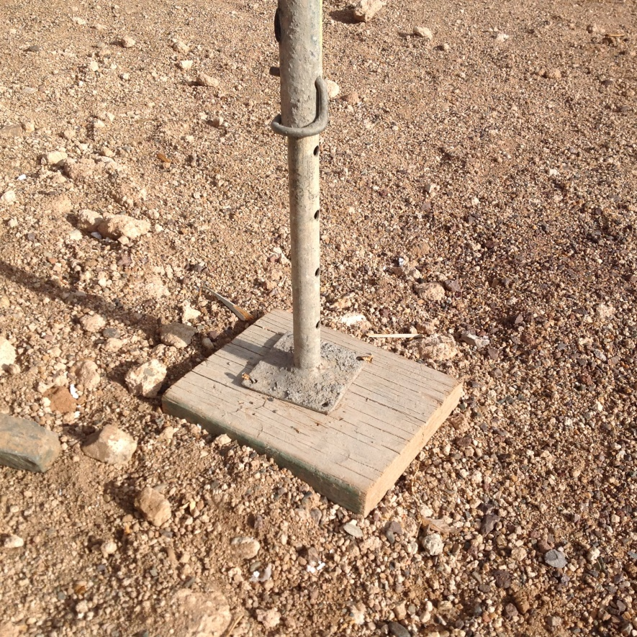
Scaffold legs need the following:
Mud Sill
Extension Base Plate
Gravity Pin
The extension base plate is inside the leg of the scaffold frame and is held in with a
gravity pin.
The extension base plate sits
on the mud sill and is nailed
together with a minimum of
two nails.
The mud sill should look like
the one in the photo.

Slide 7
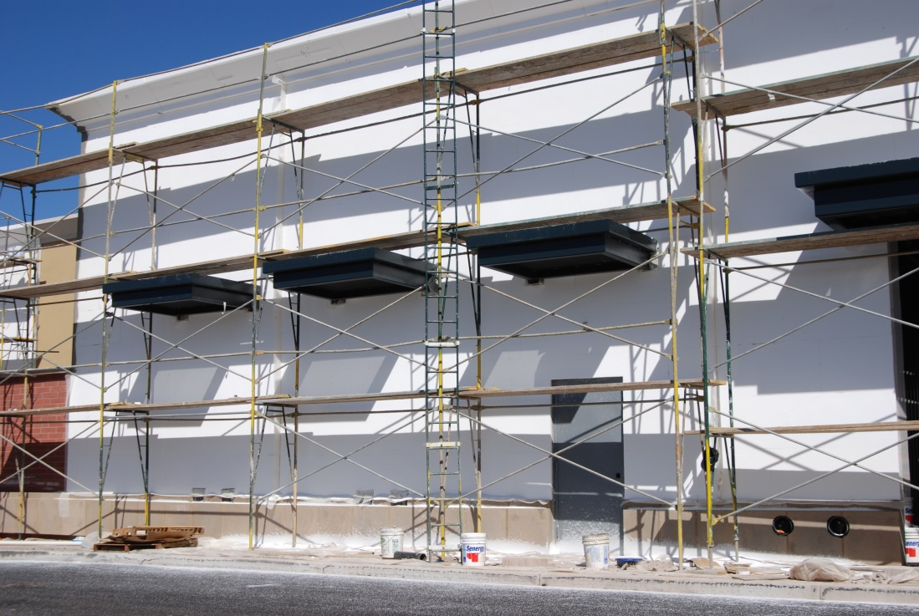
All scaffold needs to be connected with cross braces or rails. A single brace is used on the outside of the scaffold at every level with a straight rail used on the inside. On all scaffold two frames or more high, a straight rail is used with the cross brace. The brace is used as a top rail and the straight rail is used as a mid-rail.

Slide 8
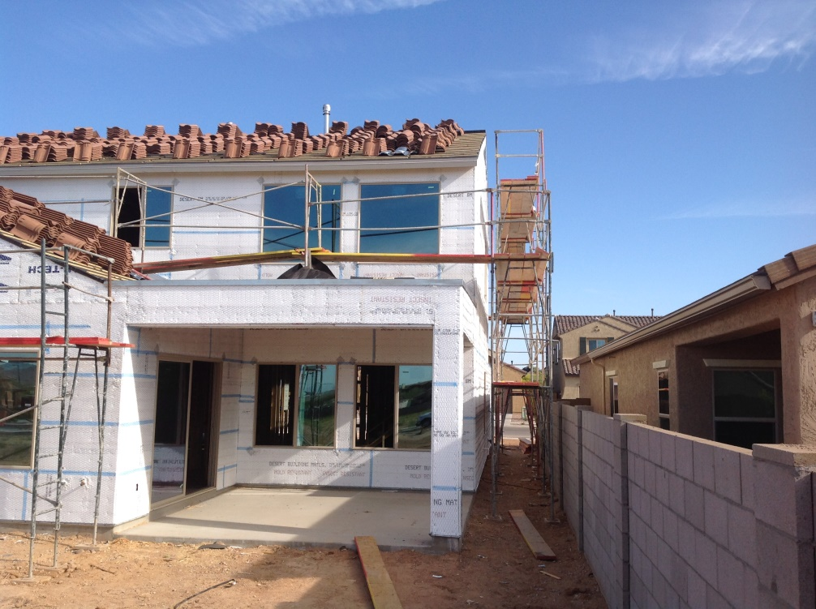
Plank
All levels should be fully planked. For 3’ wide scaffold…3 planks are required.
A minimum of 2 plank must be used at all times, even on A frames.
Plank must go a minimum of 6” past the frame header but no more than 12”.
The plank must not have excessive cracks or splits that may reduce its capacity.

Slide 9
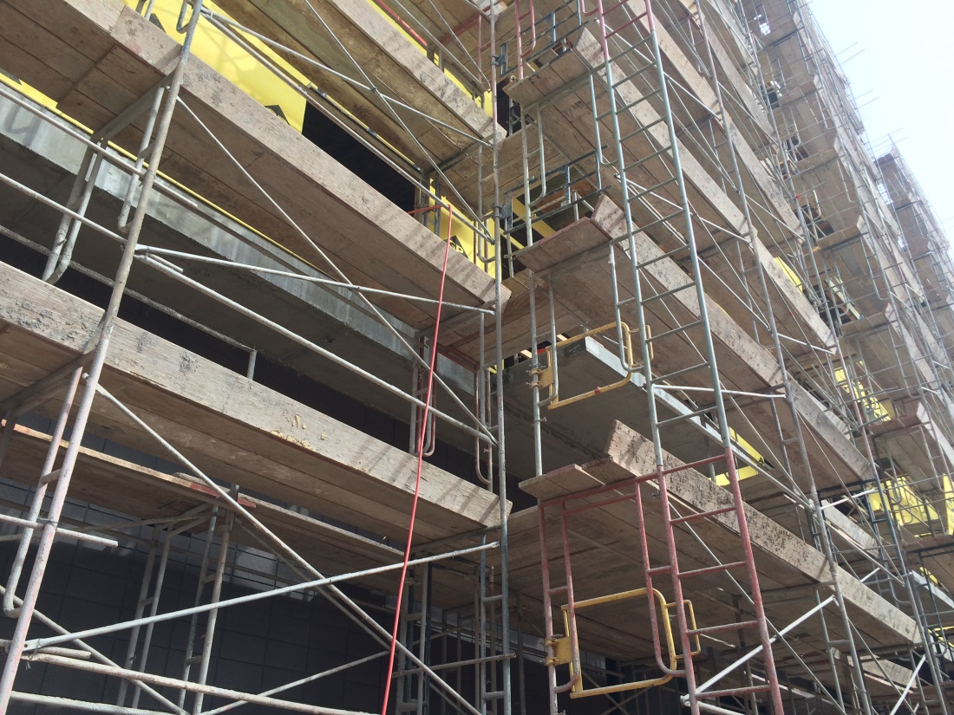
Toe Boards
OSHA requires toe boards on all scaffold platforms 10’ and higher. A minimum toe board is 3 ½” tall. It’s purpose is to prevent objects from falling off the scaffold.
Toe Boards

Slide 10
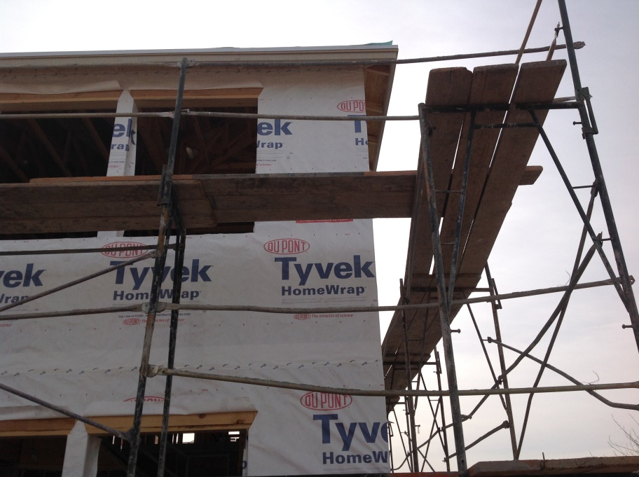
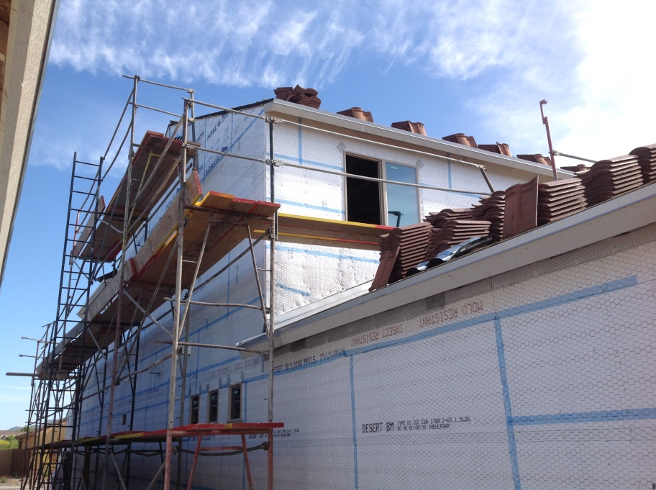
Plank around corners
Scaffold plank should be installed between towers at the corners to provide a continuous walking surface.
The same needs to be done when accessing the roof areas. Hand rails are required at each location.

Slide 11
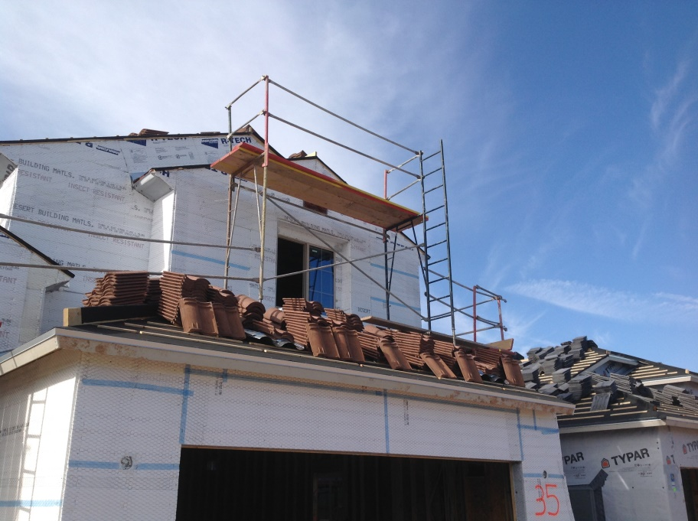

Working on the roof
Any work performed on the roof requires some form of fall protection. Below you will see how the scaffold is being used. No workers are allowed outside of these areas.

Slide 12
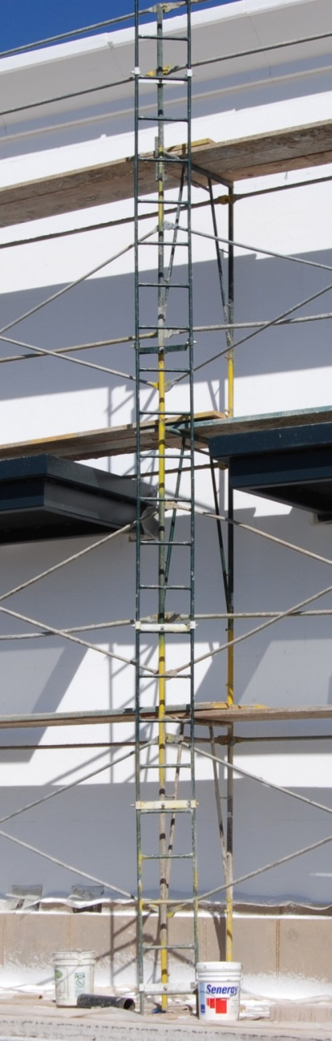
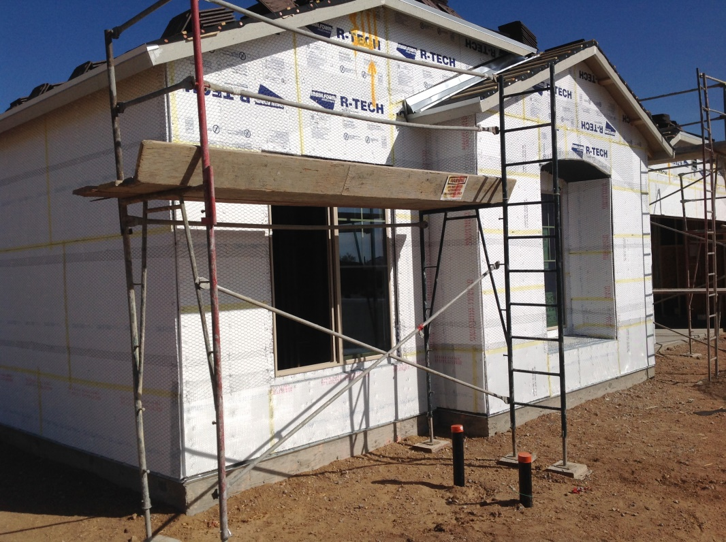
Access
Ladders must be used to access all scaffold towers. The ladder must start no more than 2’ above the ground and extend past the top plank level by 3’.

Slide 13
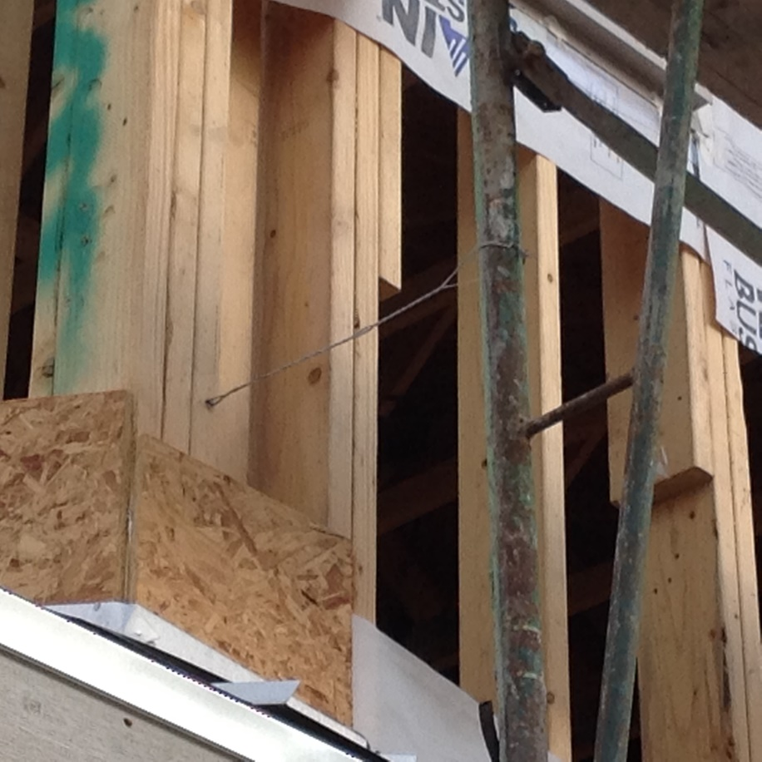
Scaffold Ties
On 3’ wide scaffold, the first tie should be no more than 12’ high. Additional ties should be no more than 20’ apart. Each end of the scaffold must be tied in also to a maximum of 30’ apart.
Scaffold Tie

Slide 14
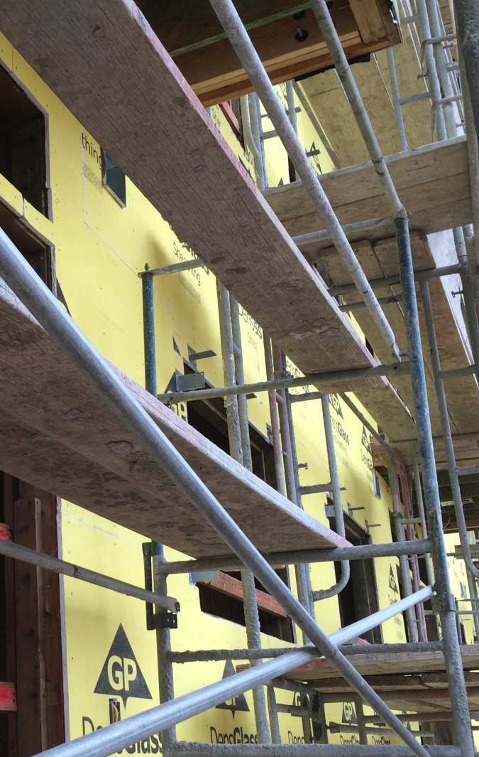
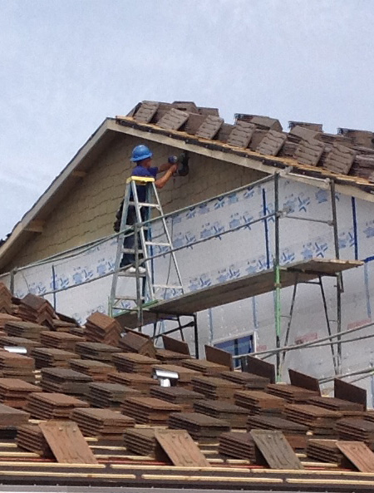
What NOT to do
At no time can you place anything on top of the plank or rails to stand on.

Slide 15
Conclusion
Please answer the questions given to you at the beginning of the program and hand it back in.
Remember, YOU are the most important safety tool on the job.
If you notice something wrong or have a question, it is YOUR RESPONSIBILITY to speak up.

