Slide 1
Ute Culture in Utah National Parks
Presented by
Rich Stoffle
University of Arizona
And
Alden Naranjo
Southern Ute Tribe
National Association of Tribal Historic Preservation Officers
18th National Tribal Preservation Conference
August 20-September 2, 2016
Ignacio, Colorado

Slide 2
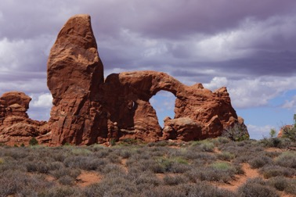
Purpose of Talk
Illustrate how Ute people are returning to traditional territories which are now held and managed by the NPS.
Tribally appointed representatives from
Southern Ute Tribe
Ute Indian Tribe of the Uintah and Ouray Reservation
Ethnographic Overview and Assessment
for two southeastern Utah parks
Arches National Park
Canyonlands National Park

Slide 3
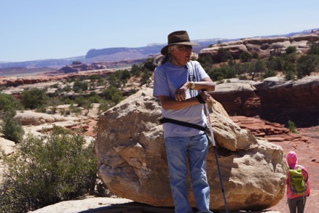
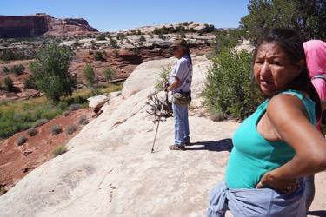
Ute Elders Identify, Evaluate and Recommend
Plants, animals, artifacts, peckings, paintings, water, topographic features, and historic places

Slide 4
Project Steps
Fieldwork
Draft Report Text
Send to Draft Text to Tribal Participants for Review
Once text is approved, report is sent to tribal governments for review
After report is reviewed and approved by tribes, it is sent to the NPS

Slide 5
Interviewing & Confidentiality
Interviews conducted with tribal representatives are built upon the understanding that confidentiality was met and will be respected during this and any subsequent ethnographic studies.
Each tribal representative is afforded the right to a private interview. No text or tape is released without the full consent of the tribal representative. Text and tapes are returned to the tribal representative at their request.
Ethnographers extract from the private interview pertinent site interpretations and evaluations of impacts and combine these into a composite text, which can have minority opinions.
Ethnographers send to the tribal representatives the composite text that builds on the private individual interviews, but reflect some ethnographic synthesis. This text generally does not involve references that could identify the representatives who contributed to the text, but being quoted is an option. Tribal representatives have the right to add, subtract, and correct the composite text.
Tribal government reviews, evaluates based on any other criteria, and approves or disapproves of composite text. Once the tribes approve the text, content cannot be altered.

Slide 6
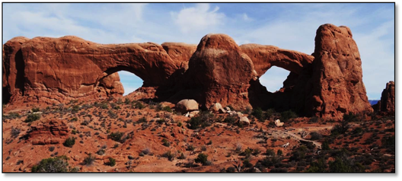
Arches National Park Ethnographic Overview and Assessment
University of Arizona
September 2015
Bureau of Applied Research in Anthropology
School of Anthropology, University of Arizona

Slide 7
Project Overview

Slide 8
About the Study
An Ethnographic Overview and Assessment report (EOA) is a baseline cultural anthropological study that document traditional associations between distinct cultural communities and landscapes, places, nature, and archaeology resources. In partnering with traditionally associated tribes this project identifies and provides descriptions of resources and sites of cultural importance.
No confidential information is being requested.
A key goal of this project is to provide baseline ethnographic documentation in a manner that is accessible to park staff and visitors, researchers and managers, interpreters and educators. So findings will be used to support public education and park interpretation to increase understanding of Native American tribes’ traditional connection with Arches and Canyonlands National Parks.

Slide 9
Invited Tribes
The Hopi Tribe
Kaibab Band of Paiute Indians
Navajo Nation
Paiute Indian Tribe of Utah
Pueblo of Zuni
Southern Ute Indian Tribe
Ute Indian Tribe - Uintah & Ouray

Slide 10
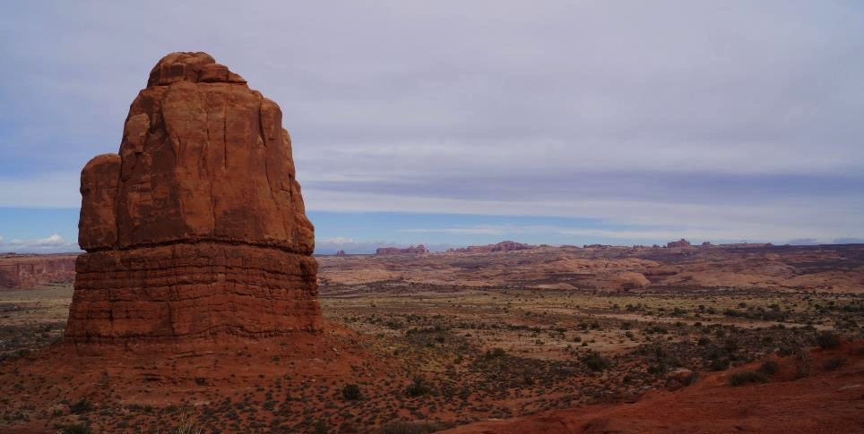
Situating The EOA

Slide 11
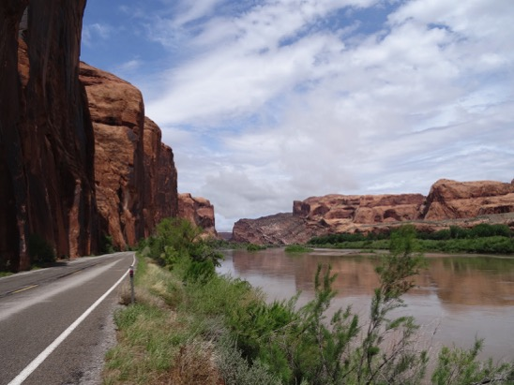
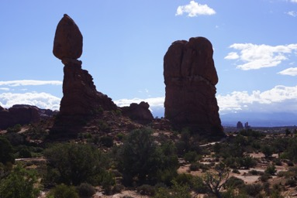
Overview of Places

Slide 12
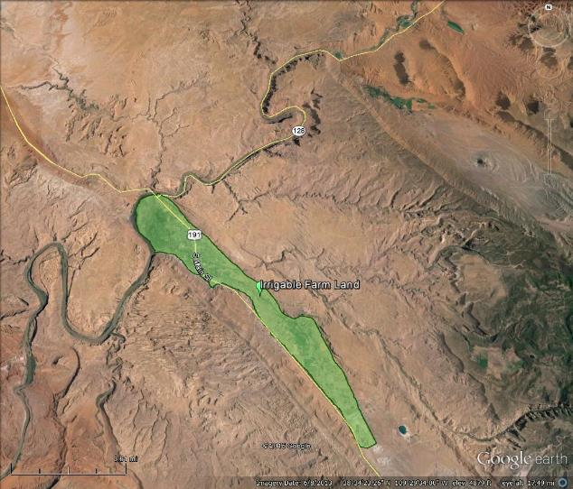
Irrigable Farm Land in Moab Valley near Courthouse Wash

Slide 13
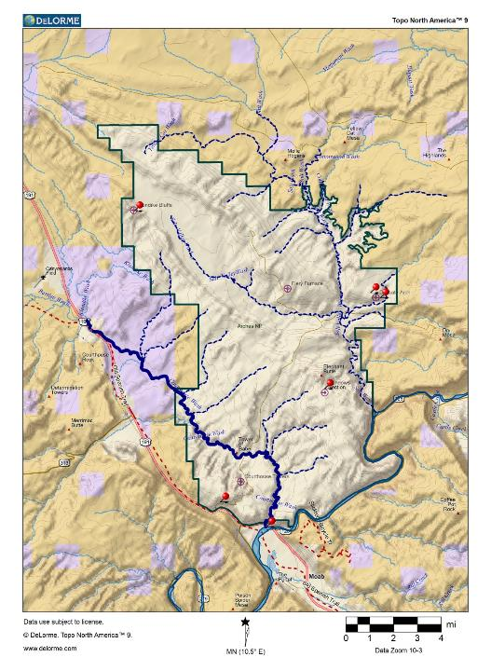
Sites to be Visited
Courthouse Wash
Wolfe Ranch
Salt Valley Overlook
Windows Section
Panorama Point
3
2
5
4
1

Slide 14
Courthouse Wash

Slide 15
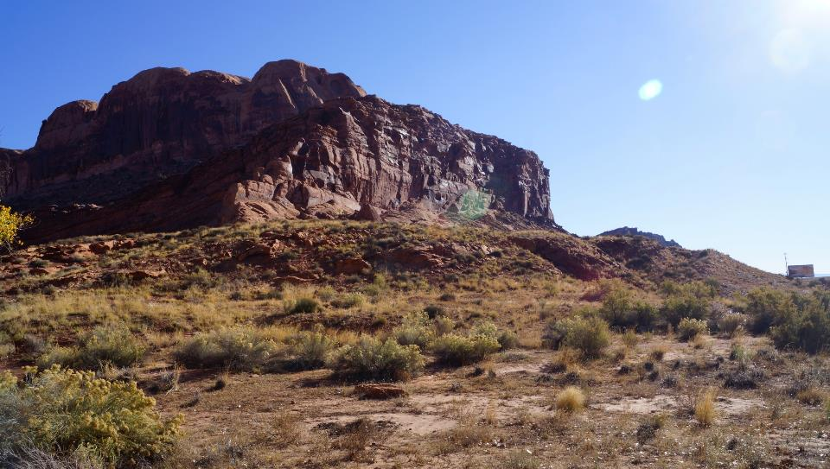
Courthouse Wash- Moab Panel

Slide 16
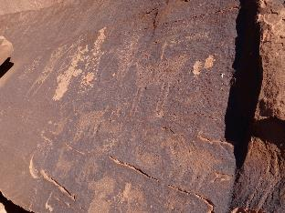
Courthouse Wash- Moab Panel

Slide 17
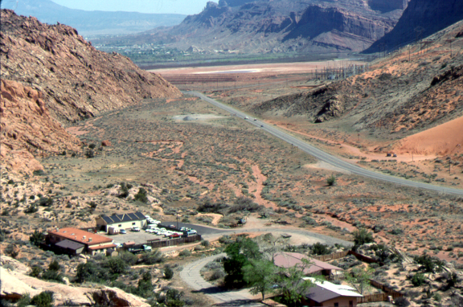
Purple Sage TCP

Slide 18
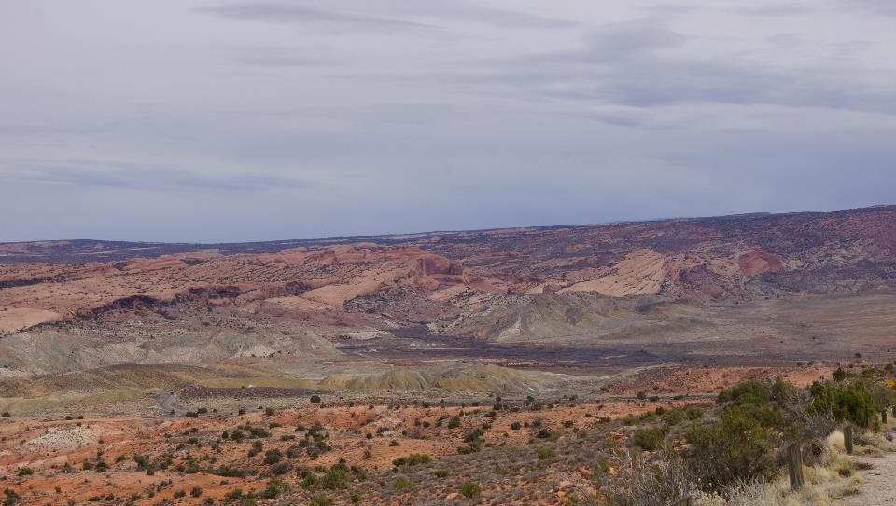
Salt Wash and Wolfe Ranch/Ute Panel

Slide 19
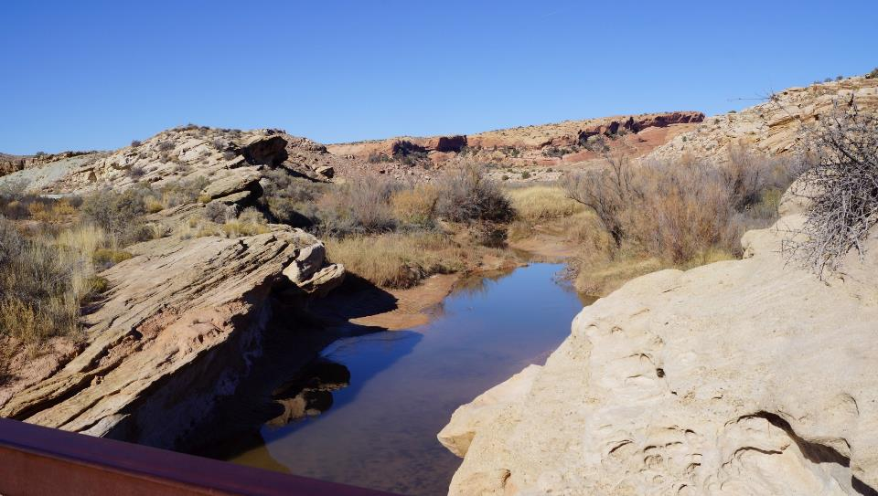
Wolfe Ranch/ Ute Panel Salt Wash

Slide 20
Plants Found Near Wolfe Ranch/Ute Panel

Slide 21
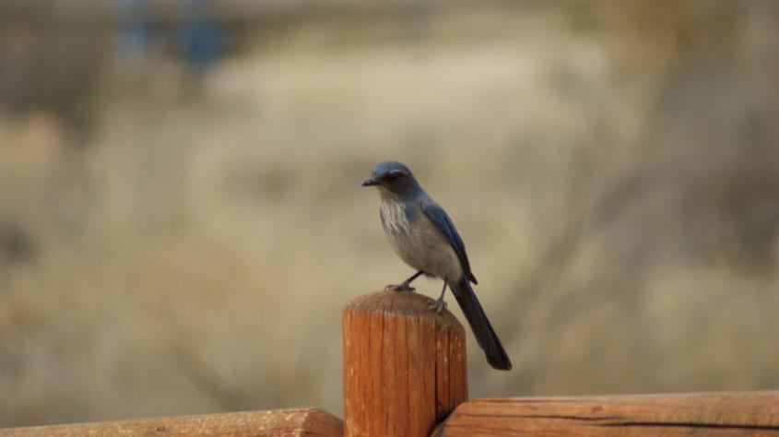
Wolfe Ranch/Ute Panel Animals

Slide 22
Wolfe Ranch/ Ute Panel

Slide 23
Wolfe Ranch Peckings

Slide 24
Salt Valley Overlook

Slide 25
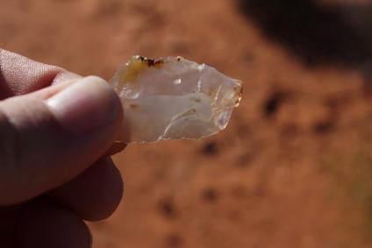
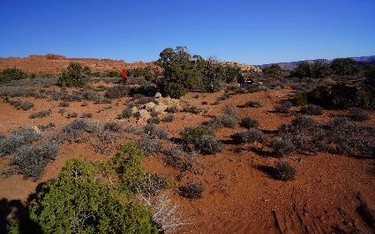
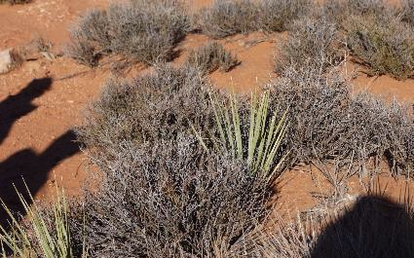
Salt Valley Overlook

Slide 26
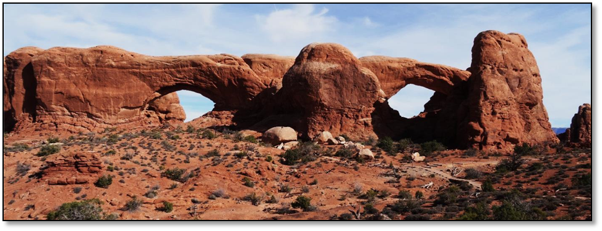
The Windows Section

Slide 27
The Windows Section

Slide 28
Park Interpretations
The park provides interpretations for the visitors.
Ute people evaluated these interpretations.
A summary of displays and evaluations is provided for each Indian Tribe.

Slide 29
Biggest Finding “We Have Always Been Here”

Slide 30
Origins Are key Issues
Essential in their relationship with the park are Ute (and other tribal and pueblo) stipulations regarding where they ultimately came from (were Created) and where they have traveled since then.
These statements of cultural association (and cultural affiliation for NAGPRA) may be disputed.
Ute people, however, stipulate that they have never been anywhere else and so they are the Fremont and earlier peoples from Utah and Colorado.
These studies lay a foundation by clarifying cultural perceptions of Origins.

Slide 31
Regional Findings
The region is best understood as the farming communities, upland use areas, and ceremonial places centered on where the old Native American Trail crosses the Colorado River.
This is called the American Indian Crossing of the Colorado River or AICC

Slide 32
Park Findings
The park was primarily a place for ceremony used by the Ute people who lived and farmed in the greater Moab Valley area.
The arches are portals in space and time, and may be used by Ute people to travel through space and time.
Hoodoos were living people or beings who not only represent the past but are sentient and can give Ute people today needed resources of various kinds.
The park contains traditional medicine plants, food plants, and paint pigments.

Slide 33
Canyonlands EOA is under Review

