Slide 1
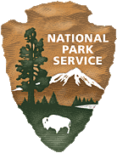
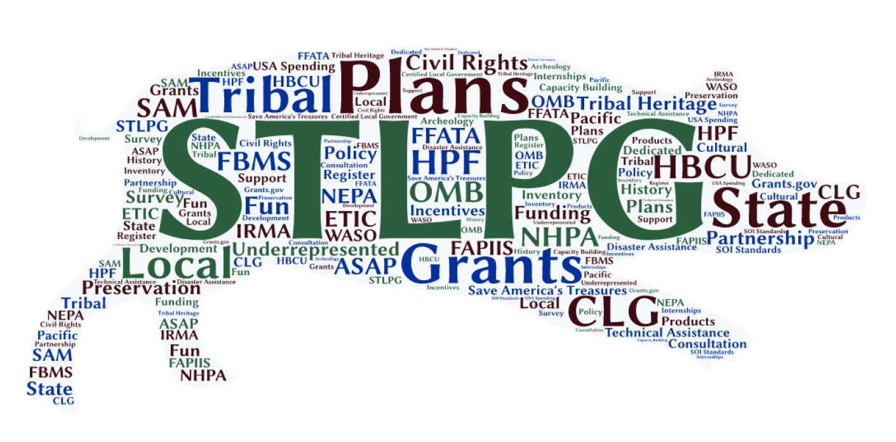
National Park Service State, Tribal, Local, Plans & Grants www.nps.gov/stlpg

Slide 2
National Park Service Historic Preservation Fund
Annual Non-Competitive/Block Grants:
State Historic Preservation Offices (SHPOs)
Tribal Historic
Preservation Offices (THPOs) - 207

Slide 3
Historic Preservation Fund (HPF) Competitive Grant Programs
African American Civil Rights (AACR) Due Dec. 1, 2021
History of Equal Rights (HER) Due Dec. 14, 2021
Underrepresented Communities (URC) Due Jan. 11, 2022
Save America’s Treasures (SAT) Due Dec. 14, 2021
Tribal Heritage Grants (THG)
Historically Black Colleges and Universities (HBCU)
Paul Bruhn Historic Revitalization Grants
Semi quincentennial

Slide 4
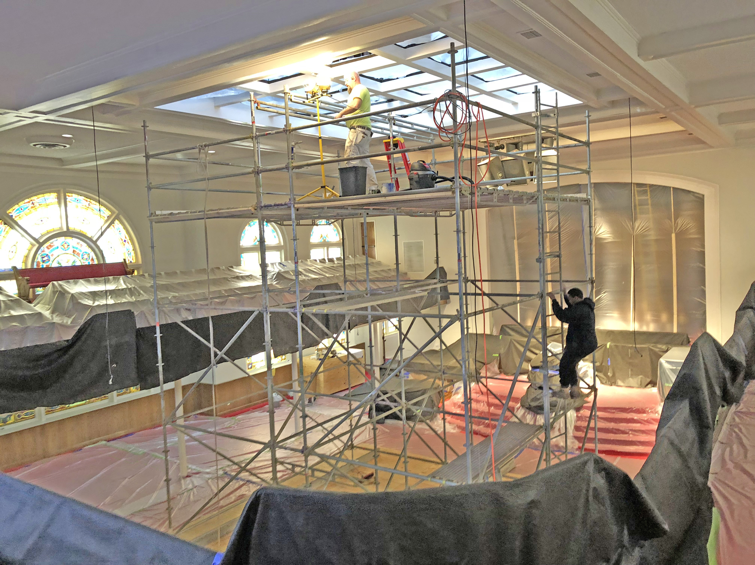
African American Civil Rights
Due Dec. 1, 2021
Grants to document, interpret, and preserve sites and stories related to the African American Civil Rights movement and sites of the transatlantic slave trade.
Projects types include preservation, and history projects (to include collections).
Eligible applicants include States, Tribes, local governments, and non-profit organizations.
go.nps.gov/civilrightsgrant
16th Street Baptist Church, Birmingham

Slide 5
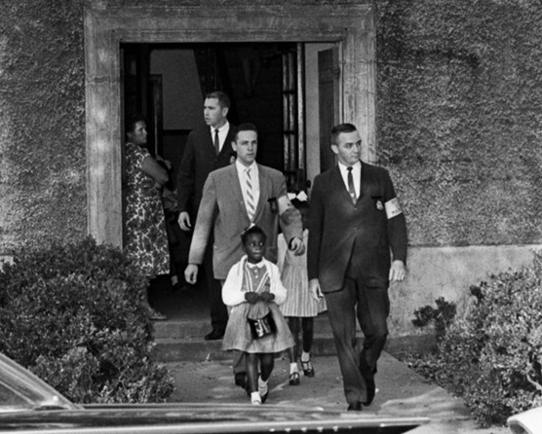
African American Civil Rights
Growing program
FY2016 $8 million
FY2017 $13 million
FY2018 $13 million
FY2019 $14.5 million
FY2020 $15.5 million
FY2021 $16.75 million
No match required
Applications due December 1, 2021
Being escorted to school in New Orleans
go.nps.gov/civilrightsgrant

Slide 6
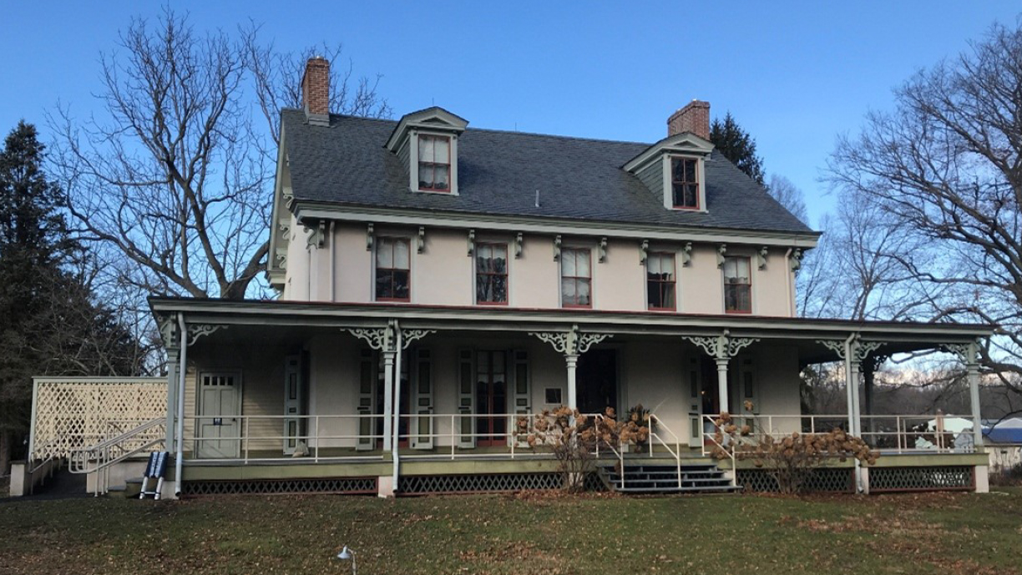
History of Equal Rights (HER)
Due Dec. 14, 2021!
Grants to preserve sites related to all Americans struggle for equal rights
No match required
Preservation Projects
FY2020 $2.5 million
FY2021 $3.4 million
Applications due December 1, 2021
Eligible applicants include States, Tribes, local governments, and non-profit organizations
Paulsdale, Alice Paul’s Childhood Home
go.nps.gov/civilrightsgrant

Slide 7
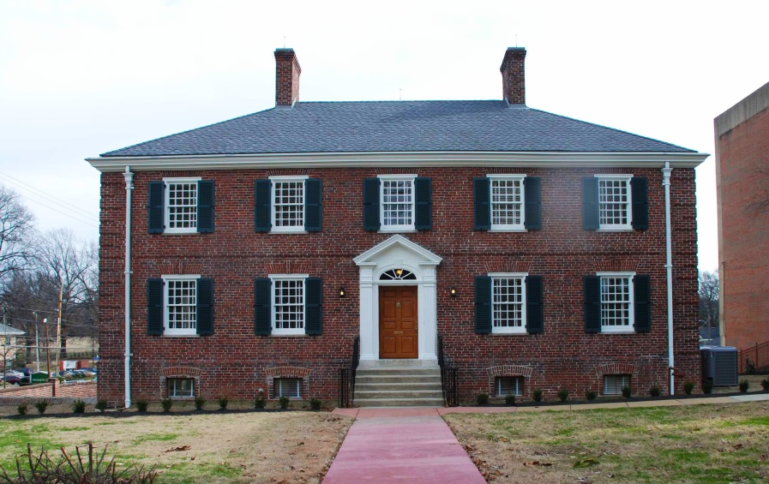
Historically Black Colleges & Universities (HBCU)
Grants to assist HBCUs preserving National Register listed buildings on their campuses
Over $40 million awarded through 2006 and since re-funded:
FY2017 $4 million
FY2018 $5 million
FY2019 $8 million
FY2020 $10 million
FY2021 $10 million
FY2021 Applications due Winter 2021
No match required
Sweeny Hall, LeMoyne-Owen College
go.nps.gov/hbcu

Slide 8
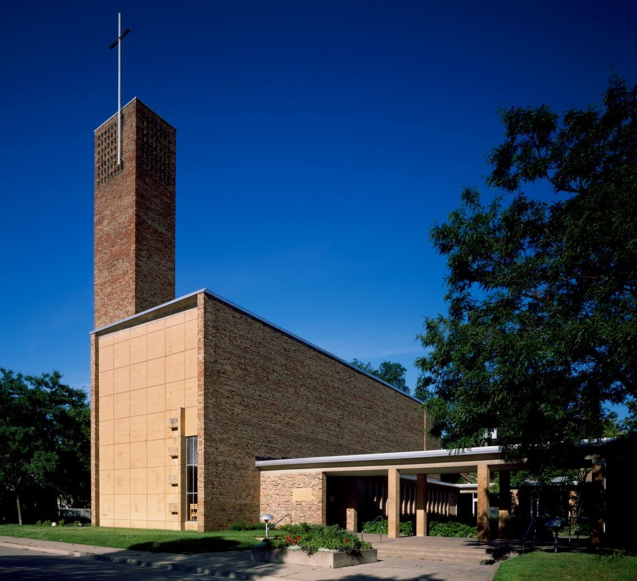
Save America’s Treasures
Due Dec. 14, 2021!
Established as part of the millennium
For the preservation and conservation of nationally significant buildings and collections in partnership with NEA, NEH, and IMLS.
From 1999 to 2010 over 3,600 applications requested $1.45 billion.
$300+ million to over 1,200 projects since 1999.
Projects funded in all 50 states, DC, and the territories.
Christ Church Lutheran
Minneapolis, MN
go.nps.gov/sat

Slide 9
Save America’s Treasures
Eligible applicants include states, tribes, local governments, and non-profits.
1:1 nonfederal match required.
Since re-funded:
FY2017 $5 million
FY2018 $13 million
FY2019 $13 million
FY2020 $16 million
FY2021 $25 million
Applications due December 14, 2021
NPS manages building projects and IMLS manages collections projects.
go.nps.gov/sat

Slide 10
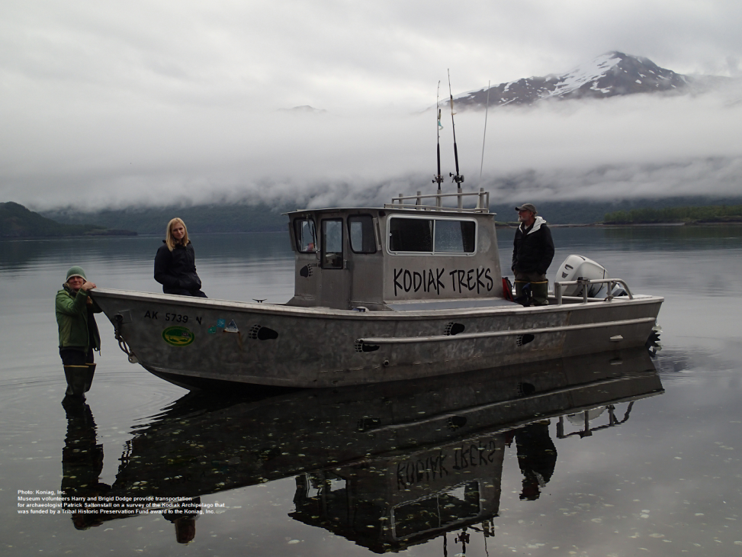
Tribal Heritage
Get Ready! Should be posted on Grants.gov by Dec 2021.
Since 1990 more than $17 million has been awarded to over 460 Indian, Alaskan Native, and Native Hawaiian communities.
Grants to assist in protecting and promoting unique cultural heritage and traditions.
No match required.
Applications for at least $500,000 in funding due winter 2022.
Projects include: oral histories, survey and inventory, education, interpretation, and preservation.
Koniag, Inc. – Survey of Kodiak Archipelago
go.nps.gov/tribalheritage

Slide 11
Paul Bruhn Historic Revitalization Grants
Physical preservation of NRHP listed and eligible sites that can encourage economic development.
Awarded as block grants to be subgranted.
FY2018 $5 million
FY2019 $5 million
FY2020 $7.5 million
FY2021 $7.5 million
Vale, Oregon
go.nps.gov/revitalization

Slide 12
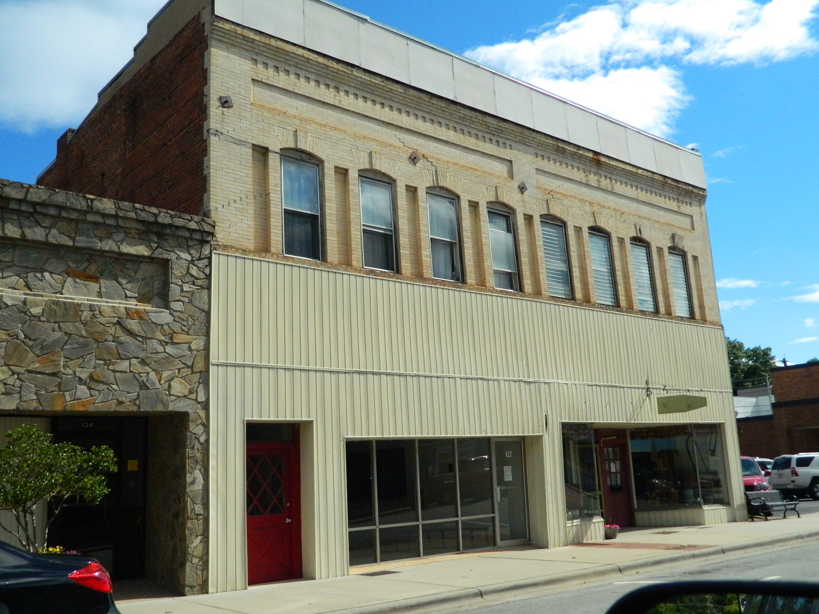
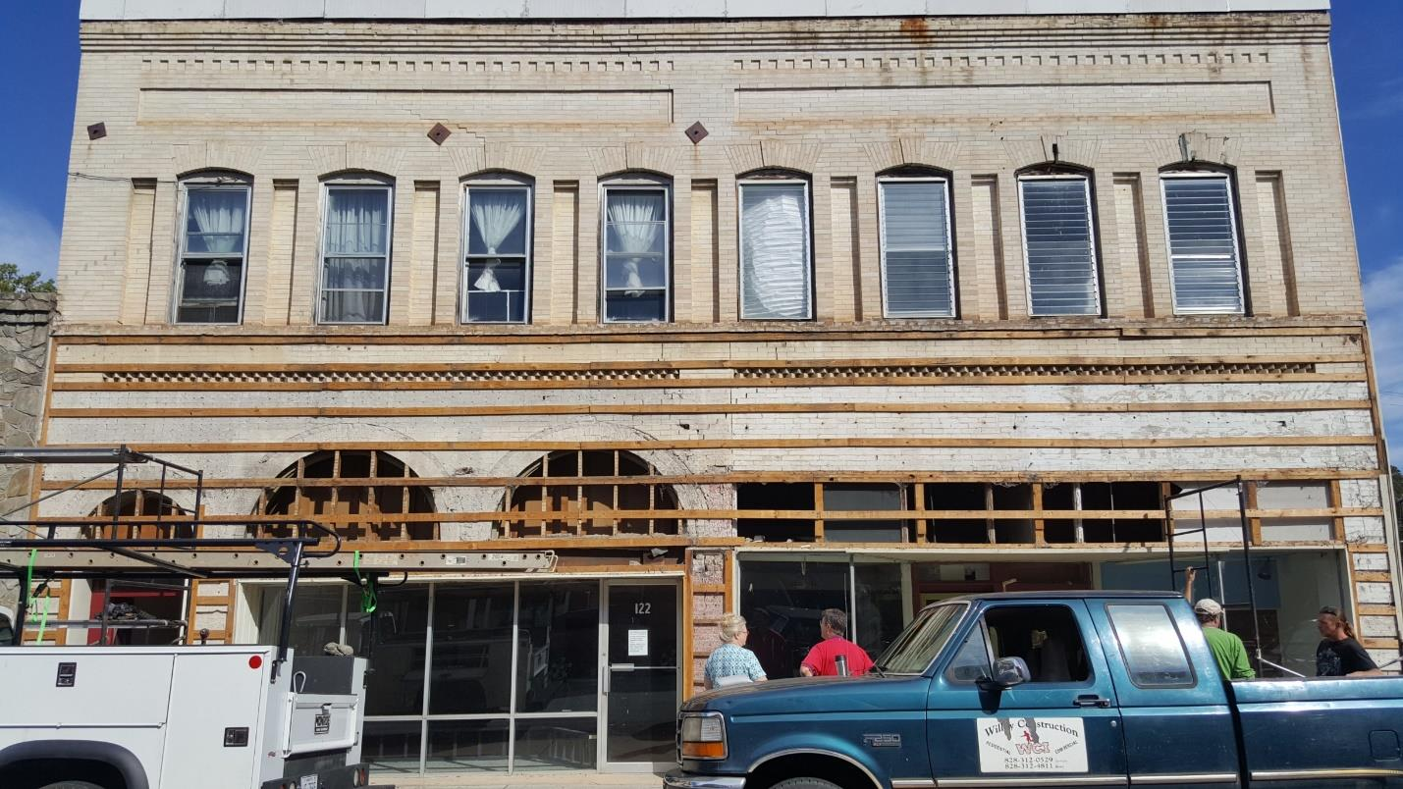
Paul Bruhn Historic Revitalization Grants
Elkin, North Carolina
Eligible Applicants: SHPOs, THPOs, Nonprofits, CLGs
Grants range from $200,000 - $750,000
No match required
Funds must be spent in rural areas – fewer than 50,000 as defined by the Census
Next Application winter 2022
go.nps.gov/revitalization

Slide 13
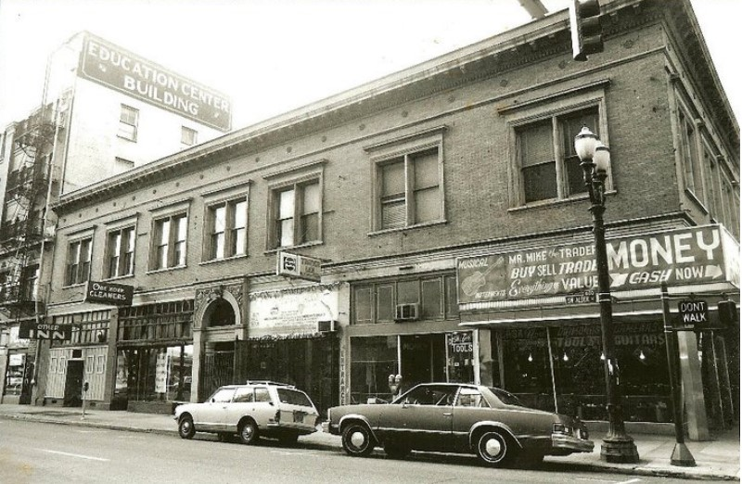
Underrepresented Communities (URC)
Funds surveys of historic properties associated with underrepresented communities, as well as nominations to the National Register for specific sites.
$25-50,000 awards
No match required
FY2014 to 2019 $500,000
FY2020 $750,000
FY2021 $1 million
FY2021 Applications due January 11, 2021
SHPOs, THPOs, CLGs may apply
The Other Inn, Portland, Oregon
go.nps.gov/urc

Slide 14
Thinking about applying?
Start Early, Start Early, Start Early!!
Register for ALL the systems EARLY! Sam.gov especially.
Is your project eligible? Logical next step?
Are you using the current application form? Oops!
2+2=5? Check math, proofread, review – don’t be the only eyes!
Less is more but don’t assume knowledge, tell the story.
Good photos but bad photos!
Deadlines – they’re not just suggestions, they are real!
Not funded? Get your comments and try again.
Youtube help: HHPreserveIt NPS

Slide 15
State, Tribal, Local, Plans & Grants Division
National Park Service
Washington, DC
http://www.nps.gov/stlpg
202-354-2020 | stlpg@nps.gov
Follow Heritage & Historic Preservation
@HHPreserveIt
Notes:
Do you have an idea for a “creative local” preservation project? Talk to us and see how we can help. We want to work with you and continue to keep local preservation in the leadership role!

