Slide 1
National Trust Funding Programs
Presentation to the National association of tribal preservation officers
October 27, 2021

Slide 2
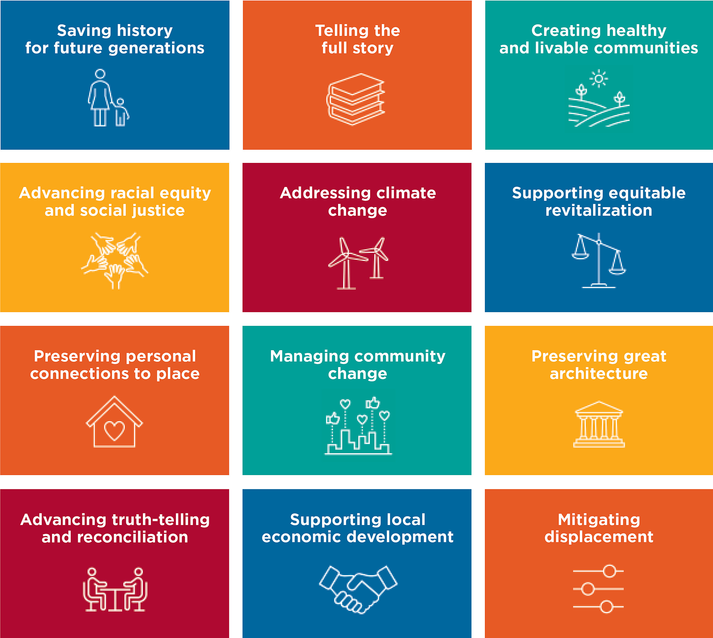
National Impact Agenda
Leading the Change Together: Draft Goals
Growing, Collaborative Networks
A Representative Movement
Climate Resilience
New, Modernized, Expanded Tools
Equitable Communities
An Engaged Public
A Truer History
Learn more: forum.savingplaces.org/connect/blogs

Slide 3
New Grant Opportunity: Telling the Full History Preservation Fund

Slide 4
Important Dates
November 1, 2021: Application Portal Opens
December 15, 2021: Applications Due
March 1, 2002: Notification Sent to Applicants
April 1, 2022: Grant Period Begins
March 31, 2023: Grant Period Ends (all projects must be complete by this date)
July 29, 2023: Final Reports Due from Grantees

Slide 5
Program Highlights
Interpret and preserve historic places of importance to underrepresented communities
Grants of $25,000 or $50,000
One-time funding opportunity
Can fund 100% of project costs (no match required)
Will fund between 60-80 projects across the country and in U.S. territories
Photo: Stewart Udall

Slide 6
Basic Eligibility
Open to:
Tribal governments or THPO
501(c)3 nonprofit
Accredited college or university
State or local gov’t agency
Applicant must have been impacted by the pandemic
Must be a humanities-based organization or must demonstrate past humanities-based work
Recipients of American Rescue Plan funds directly from NEH may not apply
Photo: Stewart Udall

Slide 7
Funding Categories
Research, planning, and implementation of interpretive programs
Architectural design and planning to preserve and activate historic buildings and landscapes
Research and documentation to enable local, state, and federal landmark designations
Training workshops to preserve and interpret historic places
Photo: Minesh Bacrania

Slide 8
Examples of Allowable Expenses
Supporting existing staff directly working on the proposed project
Hiring new staff to work on the proposed project
Obtaining the services of consultants with expertise directly related to the proposed project
Eligible costs associated with an in-person or virtual training
Designing and implementing innovative preservation education and interpretative programs
Designing, producing, and marketing printed materials or other media communications

Slide 9
Additional Criteria for Selecting Grantees
Degree to which the historic places and narratives fit within the NEH’s A More Perfect Union: Exploring America’s Story and Commemorating its 250th Anniversary project. This includes how the project addresses the experiences of Native Americans and other under-represented communities.
How the project will engage the local community
Organizational capacity
Likelihood the project will be completed as described
Feasibility of timeline and budget

Slide 10
For More Information
For Guidelines and Links to Application (November 1):
https://forum.savingplaces.org/tellingthefullhistoryfund
For Questions:
TellingtheFullHistory@SavingPlaces.org

Slide 12
Small But Mighty Preservation Fund Grants
Background: Umbrella of 56+ different state or regional funds
Deadlines: Feb. 1, June 1, Oct. 1 and out-of-round applications accepted in emergency situations
Grant Amount: Between $2,500 - $5,000
Eligible Applicants: Public agencies (e.g., tribes, local, state governments) and 501(c)(3) or other nonprofit organizations
Eligible Projects: Planning, education and outreach
Match: 1:1 required but due to pandemic, temporarily allowing f or both cash and in-kind donations to count toward the one-to-one required match

Slide 13
For More Information on All Our Funding
For Guidelines on All Our Programs:
https://forum.savingplaces.org/funding
For Questions:
Grants@SavingPlaces.org

