Slide 1
Catholic-operated Native Boarding Schools in the United States, pre-1978 (draft)
Publication date: May 9, 2023
Michele Levandoski
April 10, 2023
catholictruthandhealing@gmail.com

Slide 2
Criteria for inclusion in list:
* Religious = nuns, brothers, priests
* Congregation = a community of religious men or women
Operated by Catholic entity, such as diocese, parish or men / woman religious;
Provided on-site housing at some point in the school’s existence;
Provided formal academic or vocation training;
Established before 1978 Indian Child Welfare Act passed;
School established specifically for educating Native children; or
Existing school that received government funding specifically for the education of Native children

Slide 3
Removed from original list:
* Religious = nuns, brothers, priests
* Congregation = a community of religious men or women
School in area with large Native population but a parish school open to all Catholic members of the parish, regardless of race or ethnicity;
Government operated schools where priests or religious worked;
Schools established before the boarding school period (1819);
Day schools; and
Catechetical schools

Slide 4
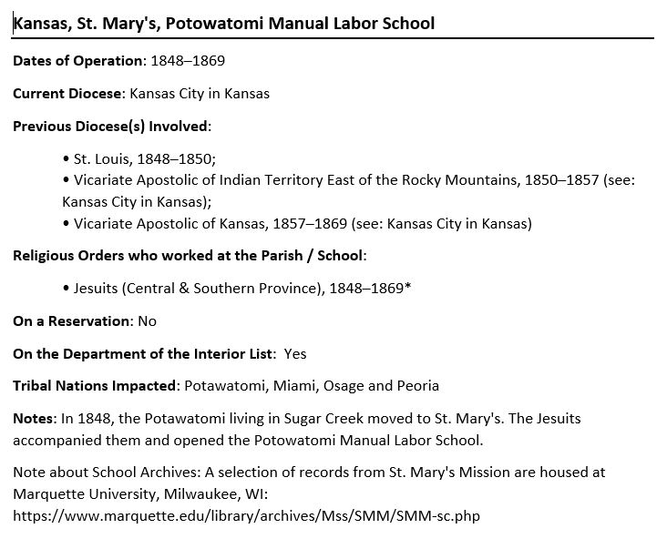
Sample Entry
* Religious = nuns, brothers, priests
* Congregation = a community of religious men or women

Slide 5
Religious / Dioceses
Jesuits
Central & Southern Province https://www.jesuitscentralsouthern.org/ Archives:
Archives and Research Center, St. Louis, MO: http://jesuitarchives.org/
Kansas City in Kansas
https://archkck.org/
Predecessor dioceses: • Vicariate Apostolic of Indian Territory East of the Rocky Mountain, 1850-1857; • Vicariate Apostolic of Kansas, 1857-1877; • Leavenworth, 1877-1947

Slide 6
Introduction to List
Glossary of Catholic terms
How to access Catholic records / archives
Who to contact at diocese or religious community
Types of relevant records in Catholic archives
Student Records
Sacramental Records
Cemetery Records
Annals / chronicles / journals
Others

Slide 7
Stats from List:
Michele Levandoski
catholictruthandhealing@gmail.com
89 schools
82 Religious communities
49 dioceses

