Slide 1
Multifamily Development in Henrico County
Trends and Focus
Henrico County, Virginia March 24, 2021

Slide 2
Multifamily development in Henrico:
What are the trends?
What is the county’s focus?
How is the county encouraging and accommodating development?
Henrico County, Virginia March 24, 2021

Slide 3
Development trends:
Pandemic has not slowed development activity in county
County continues to have high percentage of overall multifamily units when compared to region as a whole
Location of rezoning requests and makeup of unit types demonstrates county’s emphasis of locating multifamily developments in redevelopment areas
Henrico County, Virginia March 24, 2021

Slide 4
Development trends:
Pandemic has not slowed development activity in county
Henrico County, Virginia March 24, 2021

Slide 5
Development trends:
County continues to approve a large number of multifamily units and has high percentage of multifamily units when compared to region as a whole
Henrico County, Virginia March 24, 2021

Slide 6
Development trends:
Location of rezoning requests and makeup of unit types demonstrates county’s emphasis of locating multifamily developments in redevelopment areas
Henrico County, Virginia March 24, 2021

Slide 7
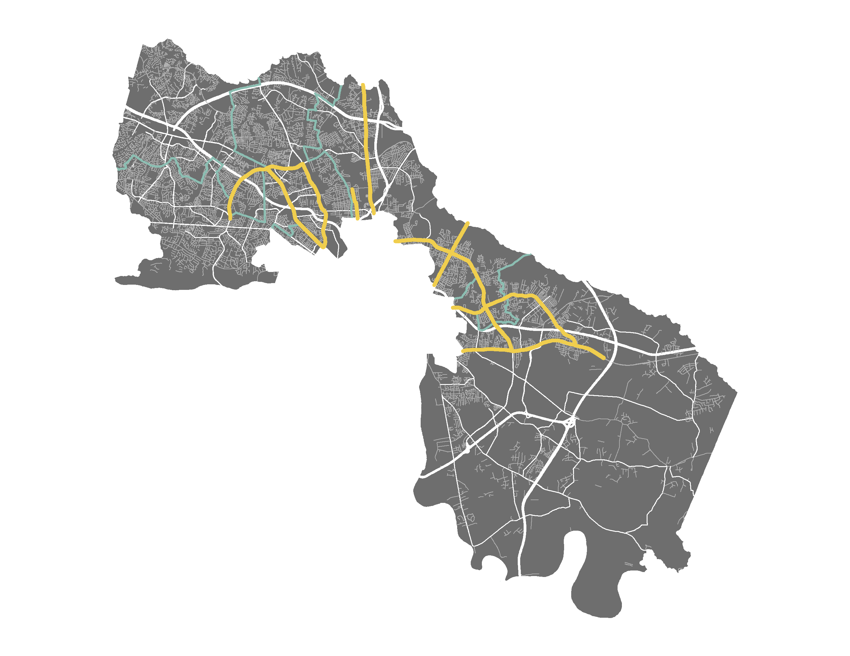
Henrico Corridors of Interest
Parham Road
West Broad Street
Staples Mill Road
Lakeside Avenue
Brook Road
Mechanicsville Turnpike
Laburnum Avenue
Nine Mile Road
Williamsburg Road
Henrico County, Virginia March 24, 2021

Slide 8
How do we target those corridors?
Westwood Redevelopment Overlay District
  Residential and development flexibility through Provisional Use Permit
Form-Based Alternative Overlay Districts
  Developed for 5 areas in the County through charrette process with extensive community input
Comprehensive Plan Update
  Examine corridors and redevelopment areas as part of ongoing Comp Plan update
  Plan can emphasize redevelopment goals and guide focus for Planning Commission and Board of Supervisors
Henrico County, Virginia March 24, 2021

Slide 9
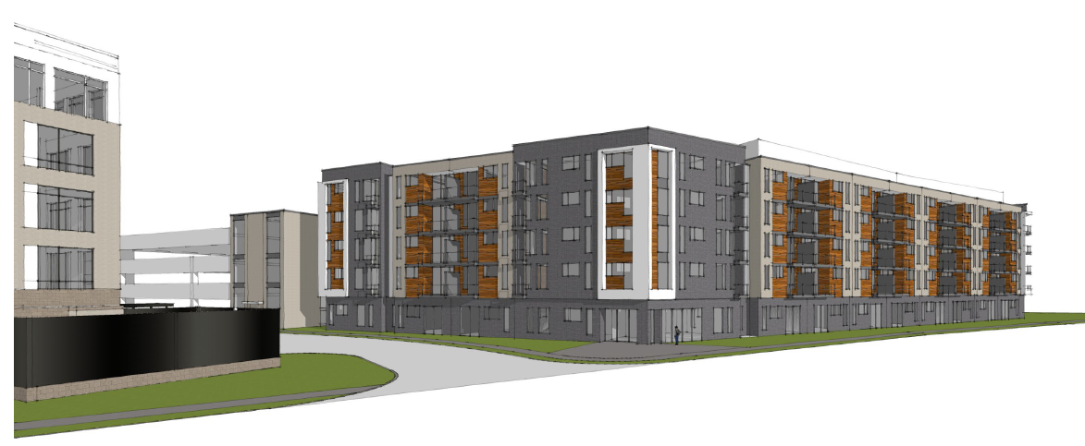
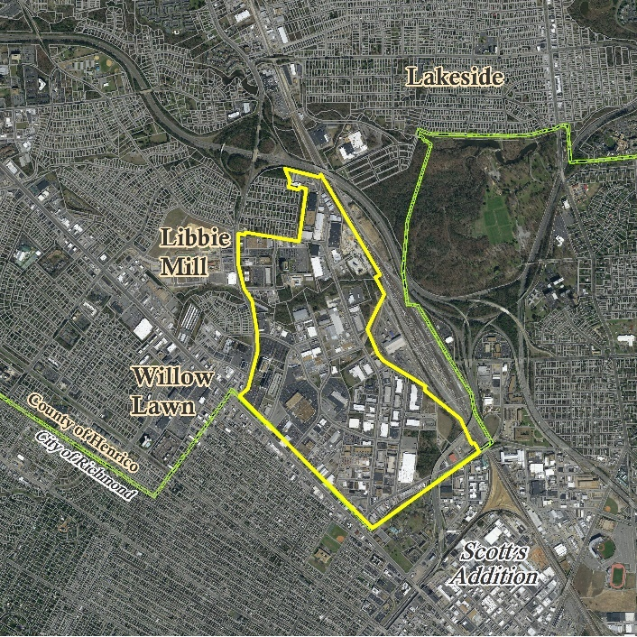
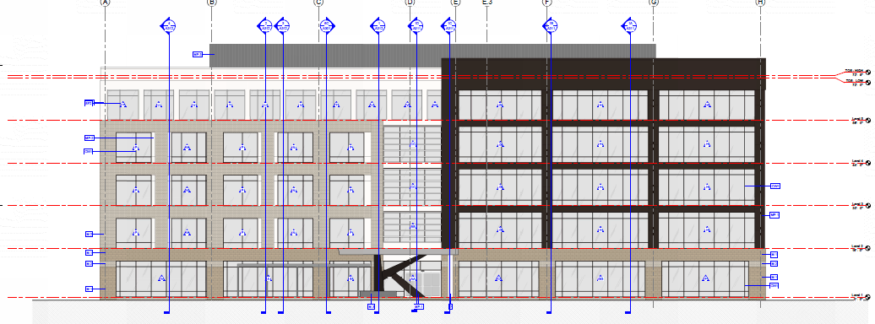
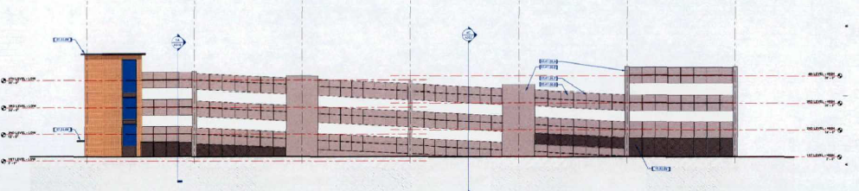
Westwood Redevelopment Overlay:
Adjacent to W. Broad Street BRT Line
Residential uses and development flexibility allowed through PUP process
Henrico County, Virginia March 24, 2021

Slide 10
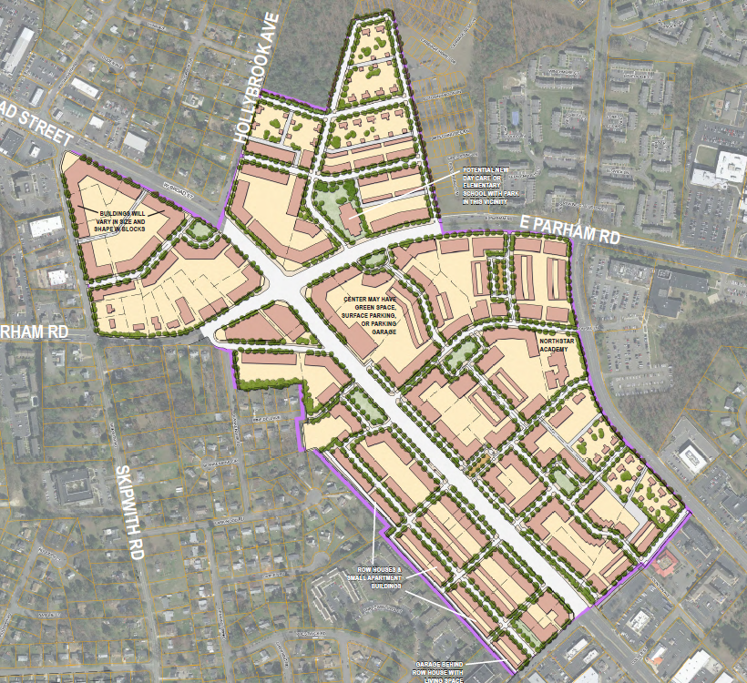
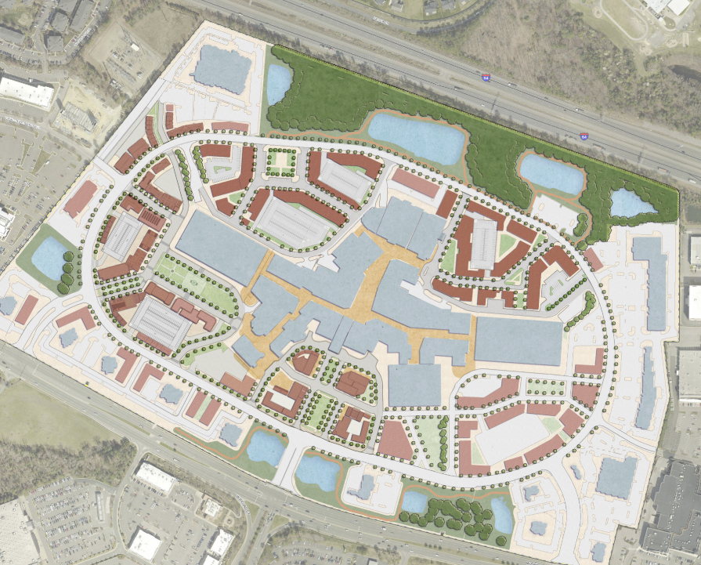
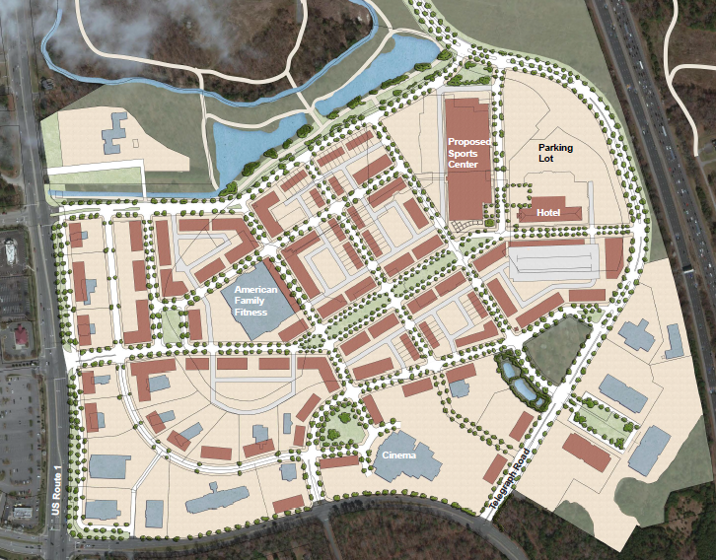
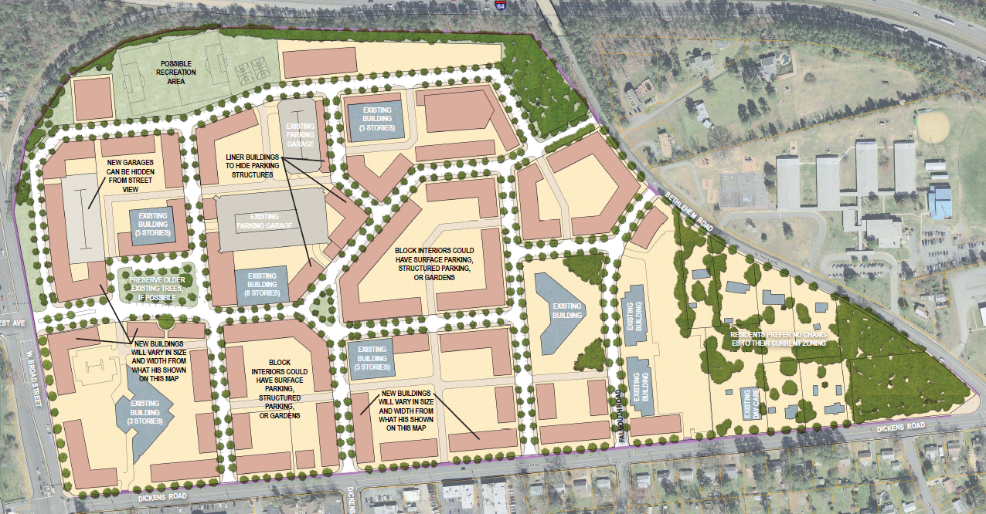
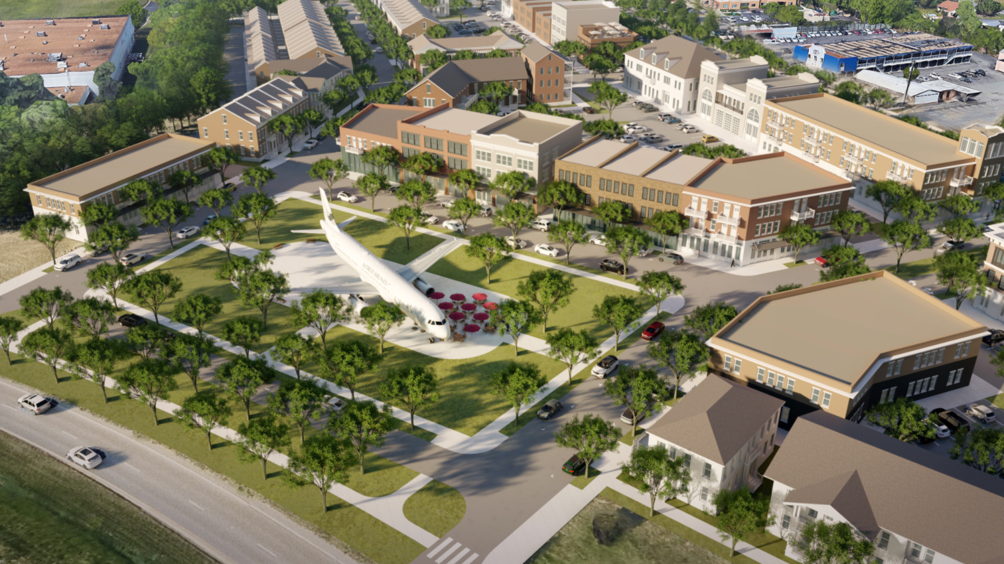
Form Based Alternatives Overlay (FBA-O)
  Developed through charrette process with extensive community input
  5 distinct areas evaluated:
    Brookfield Office Park
    Parham and W. Broad Street
    Virginia Center Commons
    Williamsburg Road
    Short Pump Town Center
Henrico County, Virginia March 24, 2021

Slide 11
What tools can be used?
Allow Residential in Business Districts
  Business and Office Districts with a Provisional Use Permit
    Limited residential units; Development standards in Zoning Ordinance
Allow Businesses and Development Flexibility in Multifamily Residence Districts
  R-6 General Residence District with a Provisional Use Permit
    Revised to allow for reduction in setbacks, parking requirements when master plan provided
    Also increased allowances for commercial uses, including outside dining
Create New Large-Scaled Mixed Use Communities
  Urban Mixed-Use District, 20-acre minimum project size
  Master plan required; Flexible development standards
Overlay Districts
  Westwood Redevelopment Overlay District
  Introduces residential uses in traditional commercial areas through provisional use permit
  Setback and parking flexibility provided through PUP process
Henrico County, Virginia March 24, 2021

Slide 12
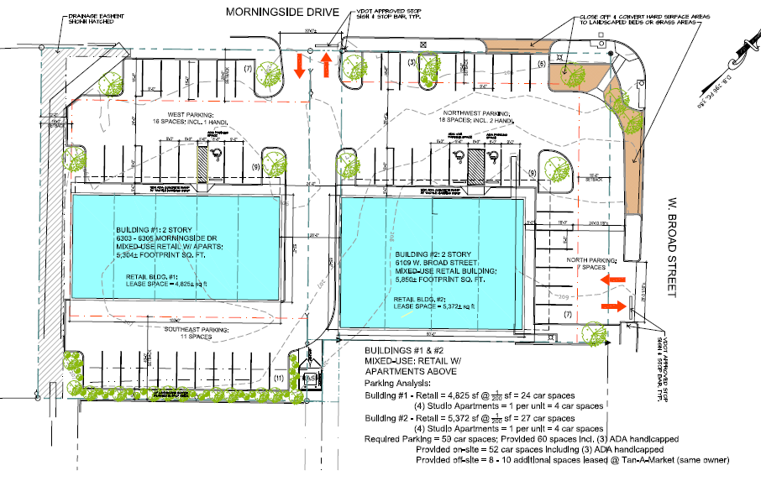
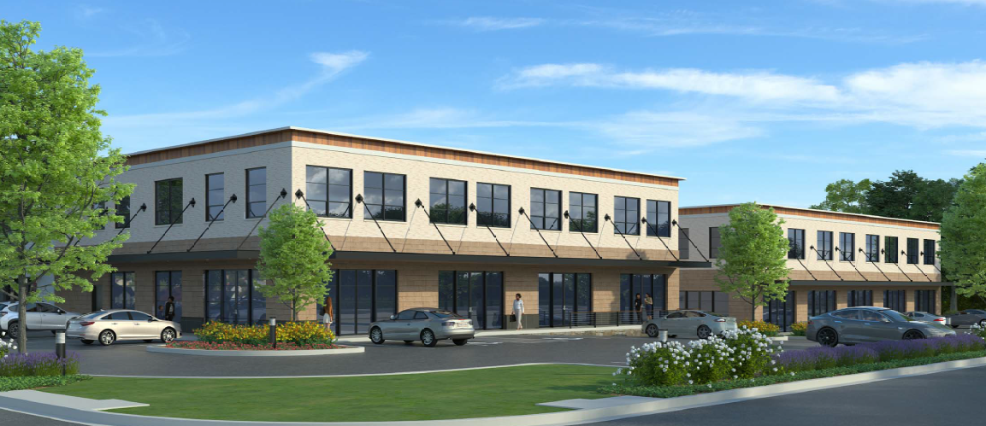
Mixed-Use in Office and Business Districts with a Provisional Use Permit (PUP):
Up to 4 accessory dwelling units, located on a floor or floors above a retail or office use
Henrico County, Virginia March 24, 2021

Slide 13
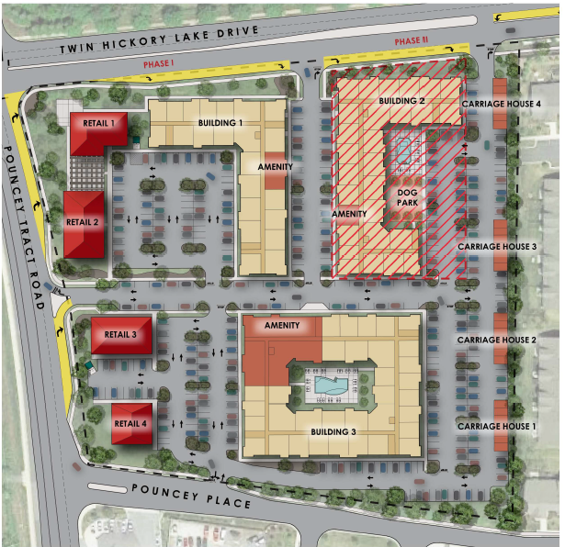
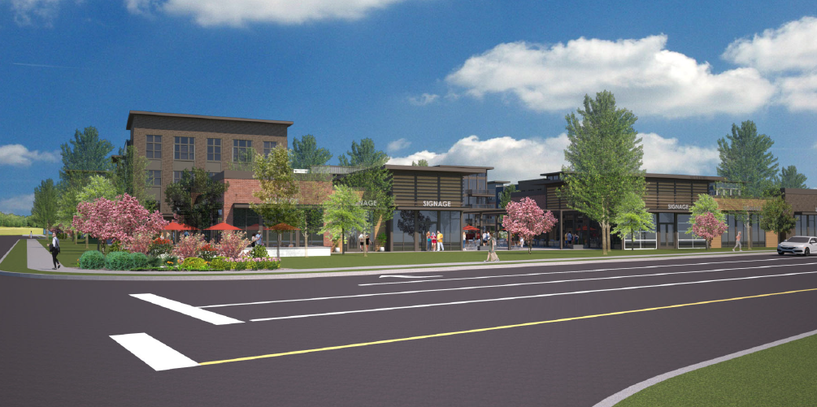
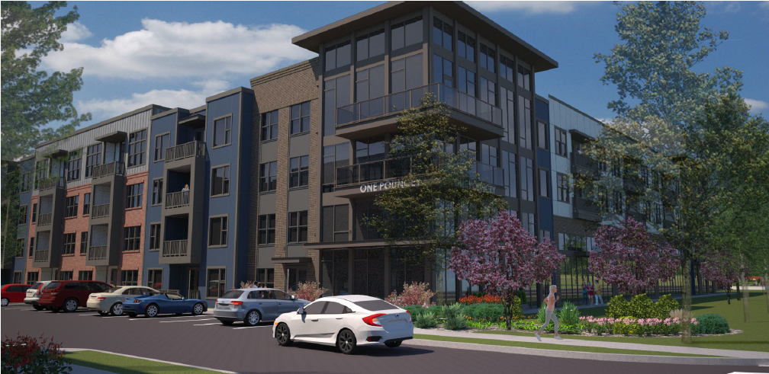
Mixed-Use in R-6 General Residence District with a PUP:
Greenfield: Pouncey Place
Maximum project area of 10 acres
Master Plan required
Increased densities
Reduced setbacks and parking
Henrico County, Virginia March 24, 2021

Slide 14
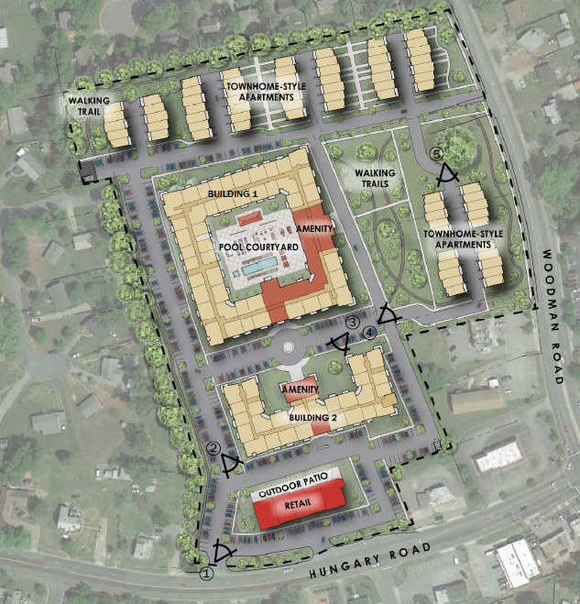
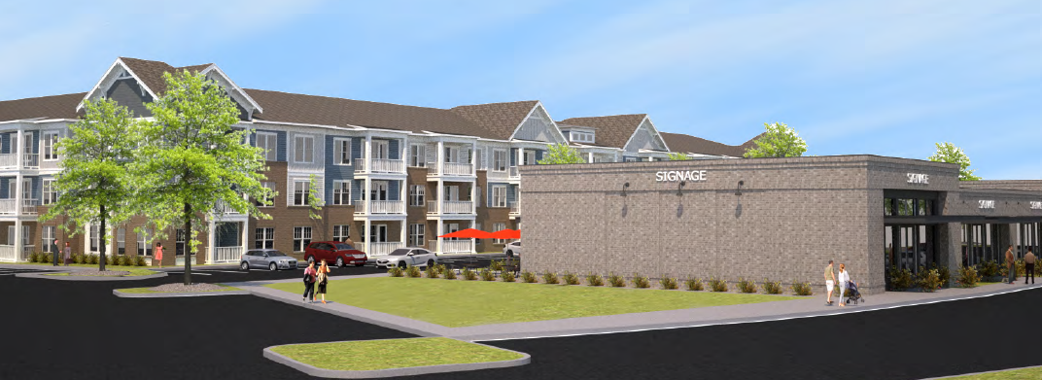
Mixed-Use in R-6 General Residence District with a PUP:
Redevelopment: Laurel Park Shopping Center
Henrico County, Virginia March 24, 2021

Slide 15
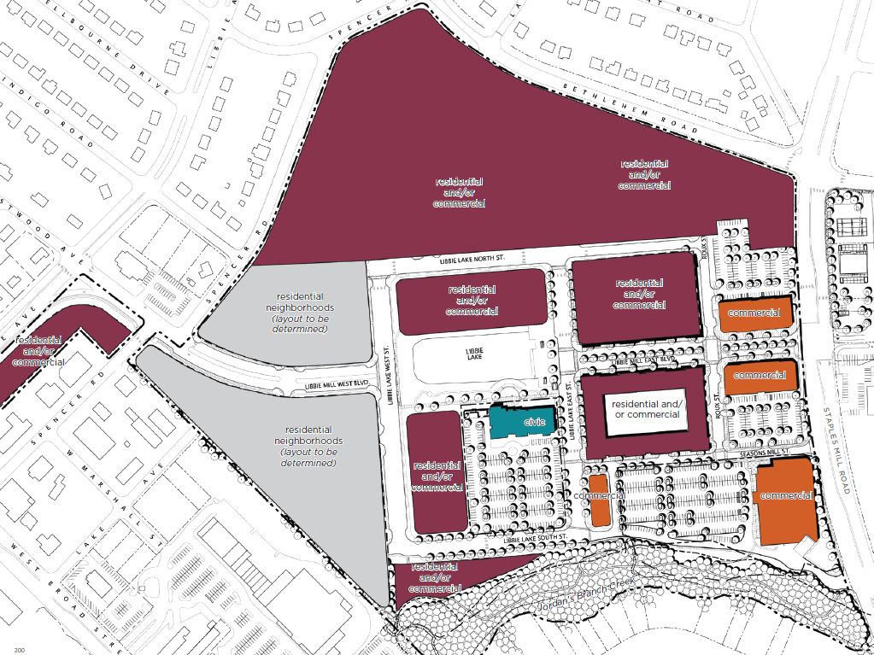
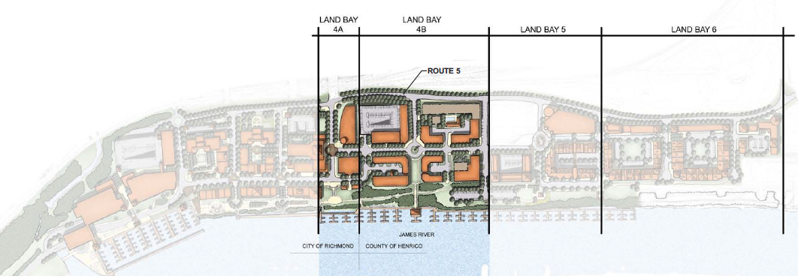
Urban Mixed-Use:
Minimum project area of 20 acres
Master Plan and development impact statements required
Flexibility for setbacks, parking, density
Focus on pedestrian infrastructure and experience
25% of building square footage devoted to commercial/office uses, unless otherwise permitted by Provisional Use Permit (PUP)
Henrico County, Virginia March 24, 2021

Slide 16
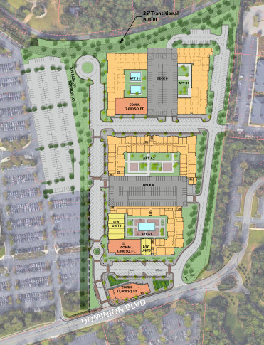
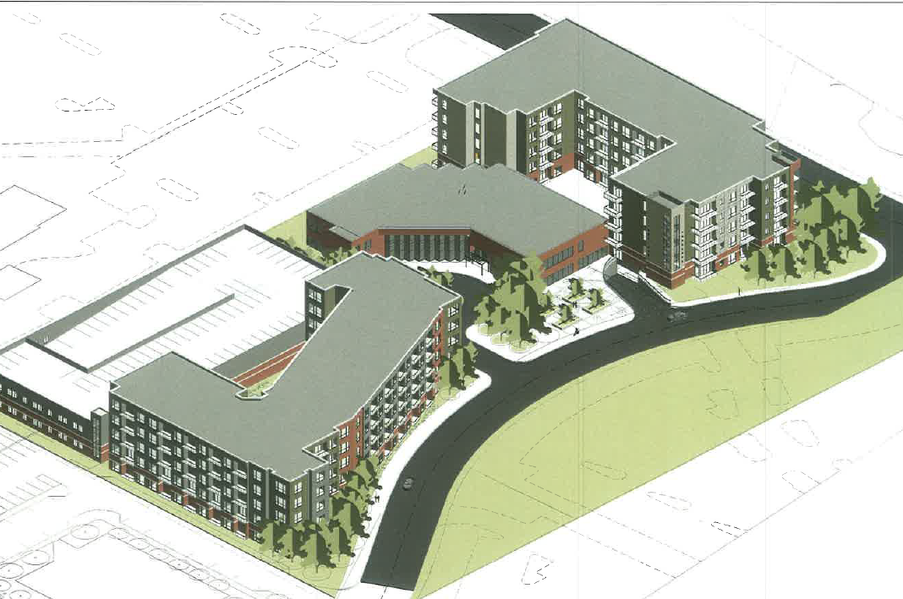
Urban Mixed-Use in the Innsbrook Redevelopment Overlay District
Reduced minimum project area of 4 acres
Development impact statements not typically required
Henrico County, Virginia March 24, 2021

Slide 17
How can the Zoning Ordinance update support these trends?
Revised UMU Requirements
  Reduced to Minimum 12 acres
  Minimum 20% of development Residential and 20% Commercial
Planned Development Districts (PD)
  SMX-PD Suburban Mixed Use Planned Development District
  TND-PD Traditional Neighborhood Development Planned Development District
  UMU-PD Urban Mixed-Use Planned Development District
  LI-PD Light Industrial Planned Development District
Introduction of Form-Based Overlays
Henrico County, Virginia March 24, 2021

Slide 18
What are the county’s goals and future focus?
Target redevelopment areas where new construction can spur investment
Emphasize mixed-use communities, access to transit, and pedestrian and bicycle amenities
Focus on form of new development, and consider opportunities to take advantage of new flexibility in density, setback, and parking standards
Incentivize creation of structured parking where appropriate
Encourage participation in Comp Plan update to guide future decision making
Henrico County, Virginia March 24, 2021

Slide 19
Questions?
Henrico County, Virginia March 24, 2021

