Slide 1
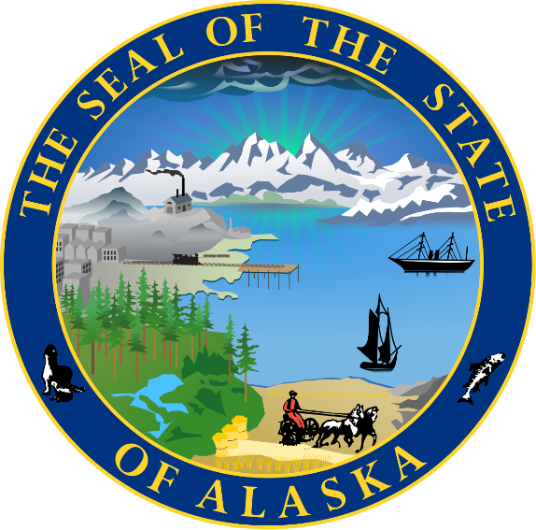

Slide 2
Alaska Infrastructure Federal Funding
Infrastructure Investment & Jobs Act
Office of Infrastructure – Mission and Deliverables
Alaska’s Key Grants & Successes
Project Bundling – Why & Obstacles
Workforce – Obstacles & Plan
Infrastructure Partnerships – We must!

Slide 3
Federal Infrastructure Funding
Infrastructure Investment & Jobs Act (IIJA) – November 2021
aka Bipartisan Infrastructure Law or BIL (FY22-26)
Inflation Reduction Act (IRA) – August 2022
Government created; Business led (tax credits)
CHIPS & Science Act (CHIPS) – August 2022
Semiconductor Manufacturing* Incentives
*While in DC in September, I pushed back on permitting obstacles for Alaska’s critical minerals needed for semiconductors: Federal siloes and talking out of both sides of their face.

Slide 4
Infrastructure Investment & Jobs Act (IIJA)
$1.2 Trillion
65% increase to Formula funding (primarily transportation)
30% Discretionary grants up for grabs from all states & territories
Of that, most will be paid directly to governments, tribes, and non-profits; many grants require matching funds*
5% Loans
Focused on Building up Underserved Communities (Justice40) and Renewable Energy
Fiscal years 2022-2026, with implementation over 10 years (maybe extended?)
Federal agencies recently added much-needed Technical Assistance
*Potential for Secretaries to waive matching fund requirements = important for Alaska

Slide 5
Office of Infrastructure
Understand Alaska’s Infrastructure Needs, Priorities, and Obstacles
Track Funding – Grants & Awards – find, understand, communicate
Connect State, Community & Tribal Partners, incl. Federal Delegates & Agencies
Coordinate & Support – Letters of Support; Matching Funds (when needed)
Maximize Funds – Project Bundling
Workforce Development – EDA ‘Recompete’ grant ($50MM); USDOT grant
Governor’s priorities, incl. Lowering Cost of Energy, Access, Food security
My goal: Cumulative Infrastructure Asset Data - & GIS Mapped!
Joint goal: Strategic Infrastructure Plans
Weekly Email & Website
SHAREEN.CROSBY@ALASKA.GOV (907) 717-5551

Slide 7
Alaska’s funding (thus far) $5.4 billion
It’s exciting
(but complicated)!

Slide 8
Broadband Equity, Access and Deployment
Allocated $42.45 Billion for all States and Territories
Alaska’s Allocation: $1,017,139,672.42
Plus Tribal & Community grants
$490,000,000+ (growing weekly)
Notes:
3 tranches

Slide 9
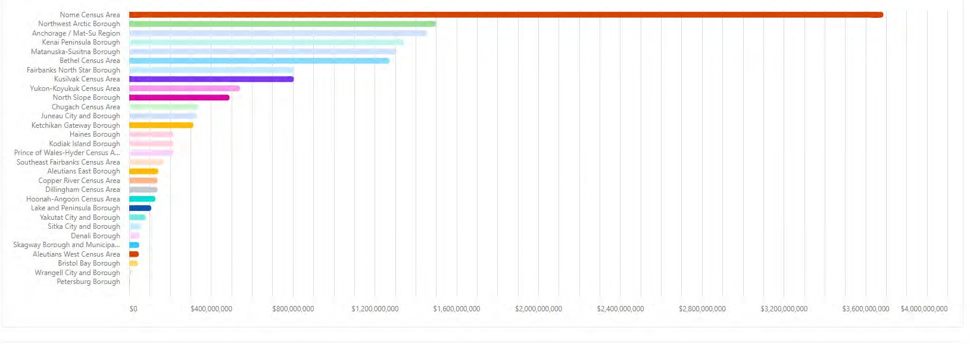
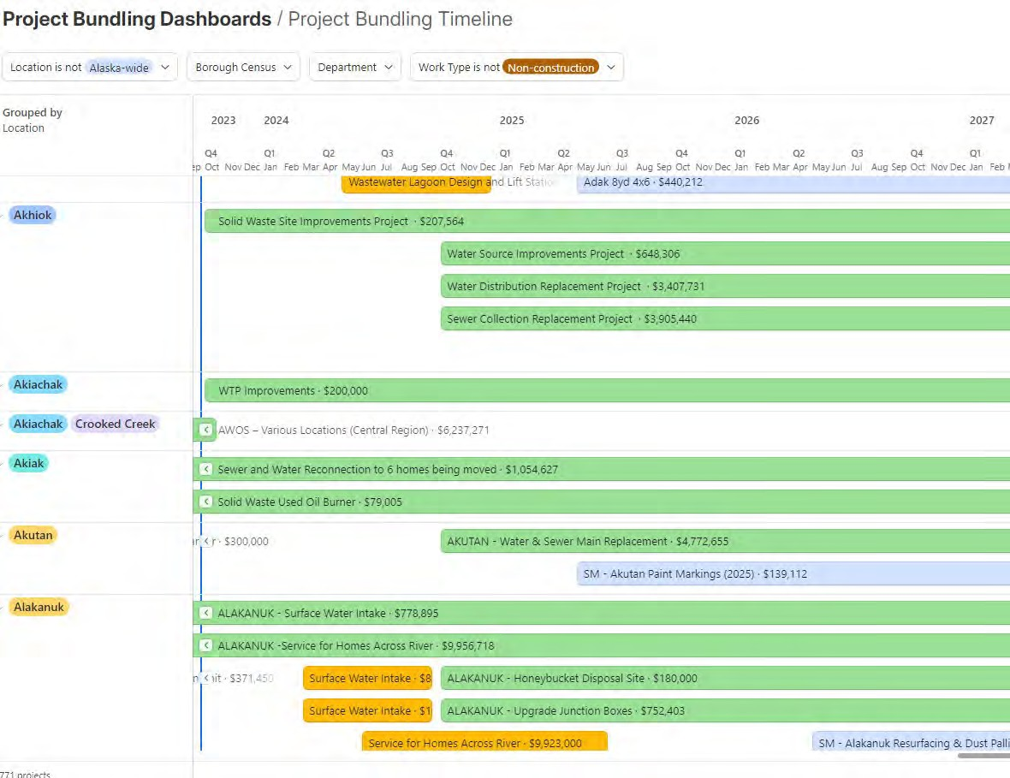
Transportation – DOT STIP + IIJA funding
IIJA Transportation funding (to date):
$3.355 billion
Includes increased formula funding + discretionary grants
DRAFT Project Bundling Dashboard –Data is for purposes of illustration only to demonstrate potential Interactive 5-year Infrastructure Dashboard
2023

Slide 10
Alaska Energy Authority AEA Secures $206.5 Million from U.S. DOE to modernize Alaska’s energy infrastructure
(Anchorage) — The Alaska Energy Authority (AEA) has secured $206.5 million for Grid Resilience and Innovation Partnership (GRIP) Topic Area 3: Grid Innovation through the United States Department of Energy Grid’s (DOE) Grid Deployment Office (GDO). A cost match of 100 percent, or $206.5 million, is required for a total project amount of $413 million.
The awarded project will construct a High Voltage Direct Current (HVDC) submarine cable to serve as a parallel transmission route from the Kenai Peninsula to Anchorage, creating a much-needed redundant system in case of disruptive events.

Slide 13
WHY?
Economies of Scale
Maximizing once-in-a-generation funding
Permitting + procurement + logistics (mobilizing)
Maximizing limited workforce
Momentum
Less community disruption
HOW? Magic!
Coordination of multiple agencies + contractors, fund sources, locations + projects
OBSTACLES (there are many):
Permitting
Accounting – fed, agency-agency
Communication between entities (one POC for site)
Project Bundling
aka ‘Dig Once’

Slide 14
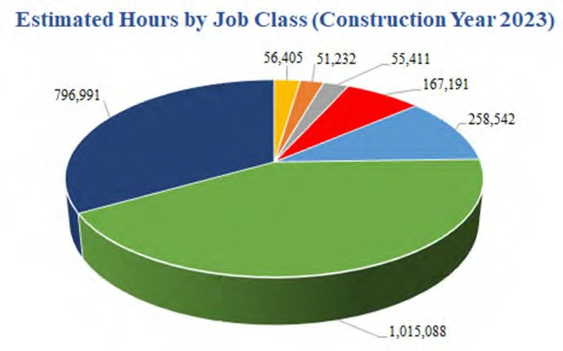
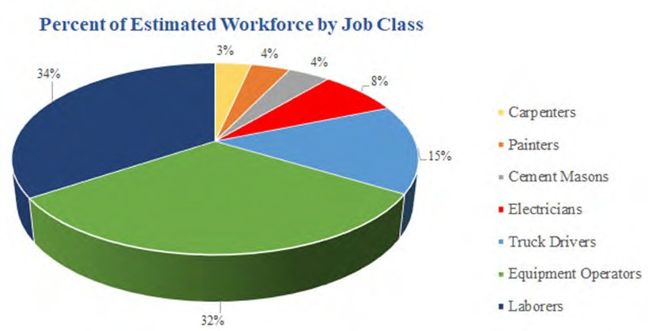
DOT Workforce Development and Training
STIP ID:34200
Transportation Workforce Development & Training
$24 million
2023

Slide 15
WORKFORCE EDA ‘Recompete’ Grant - $50 million
Applied $50 MILLION
Understanding conditions that led to high prime-age employment gaps in Alaska
Understanding workforce needs – now + 10 years
Targeting workers ages 17-53 (grant focuses on economically disadvantaged)
Training, apprenticeships, university
Partners: Office of the Governor, Alaska Department of Labor, AVTEC, Alaska Municipal League, University of Alaska, Denali Commission, Alaska Workforce Investment Board, with Alaska Safety Alliance as the primary partner + grant applicant.

Slide 16
PARTNERSHIPS
Grant applications are stronger
Shared resources in Alaska’s limited environment
Funds
Expertise
Risk
State entities, Communities, Tribes/ANCSAs, U.S. delegates, trades, non-profits, for profits
Public-Private Partnerships

Slide 17
Thank you!
Shareen Crosby
Infrastructure Investment Coordinator
Office of Infrastructure
Office of the Governor
(907) 717-5551
Shareen.Crosby@alaska.gov

