Slide 1
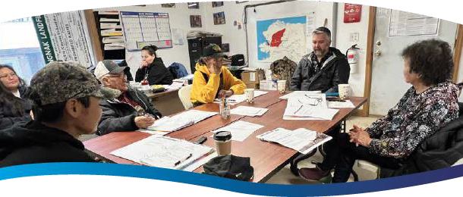
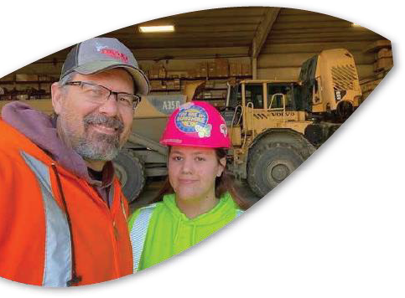
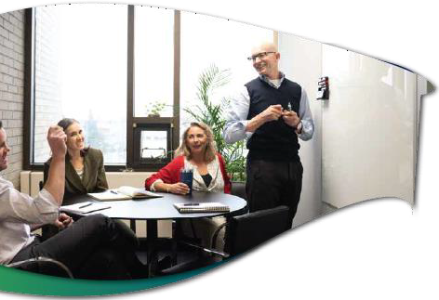
DEFENDING
ALASKANS’ RIGHTS
A s s o c i a t i o n o f G e n e r a l C o n t r a c t o r s o f
A l a s k a
A n n u a l C o n f e r e n c e
N o v e m b e r 9 , 2 0 2 3 J o s i e W i l s o n
www.aidea.org

Slide 2
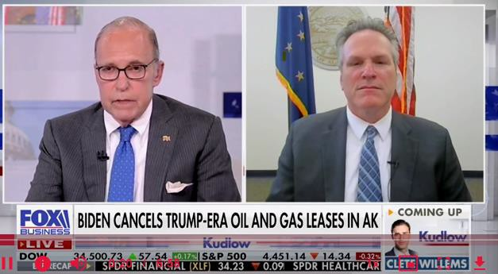
International News on September 6, 2023
A I D E A | D e f e n d i n g A l a s k a n s ’ R i g h t s | A G C o f A l a s k a A n n u a l C o n f e r e n c e | N o v e m b e r 9 , 2 0 2 3

Slide 3
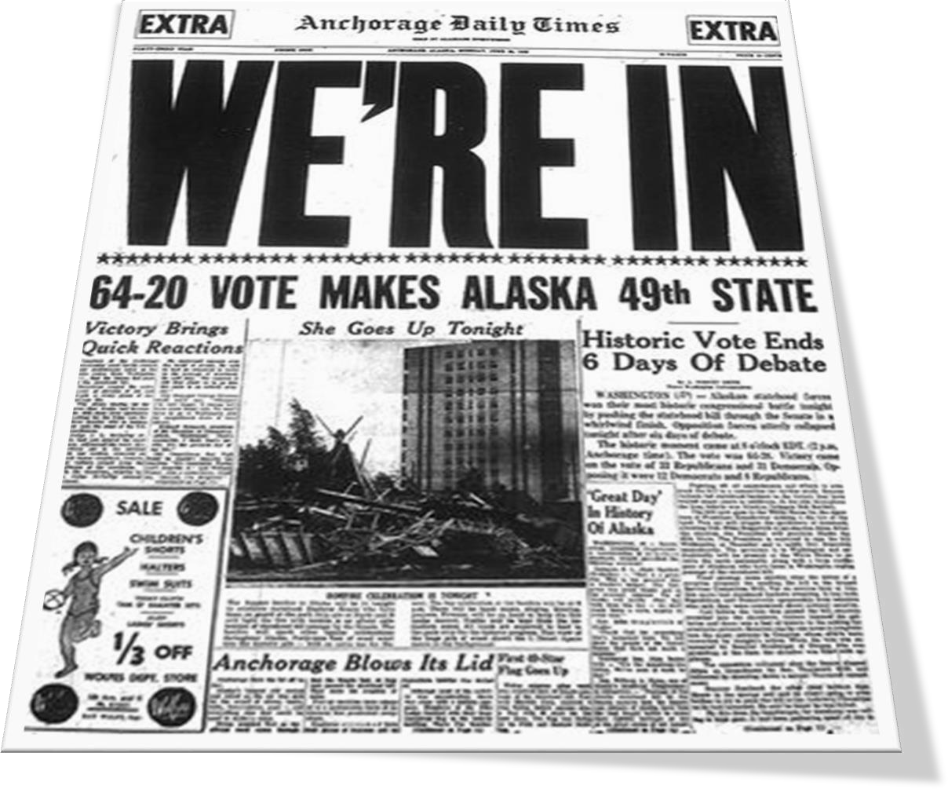
Why Is This Important To Alaskans?
Statehood Act – Section 6(i) Alaska Constitution – Article 8
The rights offered by Congress to Alaskans for statehood included:
The right to select and receive ownership title to approximately 30% of the state (102.5 million acres) as “statehood lands”
Ownership of all minerals, oil, and gas beneath statehood lands
A right of access across federal and other lands to “prospect for, mine, and remove” state-owned minerals on state land
The right to manage and decide whether resources should be developed on state lands according to laws passed by the Alaska Legislature and the Alaska Constitution
Title to submerged lands and minerals beneath navigable waters
A I D E A | D e f e n d i n g A l a s k a n s ’ R i g h t s | A G C o f A l a s k a A n n u a l C o n f e r e n c e | N o v e m b e r 9 , 2 0 2 3

Slide 4
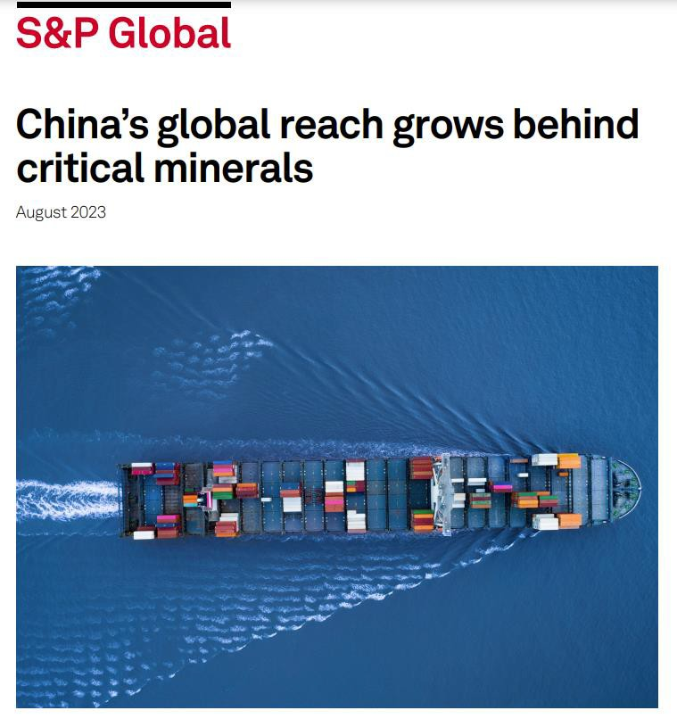
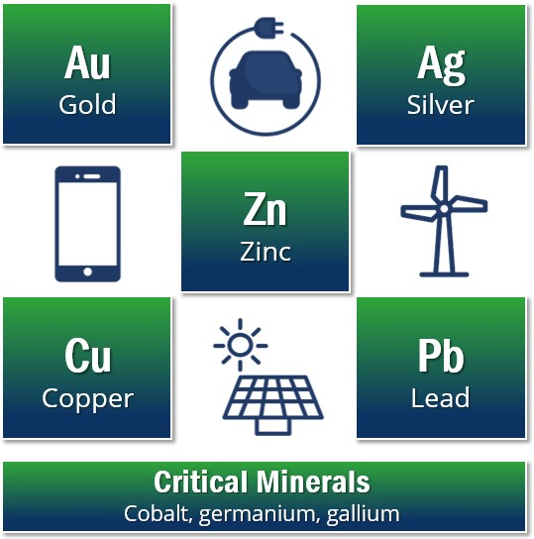
082423-china-s-global-reach-grows-behind-critical-minerals.pdf (spglobal.com)
A I D E A | D e f e n d i n g A l a s k a n s ’ R i g h t s | A G C o f A l a s k a A n n u a l C o n f e r e n c e | N o v e m b e r 9 , 2 0 2 3

Slide 5
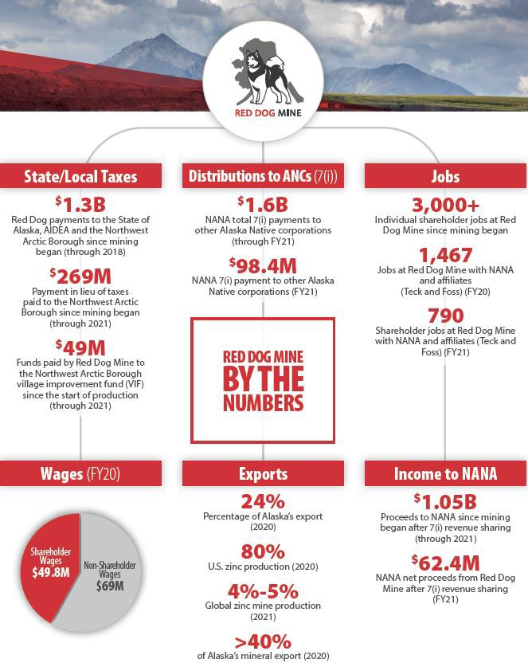
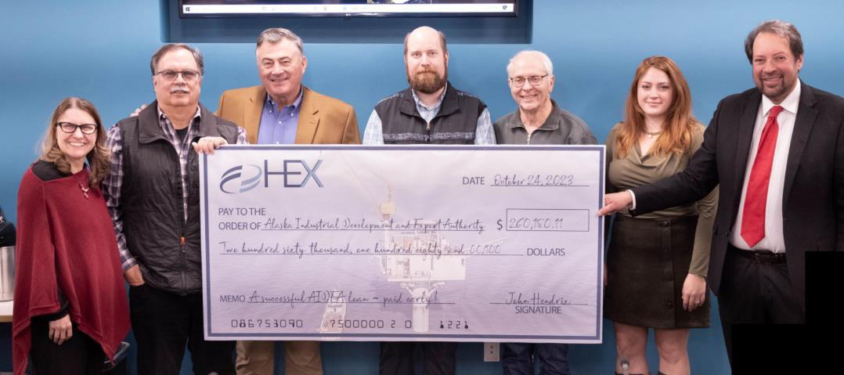
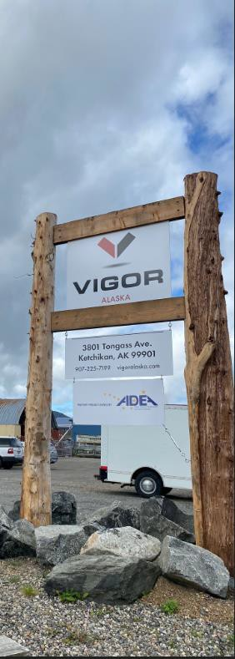
Our Other Key Initiatives Supporting Alaskans
A I D E A | D e f e n d i n g A l a s k a n s ’ R i g h t s | A G C o f A l a s k a A n n u a l C o n f e r e n c e | N o v e m b e r 9 , 2 0 2 3

Slide 6
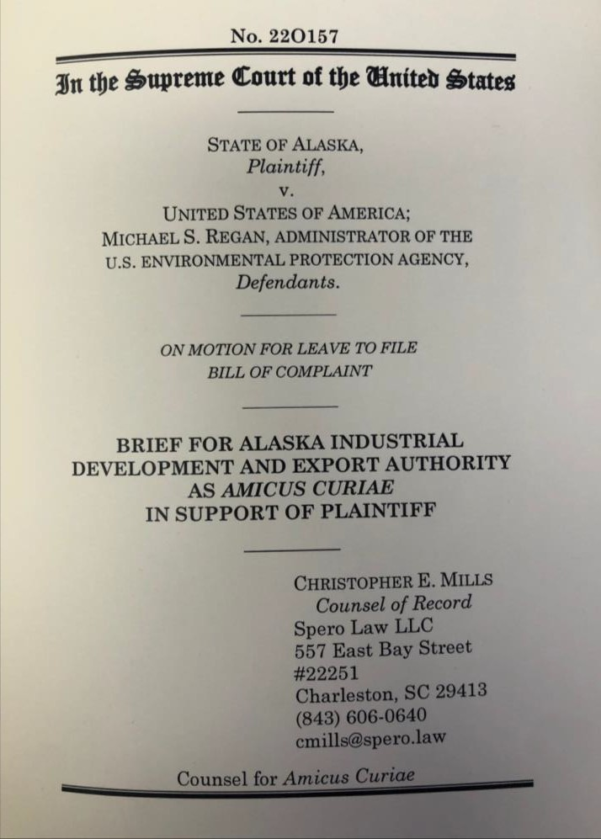
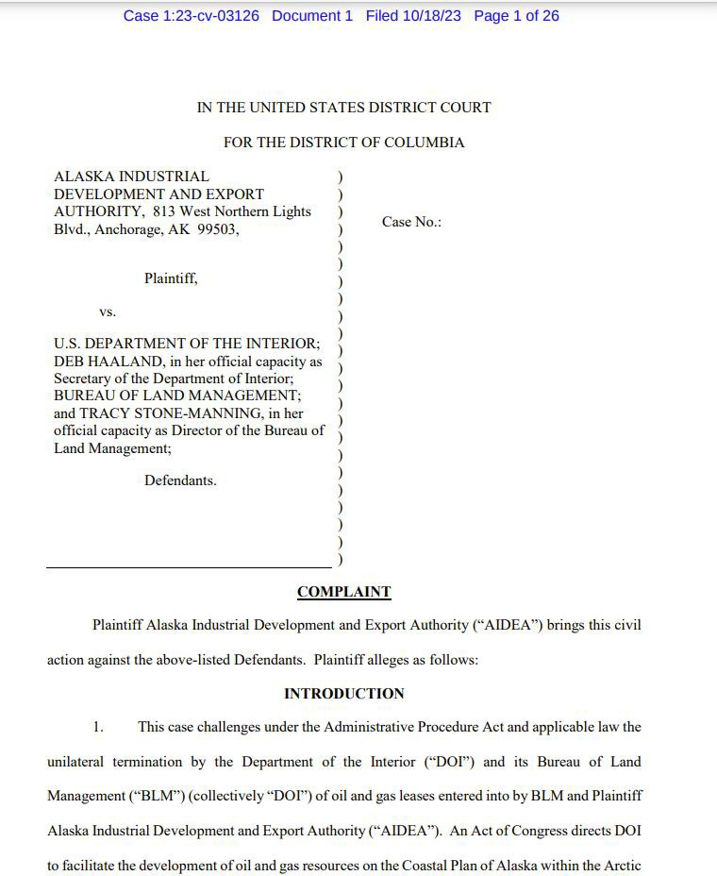
Our Other Key Initiatives Defending Alaskans’ Rights
September 25, 2023
October 18, 2023
THIS WEEK!
A I D E A | D e f e n d i n g A l a s k a n s ’ R i g h t s | A G C o f A l a s k a A n n u a l C o n f e r e n c e | N o v e m b e r 9 , 2 0 2 3

Slide 7
Introducing - AIDEA Jurisdictional Evaluation Method (JEM)
Basis
Wetlands are divisible into types and can be mapped into polygons
Wetland polygons must directly abut a non- wetland jurisdictional water
Wetlands must be indistinguishable from an adjoining jurisdictional water (other than wetlands) or relatively permanent flowing or standing water that is either a jurisdictional water or tributary to a jurisdictional water; and
Relatively permanent waters are based on the Rapanos plurality which expressly held that WOTUS "does not include channels through which water flows intermittently or ephemerally, or channels that periodically provide drainage for rainfall"
A I D E A | D e f e n d i n g A l a s k a n s ’ R i g h t s | A G C o f A l a s k a A n n u a l C o n f e r e n c e | N o v e m b e r 9 , 2 0 2 3

Slide 8
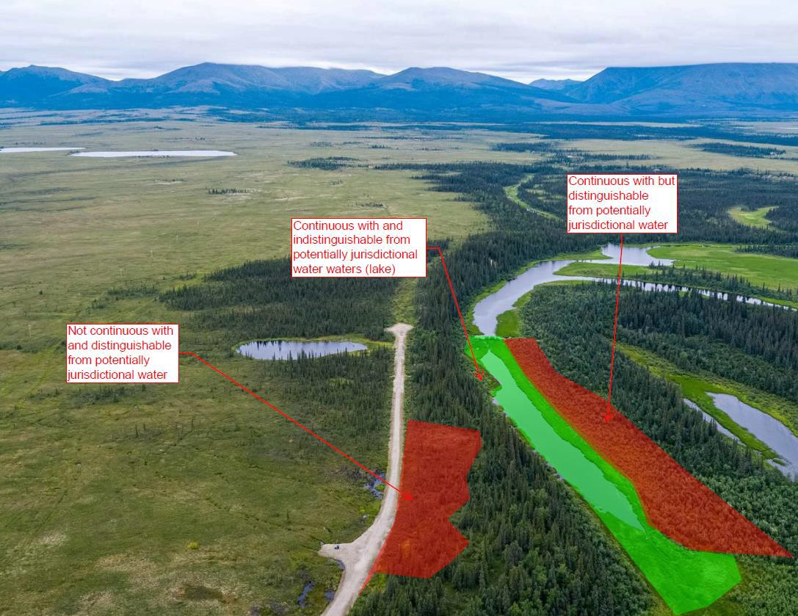
Example of Wetland Jurisdiction
A I D E A | D e f e n d i n
g A l a s k a n s ’ R i g h t s | A G C o f A l a s k a A n n u a l C o n f e r e n c e | N o v e m b e r 9 , 2 0 2 3
8

Slide 9
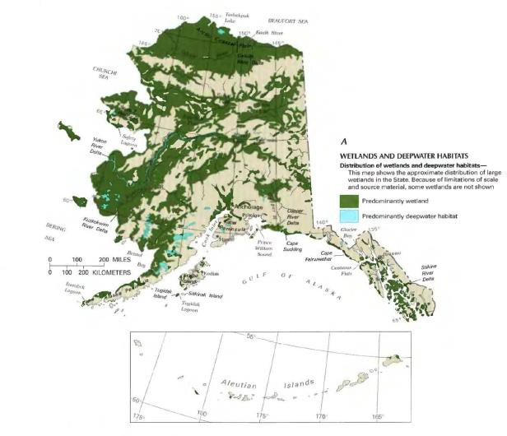
Why Do You Care About Wetland Jurisdiction?
Alaska contains “more area covered by wetlands – about
170 million acres – than the other 49 states combined.
The presence of federal wetlands triggers federal permit requirements which is costly and takes a long time.
Federal government gains significant control over resource development decisions in Alaska.
Federal government can force the landowner to pay in land or money as “mitigation” for impacts to federal wetlands.
“Crushing” penalties can be imposed on landowners for even accidental violations such as imprisonment and up to $60,000 a day in fines.
For example, each of the 348 passes with a plow by a farmer on federal wetlands is considered a separate violation.
The average applicant for an individual permit spends 788 days and $271,596 in completing the process.” - Rapanos
In Alaska, it’s often longer and more costly!
A I D E A | D e f e n d i n g A l a s k a n s ’ R i g h t s | A G C o f A l a s k a A n n u a l C o n f e r e n c e | N o v e m b e r 9 , 2 0 2 3
9

Slide 10
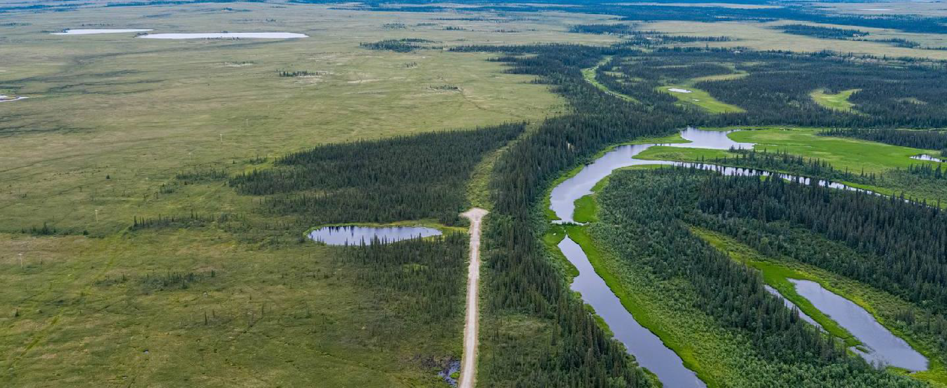
Applying JEM to the Ambler Access Project

Slide 11
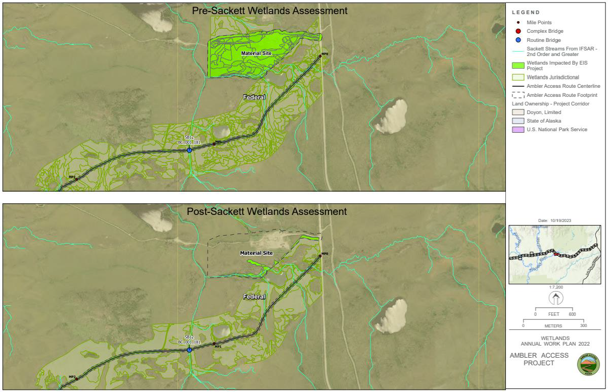
A I D E A | D e f e n d i n g A l a s k a n s ’ R i g h t s | A G C o f A l a s k a A n n u a l C o n f e r e n c e | N o v e m b e r 9 , 2 0 2 3

Slide 12
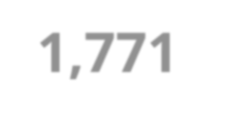
Results of JEM Application to the Ambler Access Project
Project results to jurisdictional wetlands:
Pre-Sackett Final Environmental Impact Statement (March 2020) | Post-Sackett JEM Application of Data (October 2023)
2,079 acres | 308 acres
An 85% reduction
of 1,771 acres!
A I D E A | D e f e n d i n g A l a s k a n s ’ R i g h t s | A G C o f A l a s k a A n n u a l C o n f e r e n c e | N o v e m b e r 9 , 2 0 2 3

Slide 13
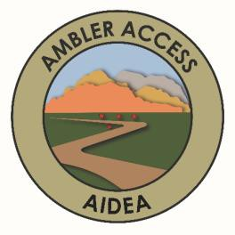
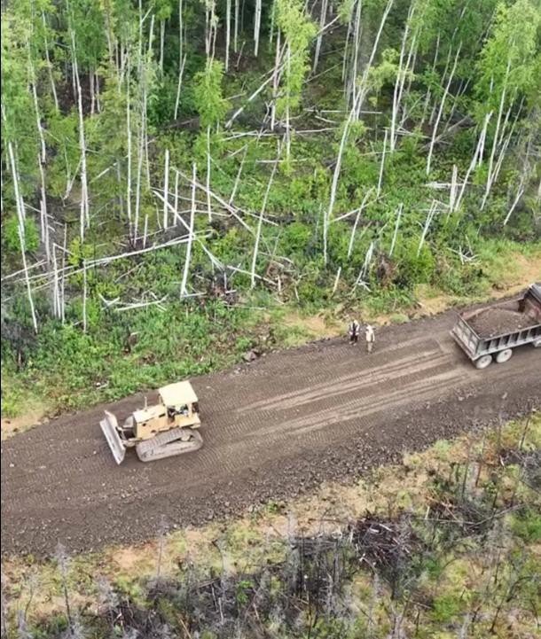
Ambler Access Project Draft SEIS
Draft Supplemental Environmental Impact Statement (SEIS) comment period now open through December 22
Key Points for the Construction Industry:
EIS suggests the construction of a road without phasing (Page 2- 4)
EIS makes construction-related recommendations based on public comments that would be problematic for construction (Page 2-20 and Section 2.4.8).
The decisions on how to build the road should be made by the actual contractors building the road and not federal regulators.
“…constructed to Phase 2 standards (year-round 1-lane road) from thestart, without the construction of a pioneer road. It is estimated thatconstruction of the route to Phase 2 requirements would require a single mobilization of construction equipment and construction timeofapproximately 2 to 3 years (compared to 3 to 4 years forseparate construction of Phase 1 and 2 roads).” - Ambler Road EIS page 2-20
A I D E A | A l a s k a S t a t e L e g i s l a t u r e | F e b r u a r y 2 8 , 2 0 2 3
13

Slide 14
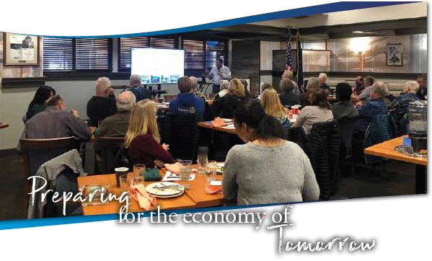
Take Action!
We Need Your Help!
1. Ambler Access Project
Comment Deadline: December 22, 2023
www.pathtoopportunity.org
2. Anchorage Public Meeting!
To be announced!
Sign up for updates at info@ambleraccess.org
A I D E A | D e f e n d i n g A l a s k a n s ’ R i g h t s | A G C o f A l a s k a A n n u a l C o n f e r e n c e | N o v e m b e r 9 , 2 0 2 3
14

Slide 15
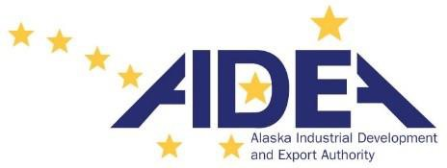
THANK YOU!
Join us on social media!
https://bit.ly/AIDEAAK
Visit AIDEA.org for more information or to contact us
A I D E A | D e f e n d i n g A l a s k a n s ’ R i g h t s | A G C o f A l a s k a A n n u a l C o n f e r e n c e | N o v e m b e r 9 , 2 0 2 3
15

