Slide 1
Debt Free 4 Life
Presented by Hunter Guthrie and German Baquero
Notes:
Introduction
Housekeeping
-Folders
-No Sheet, No Eat
-Bios

Slide 2
Effects of Supreme Court
Biden v. Nebraska & Department of Education v. Brown
Striking down administrations proposed student loan forgiveness
$430 Billion left unforgiven; Median amount of non-forgiven loan repayments at $29,400
Debt Free 4 Life

Slide 3
New Student Loan Changes
New IDR Plans (SAVE)
PSLF Expansion/Fix
On-Ramp
Ongoing Forgiveness/Lawsuits from Specific Schools
Debt Free 4 Life

Slide 4
SAVE Act
Lower Monthly Payments +
No Accrued Interest +
20- or 25-Year Plan +
Some people may see higher payments -
Best to stay on plan, or “else” -
Debt Free 4 Life

Slide 5
PSLF Expansion
Public Student Loan Forgiveness
Working for qualified Non-Profit or Gov
“98% of applications for Public Service Loan Forgiveness (PSLF) from November 9, 2020 to April 30, 2021 were rejected”
– Forbes
Debt Free 4 Life

Slide 6
“On – Ramp”
12 Month Grace Period Starting Oct 1st
Missed payments are not reported +
Interest still accrues and payments are still owed -
Missing Payments could increase future monthly payments -
Debt Free 4 Life

Slide 7
The Silver Lining
Defrauded borrows are getting forgiveness from widespread college misrepresentations
ITT Tech Scandal – 4.4 Billion Dollars Defrauded
Debt Free 4 Life

Slide 8
Savers Shortfall
Save &
Wait
$0
$0
Debt Free 4 Life

Slide 9
Savers Shortfall
Save &
Wait
Save &
Wait
$0
$0
Debt Free 4 Life

Slide 10
Savers Shortfall
Buy
Save &
Wait
Save &
Wait
Save &
Wait
$0
$0
Debt Free 4 Life

Slide 11
Savers Shortfall
Buy
Save &
Wait
Save &
Wait
Save &
Wait
$0
$0
Buy
Debtors Delima
Debt Free 4 Life

Slide 12
Savers Shortfall
Buy
Save &
Wait
Save &
Wait
Paid Off
Save &
Wait
$0
$0
Pay
Pay
Pay
Buy
Debtors Delima
Debt Free 4 Life

Slide 13
Zero Sum Game
Buy
Save &
Wait
Save &
Wait
Paid Off
Save &
Wait
$0
$0
Pay
Pay
Pay
Buy
Debt Free 4 Life

Slide 14
Wealth Creation
$0
Debt Free 4 Life

Slide 15
Wealth Creation
Pay Off
$0
Pay &
Earn
Pay &
Earn
Pay &
Earn
Debt Free 4 Life

Slide 16
Wealth Creation
Pay Off
Pay Off
Pay &
Earn
$0
Pay &
Earn
Pay &
Earn
Pay &
Earn
Pay &
Earn
Pay &
Earn
Debt Free 4 Life

Slide 17
Wealth Creation
Debt Free!!
Pay Off
Pay Off
Pay Off
Pay &
Earn
Pay &
Earn
$0
Pay &
Earn
Pay &
Earn
Pay &
Earn
Pay &
Earn
Pay &
Earn
Pay &
Earn
Pay &
Earn
Debt Free 4 Life

Slide 18
Wealth Creation
Debt Free!!
Pay Off
Pay Off
Pay Off
Pay &
Earn
Pay &
Earn
$0
Pay &
Earn
Pay &
Earn
Pay &
Earn
Pay &
Earn
Pay &
Earn
Pay &
Earn
Pay &
Earn
Constantly Compounding = Wealth
Debt Free 4 Life

Slide 19
Debt Free 4 Life

Slide 20
Bureau of Labor
Statistics
Just like you,
Americans
face this
income reality.
40%
Taxes
Debt Free 4 Life

Slide 21
Bureau of Labor
Statistics
Just like you,
Americans
face this
income reality.
40%
Taxes
10%
Savings
Debt Free 4 Life

Slide 22
Bureau of Labor
Statistics
Just like you,
Americans
face this
income reality.
40%
Taxes
25%
Debt
10%
Savings
Debt Free 4 Life

Slide 23
Bureau of Labor
Statistics
Just like you,
Americans
face this
income reality.
25%
Lifestyle
40%
Taxes
25%
Debt
10%
Savings
Debt Free 4 Life

Slide 24
Bureau of Labor
Statistics
Accumulated
Wealth only
happens 3 ways
25%
Lifestyle
40%
Taxes
25%
Debt
10%
Savings
Debt Free 4 Life

Slide 25
Bureau of Labor
Statistics
Accumulated
Wealth only
happens 3 ways
25%
Lifestyle
40%
Taxes
More
25%
Debt
10%
Savings
Debt Free 4 Life

Slide 26
Bureau of Labor
Statistics
Accumulated
Wealth only
happens 3 ways
25%
Lifestyle
40%
Taxes
Time
More
25%
Debt
10%
Savings
Debt Free 4 Life

Slide 27
Bureau of Labor
Statistics
Accumulated
Wealth only
happens 3 ways
25%
Lifestyle
40%
Taxes
Time
More
25%
Debt
More
10%
Savings
Debt Free 4 Life

Slide 28
Bureau of Labor
Statistics
Accumulated
Wealth only
happens 3 ways
25%
Lifestyle
40%
Taxes
Time
More
25%
Debt
Risk
More
10%
Savings
Debt Free 4 Life

Slide 29
Bureau of Labor
Statistics
Accumulated
Wealth only
happens 3 ways
25%
Lifestyle
40%
Taxes
Time
More
25%
Debt
Risk
More
10%
Savings
More
Debt Free 4 Life

Slide 30
Bureau of Labor
Statistics
Accumulated
Wealth only
happens 3 ways
25%
Lifestyle
40%
Taxes
Time
More
25%
Debt
Risk
More
10%
Savings
Money
More
Debt Free 4 Life

Slide 31
Bureau of Labor
Statistics
Accumulated
Wealth only
happens 3 ways
Lifestyle
Taxes
Time
More
Debt
Risk
More
Savings
Money
More
Debt Free 4 Life

Slide 32
Bureau of Labor
Statistics
Accumulated
Wealth only
happens 3 ways
Lifestyle
Taxes
Time
More
Risk
More
Savings
Money
More
Debt Free 4 Life

Slide 33
S
Bureau of Labor
Statistics
Accumulated
Wealth only
happens 3 ways
Lifestyle
Profit
Taxes
Time
More
Risk
More
Savings
Capital Improvements
Money
More
Debt Free 4 Life

Slide 34
Effective Interest Cost
or
EIC
Debt Free 4 Life

Slide 35
Catherine
Balance
Interest
Payment
Harvard
$200,000
5%
$1320
B.A.
Underwater Basket Weaving
Debt Free 4 Life

Slide 36
Catherine
Balance
Interest
Payment
Harvard
$200,000
5%
$1320
B.A.
Underwater Basket Weaving
What is Catherine’s EIC?
Debt Free 4 Life

Slide 37
Catherine
Balance
Interest
Payment
Harvard
$200,000
5%
$1320
B.A.
Underwater Basket Weaving
EIC =
53%
$704
Debt Free 4 Life

Slide 38
The Monthly Effective
Interest Cost is...
Amount
$
200,000
Term
20
Yr
0
Mo
Rate
5
.
0
%
Monthly Payment
$704.48/1,319.91 = 53%
$1,319.91
Monthly Interest
$704.48
Total Interest
$116,778.75
Total Amount
$316,778.75
Debt Free 4 Life

Slide 39
The Effective
Interest Cost is...
Amount
$
200,000
Term
20
Yr
0
Mo
Rate
5
.
0
%
Monthly Payment
$1,319.91
Interest/Amount = 58%
Monthly Interest
$704.48
Total Interest
$116,778.75
Total Amount
$316,778.75
Debt Free 4 Life

Slide 40
Catherine
Balance
Interest
Payment
Office Building
$1,000,000
8%
$7,337
EIC =
86%
$6,345
Debt Free 4 Life

Slide 41
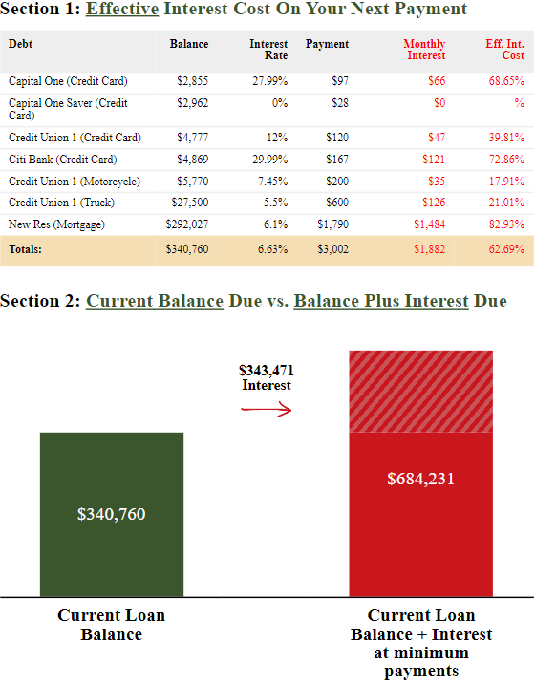
Debt Free 4 Life

Slide 42
How we help:
1. We SPIN the tables in your favor
S - Look at your situation (income, debts, & assets)
P - Identify your problems
I - Review the long-term implications of your problem
N - You decide if you need to address your problems...or not!
Debt Free 4 Life

Slide 43
How we help:
1. We SPIN the tables in your favor
S - Look at your situation (income, debts, & assets)
P - Identify your problems
I - Review the long-term implications of your problem
N - You decide if you need to address your problems...or not!
2. Snowball momentum in your favor
$0
Debt Free 4 Life

Slide 44
HERE’S WHAT YOU WILL GET…
Debt Free 4 Life

Slide 45
Q & A
Debt Free 4 Life

