Slide 1
ANC/A11 ATCT AND TRACON BASE BUILDING
Jon Ikeda – FAA Alex Thome, Ross Timm – Stantec Architecture

Slide 2
AGENDA
Project Team
Project Overview
Design Highlights
Procurement and Schedule
Open Discussion

Slide 3
1 PROJECT TEAM

Slide 4
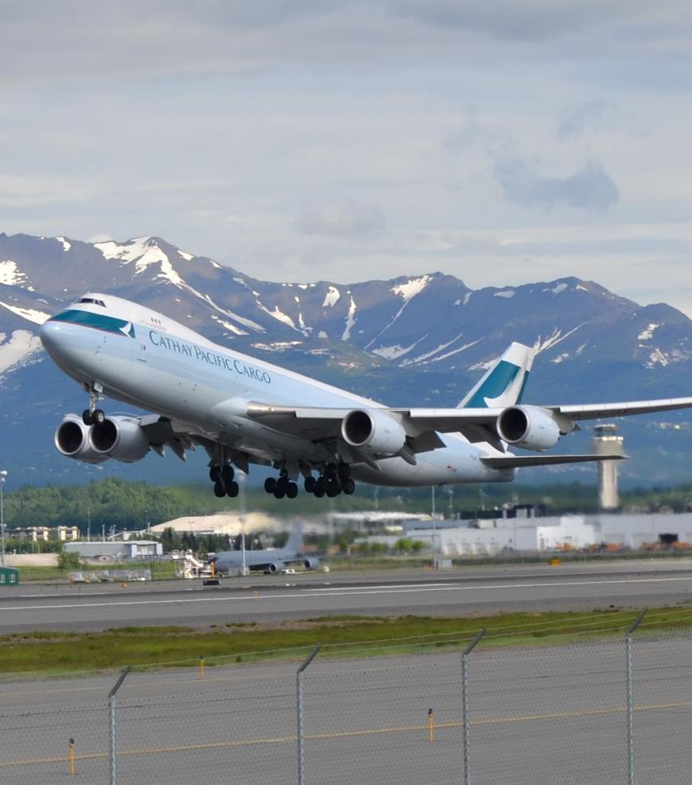
TEAM
FAA
Contracting Officer: Katherine Fogle Katherine.fogle@faa.gov
Project Manager: Jon Ikeda
Project Lead: Wilson Platt
PEER REVIEW
Thornton Tomasetti
DESIGN
Stantec Architecture Inc
Walter P Moore
Lean Technology Corp
Shannon & Wilson
Corvus
Jensen Hughes
HMS, Inc
Lerch Bates
RWDI
Selbert Perkins Design
Wiss, Janney, & Elstner
Support Services of Alaska
Agnew Beck

Slide 5
2 PROJECT OVERVIEW

Slide 6
DISCLAIMER
Funding
Due to Cost of Project, it is subject to review by FAA Joint Resources Council for Final Investment Decision
NEPA
NEPA: The Environmental Assessment is on-going for the new ATCT/TRACON Site at Ted Stevens International Airport.
No physical work or early procurement of equipment and materials can be authorized without NEPA process completed and approved.
The initial work is limited design.
EA anticipated completion March 2024

Slide 7
Replace ATCT and TRACON
The Federal Aviation Administration (FAA) intends to replace the existing ANC Airport Traffic Control Tower (ATCT) and A11 Terminal Radar Approach Control (TRACON) facility at the Ted Stevens International Airport in Anchorage, Alaska. The facilities are co-located.
ATCT and TRACON facilities are considered essential facilities by the International Building Code (IBC) (Risk Category IV) and American Society of Civil Engineers (ASCE) (Operational 1-A).
Design is progressing to Final Design

Slide 8
3 DESIGN HIGHLIGHTS

Slide 9
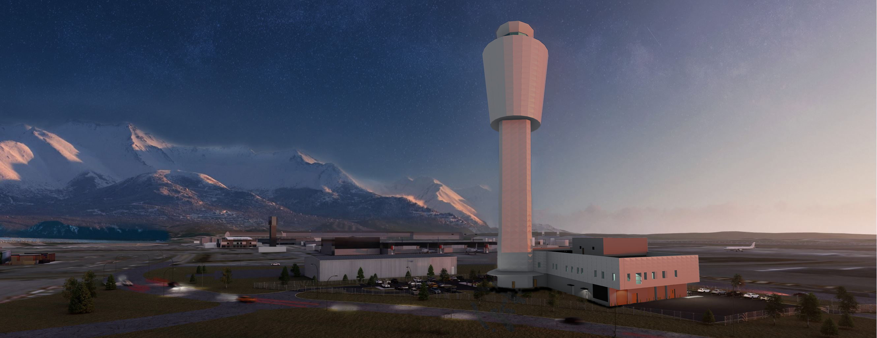
What factors are influencing your decision to pursue projects now?
What is your perception of the FAA?
How does FAA become a preferred owner?
View Looking South-Southwest

Slide 10
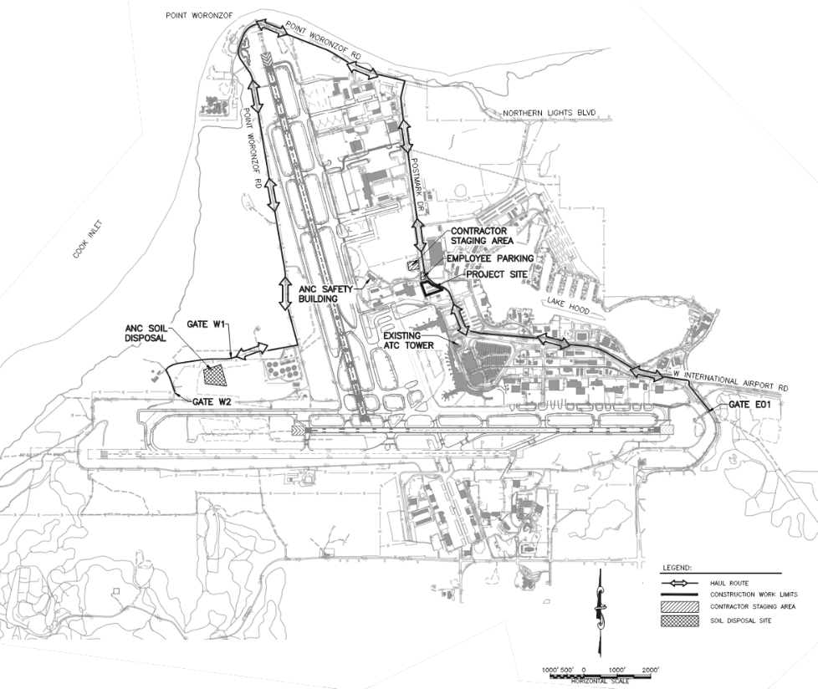
SITE DEVELOPMENT
Landside site access from Postmark Drive
Parking 118 vehicles
Landscaping, storm water control, utility relocation, fencing, and gates
Fiber Optic Transmission System (FOTS)
Upgrade Field Communications loop to meet Diversity Requirements
Provide Field Connectivity to all FAA Facilities on the Airport

Slide 11
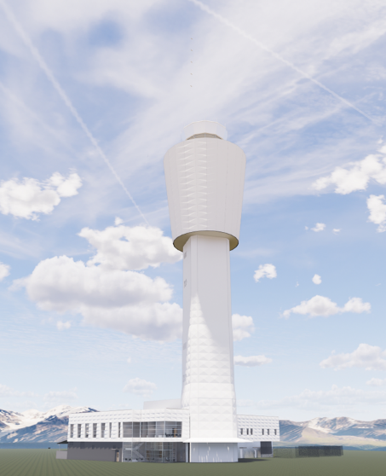
ATCT
Sited to control air traffic at Ted Stevens and Lake Hood Airport
No impacts to Terminal Approach and Missed Approach Surfaces
650 SF Cab Standard Design
7 Operational Air Traffic Control Positions
12-Sided Cab with Structural Mullions
Tallest Building in Alaska – 318’ AGL

Slide 12
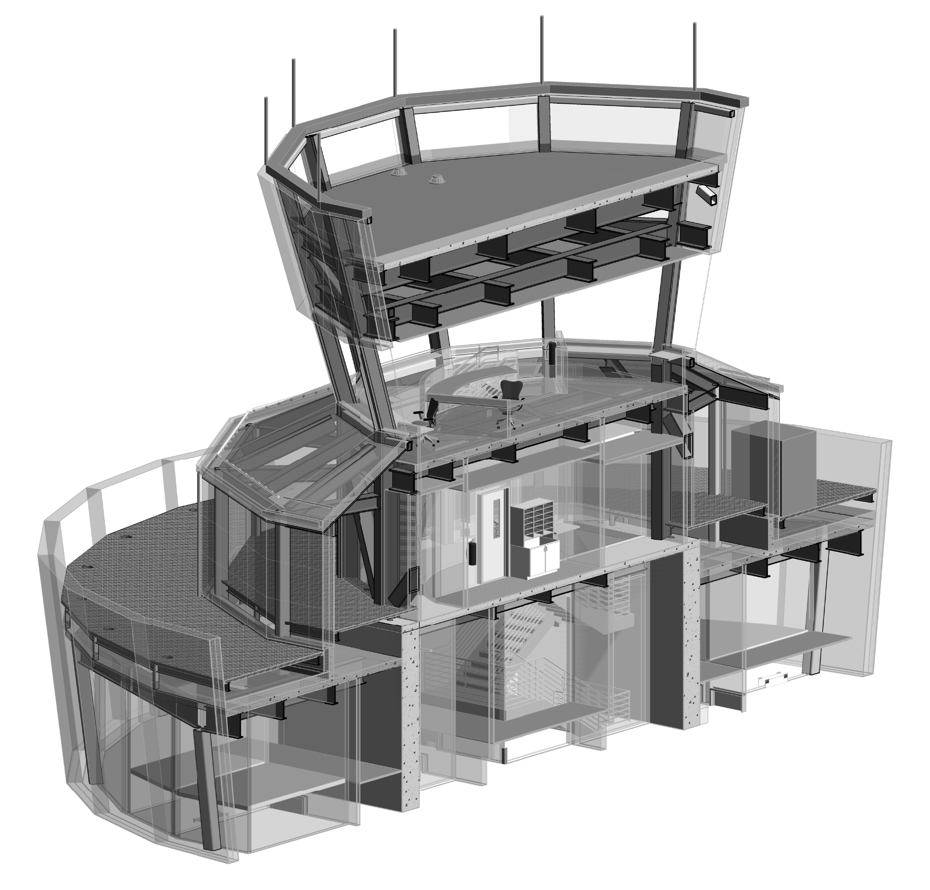
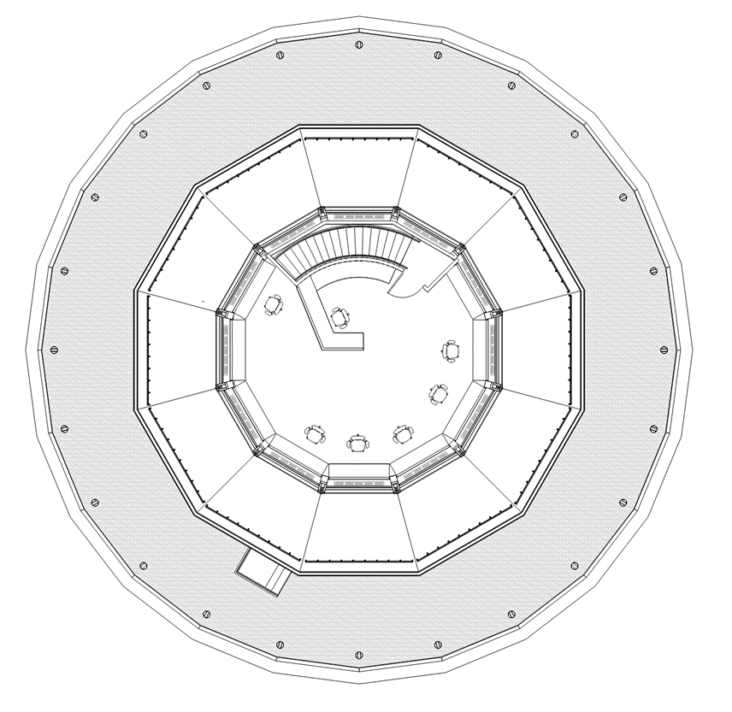
ATCT CAB
ATCT Cab Isometric View
ATCT Cab Level Floor Plan

Slide 13
TRACON/BASE BUILDING
Terminal Radar Approach Control Facility
28,000 SF, 2 Stories
13 Operational Air Traffic Positions
FAA Terminal Facility Design Standards

Slide 14
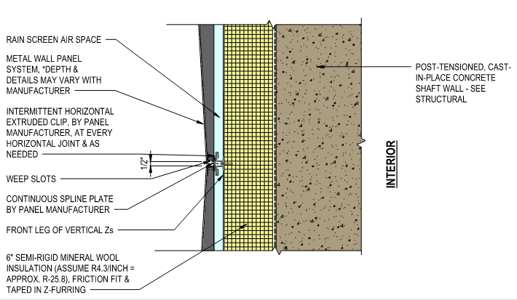
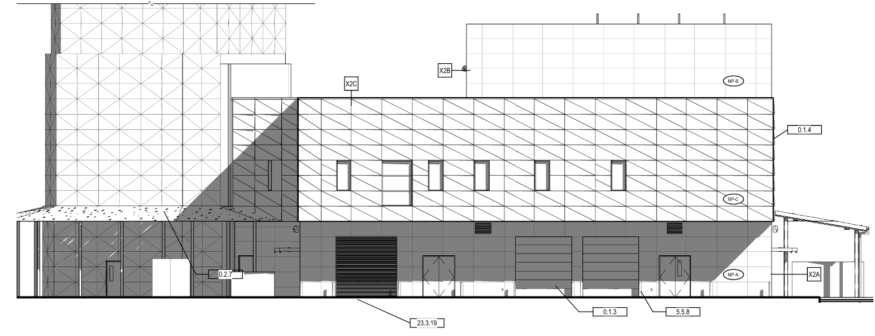
BUILDING SYSTEMS
General
Arctic Design Driven Systems
Local Best Practices
Durable Best Value Materials
Architectural
Exterior Cladding
Metal Rain Screen Aluminum Plate
Super Insulated Wall and Roof Systems
Curtain Wall Glazing
Cab Glazing
Façade Access System
Exterior Cladding System

Slide 15
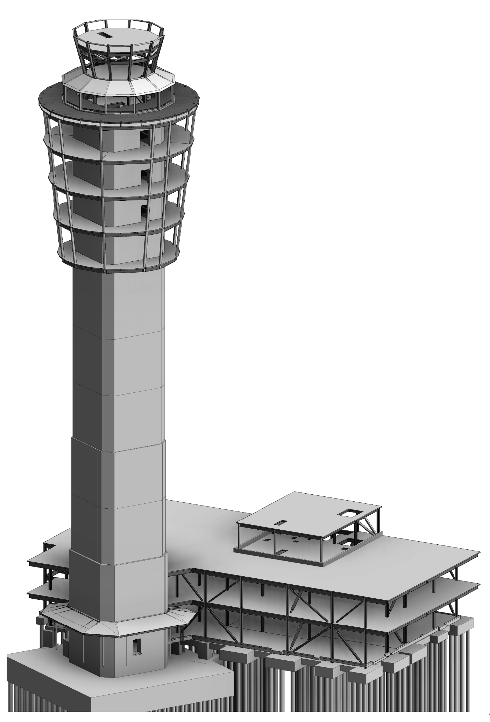
BUILDING SYSTEMS
Structural
Performance Based Seismic Design
ATCT
Vertical Post-Tension Concrete
Tuned Mass Dampers
TRACON/Base Building
Steel Braced Frame
Early Structural Analysis Structural Model

Slide 16
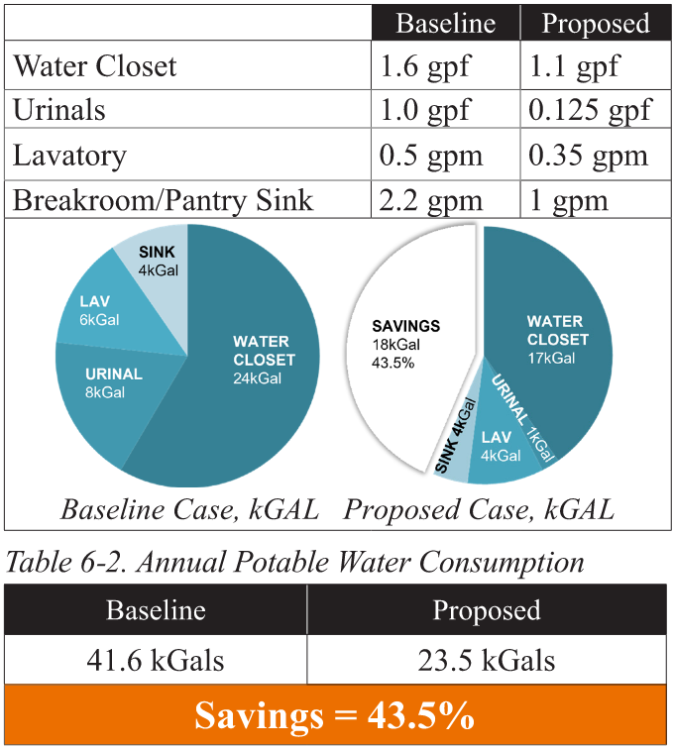
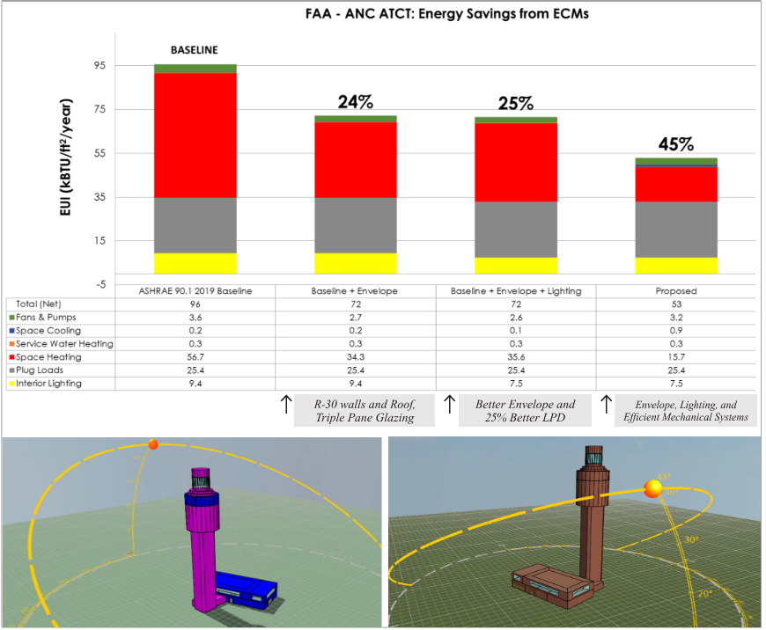
BUILDING SYSTEMS
Mechanical
Decoupled Systems – Air and Hydronic
2N redundant cooling in critical spaces
Dual Fuel Boilers
Electrical
Critical Power Distribution System, Type 1 (Engine Generator backup with a facility UPS)
Lightning Protection and Grounding
Sustainable Design
FAA Sustainable Design Guidelines
Low Energy and Water Use Systems
Occupant Health and Wellness
Energy and Water Analysis

Slide 17
4 PROCUREMENT AND SCHEDULE

Slide 18
PROCUREMENT HIGHLIGHTS
Two Phase Contract Procurement – Best Value
Phase I Request for Qualifications
Phase II Proposal
Anticipated $150M+ Contract Amount
FAA is considering options to increase bidder participation
Award Fees
Constructability Reviews – Cost Sharing
Photo source: DOT Alaska
Dan Hartman

Slide 19
SCHEDULE
 | 2022 | 2023 | 2024 | 2025 | 2026 | 2027 | 2028 | 2029
Design Complete June 2024:
Environmental Assessment – Complete February 2024
Solicitation March 2024 to December 2024
Advertise RFQ March 2024
RFP June 2024 to August 2024
Award December 2024
Construction 2025-2028:
Building Commissioning: TBD

Slide 20
5 CONSTRUCTION INDUSTRY INPUT

Slide 21
CONSTRUCTION INDUSTRY INPUT TO FAA
What factors are influencing your decision to pursue projects now?
What is your perception of the FAA?
How does FAA become a preferred owner?

