Slide 1
Taking The Risk Out Of Retirement
Sponsored by:
Safe Money Specialists, Inc.
www.safemoneyspecialists.net
877-887-3131

Slide 2
Seven of The Biggest Retiree Risks
MARKET RISK
WITHDRAWAL RATE RISK
INFLATION RISK
TAXATION RISK
MORTALITY RISK
LONG TERM CARE RISK
LONGEVITY RISK

Slide 3
RISK #1
MARKET RISK

Slide 5
Recovering from Loss
Most people do not understand the following numbers.
Most people would rather not go backwards.
 | Traditional Investing
Amount of Loss | % Gain Needed to Recover the following year.
20% | 25%
30% | 43%
40% | 66%
50% | 100%

Slide 6
Traditional Wealth Building
How does the American investor typically build wealth?
Stocks and mutual funds.
How would that work out for most people?
2000-2002 crash
The S&P 500 stock index lost from the highest point to the lowest point 46% of its value.
2007-2009 crash
The S&P 500 stock index lost from the highest point in October of 2007 to the lowest point in March of 2009 59% of its value.
In 2008 alone the S&P 500 was down over 39%.
From 1998-2008, the S&P 500 earned a return of -1.4%.

Slide 8
Knowledge is Power

Slide 9
RISK #2
WITHDRAWAL RATE RISK

Slide 10
When is the WORST time to have a Market Reversal?
>Immediately BEFORE or
Immediately AFTER Retirement

Slide 11
According to David Blanchett, Head of Retirement Research for the Morning Star Investment Management:
Over 25 years ago it was suggested that if you took withdrawals of no more than 4% out of your retirement account, it would provide you an income for 30 years.
Based on current data, the new recommendation is that you withdraw no more than 2.5%-3% out of your account to achieve the same 30 year goal

Slide 12
Current Hypothetical Annuity Payout Rates
Age | Life Only | Life w/ Cash Refund
65 | 6.30% | 5.73%
75 | 8.58% | 7.16%
85 | 14.83% | 9.68%
This example is for illustrative purposes only and does not represent the performance of an actual investment. There is no assurance that similar rates will be offered. Contact a licensed financial professional to get up to date and live quotes based on your situation. This example assumes a $100,000 investment of a single male.
Source: https://www.immediateannuities.com. Jan 2020..
Notes:
Here’s why. These are the payout rates from almost any life insurance company in America (be aware, rates can change). For those still more inclined to invest in bank products: do banks offer different interest rates based on age? No, they pay everyone the same rate. As do bonds. Their CPA may say that she likes municipal bonds, but those also pay everyone the same rate.
Finally, people should ask their stockbroker - do stocks pay higher dividends based on someone’s age? No! So here is an important concept to understand: a lifetime income annuity has higher payout rates based on age because the annuity holder gets paid mortality credits. In effect, the main reason someone wants to buy a lifetime income annuity is because they get paid mortality credits. CDs do not pay mortality credits. Municipal bonds do not pay mortality credits. Stocks have never paid a mortality credit in the entire history of the stock market!
Lifetime income annuities are structured to satisfy the needs of aging clients, and that is why annuities are the only financial product that offers mortality credits. Dr. Moshe Milevsky refers to these mortality credits as “longevity credits” because people actually get paid for living longer!
Update the source

Slide 13
RISK #3
INFLATION

Slide 15
Retirement Income Concerns - Inflation
What might $10,000 buy in the future?
Hypothetical Inflation Rate
Years From Now | 0% | 1% | 2% | 4% | 6% | 8% | 10%
1 | $10,000 | $9,901 | $9,804 | $9,615 | $9,434 | $9,259 | $9,091
5 | $10,000 | $9,515 | $9,057 | $8,219 | $7,473 | $6,806 | $6,209
10 | $10,000 | $9,053 | $8,203 | $6,756 | $5,584 | $4,632 | $3,855
15 | $10,000 | $8,613 | $7,430 | $5,553 | $4,173 | $3,152 | $2,394
20 | $10,000 | $8,195 | $6,730 | $4,564 | $3,118 | $2,145 | $1,486
25 | $10,000 | $7,798 | $6,095 | $3,751 | $2,330 | $1,460 | $923
30 | $10,000 | $7,419 | $5,521 | $3,083 | $1,741 | $994 | $573
35 | $10,000 | $7,059 | $5,000 | $2,534 | $1,301 | $676 | $356
Notes:
For example, if a person gets $1,000 per month from their nest egg, the purchasing power at 4% inflation will be cut by more than half in 20 years and by more than two-thirds in 30 years. There have even been some periods, such as the late 1970s, when inflation soared into the double digits. Inflation is extremely problematic for retirees, who are on fixed incomes and depend on their retirement savings to help make ends meet. High inflation can erode both their income and their portfolio if they do not plan for it. The U.S. has experienced a period of relative price stability and low inflation for the past 25 years or so. Even so, prices of food, gas, stamps, and other items have gone up significantly over this same period.

Slide 16
Fortunately, there are numerous products that will provide the customer with guaranteed payment increases for life, while accounting for inflation.

Slide 17
RISK #4
TAXATION

Slide 18
With our National Debt and current Washington spending, do you think Taxes will go UP or DOWN?

Slide 19
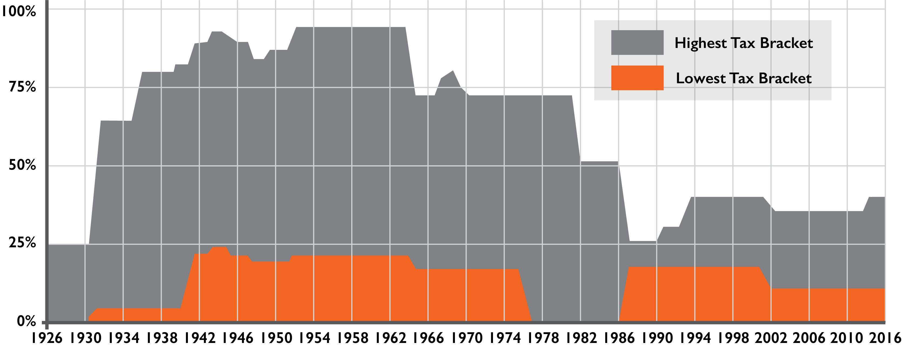
Where Do You Think Tax Rates Are going?
>Tax Rates are at historically low levels, suggesting that they may be higher when you retire.
>Tax diversifying your retirement may also make sense.
The graph to the left illustrates the high and low marginal federal income tax rates over history. Exceptions, deductions, and state and local taxes are not taken into account when illustrating the marginal tax rates. Your actual tax rates may vary from those shown on the graph. Remember that historical rates are not a guarantee of future rates.
Source: taxfoundation.org/taxdata/show/151.html (2010)
Tax Brackets
Notes:
19
Those women could be the BENEFICIARY of a life insurance contract. Because they live longer and typically marry men older than themselves they may be widows for 10, 20 even 30 years. With the recent drop in markets and housing, many of the Baby Boomer men are depressingly underinsured. Who will pay the consequences? Women! Not convinced? Go find an widow who is living well and widow who isn’t. Ask them. The difference is life insurance.
They must see to it that they and their spouse are properly insured.

Slide 20
The “Tax Perfect” Retirement Plan
The “Tax Perfect’ plan would include:
1.
2.
3.
Contributions
that are tax
deductible
Accumulation that is tax deferred
Distributions that as tax free
Notes:
If someone invested in the “Tax Perfect” retirement plan what would it look like? It would probably include:
Contributions that are tax-deductible
2. Accumulation that is tax-deferred
3. Distributions that are tax-free
Unfortunately, such a plan does not exist. But people may be able to get either 1 & 2 or 2 & 3. Many people increasingly like the idea of paying taxes now on savings for retirement, knowing that they will not have to pay taxes on the growth OR the distribution of that savings!
Here’s a different way of looking at it: Would a farmer rather pay tax on the seed… or the harvest? Almost every farmer would rather pay tax on the seed. It works the same way with money.
The most common financial vehicles that do that are a ROTH IRA, tax-free municipal bonds, and cash value life insurance. ROTH IRAs are great, but they do not allow unlimited contributions.
Tax-free bonds can work but the person buying them needs to be very careful, since states and municipalities are having significant financial issues. Additionally, as interest rates rise, the value of the bonds will go down.
Permanent life insurance that builds cash value can be a great tool in this situation. The premiums are paid with after-tax dollars. The policy grows tax-deferred and people can access those cash values before or after retirement on a tax-free basis as long as it is structured properly! Upon death, the death benefit is paid to their beneficiaries tax-free.

Slide 21
The “Tax Perfect” Retirement Plan
Such a plan does not exist, but you may be able to get 1&2 or 2&3
1. Contributions
Tax deductible
After Tax
2. Accumulation
Tax deductible
Tax deductible
3. Distributions
TAXABLE
Tax Free
Financial Vehicles
Traditional IRA
Traditional IRA
401 (k) plan
Tax-free municipal bon
Pension plan
Profit-sharing plan
Cash value life insurance
Keogh plan
Notes:
If someone invested in the “Tax Perfect” retirement plan what would it look like? It would probably include:
1. Contributions that are tax-deductible
2. Accumulation that is tax-deferred
3. Distributions that are tax-free
Unfortunately, such a plan does not exist. But people may be able to get either 1 & 2 or 2 & 3. Many people increasingly like the idea of paying taxes now on savings for retirement, knowing that they will not have to pay taxes on the growth OR the distribution of that savings!
Here’s a different way of looking at it: Would a farmer rather pay tax on the seed… or the harvest? Almost every farmer would rather pay tax on the seed. It works the same way with money.
The most common financial vehicles that do that are a ROTH IRA, tax-free municipal bonds, and cash value life insurance. ROTH IRAs are great, but they do not allow unlimited contributions.
Tax-free bonds can work but the person buying them needs to be very careful, since states and municipalities are having significant financial issues. Additionally, as interest rates rise, the value of the bonds will go down.
Permanent life insurance that builds cash value can be a great tool in this situation. The premiums are paid with after-tax dollars. The policy grows tax-deferred and people can access those cash values before or after retirement on a tax-free basis as long as it is structured properly! Upon death, the death benefit is paid to their beneficiaries tax-free.

Slide 22
Life Insurance as a Vehicle to create a Tax Free Income 1. High Rates of Return 2. Tax Free Income for Life 3. Tax Free Death Benefit to Beneficiary

Slide 23
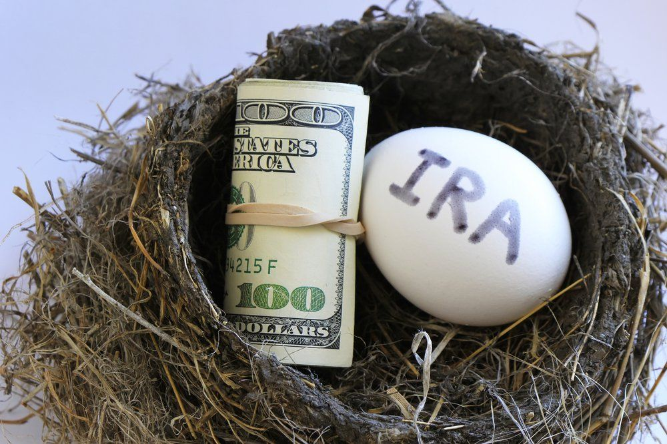
ROTH IRA’s
Tax Free Growth
Tax Free Income
Known versus Unknown
This Photo by Unknown Author is licensed under CC BY-NC

Slide 24
RISK #5
MORTALITY RISK

Slide 25
Women Have a Longer Average
Life Expectancy than Men
>Seven out of 10 Baby Boomer women (those born between 1946 and 1964) are expected to outlive their husbands.
>Not only do women have a longer average life expectancy than men, they tend to marry men older than themselves.
>The rate of poverty among elderly widows is consistently three to four times higher than elderly married women.
20Sources:www.ssa.gov. Accessed on 4/10/2017Administration on Aging: “Older Women-Older Americans Month 2000: In the New Century…the Future is Aging
Notes:
25
Those women could be the BENEFICIARY of a life insurance contract. Because they live longer and typically marry men older than themselves they may be widows for 10, 20 even 30 years. With the recent drop in markets and housing, many of the Baby Boomer men are depressingly underinsured. Who will pay the consequences? Women! Not convinced? Go find an widow who is living well and widow who isn’t. Ask them. The difference is life insurance.
They must see to it that they and their spouse are properly insured.

Slide 26
What will happen to your Social Security income if your Spouse dies? (hypothetical Illustration)
In retirement, a married couple often counts on
two social security checks
Example of Social Security Monthly income based on 2011 Benefit:
Husband: $2100
Wife: $1100
Total Monthly Income
from Social Security: $3200
What happens if the Husband dies?
Generally, a surviving spouse (beginning age 62) is entitled to Collect the greater of their own benefit, or a widows or widowers benefit equal to 100% of their spouses benefit, providing they were married 10 years.
Husband: $0
Wife: $2100
Total Monthly Income
from Social Security: $2100
Would you miss the loss of one Social Security Check?
Can you prepare now for this potential loss later?
Loss of $1,100 per month income!
Notes:
Go over slide
26

Slide 27
Life Insurance isn’t Just for Young Families (hypothetical illustration)
Conventional wisdom says that a young family needs life insurance on a working spouse to help replace the lost income if the spouse unexpectedly dies.
What about life insurance to replace retirement income that will cease at the death of a spouse, such as social security?
Permanent cash value life insurance can provide cash at death (generally income tax free) to provide income for the surviving spouse.
“People age 60+” is the fastest growing segment buying new life insurance policies. This is why you should consider permanent life insurance earlier.
Many people buy permanent life insurance while they are still working, knowing that the death benefit can be used to help replace lost income, whether from social security or any other source.
Your agent can help you protect those you care about by obtaining life insurance that
fits your budget
is the right amount
is the most suitable kind of insurance coverage.
An Example
$1,100 / month loss of income
Age of Widow | Lump Sum needed to generate $1,100/mo. for life
65 | $198,738
70 | $177,331
75 | $151,361
80 | $123,736
*Based on the payout rate for female life only option. Payout rates are subject to change. Payout amount includes interest and return of premium and depends on payment
option selected, age and gender.
Notes:
Age 65: $216,285, Age 70: $190,158, Age 75: $165,340, Age 80: $144,721
27

Slide 28
Joint Payout Options on Retirement Accounts
Same Benefit As Your Spouse
Guaranteed For Life
Inflation Protection

Slide 29
Life Insurance Benefits
Estate/Legacy Creation
Income for Dependents
Debt Liquidation
Tax Free Benefits
Living Benefits
Long Term Care Benefits
Estate Planning

Slide 30
RISK #6
LONG TERM CARE

Slide 31
Why Long Term Insurance (LTCi)?
Odds of Having a Fire? About 3%
*Source: The 2010 Sourcebook for Long-Term Care Insurance. 2010.
(data compiled by Milliman) For illustrative purposes only.
Notes:
Here are some interesting statistics: The odds of your home burning down between now and the day you die are about 3 out of 100 (3%), but nearly every homeowner has homeowner’s insurance.
31

Slide 32
Why Long Term Insurance (LTCi)?
Odds of Having a Car Accident? About 18%
*Source: The 2010 Sourcebook for Long-Term Care Insurance. 2010.
(data compiled by Milliman) For illustrative purposes only.
Notes:
The odds of you totaling your car between now and the day you die are about 18 out of 100 (18%), yet nearly every automobile owner carries auto insurance.
32

Slide 33
Why Long Term Insurance (LTCi)?
Odds of Needing Long-Term Care Insurance About 72%
*Source: The 2010 Sourcebook for Long-Term Care Insurance. 2010.
(data compiled by Milliman) For illustrative purposes only.
Notes:
The odds that you will need some form of long-term care between now and the day you die are about 72 out of 100 (72%). However, less than 30% of Americans over the age of 45 have purchased long-term care insurance. Source: The 2010 Sourcebook for Long Term Care Insurance 2010 (data compiled by Millman
33

Slide 34
Average cost of long-term care per year:
Private room: $79,935¹
Cost for average 2.5 year stay: $199,837
Semi-private room: $72,270¹
Assisted living facility: $37,572¹
1 National Clearing House for Long-term Care Information, U.S. Dept of Health and Human Services, 2010.

Slide 35
How loved ones paid for the costs of their own long-term care:
Lincoln Financial Life Stages Survey: Long-Term Care, September/October 2010.

Slide 36
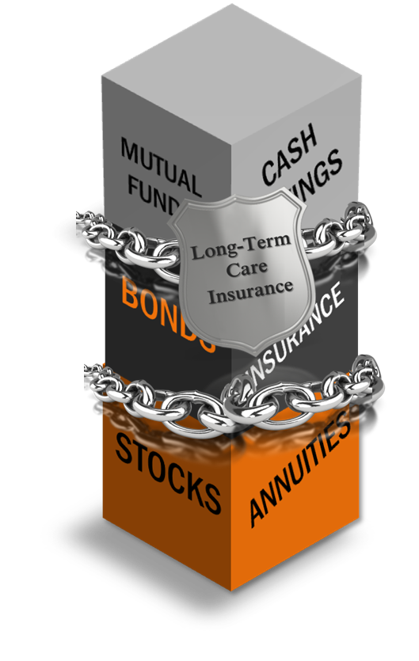
Long-Term Care Insurance Risk Management Tool
LTCi is a shield of protection to help preserve assets and income for a
long life.
Investments and savings may be kept intact.
Assets can be preserved to pass over to a spouse or to children.
Funds can be used as wanted not as needed
Hypothetical example for illustrative purposes only.
Notes:
Think of LTCi as simply a shield that can help protect your assets. So you are able to spend your money the way you want to instead of the way you have to.
36

Slide 37
Asset Repositioning – Nancy, 65
$200,000
Freed-up funds for her use
$332,812
Additional LTC
benefit
$300,000
Set aside for emergencies
$100,000
Moved (premium)
$166,046
Death benefit or LTC benefit

Slide 38
RISK #7
LONGEVITY

Slide 39
There are 78 Million Baby Boomers!
Racing Headlong and Headstrong into Retirement
Source: "Sixth Annual Update on the Retirement Preparedness of the Boomer Generation." Insured Retirement Institute (2016): n. page. Web. 10 Apr. 2017. <https://www.myirionline.org/docs/default-source/research/boomer-expectations-for-retirement-2016.pdf>.
Notes:
39
All of this is happening right when 78 million baby boomers are heading towards retirement. A time when people need guaranteed lifetime income more than ever, and they don’t have it.

Slide 40
The fastest growing segment of our population is people age 85 and over

Slide 41
Facts about Retirement
Spend 25 years in retirement*
Average life expectancy:
>65 year old male, live to 86**
>65 year old female, live to 89**
Half of us will Outlive our Own Life Expectancy!
Sources: "RP-2014 Mortality Tables." Society of Actuaries. Society of Actuaries, Nov. 2014. Web. Marc. 2017

Slide 42
The problem is not that people are dying too young, but that people are faced with the reality of outliving their assets.

Slide 43
Investment Solutions | What others are saying
“Many guaranteed income products can ensure that the stream of income from a given amount of savings will not run out or be diminished by market returns.”
BlackRock
“Income reimagined”
June 30, 2019
Notes:
Read slide

Slide 44
Investment Solutions | What others are saying
Respondents said the greatest benefits of having a protected lifetime income are protection against longevity risk, peace of mind, and being better able to budget – all of which can make for a less stressful and happier overall retirement.
Greenwald & Associates
“Fourth Annual 2018 Guaranteed Lifetime Income Study (GLIS).”
January 2019
Notes:
Read slide

Slide 45
Investment Solutions | What others are saying
“If the reason you saved for retirement was to provide a secure lifestyle, there’s no more efficient way to create lifetime income than through an annuity.”
Michael Finke PhD
Wade Pfau PhD
“It’s More than Money.”
2019
Notes:
Read slide

Slide 46
What is a Lifetime Income Annuity?
Guaranteed Paycheck for Life

Slide 47
Features of a Income Annuity
Guaranteed Income for Life of Both Spouses
No Market Risk
Benefits for LTC and Terminal Illness
Inflation Protection

Slide 48
Annuities and Retirement Happiness
By Steve Nyce and Billie Jean Quade September 2012
“Retirement satisfaction has steadily declined over the last decade.”
“Satisfaction is highest among those with high levels of wealth and income who are very healthy and annuitize their income.”
“Among retirees with similar wealth and health characteristics, those with annuitized incomes are happiest.”
“Annuities provide the biggest satisfaction boost to retirees with less wealth and those in poor health”
Notes:
48
Read slide

Slide 49
SAFE MONEY SPECIALISTS INC.
WWW.SAFEMONEYSPECIALISTS.NET
TOLL FREE #877-887-3131
thad.scholl@gmail.com
zachscholl.sms@gmail.com

