Slide 1

CAPSTONE PROJECT
DEI On-boarding Framework:
Addressing Manufacturing Labor Shortage
Group 3: Imelda Scott, Joseph Tobon, Mira Shenouda, Thania esquivel

Slide 2


Agenda
Problem
Process
Roles & Framework
Success Stories

Slide 3
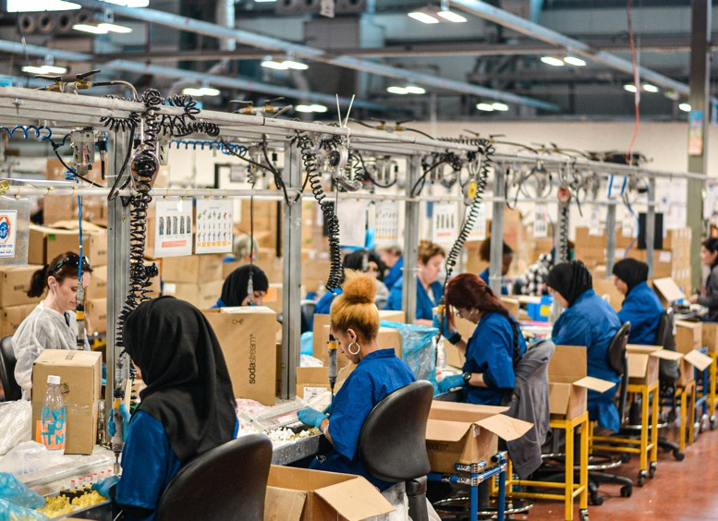
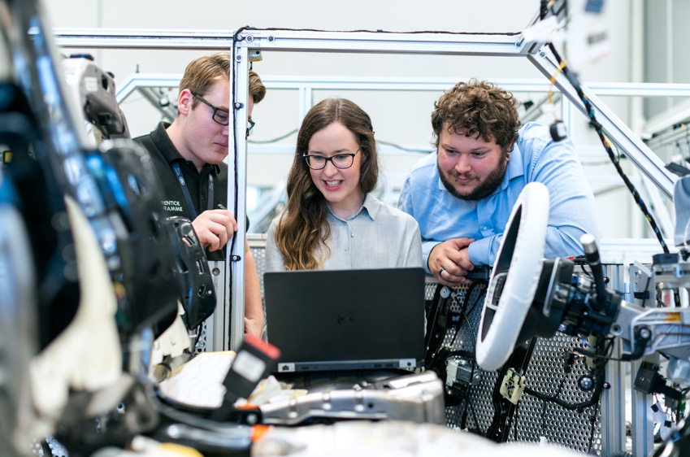
Problem Statement
Manufacturing is currently facing a workforce shortage (hourly workers). Companies need to create a plan to attract and retain other historically marginalized groups in order to address these challenges. US manufacturing is expected to have 2.1 million unfilled jobs by 2030.
How can employers roll out DEI for the hourly population?
How can DEI shape the culture for manufacturing?
How to attract and retain more women, minorities, millennials and Gen Z's?
How can we enhance the employee experience?

Slide 4
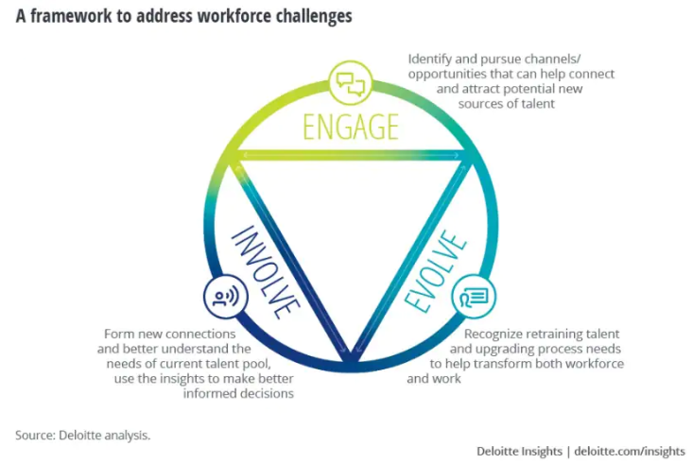
Process
Research
Investigate current labor shortage challenges and identify opportunities.
Benchmark
Best practices to attract and retain talent.
Identify
Key priorities in attracting women, minorities, millennials and Gen Z's.
Propose
The Path Forward
The case for women in manufacturing, why it is critical to tap into the female workforce and its benefits.

Slide 5
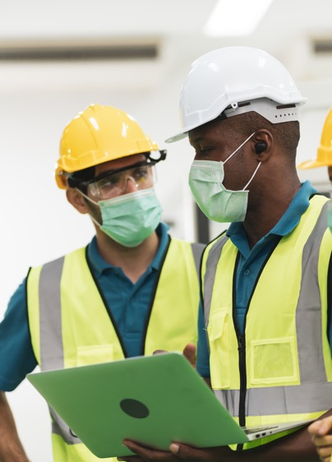
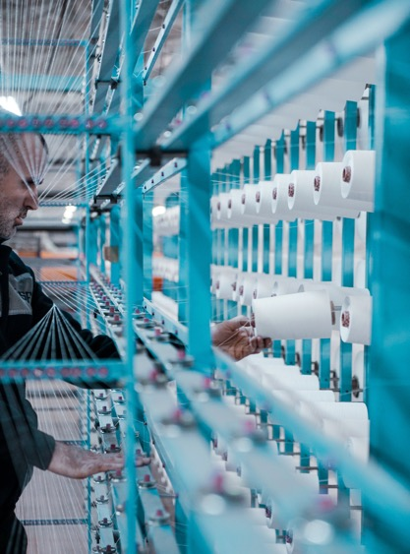

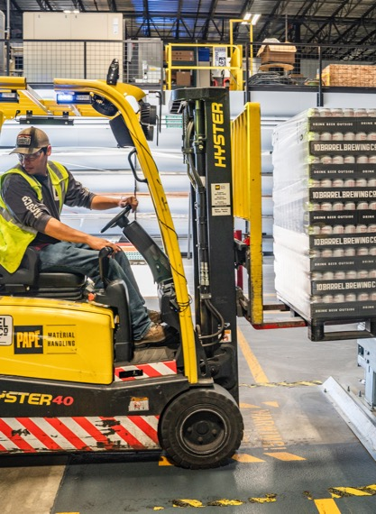
Final Deliverable
Identification of challenges and opportunities with current labor shortage
Attracting and retaining diverse talent through engagement and communications
On-boarding framework, one-year journey
  Timeline with key deliverables
  Clear role definitions and responsibilities
  Examples of DEI best practices

Slide 6

Attracting and Retaining underrepresented minorities in manufacturing

Slide 7
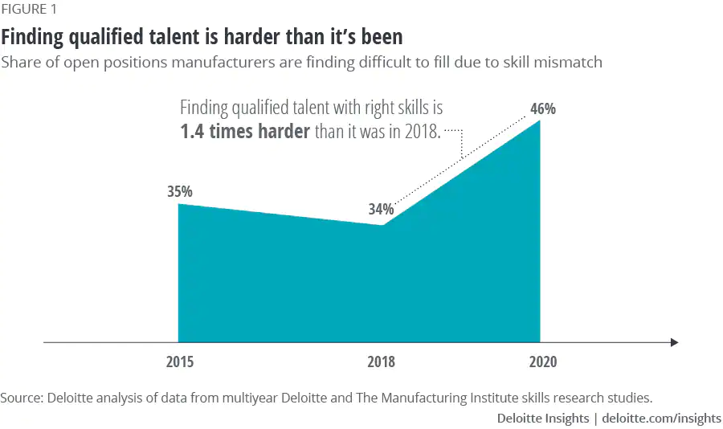
Labor Shortage Challenges
Strong competition between companies for qualified workers
Increase overtime for existing workforce driving burn-out and frustrated workers
Higher turnover and frequent retraining
Digital transformation will require changes to the skills composition of the workforce

Slide 8

Labor Shortage opportunities
Attract high school students
  Establish programs to offer career pathways
Attract female workforce and offer flexible schedules
Re-skilling
  Provide apprenticeships, training and certification opportunities to new hires
Build the next leadership pipeline under a DEI lens-establish company targets to increase women and minority representation

Slide 9
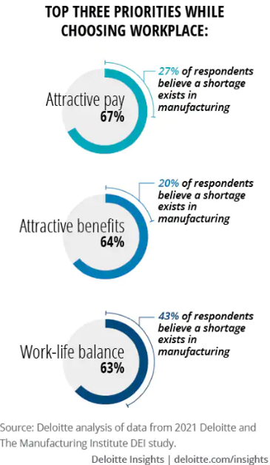
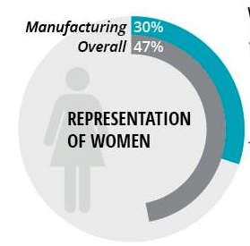
Women in manufacturing-challenges
Women are underrepresented in line jobs and higher-paying manufacturing sectors
Pay inequality
  Women have lower pay than men
  Black and Hispanic women make less than white women
Sexual harassment is widespread in the manufacturing industry
Dissatisfaction with family leave policies and work-life balance

Slide 10
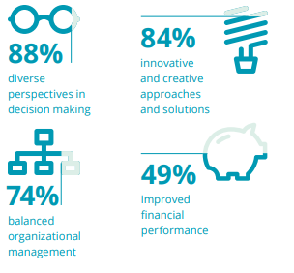
Women in manufacturing-opportunities
Support training and re-skilling
  Provide in-house certifications, tuition reimbursement
Ensure equality in pay and promotions
Zero tolerance policies on sexual harassment and anti-discrimination policies
  Train managers to handle complaints and enforce inclusive behaviors
Improve family friendly policies and other benefits
  Flex schedule, childcare subsidy (age 0-5), work with local daycare centers to offer employee discounts
Source: Deloitte

Slide 11





Dei onboarding roles
HR
Direct Labor
First Line Manager
Site Leader
DEI Ambassador
Local HR representative
Liaison between manufacturing site and corporate
Production floor
Hourly
Direct supervisor of direct labor
Highest level of management at location (GM)
Designated individuals within organization
Representing affinity groups

Slide 12
DEI onboarding framework
 | First Week | 1-2 Months | 2-9 Months | 12 Months | 1+ Year
HR | Welcome and DEI Packet with information on current events, letter and video from CEO, DEI allyship badge etc. | In-person lunch educational booth On-going support in employee journey Strong alignment and partnership with MARCOM Set objectives for management tied to DEI mission |  |  | Create annual survey to gage team satisfaction and encourage all employees to participate
Direct Labor | Attend onboarding orientation | Complete DEI training and all mandatory training | Active involvement in DEI activities |  | All employees to participate in workplace survey
First Line Manager | Welcome new employee, ensure new employee knows who to connect for questions, ideas, concerns and feedback | Continue regular check-ins with new employee Encourage monthly participation in ERG and DEI Activities |  |  | All employees to participate in workplace survey
Site Leader | Senior leadership commitment on first day of tour | Interactive participation in townhalls Acknowledge DEI leadership/allyship within hourly team “Inclusive behaviors” |  |  | All employees to participate in workplace survey
DEI Ambassador | Participate in onboarding orientation DEI: Vision, mission and pillars of focus, affinity group | Welcome and introductions to new affinity members | Conduct focus groups within each site to better customize DEI resources and communication strategy for the site |  | Prioritize site strategy and summarizing/distributing KPIs with corporate
DEI Calendar with key celebrations relevant to region (monthly educational videos, employee spotlights, newsletter).

Slide 13
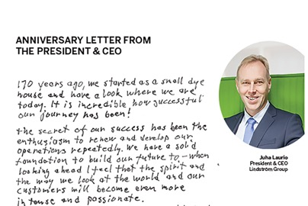
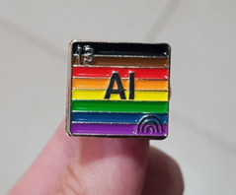
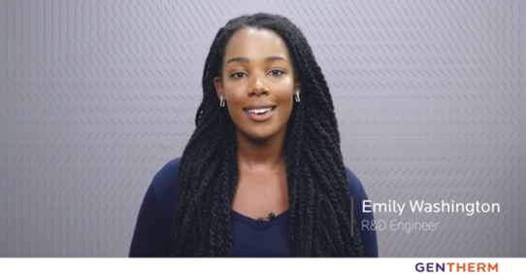
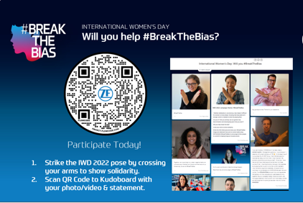
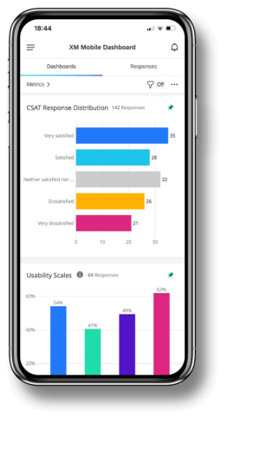
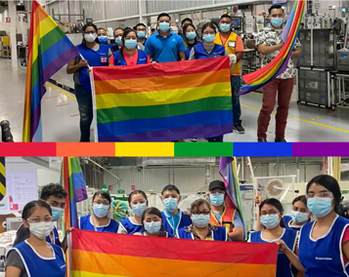
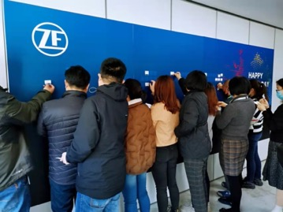
Examples
CEO Letter
Allyship Badge
Employee Spotlight
Training
Survey
Information Boards
Monthly Activities

Slide 14
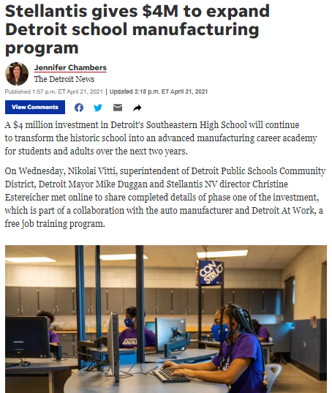
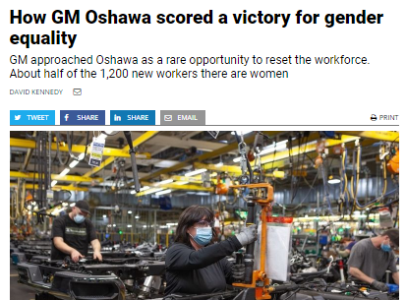
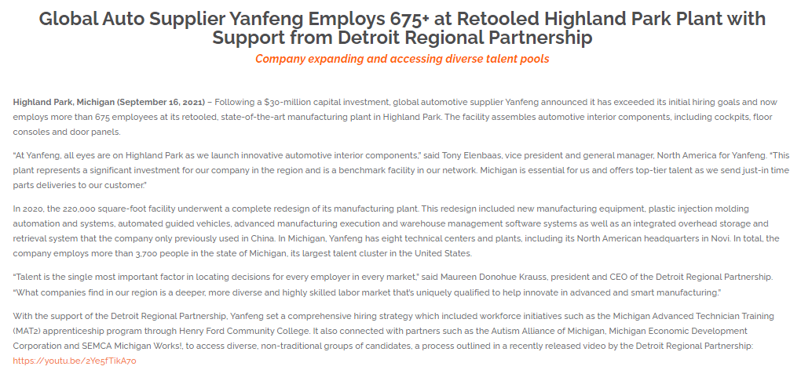
Industry success stories
Partnership with Michigan Advanced Technician Training programs with Henry Ford Community College.
Autism Alliance of Michigan, Michigan Economic Development Corporation and SEMCA Michigan Works.

Slide 15



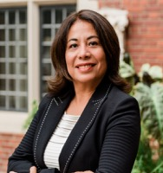
DEI practitioners contact
Thania Esquivel
Global Marketing Director
Gentherm
Email: Thania.Esquivel@gentherm.com
Mira Shenouda, MBA
Regional Diversity & Inclusion (DEIB) Lead
ZF Group
Email: mira.shenouda@zf.com
Joseph Tobon
Senior Sales Manager
Adient
Email: joseph.tobon@adient.com
Imelda Castro Scott, MBA, CPA
Director of Accounting
Yanfeng Automotive Interiors
Email: imelda.scott@yanfeng.com

Slide 16
appendix

Slide 17
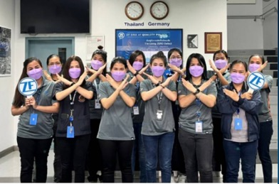

DEI Onboarding Framework-HR
Week 1
Initial Onboarding
1-3 Months
Culture Immersion
2-9 Months
DEI Strategy Implementation
10 – 12 Months
1+ Year
Leadership Engagement
Data Collection Best Practices Shared
Unconscious Bias Training
DEI Vision & Strategy
“HR as a Safe Space” Campaign buy-in. Ex: allyship badge.
In-person lunch educational booths/events.
on-going support in employee journey
Strong partnership with HR, Employer Branding & Comms.
Strong partnership with Corporate HR, Employer Branding & Comms.
Engage site leaders in inclusive behaviors
Courageous Conversations
Introduction to culture, ERGs policies, code of conduct.
Example: Personal card from leader/CEO.
HR members to take annual DEI Best Practices & Feedback Survey
Assess site engagement performance.
HR: Local HR representative who serves as liaison between the manufacturing site and Corporate

Slide 18
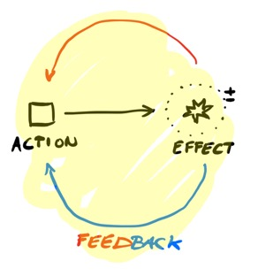
DEI Onboarding Framework-Direct Labor
Week 1
Initial Onboarding
1-3 Months
Culture Immersion
2-9 Months
Personal Engagement
10 – 12 Months
1+ Year
Communication Loops
Feedback Collection
Unconscious Bias Training
Incentive: Take additional training on active allyship to earn allyship badge & promote a safe space.
Active involvement in campaigns, development programs and activities.
In-person lunch educational booths/events.
Act as change agents in company
Attend regular 1:1 check-ins with line manager
Skip level meetings
Courageous Conversations
Introduction to culture, ERGs policies, code of conduct.
Example: Personal card from leader/CEO.
Employees to take annual DEI Culture Feedback Survey
Direct labor: line worker who does not have access to a computer

Slide 19
DEI Onboarding Framework-First Line Manager
Week 1
Initial Onboarding
1-3 Months
Culture Immersion
2-9 Months
Personal Engagement
10 – 12 Months
1+ Year
Communication Loops
Feedback Collection
Unconscious Bias Training
DEI Calendar & Vision
Promote Safe Space with Ally Badge
Establish relationship with site HR & DEI Ambassadors
Promote and actively engage in campaigns, development programs and activities.
Attend and volunteer to lead In-person lunch educational booths/events.
Attend regular 1:1 check-ins with line manager
Skip level meetings
Courageous Conversations
Introduction to culture, ERGs policies, code of conduct.
Example: Personal card from leader/CEO.
Employees to take annual DEI Culture Feedback Survey
First Line Manager: Direct supervisor of the direct labor

Slide 20

DEI Onboarding-Site Leader
Week 1
Initial Onboarding
1-3 Months
Culture Immersion
2-9 Months
Personal Engagement
10 – 12 Months
1+ Year
Communication Loops
Feedback Collection
Unconscious Bias Training
DEI Vision & Strategy
Promote Safe Space with Ally Badge
Inclusive Leadership and Courageous Conversation training
Promote and actively engage in campaigns, development programs and activities.
Lead In-person lunch educational booths/events.
Attend regular 1:1 check-ins with line manager
Lead Skip Level Meetings
Lead Courageous Conversations
Introduction to culture, ERGs policies, code of conduct.
Example: Personal card from leader/CEO.
Employees to take annual DEI Culture Feedback Survey
Site Leader: Individuals at the highest level of management at their location (site leader)

Slide 21
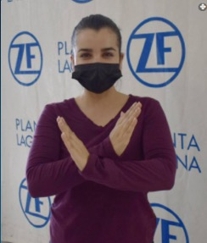
DEI Onboarding-DEI Ambassador
Week 1
Initial Onboarding
1-3 Months
Culture Immersion
2-9 Months
Personal Engagement
10 – 12 Months
1+ Year
Communication Loops
Feedback Collection
Unconscious Bias Training
Deep dive all DEI Vision & Strategy
Promote Safe Space with Ally Badge
Introduction to ERG core teams
Promote and actively engage in campaigns, development programs and activities.
Partner with HR to champion local initiatives
Volunteer to host lunch educational booths/events.
Conduct focus groups within each site to better customize DEI resources and communication strategy for the site.
Support in Courageous Conversations
Introduction to culture, ERGs policies, code of conduct.
Example: Personal card from leader/CEO.
Employees to take annual DEI Culture Feedback Survey
DEI Ambassadors: Designated individuals within the organzation representing certain affinity groups

